Slide 1
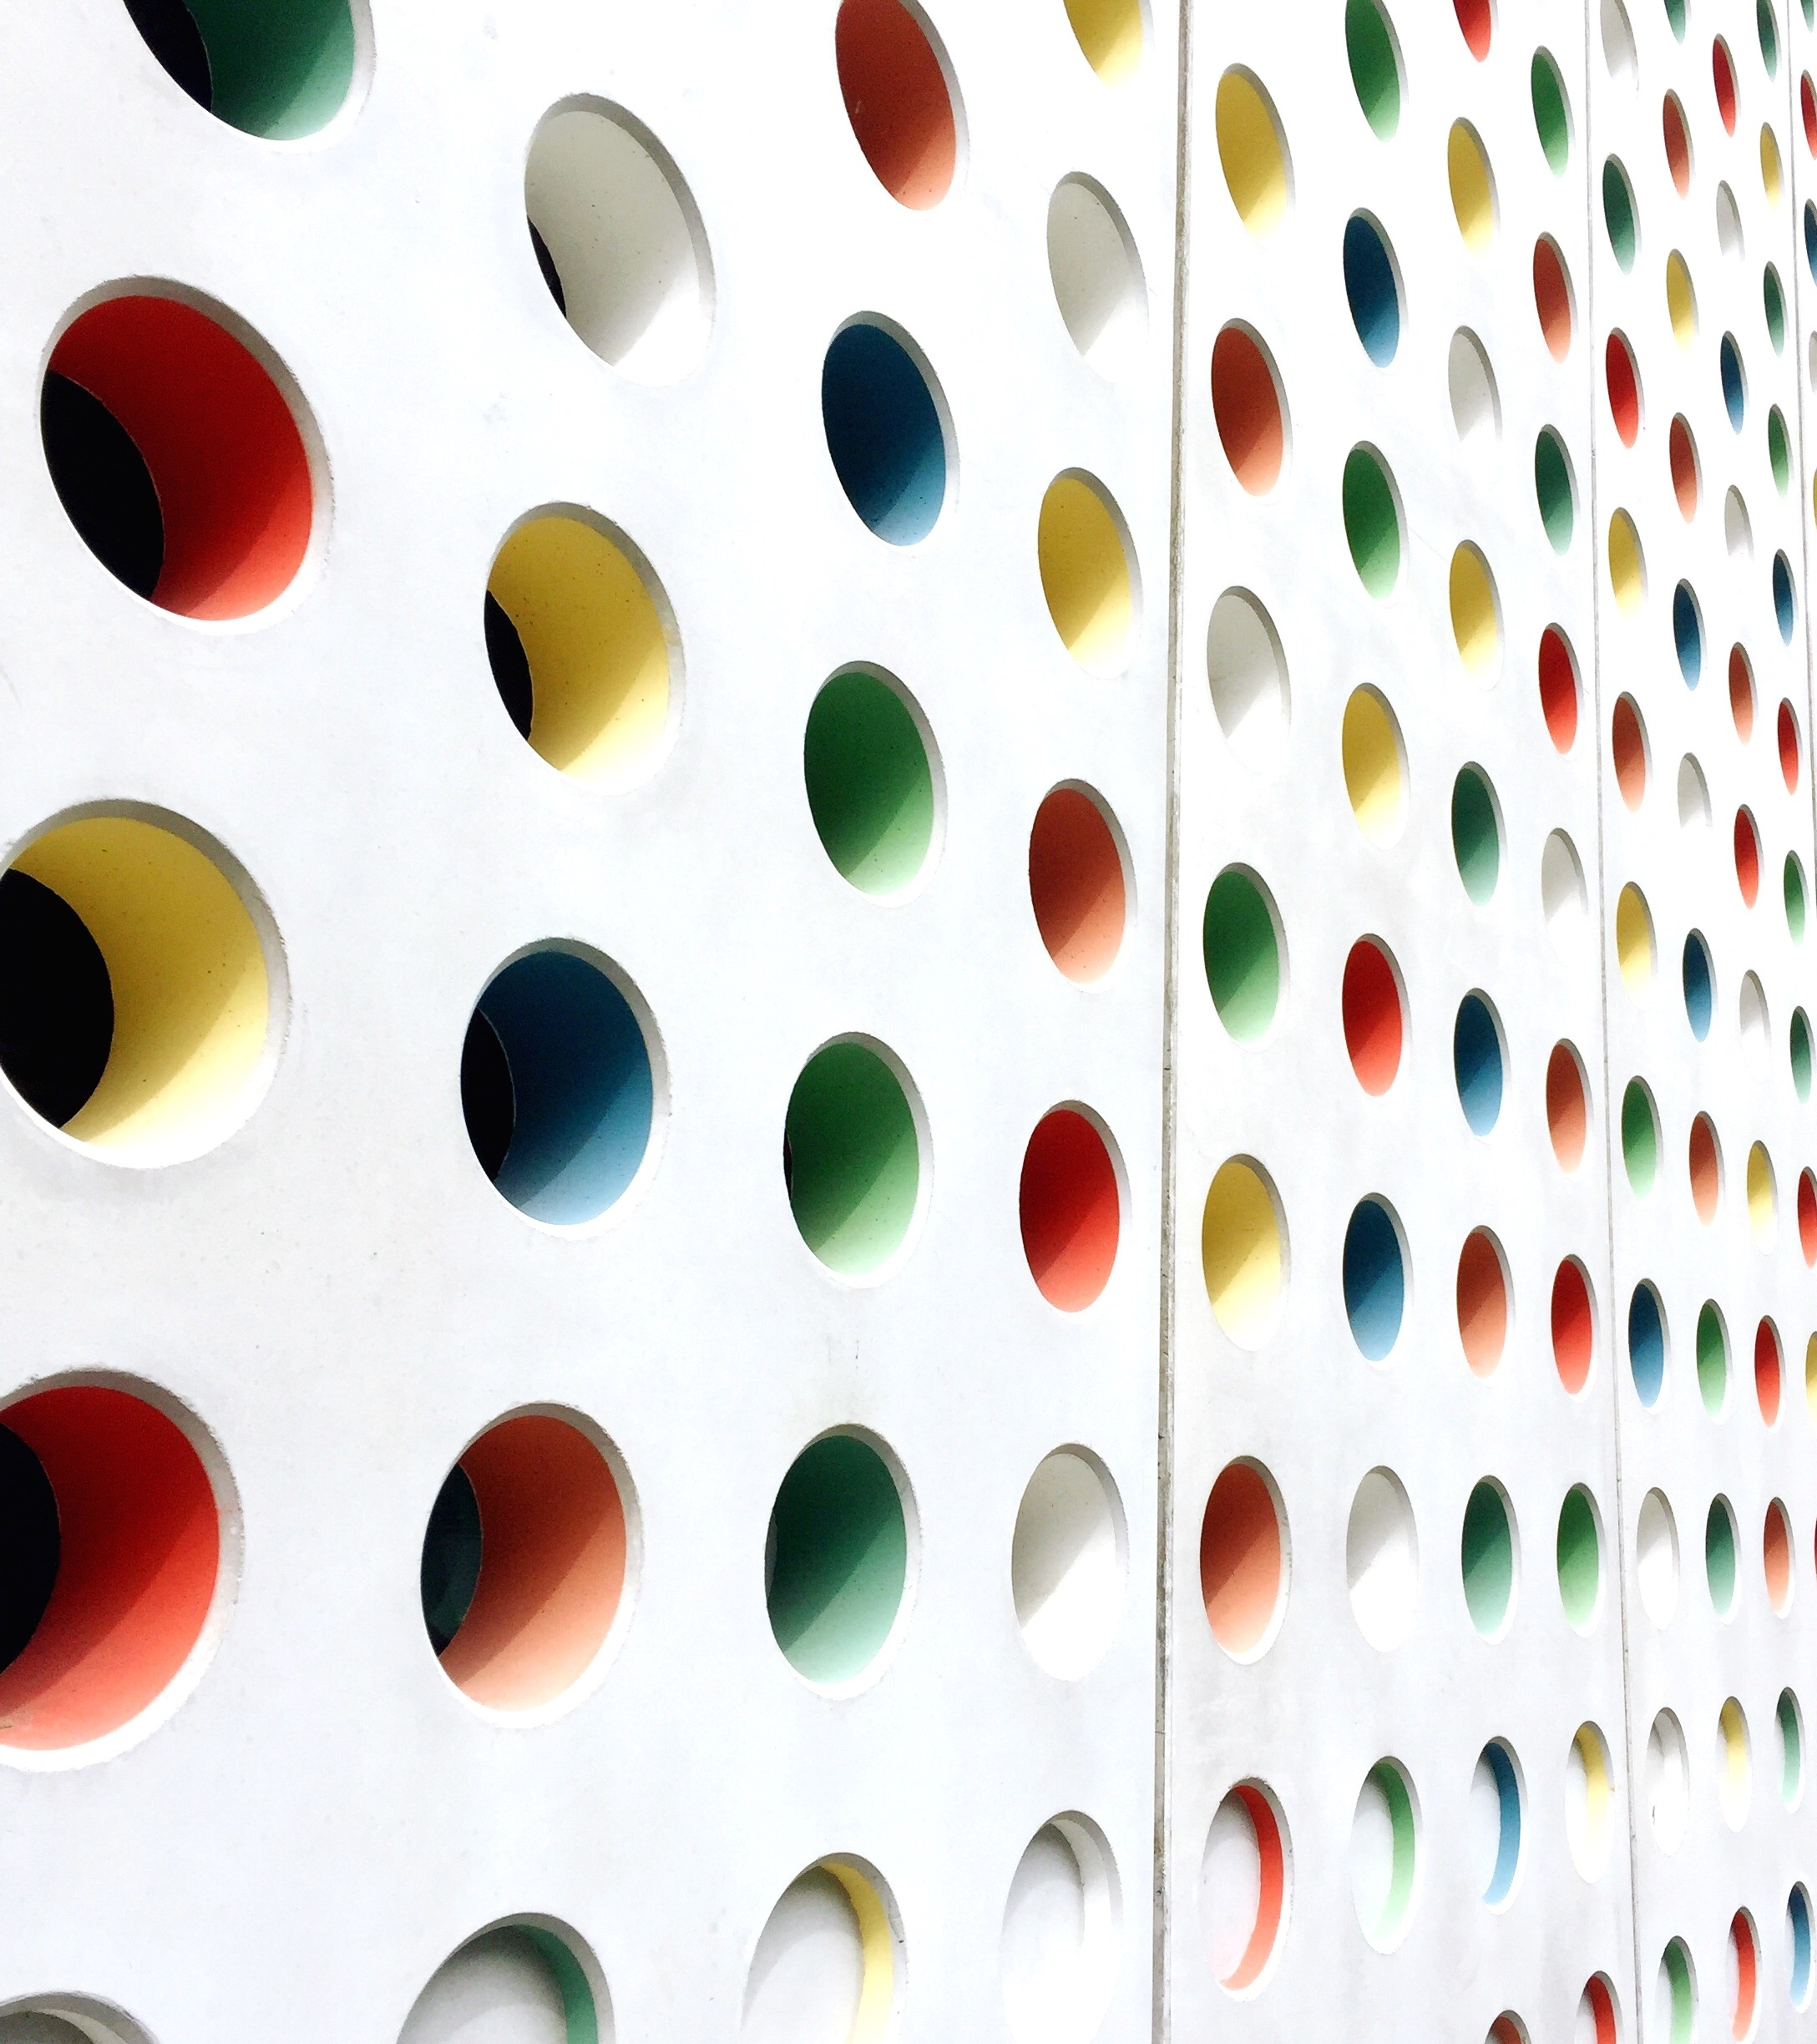
mart udako olver
S
Hemanth RangeGowda S P
M Chinmaya Rao
Nishanth S Raj

Slide 2
Introduction:
In real life we come across Sudoku puzzles of varying difficulty levels in newspapers and other text and digital media. It is a common leisure activity for a lot of people. However, it is observed that the solution is not always immediately available for verification. In most cases, people have to wait till the next day to check the solutions of the Sudoku they just solved. Hence our motivation for this project was to develop the solution for the puzzle by taking an input image of the sudoku and generating an immediate output image of solved sudoku using a CNN architecture model.

Slide 3
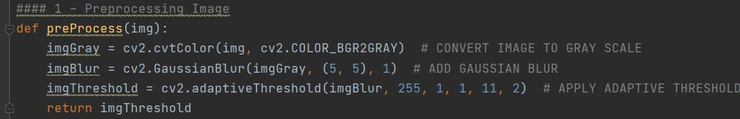
Extracting the puzzle grid
Smoothing and thresholding
First we need to preprocess our input image. Pre-processing involves converting into gray scale applying gaussian blur and applying adaptive thresholding resulting in robust grid corner extraction.
Preprocessing code

Slide 4
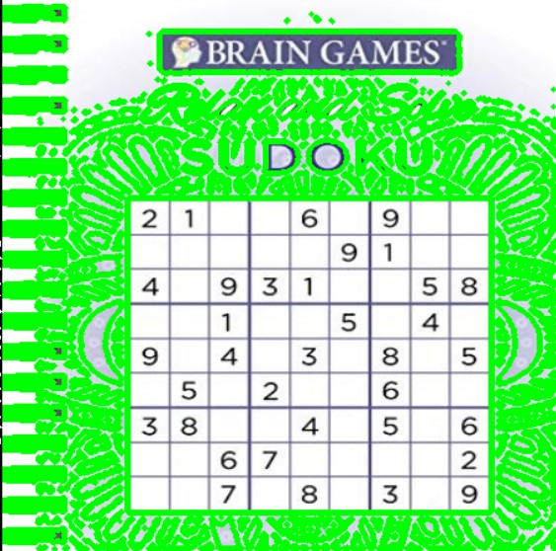
Identifying all the contours
Image contouring is the process of identifying structural outlines of objects in an image which can help us identify the shape of the object. We draw contours on the image using opencv draw Contours function.
Code for drawing contours
All the identified contours are drawn in ‘green lines’ in the above image.

Slide 5
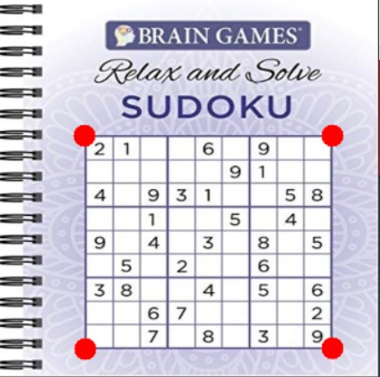
Extracting the sudoku grid
We assume that the biggest area contour with 4 sides in the input image is our sudoku puzzle. After identifying the sudoku puzzle in our image we mark the 4 corner points.
Corner points of the new image are marked in the above input image as shown in the above figure and isolated the puzzle from the input image and stored as a new image as shown in below figure.

Slide 6
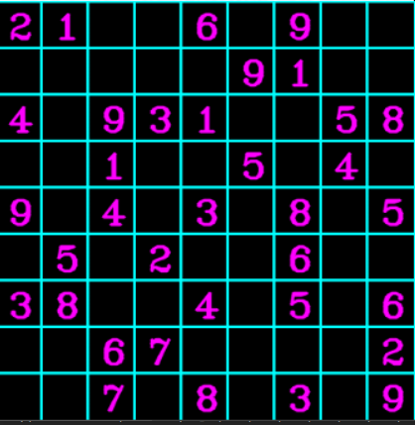
This image is used for identifying the numbers in the sudoku and solving the sudoku by backtracking algorithm.

Slide 7
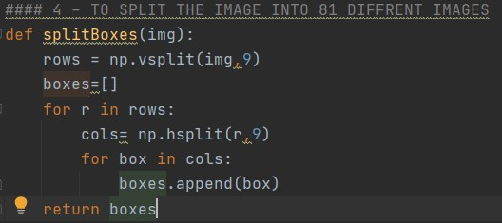
Recognition of digits
Extracting the given digits form grid
We know our sudoku grid consists of smaller squares which are 9 x 9=81 in number. Each smaller grid has a number in range [1-9] or empty cell. We perform horizontal and vertical split on our extracted sudoku puzzle with factor 9 and we get 9 x 9=81 new images. These 81 images we fed as inputs to our CNN model to recognize the digits.
Code for splitting grid into 81 smaller images

Slide 8
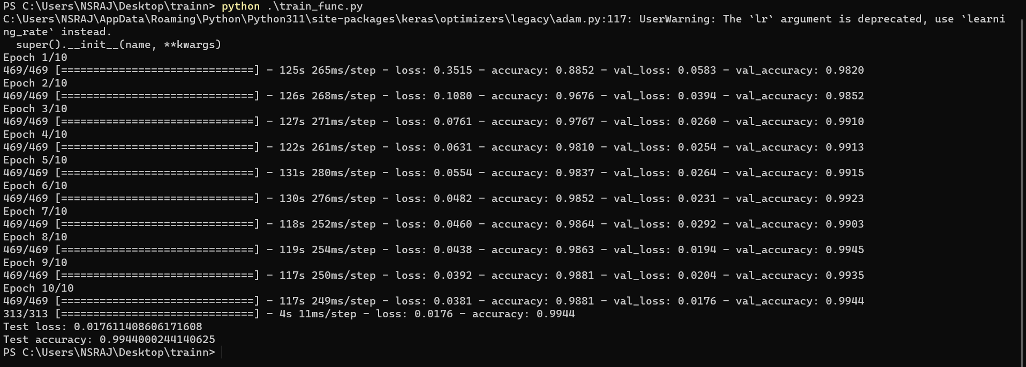
Training the model

Slide 9
Solving the sudoku
After identifying each digit in smaller grid through our CNN model we store them in new 9 x 9 matrix. We now apply backtracking sudoku solving algorithm to solve the puzzle

Slide 10
Overlaying our solution on original image:
To overlap the sudoku solution on our original image first we need to store the positions of 4 corner points of the sudoku grid in original image. These points is stored in variable biggest as shown in code. By using opencv warp Perspective function we will be able to put the solved digits on blank image which is same size as original image and at same positions where numbers are missing in original sudoku image. Now with help of opencv add Weighted function we will be able to overlay our image which we got from wrap Perspective function on original image.

Slide 11
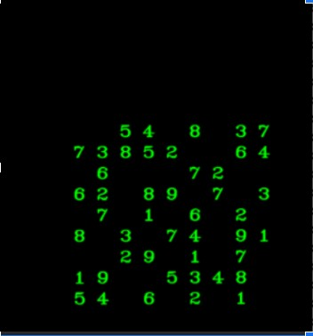
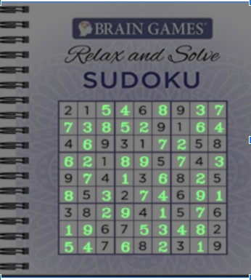
a)Wrap Perspective output image b) Final overlayed image

Slide 12
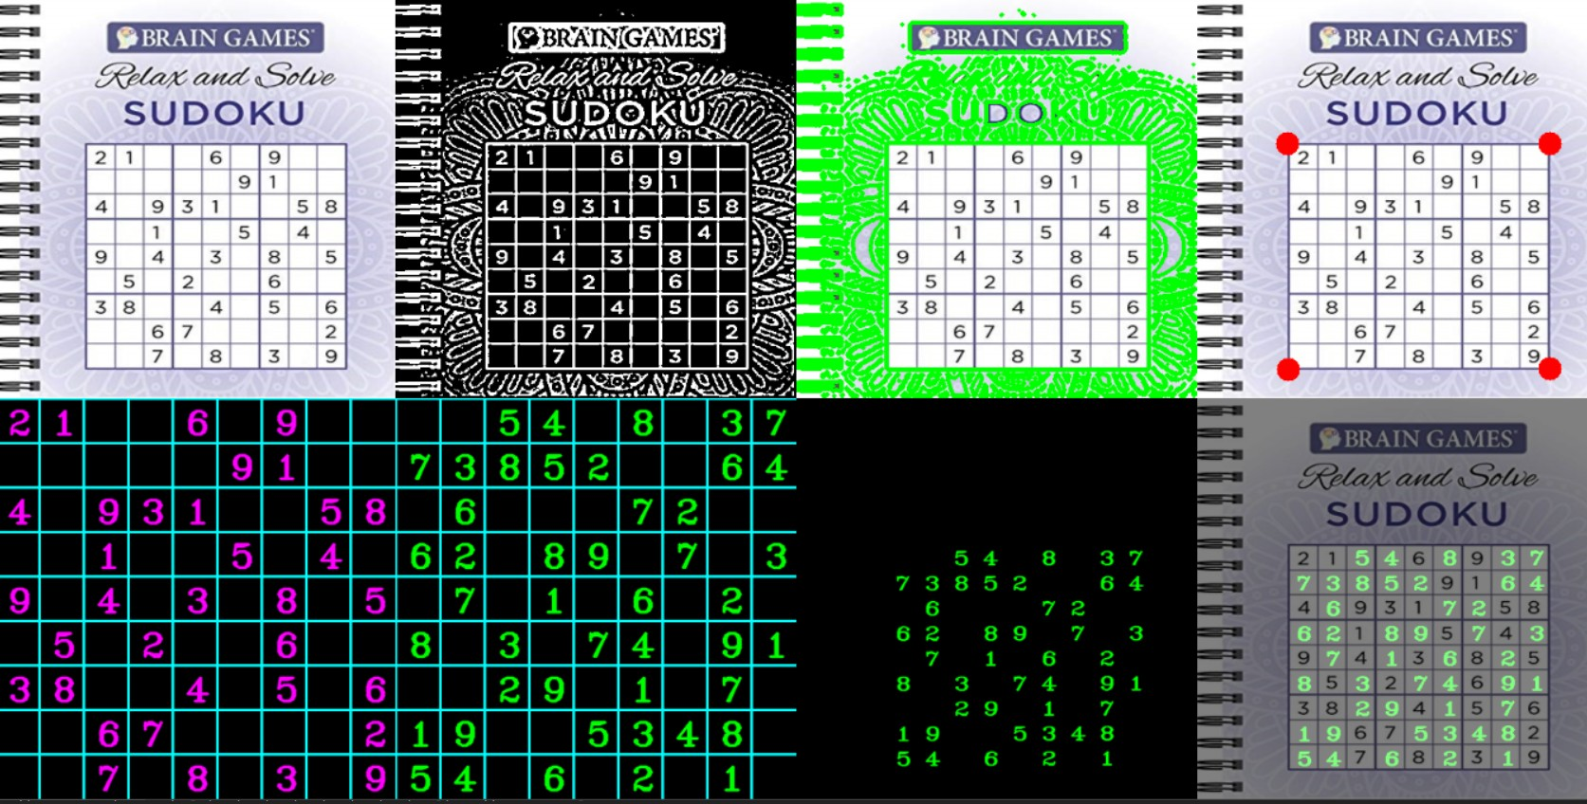
Summary

Slide 13
limitations:
Our algorithm is not robust to blurring, drastic occlusions and also if any of the four corners of the Sudoku grid are not present in the captured image. The biggest contour with 4 sides must be sudoku grid otherwise we get wrong answers. If any of the digit is wrongly predicted then we will not get the results. So we have to detect the digits with high accuracy.

Slide 14
Conclusion
We present a Smart Sudoku Solver that can solve unsolved Sudoku images with a small amount of perspective. Also illumination changes across the images are taken care of. Since the scale of the image also varies from image to image, our algorithm efficiently manages these problems.

Slide 15
References
https://towardsdatascience.com/building-a-sudoku-solving-applic ation-with-computer-vision-and-backtracking-19668d0a1e2
https://www.pyimagesearch.com/2020/08/10/opencv-s udoku-solver-and-ocr/
https://www.techwithtim.net/tutorials/python-program ming/sudoku-solver-backtracking/
https://ieeexplore.ieee.org/document/7414762

