Slide 1
Quantization
Royaljohn Southammavong, Ben Blechman

Slide 2
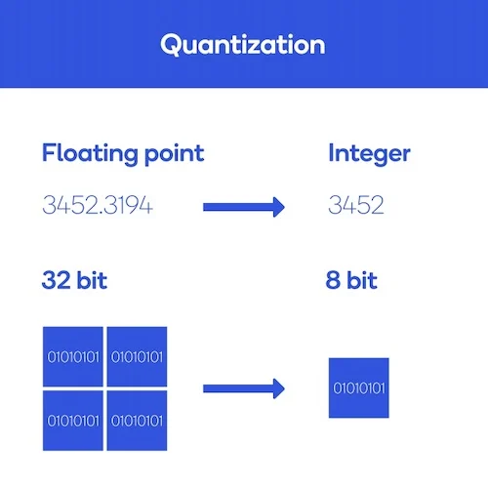
What Is Quantization?
Model compression technique
Reduces precision by representing weights in smaller sizes
Standard size is 32-bit floating point (torch.float32)
Quantization reduces to any of the following within PyTorch but 8-bit signed integer is most commonly used
8-bit unsigned int
8-bit signed int
32-bit signed int
16-bit float

Slide 3
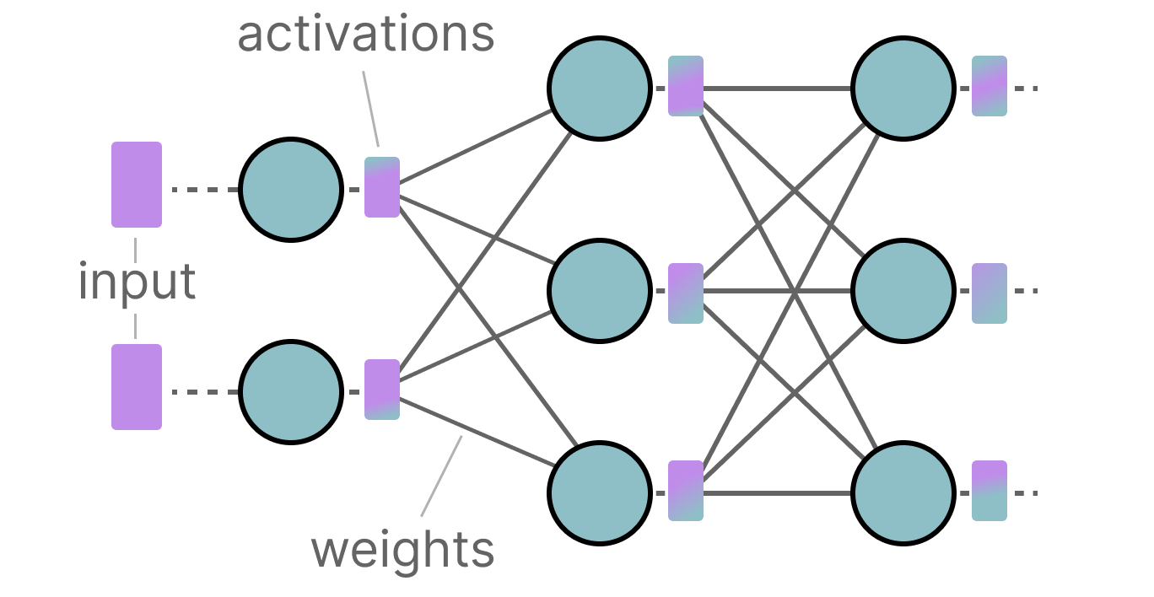
Math

Slide 4
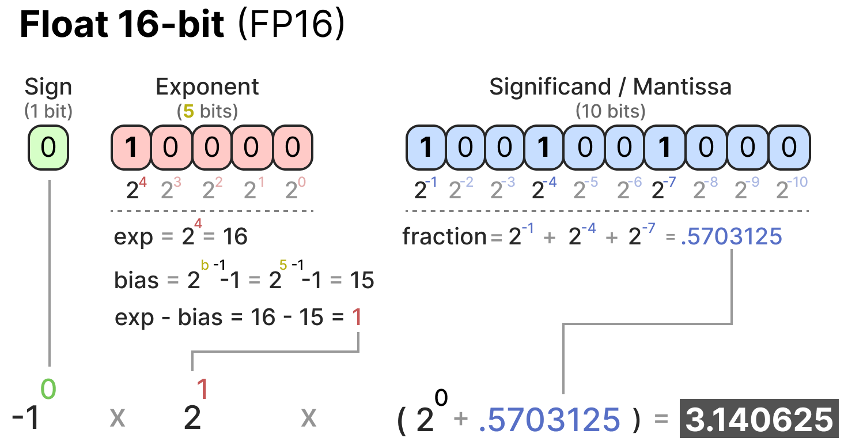
Math

Slide 5
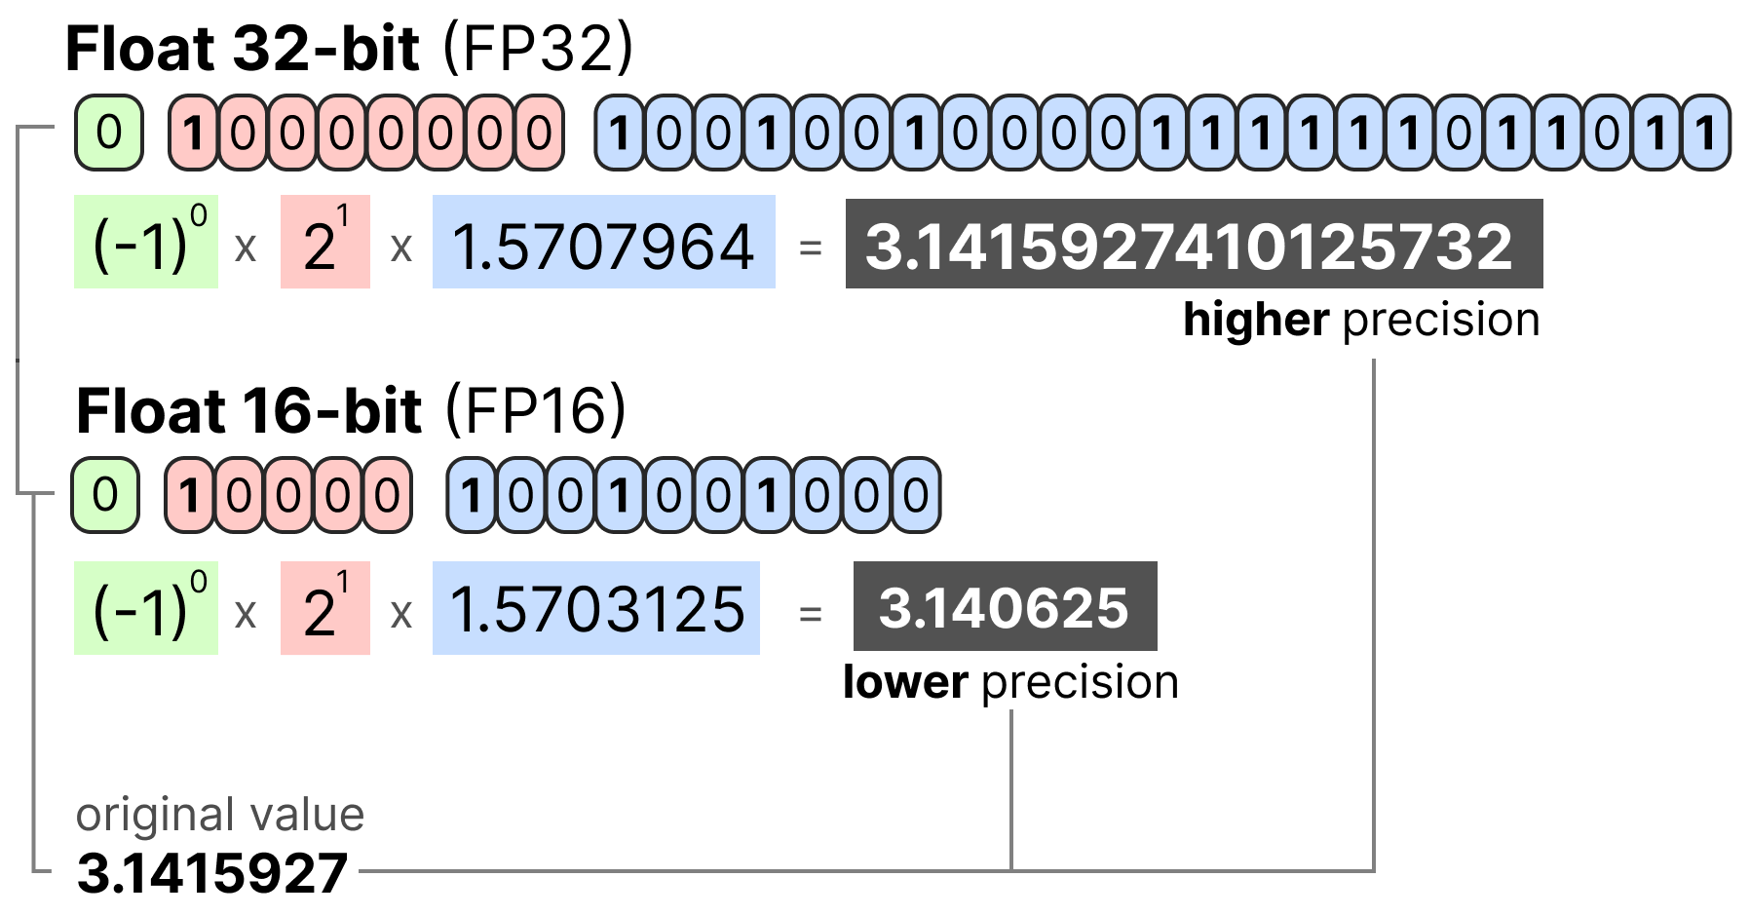
Math
Sign | Exponent | Significand/Mantissa/Fraction

Slide 6
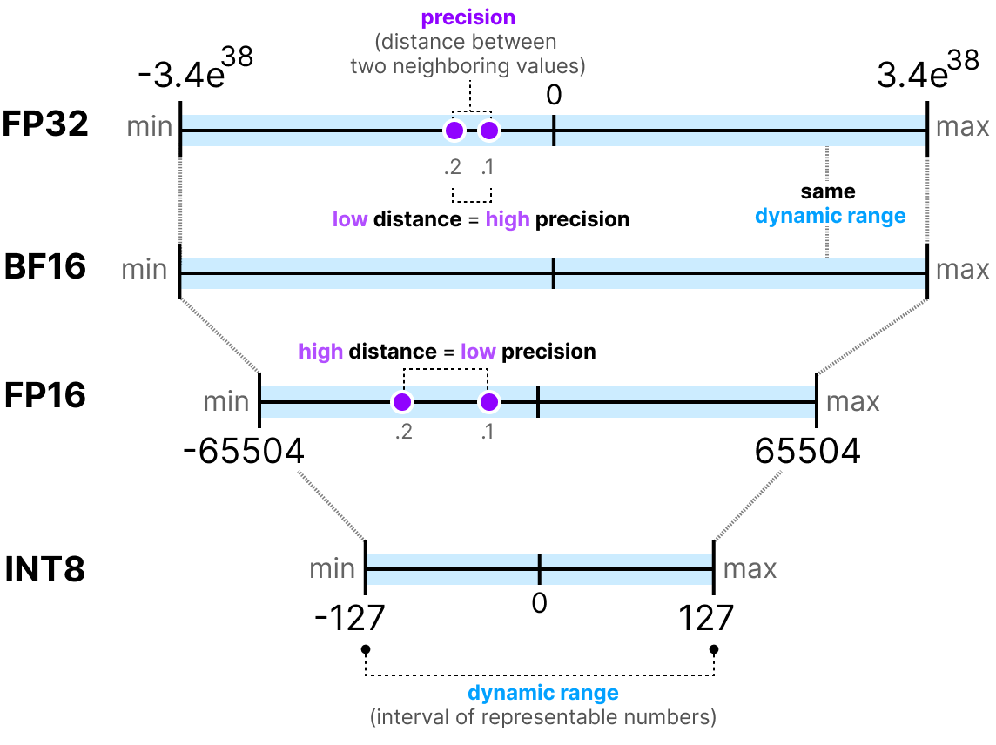
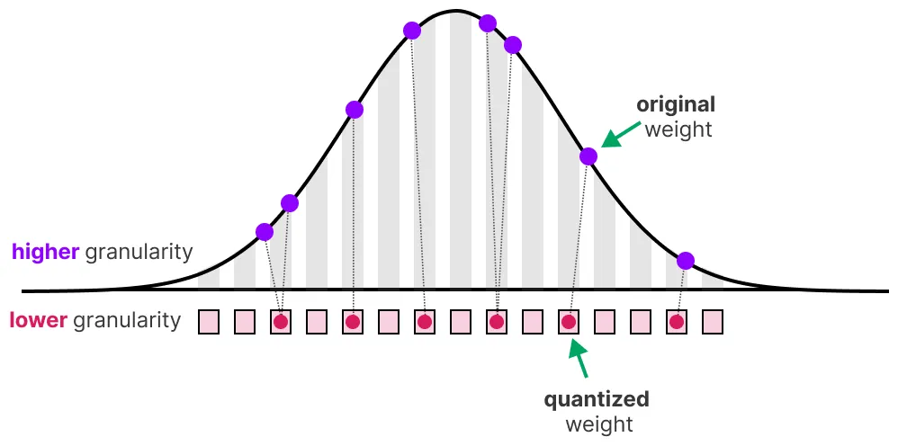
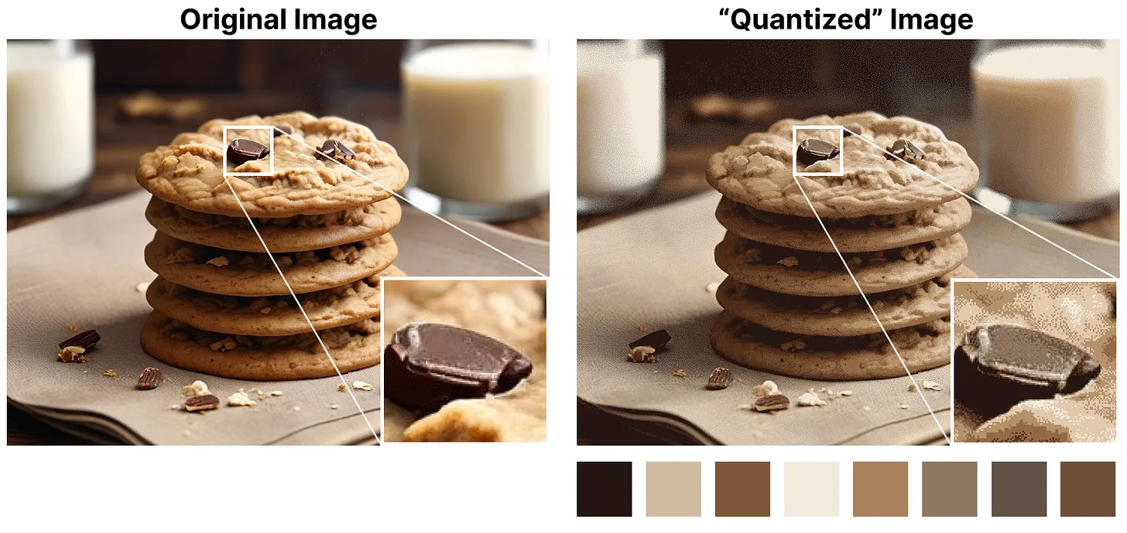
Math

Slide 7
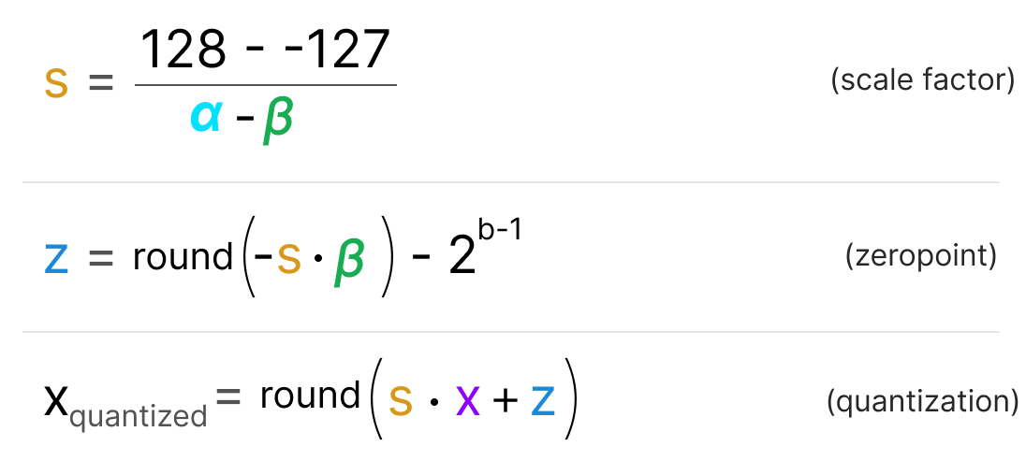
Math
Max
Min

Slide 8
Quantization Applications
Used when computational power and memory are limited
This includes applications such as:
Mobile computing (Smartphones, Smartwatches, etc)
IoT such as smart home integration
Embedded devices
Speeds up inference (integer operations are faster than floating point)
Real-time applications
Also allows for users without access to a GPU to utilize models as CPUs are typically much more optimized to handle integer values than floating-point values

Slide 9
Specifications for PyTorch
PyTorch allows you to add quantization to your code with torch.quantization
Pytorch allows Post Training Quantization (PTQ) and Quantization Aware Training (QAT)
INT8 Quantization*
4x reduction in model size
2-4x reduction in memory bandwidth requirements
Hardware support for INT8 computations is 2-4x faster compared to FP32 compute

Slide 10
Modes of Quantization

Slide 11
Post Training Quantization (PTQ)
Allows a user to quantize their model after its been trained (calibration)
Feed batches of sample data through the network and compute activations
Observer modules record activation distributions to determine activation scaling factors
Pros:
No retraining required (easy to apply to pre-trained models)
Low latency
Cons:
Poor sample data → poor calibration → poor accuracy
Some deep networks may suffer from accuracy degradation
Complex implementation (observer modules, operator fusion, per-channel quantization)

Slide 12
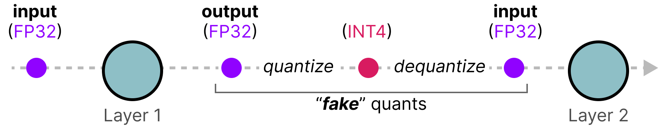
Quantization Aware Training (QAT)
Weights and activations are “fake quantized” in forward and backward passes
Float values are rounded to mimic INT8 values, computations still done with floating point #’s
All weight adjustments are made with the “awareness” of ultimately being quantized
Pros:
Usually yields highest accuracy than PTQ
Better for models sensitive to precision loss (NLP, image recognition CNNs)
Cons:
Requires retraining from scratch
Slower training (due to added overhead)
Data availability (access to original data needed)

Slide 13
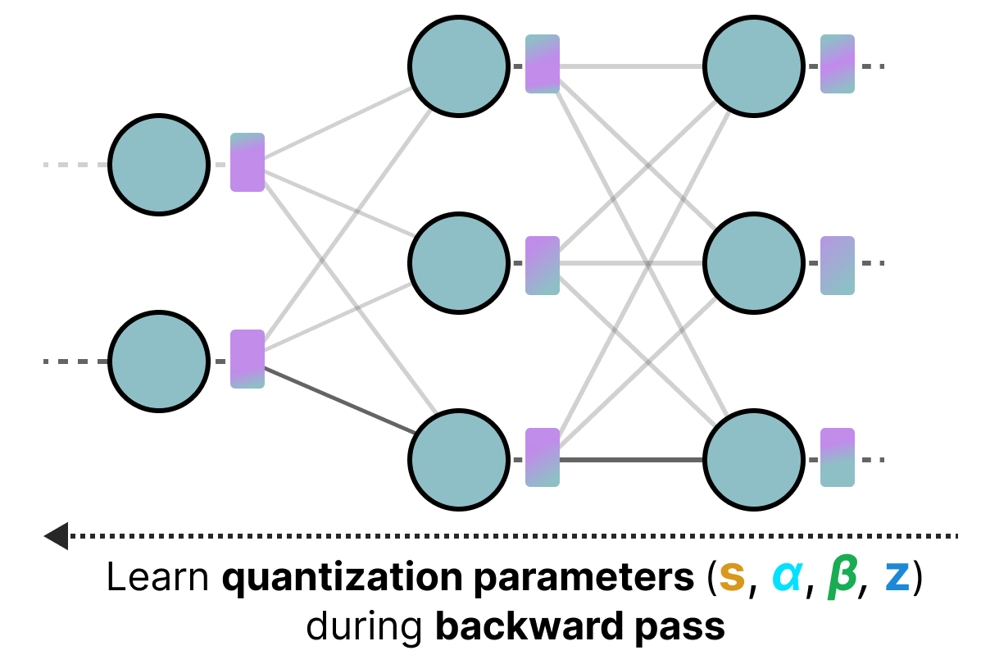
Quantization Aware Training (QAT)

Slide 14
Types of Quantization

Slide 15
Weight Only Quantization
Converts weight to INT8 (universal for all quantization techniques)
Activations remain in floating point
Pros:
Benefits from reduced model size
Cons:
Computations still involve floating point math, not as fast as pure INT8

Slide 16
Dynamic Quantization
Converts weights to INT8 (universal for all quantization techniques)
Activations are read/stored in floating point
Converts activations to INT8 before computations (matrix multiplication, convolution)
Pros:
Faster compute
Minimal accuracy loss
Cons:
Activations read and written to memory in floating point format

Slide 17
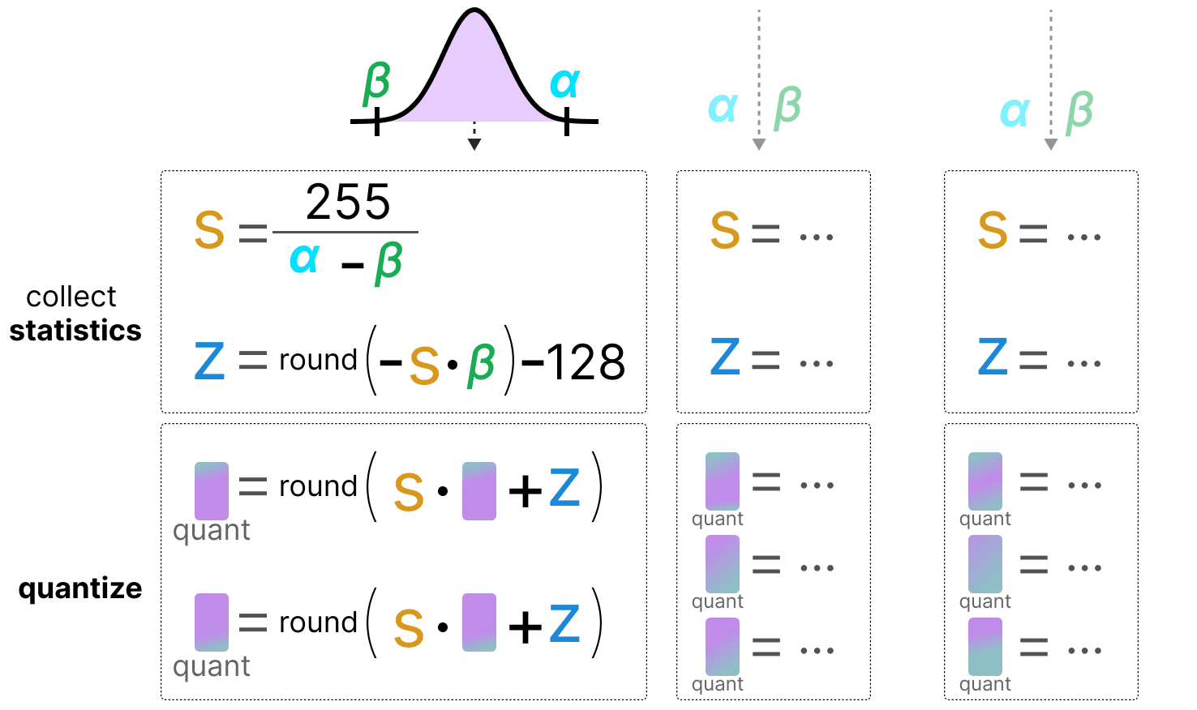
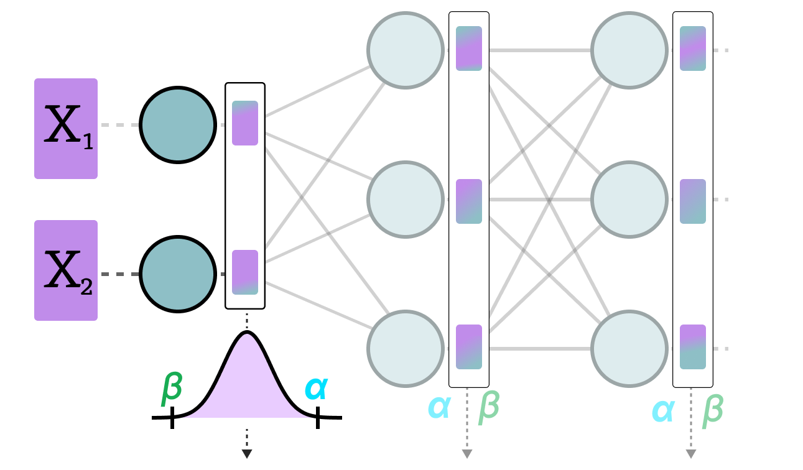
Dynamic PTQ

Slide 18
Static Quantization
Converts weights to INT8 (universal for all quantization techniques)
Converts activations to INT8
Able to pass quantized values between operations
No need to convert between floats and ints
Pros:
Fast
Cons:
Less accuracy

Slide 19
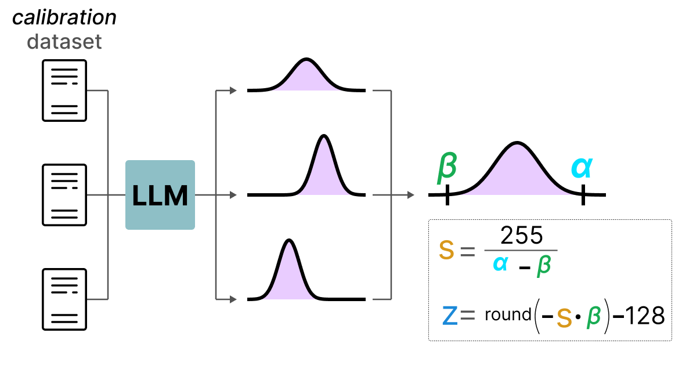
Static Quantization

Slide 20
Quantization Tradeoffs
Accuracy vs. Model Size
Approximations = less accuracy
These techniques attempt to minimize the gap between the full floating point accuracy and the quantized accuracy
Inference Speed vs. Accuracy
Full integer math (static quantization) is fastest but rounds aggressively
Dynamic quantization is slower but preserves more accuracy
Weight-only quantization speeds up inference and maintains better accuracy
Calibration Effort vs. Deployment Readiness
Post Training Quantization (PTQ) is easy to apply but needs calibration
Quantization Aware Training (QAT) requires retraining (expensive)
Hardware Support vs. Quantization Type
Some hardware are optimized for INT8 math, but GPUs are not (may perform better with FP16 quantization

Slide 21
How to choose?
Model/target requirements: Some models sensitive to quantization, requiring quantization aware training
Operator/backend support: Some backends require fully quantized operators
Model Type | Preferred scheme | Why
LSTM/RNN | Dynamic Quantization | Throughput dominated by compute/memory bandwidth for weights
BERT/Transformer | Dynamic Quantization | Throughput dominated by compute/memory bandwidth for weights
CNN | Static Quantization | Throughput limited by memory bandwidth for activations
CNN | Quantization Aware Training | In the case where accuracy can't be achieved with static quantization

Slide 22
Quantization Mode |  |  | Dataset Requirement | Works Best For | Accuracy | Notes
Post Training Quantization | Dynamic/Weight Only | Dynamic: Activation (or not quantized) Static: Weight | None | LSTM MLP Embedding Transformer | Good | Easy to use, Close to static when weights limit compute/memory
 | Static | Static: Activation Weight | Calibration dataset | CNN | Good | Best performance, big impact on accuracy, good for hardware that only supports int8 computation
Quantization Aware Training | Dynamic | Fake Quantized: Weight Activation | Fine-tuning dataset | MLP Embedding | Best | Limited support
 | Static | Fake Quantized: Weight Activation | Fine-tuning dataset | CNN MLP Embedding | Best | Used when static quantization gives bad accuracy, and used to close accuracy gap

Slide 23
Operator Support | Static Quantization | Dynamic Quantization
nn.Linear | Y | Y
nn.Conv1d/2d/3d | Y | N
nn.LSTM | Y (through custom modules) | Y
nn.GRU | N | Y
nn.RNNCell | N | Y
nn.GRUCell | N | Y
nn.LSTMCell | N | Y
nn.EmbeddingBag | Y (activations are in FP32) | Y
nn.Embedding | Y | Y
nn.MultiheadAttention | Y (through custom modules) | Not supported
Activations | Broadly supported | Unchanged, computations stay in FP32

Slide 24
Workflow
Prepare
Insert Observer/FakeQuantize modules
Calibrate/Train
Allow Observers to collect stats or FakeQuantize modules to learn quantization parameters
Convert
Convert a calibrated/trained model to a quantized model

Slide 25
Questions?
Read the docs:
https://pytorch.org/docs/stable/quantization.html
https://pytorch.org/blog/introduction-to-quantization-on-pytorch/ (may be outdated)

