Slide 1





Slide 2
Project AKSHARA – The Brief
Project AKSHARA is a joint initiative of 100 Smiles Charity Foundation and Abhaya Foundation with the Support of Mahabubabad District Administration, to completely revamp and plug infrastructural gaps in Two (2) Government School Clusters consisting of 30 Schools of Thorrur and Bayyaram Mandal's in Mahabubabad District

Slide 3
Project AKSHARA – Need of hour
Telangana has around 30,000 government schools. Though some schools are good, many lack in basic infrastructure and cannot be a choice for parents when compared to private schools. "Education is a right but quality is still a dream". So, there is a need to plug both infrastructure and outcome gaps. We are plugging infrastructure gaps through this project so that teachers could concentrate on outcomes. School Management Committees will sustain the facilities that are provided. From our experience of 5 years in working with Government schools, we have come up with this cluster-based development.

Slide 4
100 Smiles Charity Foundation
100 Smiles was born as an idea, triggered by a need. It is a non-profitable NGO started in 2016 with people from diversified backgrounds who have come together with a common idea of 100Smiles. 100 Smiles provides Infrastructure support to rural government schools. 100 Smiles aims to improve quality of education in government schools and make them equally benefited as private school children. And ensure that every child is able to fulfill their potential, irrespective of his or her circumstances and background.
abhaya Foundation
abhaya foundation’s mission is to help people in need, irrespective of color, caste, creed, age or gender. AF is here to strengthen rural schools to empower unemployed youth make a meaning of their own lives, and subsequently the society, which is AF’s mission. AF’s makes every attempt to provide relief in some measure so that the need of the individual is addressed. AF’s services are not limited it expanded throughout India

Slide 5
Our Previous Works

Slide 6
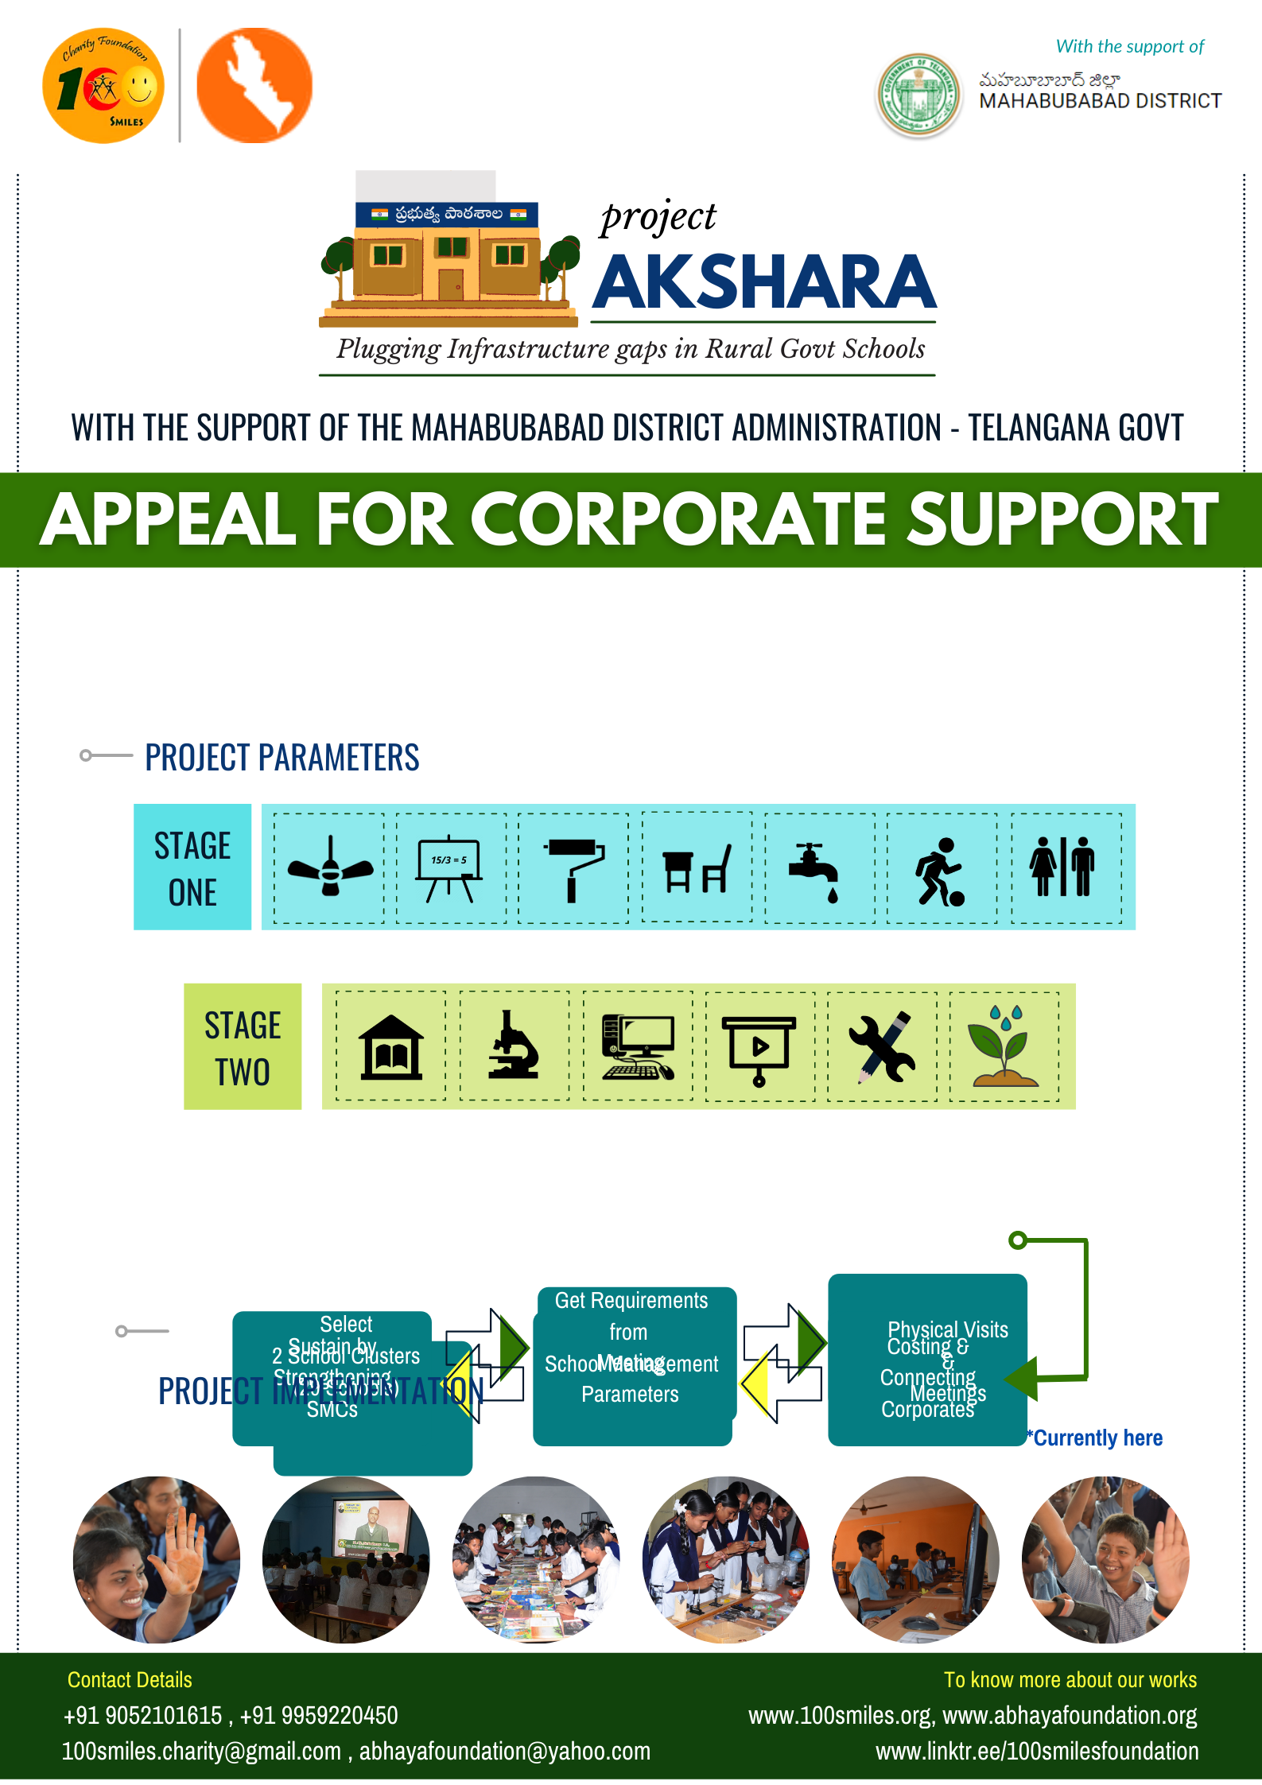
Project AKSHARA – Explained In detail
Project AKSHARA aims in developing 30 Government schools in all aspects.
Strengthening School Management Committees (SMCs), Community Participation & Involving the Government administration to maintain and sustain the facilities provided.
Making sure that lack of basic infrastructure don't hinder the joy of learning
Project AKSHARA have fixed few Ideal parameters that has to be present in every government school & we have divided these parameters into 2 stages.
Fans, Green Boards, Paintings, Desks, Drinking Water, Sports Materials, Toilets
Library, Science Lab, Computer Lab, Digital Classroom, Skill Centers, Plantations.

Slide 7
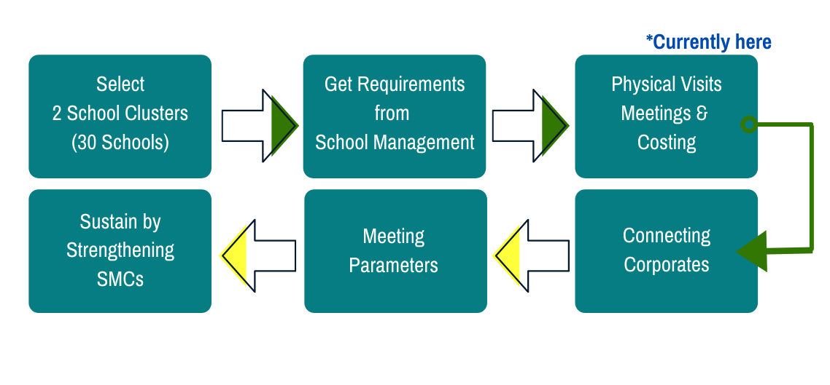
Project AKSHARA – PROJECT IMPLEMENTATION

Slide 8
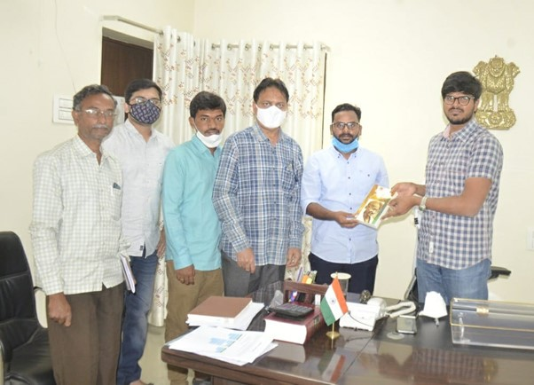
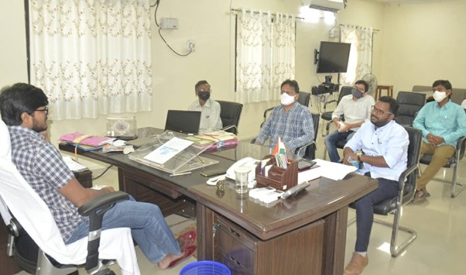
Project AKSHARA – Involving Government Administration
Though NGOs play a role to plug the gaps in infrastructure or outcomes, the daily and central work is always done by the government. School can only be uplifted through effective collaboration with the administration. Right from helping us in selecting the schools, motivating teachers and other stakeholders to come up with the requirements, district administration will support this project. Even after completing the project, district administration will help the project to sustain.
Team Members discussing with Mahabubabad District Collector Shri V.P Gautham, DEO Shri Sharma Garu and DSO Shri Apparao in January 2021 regarding cluster wise development of government schools

Slide 9
Project AKSHARA – Benefits
As initial estimates, around 3700 students from 30 schools comprising of primary, upper primary and high schools will be directly benefitted from this project.
This project will also act as a model to get inspired and follow in other places.
Project Akshara helps in Increasing the Students enrollment and decrease the dropout ratio
Boost Confidence to students that they are second to none
Plug infrastructure gaps so that teachers can focus on outcomes
Reduce out of pocket expenses for low-income families on education by attracting private school students to join government schools
Make parents as active participants in school development by improving SMC’s

Slide 10
Project AKSHARA – Total Budget Estimation
Fans & Lights | Water Bubbles | Paintings | green boards | desk benches | Sports Materials
25 Schools | 30 Schools | 30 Schools | 85 Green Boards | 260 benches | 30 Schools
Price 2 Lakhs | Price 60k | Price 9 Lakhs | Price 1.7Lakh | Price 7.8 Lakhs | Price 3.15Lakhs
UPS Library | UPS Science KIT | PS Library | PS Science Kit | PS Smart TV
6 Schools | 6 Schools | 15 Schools | 15 Schools | 15 Schools
Price - 90k | Price - 90k | Price 1.5 lakh | Price 75k | Price - 4.5 lakh
Total Estimated Budget
56.3 Lakhs
HS Computer Labs | HS Science Labs | HS Library | Digital Classroom | HS - Skill Center
6 Schools | 9 Schools | 9 Schools | 8 Schools | 9 schools
Price - 9 Lakhs | Price 3.5 Lakhs | Price 3.6 Lakhs | Price 5.6 Lakh | Price 1.8 Lakhs
Excluding compound wall, Toilets

Slide 11
Project AKSHARA – Avg Budget Estimation per school
1 ZPHS School
3.2 Lakhs
1 UP School
1.7 Lakhs
1 MPPS School
1.2 Lakhs

Slide 12
Project AKSHARA – Support Required From Corporates
We are looking for responsible corporates who supports us in donating CSR Funds for this initiative to make quality education accessible to all, irrespective of accident of birth.
abhaya foundation & 100 Smiles Foundation both NGO are eligible for receiving Corporate, FCRA donations.
*FCRA Contributions
Name : 100 Smiles Charity Foundation Account No : 6468886184 IFSC : IDIB000M180 Bank: Indian Bank, Branch: Madhapur, Hyderabad
Account Name : Abhaya FOUNDATION Account No: 910010042902046 MICR Code: 500211002 RTGS/IFSC Code:UTIB0000008 Bank: AXIS Bank Ltd Branch: Begumpet, Hyderabad
Account Name : Abhaya FOUNDATION Account No: 052210011051007 MICR Code: 500011042 RTGS/IFSC Code:ANDB0000522 Bank: ANDHRA Bank Branch: S.R.Nagar, Hyderabad
http://100smiles.org/#/donateUs
https://abhayafoundation.org/donations.aspx
Weblinks:

Slide 13
Project AKSHARA – Happy to work with you

