Slide 1

Android Forensics
Session C4
Tuesday, April 3, 2012
Ming Chow
Lecturer, Department of Computer Science
Tufts University
Notes:
TITLE
MIS Training Institute Section # - Page <number> XXXXXX XXX
©

Slide 2
Introduction
Over 700,000 Android phones activated per day
  ~250 million devices activated so far
Android is a loosely defined platform:
  Hardware: varies (e.g., phones, tablets, appliances); manufacturers and carriers can customize it
  Operating system: Based on Linux; over 3 major releases in the last 1.5 years (more later)
What this presentation is: how to acquire and analyze data from an Android device

Slide 3
What We Will Not Cover
Jailbreaking or rooting an Android device
Developing apps or scripts for Android
Fundamentals of computer forensics and investigations
Anything specific to law enforcement or the court system
Using commerical tools such as FTK or EnCase
Linux internals
Notes:
Yes, I teach Android Development. Contact me if you want my notes.
TITLE
MIS Training Institute Section # - Page <number> XXXXXX XXX
©

Slide 4
What You Will Need
Android Standard Development Kit (SDK)
  http://developer.android.com/sdk/index.html
Basic *nix (Unix or Linux) command line skills

Slide 5
Android Architecture (continued)
Based on Linux 2.6 for core system services (e.g., memory and process management, network stack)
How the apps are run: by the Android Runtime System utilizes the Dalvik virtual machine (VM)
  Allows multiple apps to run concurrently
  Each app has its own separate VM (e.g., unique user ID and process)
  Sandboxed apps: files created by an app cannot be viewed by another app (i.e., based on privilege separation)
Notes:
The idea of sandboxing also applies to iOS
TITLE
MIS Training Institute Section # - Page <number> XXXXXX XXX
©

Slide 6
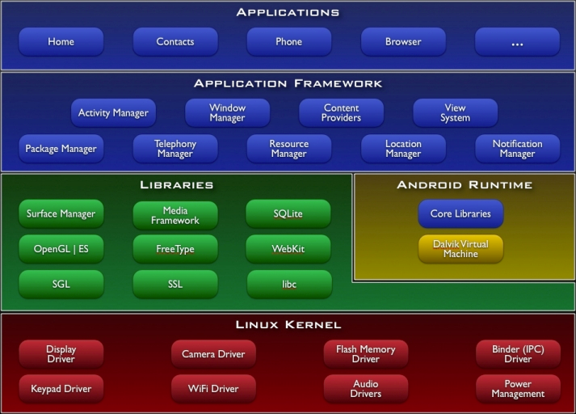
Android Architecture

Slide 7
Android File System
File system is Yet Another Flash File System 2 (YAFF2)
Base file system is “/”; generally recreated everytime using ramdisk content
/cache => Used as scratch pad by OS place dex optimized dalvik bitecode
/data => Contains USER Data Stored as a separate partition in mtdblocks mounted at bootup
/default.prop => Default property settings, values restored from this file on every restart
/proc
/sbin
/sys
/system
/sdcard => The removable sdcard directory
Interactive: http://anantshri.info/andro/file_system.html

Slide 8
Memory and Storage
SIM card
Removable Flash
RAM (on the device itself)

Slide 9
Forensics Caveats
Can’t “pull the plug”
Devices are always online (either using Wi-Fi or provider’s network)
Data stored on the device and in the cloud
Android devices are strongly coupled with Google services (e.g., Gmail, Calendar, Voice)
Notes:
You can turn off the device but…
TITLE
MIS Training Institute Section # - Page <number> XXXXXX XXX
©

Slide 10
Anatomy of an Android App
Android apps are developed using Java and the Android SDK
An app use least-privilege permissions to access various components on device (e.g., camera, networking, GPS, flashlight)
The binary: a signed.apk file; you can unzip it!
  AndroidManifest.xml: details about the app including permissions, version number, and main class
  res/: resources such as images
Each app runs its own Dalvik VM
Notes:
DEMO. Why is this important? To give you insights on how an app stores application privileges and more importantly, your data and personal preferences
Why signing? To validate the digital signature to identify the developer
TITLE
MIS Training Institute Section # - Page <number> XXXXXX XXX
©

Slide 11
Anatomy of an Android App (continued)
Data stored in /data/data/ of where the app is installed
  Each app has a package name (such as com.google.dev or edu.tufts.cs.mchow; URL reversed)
  Subdirectories
    lib/ - Custom library files or dependencies
    files/ - Files used by the app
    cache/ - Cached files, often from the browser
    databases/ - Namely SQLite databases
Notes:
DEMO (plug in device)
TITLE
MIS Training Institute Section # - Page <number> XXXXXX XXX
©

Slide 12
Secure the Device
Unlock device
  Enter or break pass code
  Increase screen timeout
Isolate device from network
  Put device in Airplane Mode
Enable USB debugging
  On the device, go to Settings > Applications > Development > check off “USB debugging”
Remove SIM card
Remove SD card
Find the right USB and power cables
Notes:
Well, what if you can’t break pass code?
TITLE
MIS Training Institute Section # - Page <number> XXXXXX XXX
©

Slide 13
Logical Acquisition
Download latest version of Andrew Hoog’s AFLogical open source at http://code.google.com/p/android-forensics
  Unzip .apk file and send to device
  Instructions: http://code.google.com/p/android-forensics/wiki/WikiPageUse
Information acquired include browser history, call logs, metadata of various media files, MMSes, SMSs, apps installed (with version), contacts; results to CSV files
Information about the device saved to info.xml file
Notes:
DEMO
./adb install AFLogical-OSE_1.5.2.apk
./adb uninstall com.viaforensics.android.aflogical_ose
TITLE
MIS Training Institute Section # - Page <number> XXXXXX XXX
©

Slide 14
Physical Acquisition
Bit-by-bit copy of an entire physical store or SD card (FAT32)
  Gold mine of deleted and active personal data including photos, music, downloads, app data
Use dd

Slide 15
Online Analysis with Android Debug Bridge (adb)
http://developer.android.com/guide/developing/tools/adb.html
Command line tool; found in <sdk>/platform-tools/
Client-server based; communication between your computer and the device
Make sure “USB debugging” is enabled on device
Commands:
  adb devices => see list of connected devices
  adb shell => interact with with device
  You can push and pull files to and from the device via adb push and adb pull
  adb logcat => print system log (includes app stuff)
Notes:
Examples:
* cat /proc/filesystems
* adb ull /sys sys
TITLE
MIS Training Institute Section # - Page <number> XXXXXX XXX
©

Slide 16
Online Analysis with the Dalvik Debug Monitor Server (DDMS)
http://developer.android.com/guide/developing/debugging/ddms.html
Command line tool; found in <sdk>/tools/
Again, make sure “USB debugging” is enabled on device
Graphical
Can take screenshots of device
Overlaps with adb (e.g., logcat)
Can emulate phone operations, location
Can spoof calls and text messages
Can dump application state
Notes:
DEMO
Notice how device is always connected
Another method to do online analysis: mitmproxy
TITLE
MIS Training Institute Section # - Page <number> XXXXXX XXX
©

Slide 17
Conclusion
Challenges
  Fragmentation
    Many different Android OSes
    Many different carriers and devices
  Varies file systems used by Android(YAFFS2, FAT32, etc.)
  Rooted vs. un-rooted devices
Still a very young field (mobile forensics)
Both logical and physical techniques are necessary
Android continues to grow --fast
Notes:
At least 4 major Android OS revisions within the last 2 years
TITLE
MIS Training Institute Section # - Page <number> XXXXXX XXX
©

Slide 18
References and Resources
“Android Forensics: Simplifying Cell Phone Examinations,” Lessard & Kessler, Small Scale Digital Device Forensics Journal, Vol. 4, No. 1, September 2010, http://www.ssddfj.org/papers/SSDDFJ_V4_1_Lessard_Kessler.pdf
“Introduction to Computer Forensics and Android Forensics,” Simson Garfinkel http://simson.net/ref/2011/2011-07-12%20Android%20Forensics.pdf
“Android Forensics: Investigation, Analysis, and Mobile Security for Google Android,” Andrew Hoog, Syngress Press, June 2011. http://my.safaribooksonline.com/book/-/9781597496513
“Android: Forensics and Reverse Engineering,” Raphael Rigo, https://deepsec.net/docs/Slides/DeepSec_2010_Reverse_Forensics.pdf
http://computer-forensics.sans.org/blog/2010/03/01/open-source-android-digital-forensics-application/
http://code.google.com/p/android-forensics/
http://www.dfinews.com/article/introduction-android-forensics
http://viaforensics.com/services/mobile-forensics/android-forensics
https://viaforensics.com/android-forensics/htcia-android-forensics-training-presentation-february-14-2012.html
http://techcrunch.com/2011/12/22/android-700000/
http://developer.android.com/sdk/index.html

