Slide 1
Documentation: Airplane Data Analysis With Machine Learning
Mitali Chowdhury
June 2018

Slide 2
The Data:
Information about the Dataset and the Process of Preparing of Data

Slide 3
The Dataset
Unfiltered flight data, including:
Altitude
Engine Information
Air Pressure
Location
Speed
Turbulence
Plane Information
Raw data in JSON format

Slide 4
Research Goals
Using machine learning, explore the patterns inherent in the data set
In addition, research various machine learning algorithms and how they may apply to the data
Finally, use one or more machine learning algorithms to identify potential anomalies in the data, particularly in time series constructed from the data set

Slide 5
Setup (Python)
Download Data files from website
https://www.adsbexchange.com/data/
Be able to run Python and import
sci-kit learn
pandas
matplotlib.pyplot
seaborn
json
numpy

Slide 6
Loading Data (Python)
Read in data from JSON file
Store as a pandas Dataframe
#imports
import json
import pandas as pd
#load data from json
with open('file_name.json') as f:
data = json.load(f)
#store in dataframe
df = pd.DataFrame(data['acList'])

Slide 7
Cleaning Data and Selecting Variables
Cleaning Data
Is necessary to ensure accuracy of data analysis
Avoids errors in programs
Can be done with pandas functions such as dropna()
Also includes removing data points with impossible values
Selecting Variables
Important step to find which features to use later on
Can help guide which algorithm to use
Airplane Data
Removing columns with more than 25% missing data
Removing columns that are not relevant to our purpose

Slide 8
Code for Cleaning
Remove columns:
with less than 75% data
not selected in list of variables
Remove data points:
which are missing information
which contain impossible values
features = [selected]
for col in df:
#missing data
num = df[col].isnull().sum()
if(num > 1000):
df = df.drop(col, axis=1)
#remove columns not selected
elif(col not in features):
df = df.drop(col, axis=1)
#missing information
df = df.dropna(axis=0)
#limit data
df = df[df.Spd < 666]
df = df[df.Alt < 50000]

Slide 9
Variables Used
Variable | Type | Unit or Categories | Description
Alt | int | feet, at standard pressure | Altitude
AltT | boolean | 0 = standard pressure altitude (default), 1 = indicated altitude (above mean sea level) | Type of Altitude
EngMount | int | 0 = Unknown 1 = Aft Mounted 2 = Wing Buried 3 = Fuselage Buried 4 = Nose Mounted 5 = Wing Mounted | Placement of engines on the aircraft
EngType | int | 0 = None 1 = Piston 2 = Turboprop 3 = Jet 4 = Electric | Type of engine
Engines | alphanumeric | ICAO documentation for strings | Number of engines
GAlt | int |  | Altitude adjusted for local air pressure - approx. height above mean sea level
Gnd | boolean | true = on the ground
InHg | float | inches of mercury | Air Pressure used to calculate the AMSL altitude from standard pressure altitude
Lat | float |  | latitude over ground
Long | float |  | longitude over ground
Variable | Type | Unit or Categories | Description
Mil | boolean | true = appears to be military
Mlat | boolean | true = lat/long appear to be calculated by MLAT server
Spd | float | knots | ground speed
SpdTyp | int | 0/missing = ground speed, 1 = ground speed reversing, 2 = indicated air speed, 3 = true air speed | Type of speed for spd
Species | int |  | general aircraft type
TT | string | empty for plain trails, ‘a’ for trails that include altitude, ‘s’ for trails that include speed | trail type
Trak | float | degrees, clockwise from 0 deg north | track angle across ground
TrkH | boolean | true = trak is aircraft's heading, false = ground track | ground track is default
Vsi | int | feet per minute | vertical speed
VsiT | boolean | 0 = vertical speed is barometric, 1 = vertical speed is geometric. Default to barometric until told otherwise.
WTC | int | 0 = None 1 = Light 2 = Medium 3 = Heavy | Wake Turbulence category

Slide 10
Defining the Problem
Goal: Identify anomalous flight paths
Strategy
First step is to identify which variables will be most useful
Such features should be closely correlated
There should be a clear tendency in the data
Therefore, it should be easy to identify data points which do not follow the general trend

Slide 11
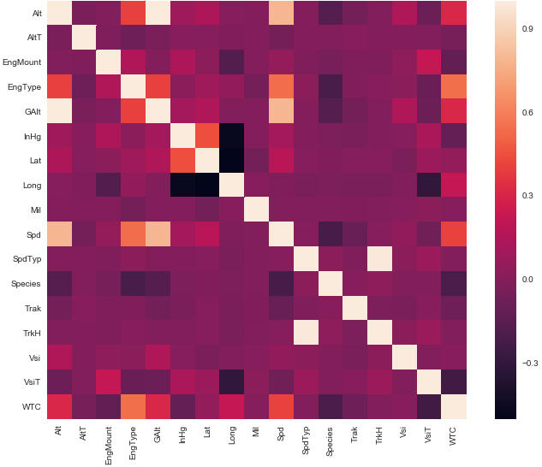
Finding Correlated Variables: Heatmap
Using seaborn, create heatmaps to find correlated variables
Code:
import seaborn as sns
#correlation matrix
corrmat = df.corr()
f, ax = plt.subplots(figsize=(12, 9))
sns.heatmap(corrmat);

Slide 12
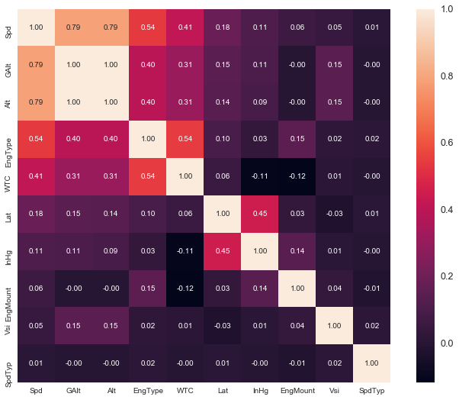
Finding Correlated Variables: Zoomed Heatmap
Choose a variable to see more in-depth
Code, looking at Speed:
import seaborn as sns
cols = corrmat.nlargest(10,'Spd')['Spd'].index
cm = np.corrcoef(df[cols].values.T)
hm = sns.heatmap(cm)
plt.show()

Slide 13
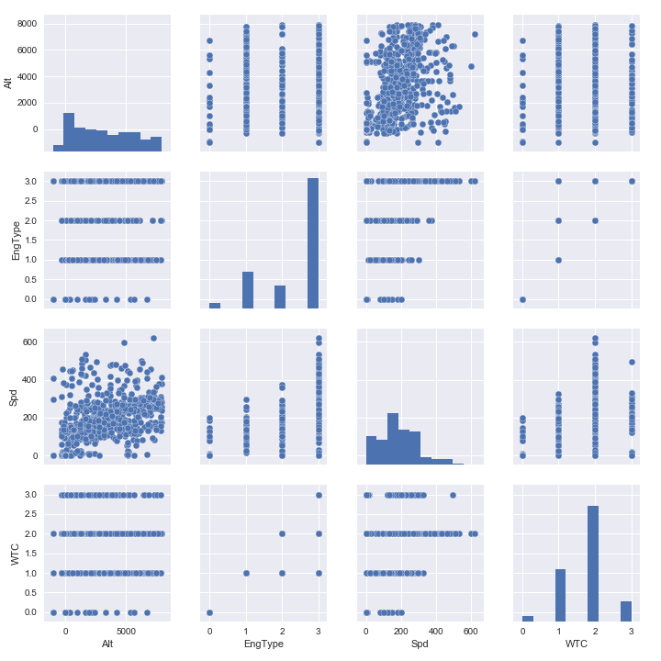
Finding Correlated Variables: Pairplots
Create pairplots to visually find further correlations and trends
Code:
import seaborn as sns
#scatterplot
sns.set()
cols = ['Spd', 'Alt', 'EngType', 'WTC']
sns.pairplot(df[cols], size = 2.5)
plt.show();

Slide 14
Statistical Assumptions (Not used)
Based on following tutorial: https://www.kaggle.com/pmarcelino/comprehensive-data-exploration-with-python
Normal Distribution
Avoid problems when calculating some statistics
Homoscedasticity
Evens out error term
Patterns
If using linear regression, transformations may be necessary
Correlated Errors
Should not have any systematically related error

Slide 15
The Algorithms:
Brief Overview of Useful ML Algorithms and Other Concepts

Slide 16
Machine Learning
Subset of Artificial Intelligence
Primary goal is for computer to perform a function without being explicitly programmed to do so
Given input
develops models to classify or group data
identifies mathematical relationships
makes predictions
Many libraries allow easy use of ML algorithms
sci-kit learn was used for some of the project

Slide 17
Supervised vs. Unsupervised Learning
Two common categories of Machine Learning are Supervised and Unsupervised
Supervised Learning
Deals in labelled data
Training set contains various data points, each with features and a label
Model will then predict a label for given features
Unsupervised Learning
Deals in data patterns
Uses unlabeled training data to explore the shape of the data
Can reveal hidden relationships in data

Slide 18
Linear Regression
Used to find the linear equation of relationship between two variables
Continuous output, rather than discreet predictions
Minimizes the square distance between points and the line

Slide 19
Linear Regression - Example
Based on linear trend of Speed vs Altitude
Using sklearn
linear_model.LinearRegression
Basic least squares linear regression model
Documentation: http://scikit-learn.org/stable/modules/generated/sklearn.linear_model.LinearRegression.html
svm.SVR(kernel = 'linear’)
Support Vector Machine linear regression
Documentation: http://scikit-learn.org/stable/modules/generated/sklearn.svm.SVR.html

Slide 20
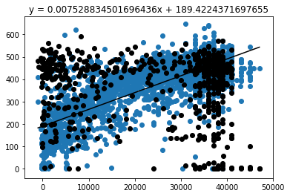
Linear Model
#split and setup data
x0_train = df.Alt[:3000]
y_train = df.Spd[:3000]
x0_test = df.Alt[3000:]
y_test = df.Spd[3000:]
x0_test = x0_test[:,np.newaxis]
x0_train = x0_train[:,np.newaxis]
x0_test.sort(axis=0)
#create machine learning model
mod = linear_model.LinearRegression()
mod.fit(x0_train,y_train)
#find and store equation
y = mod.predict(x0_test)
s = "y = " + str(mod.coef_[0]) + "x + " + str(mod.intercept_)
#plot
plt.scatter(x0_train, y_train)
plt.scatter(x0_test,y_test)
plt.plot(x0_test,y)

Slide 21
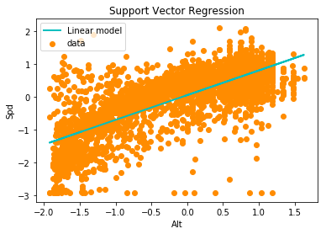
SVR Model (Scaled Data)
X = df.Alt
y = df.Spd
X = X[:,np.newaxis]
X = scale(X)
y = scale(y)
#fit regression model
svr_lin = SVR(kernel='linear', C=1000)
y_lin = svr_lin.fit(X, y).predict(X)
#plot
plt.scatter(X, y)
plt.plot(X, y_lin)
plt.show()

Slide 22
Time Series Analysis
Time Series
A record of a variable changing over time
Applicable to the airplane dataset to track altitude, speed, position, etc. of a single airplane over a given period of time
Analysis of Time Series
Can reveal trends and patterns
Can serve as a basis for finding variation
Possible method of detecting anomalous aircraft behavior

Slide 23
Dynamic Time Warping (DTW) Algorithm
A measure of similarity between two time series
Maps points to minimize square distances, rather than match by elapsed time or Euclidean distances
Process
Create table to hold all values
Find square distance between each point of both series
Map paths from end of one time series to end of other
Minimize sum of square distances along path

Slide 24
DTW - Example

Slide 25
DTW - Table
Series | 2 | 3 | 1
3
2
3

Slide 26
DTW – Distances
Series | 2 | 3 | 1
3 | 1 | 0 | 4
2 | 0 | 1 | 1
3 | 1 | 0 | 4

Slide 27
DTW – Map
Series | 2 | 3 | 1
3 | 1 | 0 | 4
2 | 0 | 1 | 1
3 | 1 | 0 | 4
DTW Dist = 2.236

Slide 28
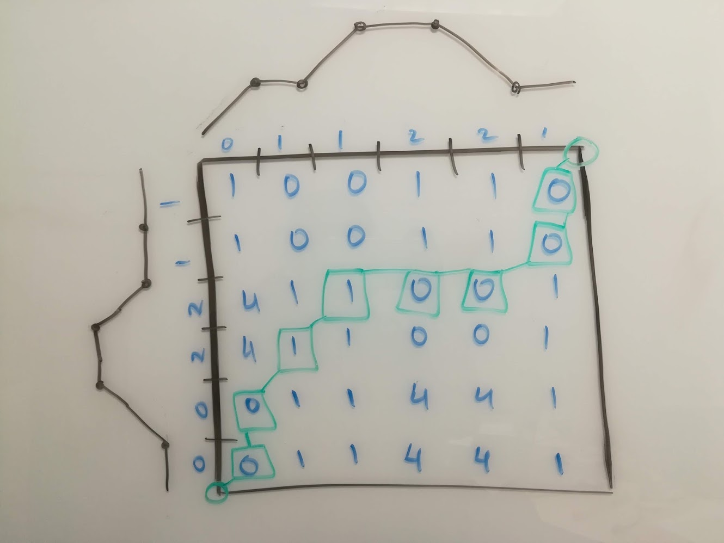
DTW – Visual Example

Slide 29
DTW (Python Algorithm) Source: http://nbviewer.jupyter.org/github/alexminnaar/time-series-classification-and-clustering/blob/master/Time%20Series%20Classification%20and%20Clustering.ipynb
def DTWDistance(s1, s2):
DTW={}
w = max(abs(len(s1)-len(s2)))
#prepare array
for i in range(-1,len(s1)):
for j in range(-1,len(s2)):
DTW[(i, j)] = float('inf')
DTW[(-1, -1)] = 0
#fill array with corresponding DTW values
for i in range(len(s1)):
for j in range(max(0, i-w), min(len(s2), i+w)):
dist= (s1[i]-s2[j])**2
DTW[(i, j)] = dist + min(DTW[(i-1, j)],DTW[(i, j-1)], DTW[(i-1, j-1)])
#return distance
return np.sqrt(DTW[len(s1)-1, len(s2)-1])

Slide 30
K-Means Clustering Algorithm
An unsupervised learning algorithm to categorize data into clusters
Predictions are made by grouping data points with similar features
Process
Randomly assign centroids
Divide data points into groups based on closest centroid
Reposition centroid to be closest to center of assigned data
Redistribute data to centroids in new positions
Repeat until optimal clusters are obtained

Slide 31
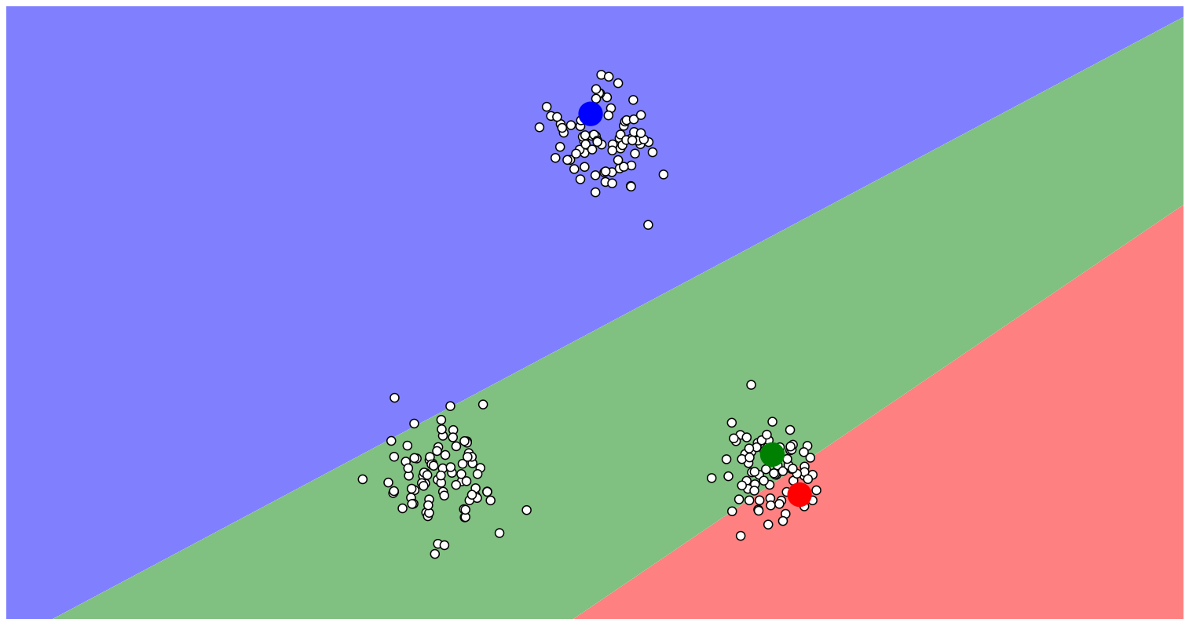
K-Means Clustering
Create Centroids

Slide 32
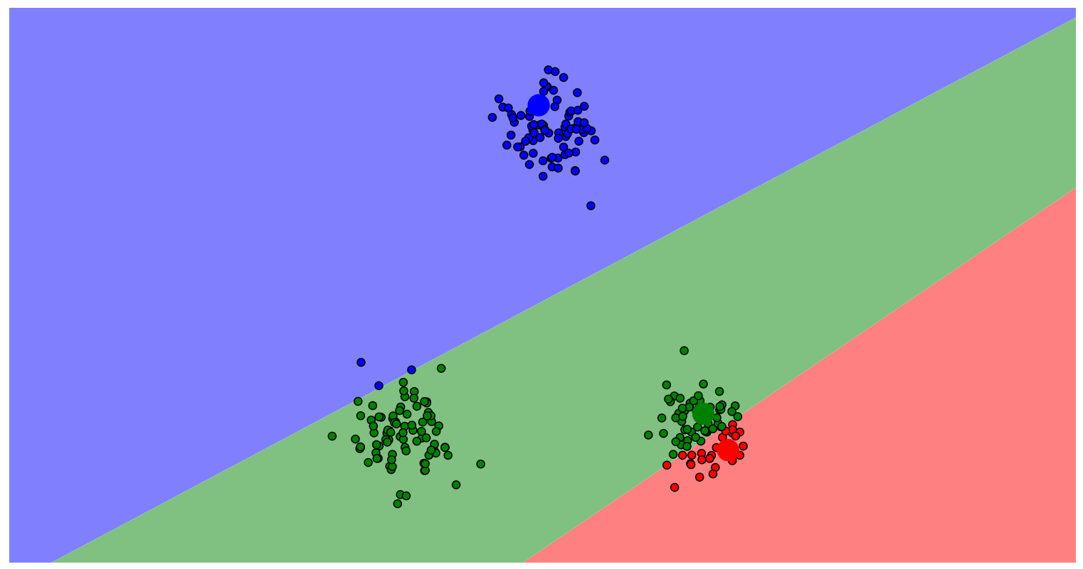
K-Means Clustering
Assign Points
Create Centroids

Slide 33
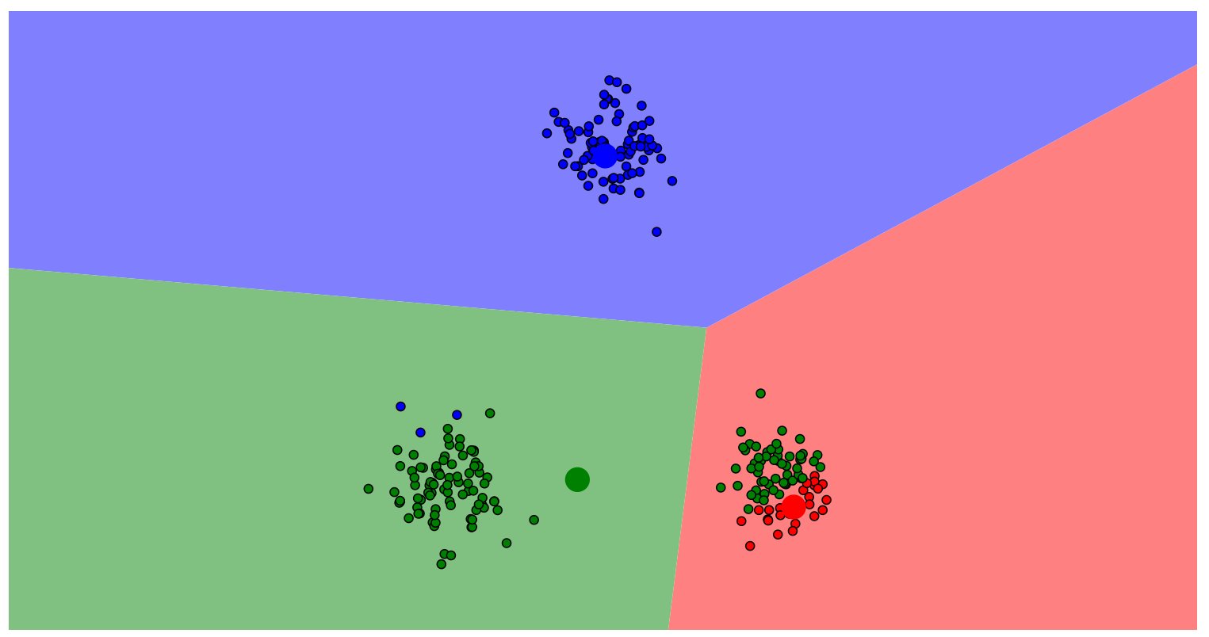
K-Means Clustering
Create Centroids
Assign Points
Optimize Centroid Location

Slide 34
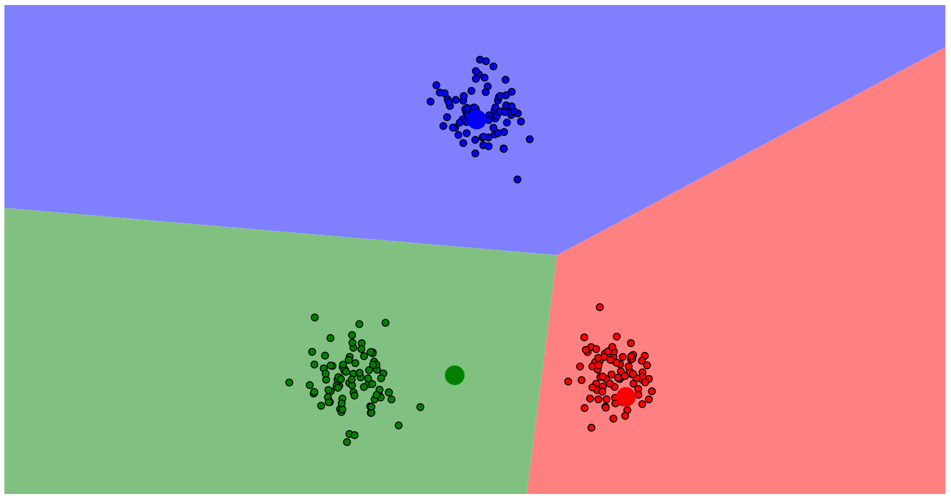
K-Means Clustering
Create Centroids
Assign Points
Optimize Centroid Location
Reassign Points

Slide 35
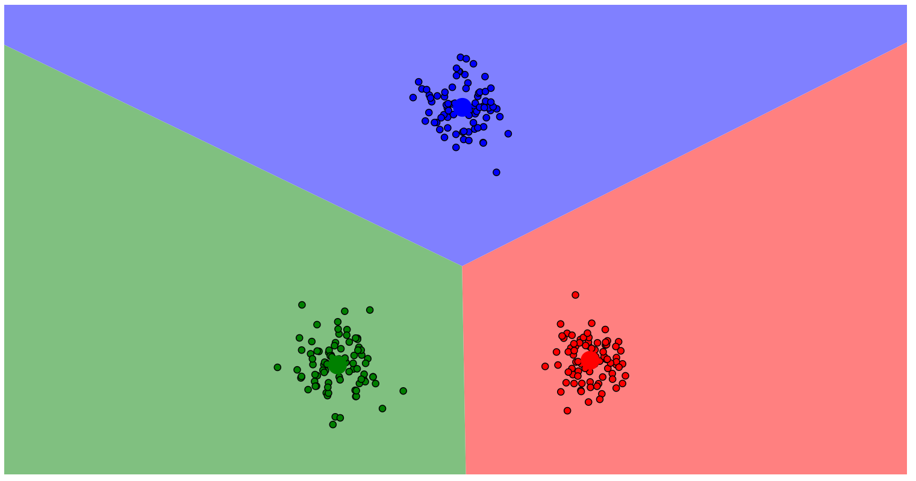
K-Means Clustering
Create Centroids
Assign Points
Optimize Centroid Location
Reassign Points
Repeat until Optimized

Slide 36
K-Means Clustering Creating Centroid (Python) Source: http://nbviewer.jupyter.org/github/alexminnaar/time-series-classification-and-clustering/blob/master/Time%20Series%20Classification%20and%20Clustering.ipynb
def k_means_clust(data,num_clust,num_iter, w=5):
centroids=random.sample(data,num_clust)
counter=0
for n in range(num_iter):
counter+=1
print counter
assignments={}
#assign data points to clusters
for ind,i in enumerate(data):
min_dist=float('inf')
closest_clust=None
for c_ind,j in enumerate(centroids):
if LB_Keogh(i,j,5)<min_dist:
cur_dist=DTWDistance(i,j,w)
if cur_dist<min_dist:
min_dist=cur_dist
closest_clust=c_ind
if closest_clust in assignments:
assignments[closest_clust].append (ind)
else:
assignments[closest_clust]=[]
#recalculate centroids of clusters
for key in assignments:
clust_sum=0
for k in assignments[key]:
clust_sum=clust_sum+data[k]
centroids[key]=[m/len(assignments[key]) for m in clust_sum]
return centroids

Slide 37
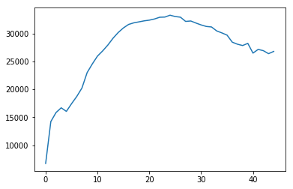
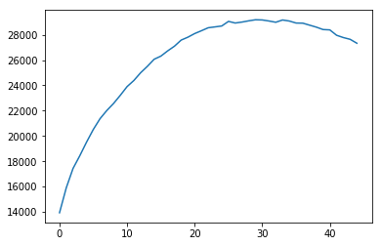
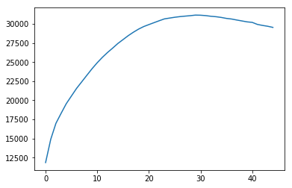
Results of Clustering with DTW
Clustering with one centroid creates an average time series
10 planes vs 100 planes vs 1000 planes

Slide 38
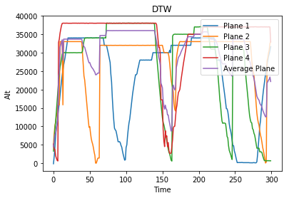
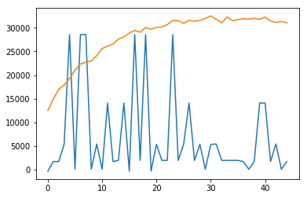
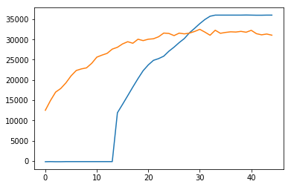
Example of anomalies based on minimum and maximum DTW distance

Slide 39
Using Clustering to Detect Anomalies Source: https://anomaly.io/anomaly-detection-clustering/, https://anomaly.io/anomaly-detection-normal-distribution/
Noise Limits
Plotting difference between centroid and data points yields noise
If noise exceeds a certain threshold, the data can be considered anomalous
Noise should be concentrated at zero
If concentration is skewed, the data can be considered anomalous
Outlier Values
Based on mean and standard deviation of DTW distance
If a time series is outside a certain number of standard deviations from the mean, the data can be considered anomalous

