Slide 1
Documentation: Airplane Data Analysis With Machine Learning
Mitali Chowdhury
June 2018

Slide 2
The Data:
Information about the Dataset and the Process of Preparing of Data

Slide 3
Setup
Download Data files from website
https://www.adsbexchange.com/data/
Be able to run Python and import
sci-kit learn
pandas
matplotlib.pyplot
seaborn
json
numpy

Slide 4
Loading Data
#imports
import json
import pandas as pd
#load data from json
with open('file_name.json') as f:
data = json.load(f)
#store in dataframe
df = pd.DataFrame(data['acList'])

Slide 5
Cleaning Data and Selecting Variables
Cleaning Data
Is necessary to ensure accuracy of data analysis
Avoids errors in programs
Can be done with pandas functions such as dropna()
Also includes removing data points with impossible values
Selecting Variables
Important step to find which features to use later on
Can help guide which algorithm to use
Airplane Data
Removing columns with more than 25% missing data
Removing columns that are not relevant

Slide 6
Code for Cleaning
features = #selected list of variables
for col in df:
#remove columns with less than 75% data
num = df[col].isnull().sum()
if(num > 1000):
df = df.drop(col, axis=1)
#remove columns not selected
elif(col not in features):
df = df.drop(col, axis=1)
#remove data points with missing information
df = df.dropna(axis=0)
#limit data to feasible values only
df = df[df.Spd < 666]
df = df[df.Alt < 50000]

Slide 7
Variables Used
Variable | Type | Unit or Categories | Description
Alt | int | feet, at standard pressure | Altitude
AltT | boolean | 0 = standard pressure altitude (default), 1 = indicated altitude (above mean sea level) | Type of Altitude
EngMount | int | 0 = Unknown 1 = Aft Mounted 2 = Wing Buried 3 = Fuselage Buried 4 = Nose Mounted 5 = Wing Mounted | Placement of engines on the aircraft
EngType | int | 0 = None 1 = Piston 2 = Turboprop 3 = Jet 4 = Electric | Type of engine
Engines | alphanumeric | ICAO documentation for strings | Number of engines
GAlt | int |  | Altitude adjusted for local air pressure - approx. height above mean sea level
Gnd | boolean | true = on the ground
InHg | float | inches of mercury | Air Pressure used to calculate the AMSL altitude from standard pressure altitude
Lat | float |  | latitude over ground
Long | float |  | longitude over ground
Variable | Type | Unit or Categories | Description
Mil | boolean | true = appears to be military
Mlat | boolean | true = lat/long appear to be calculated by MLAT server
Spd | float | knots | ground speed
SpdTyp | int | 0/missing = ground speed, 1 = ground speed reversing, 2 = indicated air speed, 3 = true air speed | Type of speed for spd
Species | int |  | general aircraft type
TT | string | empty for plain trails, ‘a’ for trails that include altitude, ‘s’ for trails that include speed | trail type
Trak | float | degrees, clockwise from 0 deg north | track angle across ground
TrkH | boolean | true = trak is aircraft's heading, false = ground track | ground track is default
Vsi | int | feet per minute | vertical speed
VsiT | boolean | 0 = vertical speed is barometric, 1 = vertical speed is geometric. Default to barometric until told otherwise.
WTC | int | 0 = None 1 = Light 2 = Medium 3 = Heavy | Wake Turbulence category

Slide 8
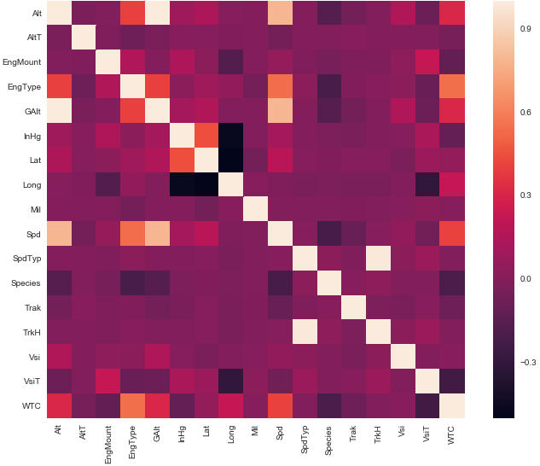
Finding Correlated Variables: Heatmap
Using seaborn, create heatmaps to find correlated variables
Code:
import seaborn as sns
#correlation matrix
corrmat = df.corr()
f, ax = plt.subplots(figsize=(12, 9))
sns.heatmap(corrmat);

Slide 9
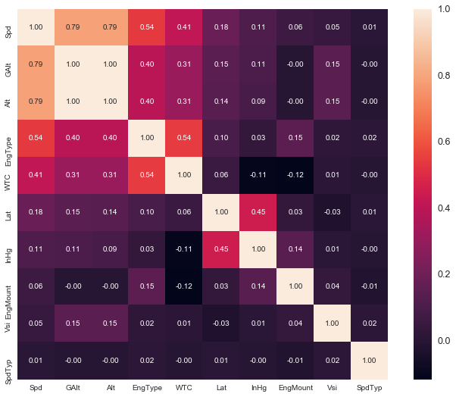
Finding Correlated Variables: Zoomed Heatmap
Choose a variable to see more in-depth
Code, looking at Speed:
import seaborn as sns
cols = corrmat.nlargest(10,'Spd')['Spd'].index
cm = np.corrcoef(df[cols].values.T)
hm = sns.heatmap(cm)
plt.show()

Slide 10
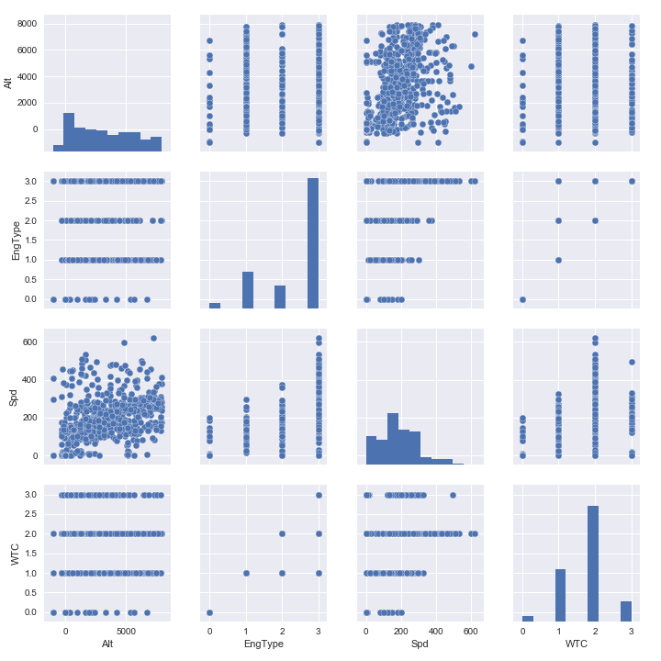
Finding Correlated Variables: Pairplots
Create pairplots to find further correlations and trends
Code:
import seaborn as sns
#scatterplot
sns.set()
cols = ['Spd', 'Alt', 'EngType', 'WTC']
sns.pairplot(df[cols], size = 2.5)
plt.show();

Slide 11
Statistical Assumptions (Not used)
Based on following tutorial: https://www.kaggle.com/pmarcelino/comprehensive-data-exploration-with-python
Normal Distribution
Avoid problems when calculating some statistics
Homoscedasticity
Evens out error term
Patterns
If using linear regression, transformations may be necessary
Correlated Errors
Should not have any systematically related error

Slide 12
The Algorithms:
Brief Overview of Useful ML Algorithms and Other Concepts

Slide 13
Machine Learning
Subset of Artificial Intelligence
Primary goal is for computer to perform a function without being explicitly programmed to do so
Given input
develops models to classify or group data
identifies mathematical relationships
makes predictions
Many libraries allow easy use of ML algorithms
sci-kit learn was used for some of the project

Slide 14
Linear Regression
Used to find the linear equation of relationship between two variables

Slide 15
Linear Regression - Example
Based on linear trend of Speed vs Altitude
Using sklearn
linear_model.LinearRegression
Basic least squares linear regression model
Documentation: http://scikit-learn.org/stable/modules/generated/sklearn.linear_model.LinearRegression.html
svm.SVR(kernel = 'linear’)
Support Vector Machine linear regression
Documentation: http://scikit-learn.org/stable/modules/generated/sklearn.svm.SVR.html

Slide 16
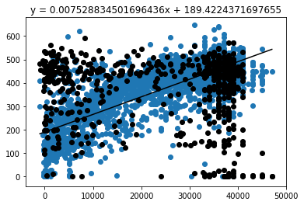
Linear Model
#split and setup data
x0_train = df.Alt[:3000]
y_train = df.Spd[:3000]
x0_test = df.Alt[3000:]
y_test = df.Spd[3000:]
x0_test = x0_test[:,np.newaxis]
x0_train = x0_train[:,np.newaxis]
x0_test.sort(axis=0)
#create machine learning model
mod = linear_model.LinearRegression()
mod.fit(x0_train,y_train)
#find and store equation
y = mod.predict(x0_test)
s = "y = " + str(mod.coef_[0]) + "x + " + str(mod.intercept_)
#plot
plt.scatter(x0_train, y_train)
plt.scatter(x0_test,y_test)
plt.plot(x0_test,y)

Slide 17
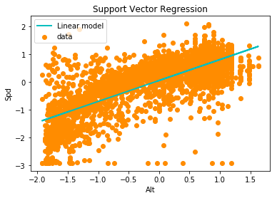
SVR Model (Scaled Data)
X = df.Alt
y = df.Spd
X = X[:,np.newaxis]
X = scale(X)
y = scale(y)
#fit regression model
svr_lin = SVR(kernel='linear', C=1000)
y_lin = svr_lin.fit(X, y).predict(X)
#plot
plt.scatter(X, y)
plt.plot(X, y_lin)
plt.show()

Slide 18
Time Series Analysis
Time Series
A record of a variable changing over time
Applicable to the airplane dataset to track altitude, speed, position, etc. of a single airplane over a given period of time
Analysis of Time Series
Can reveal trends and patterns
Can serve as a basis for finding variation
Possible method of detecting anomalous aircraft behavior

Slide 19
Dynamic Time Warping (DTW) Algorithm
A measure of similarity between two time series
Maps points to minimize square distances, rather than match by elapsed time
Process
Create table to hold all values
Find square distance between each point of both series
Map paths from end of one time series to end of other
Minimize sum of square distances along path

Slide 20
DTW - Example

Slide 21
DTW - Table
Series | 2 | 3 | 1
3
2
3

Slide 22
DTW – Distances
Series | 2 | 3 | 1
3 | 1 | 0 | 4
2 | 0 | 1 | 1
3 | 1 | 0 | 4

Slide 23
DTW – Map
Series | 2 | 3 | 1
3 | 1 | 0 | 4
2 | 0 | 1 | 1
3 | 1 | 0 | 4
DTW Dist = 2.236

Slide 24
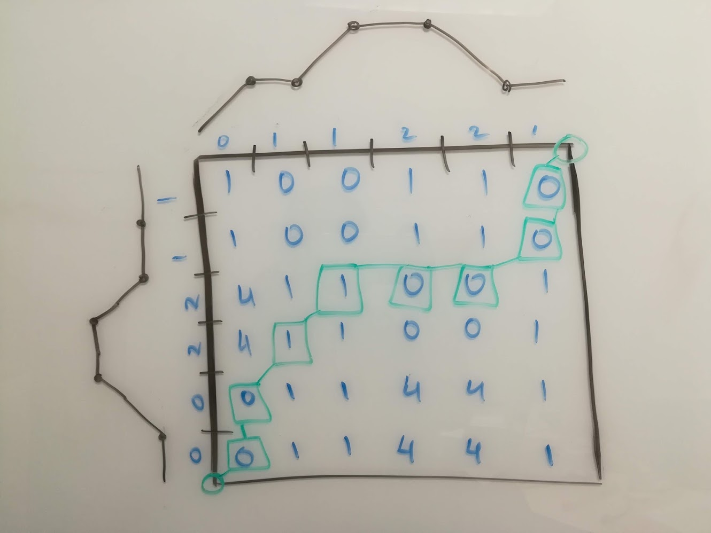
DTW – Another Example

Slide 25
DTW – Code Source: http://nbviewer.jupyter.org/github/alexminnaar/time-series-classification-and-clustering/blob/master/Time%20Series%20Classification%20and%20Clustering.ipynb
def DTWDistance(s1, s2):
DTW={}
w = max(abs(len(s1)-len(s2)))
#prepare array
for i in range(-1,len(s1)):
for j in range(-1,len(s2)):
DTW[(i, j)] = float('inf')
DTW[(-1, -1)] = 0
#fill array with corresponding DTW values
for i in range(len(s1)):
for j in range(max(0, i-w), min(len(s2), i+w)):
dist= (s1[i]-s2[j])**2
DTW[(i, j)] = dist + min(DTW[(i-1, j)],DTW[(i, j-1)], DTW[(i-1, j-1)])
#return distance
return np.sqrt(DTW[len(s1)-1, len(s2)-1])

Slide 26
K-Means Clustering Algorithm
An unsupervised learning algorithm to categorize data into clusters
Predictions are made by grouping data points with similar features
Process
Randomly assign centroids
Divide data points into groups based on closest centroid
Reposition centroid to be closest to center of assigned data
Redistribute data to centroids in new positions
Repeat until optimal clusters are obtained

Slide 27
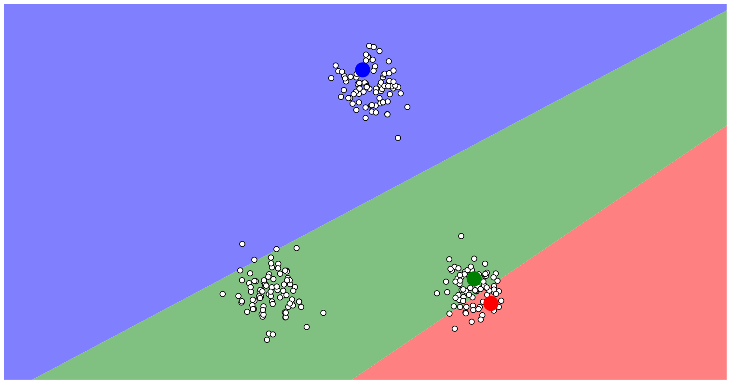
K-Means Clustering
Create Centroids

Slide 28
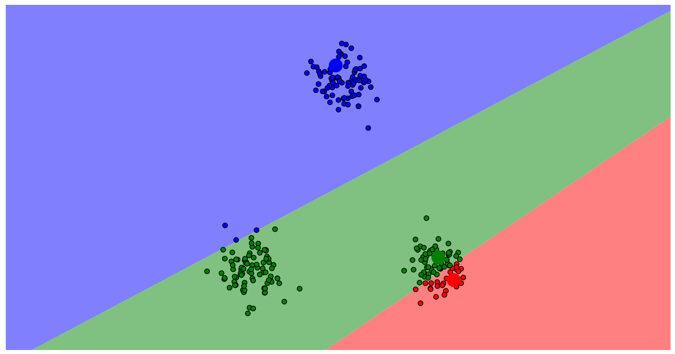
K-Means Clustering
Assign Points
Create Centroids

Slide 29
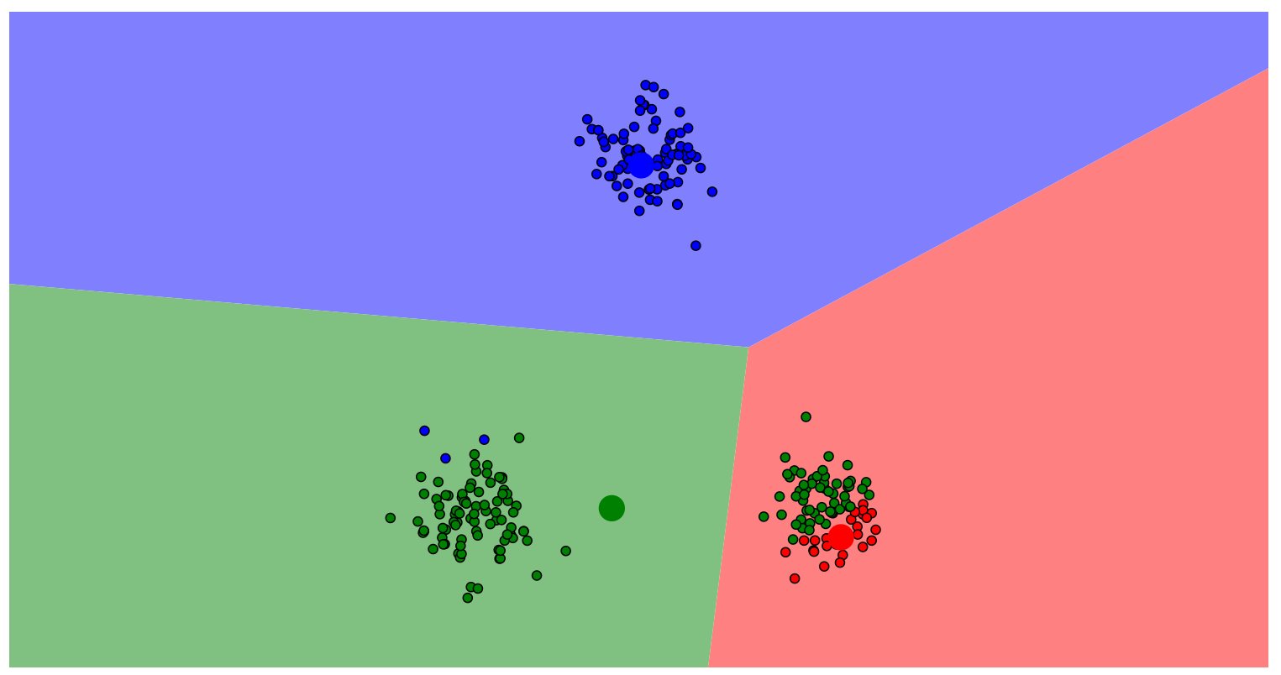
K-Means Clustering
Create Centroids
Assign Points
Optimize Centroid Location

Slide 30
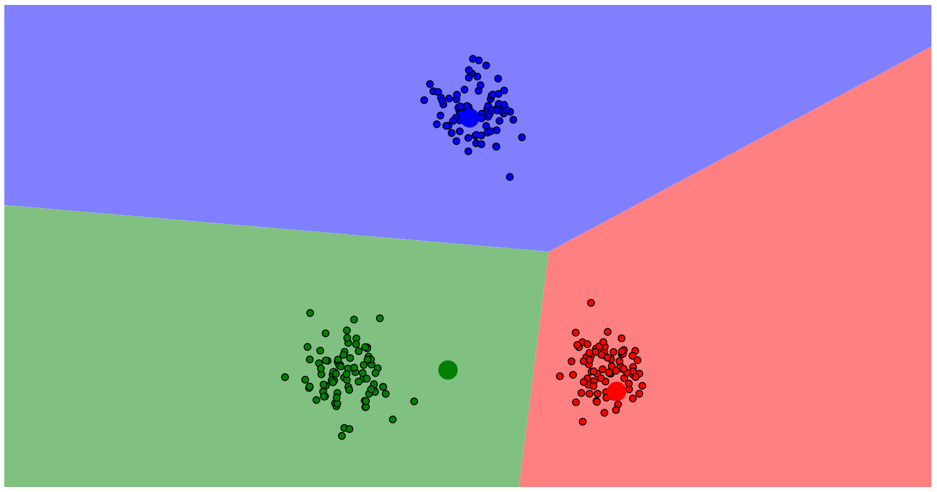
K-Means Clustering
Create Centroids
Assign Points
Optimize Centroid Location
Reassign Points

Slide 31
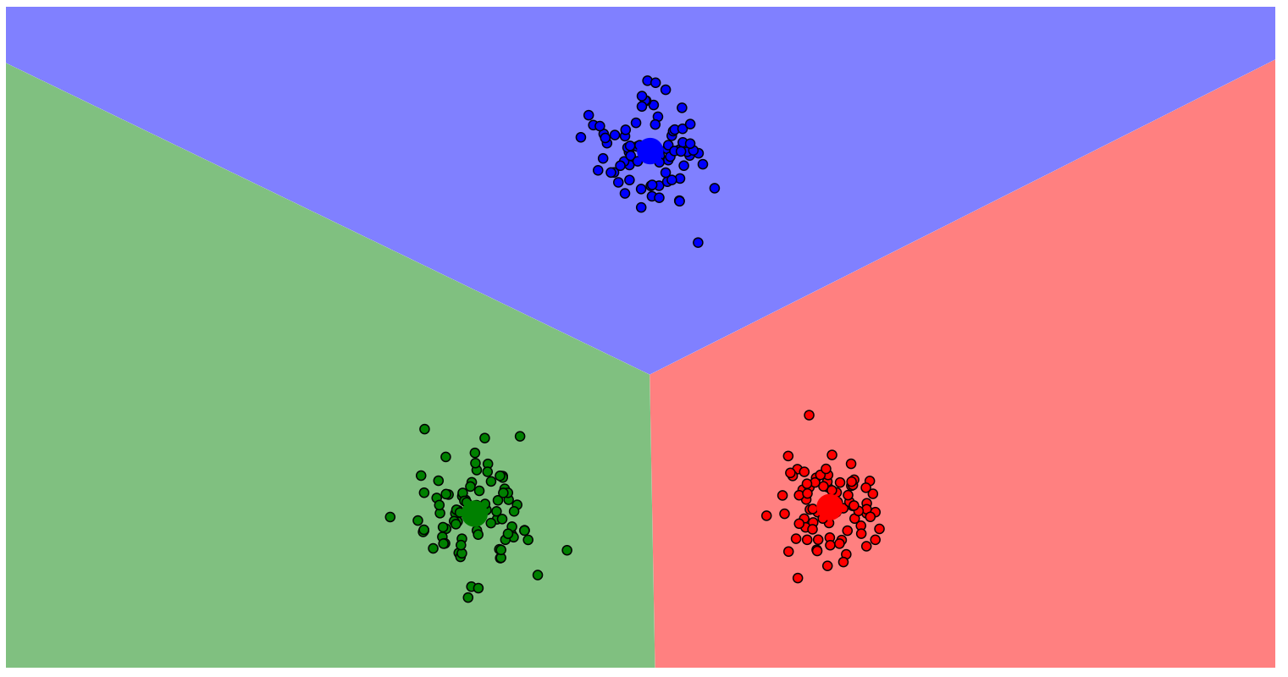
K-Means Clustering
Create Centroids
Assign Points
Optimize Centroid Location
Reassign Points
Repeat until Optimized

Slide 32
K-Means Clustering – Code to create Centroids Source: http://nbviewer.jupyter.org/github/alexminnaar/time-series-classification-and-clustering/blob/master/Time%20Series%20Classification%20and%20Clustering.ipynb
def k_means_clust(data,num_clust,num_iter, w=5):
centroids=random.sample(data,num_clust)
counter=0
for n in range(num_iter):
counter+=1
print counter
assignments={}
#assign data points to clusters
for ind,i in enumerate(data):
min_dist=float('inf')
closest_clust=None
for c_ind,j in enumerate(centroids):
if LB_Keogh(i,j,5)<min_dist:
cur_dist=DTWDistance(i,j,w)
if cur_dist<min_dist:
min_dist=cur_dist
closest_clust=c_ind
if closest_clust in assignments:
assignments[closest_clust].append (ind)
else:
assignments[closest_clust]=[]
#recalculate centroids of clusters
for key in assignments:
clust_sum=0
for k in assignments[key]:
clust_sum=clust_sum+data[k]
centroids[key]=[m/len(assignments[key]) for m in clust_sum]
return centroids

Slide 33
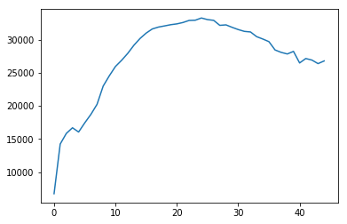
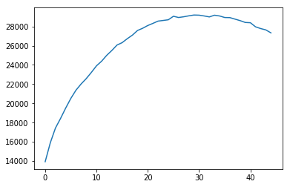
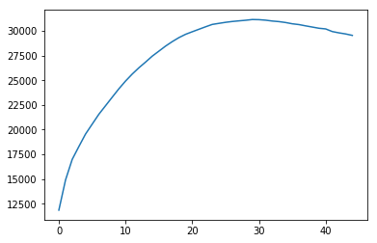
Results of Clustering with DTW
Clustering with one centroid creates an average time series
10 planes vs 100 planes vs 1000 planes

Slide 34
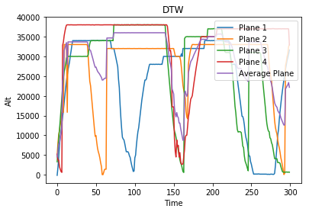
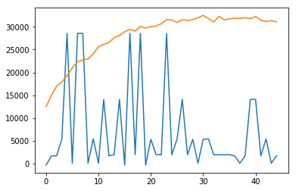
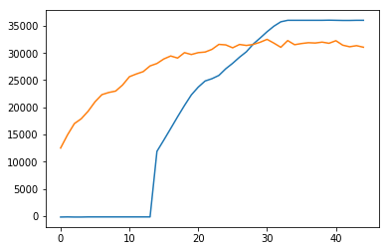
Example of minimum and maximum DTW distance

Slide 35
Using Clustering to Detect Anomalies Source: https://anomaly.io/anomaly-detection-clustering/, https://anomaly.io/anomaly-detection-normal-distribution/
Noise Limits
Plotting difference between centroid and data points yields noise
If noise exceeds a certain threshold, the data can be considered anomalous
Noise should be concentrated at zero
If concentration is skewed, the data can be considered anomalous
Outlier Values
Based on mean and standard deviation of DTW distance
If a time series is outside a certain number of standard deviations from the mean, the data can be considered anomalous

