Slide 1
Global Unicorn COMPANIES
- Muskan Chowatia

Slide 2
CONTENTS
Scope of the Project​
About the Data
Data Wrangling
​​Data Visualization​
Key Findings

Slide 3
Scope of the PROJECT
This project provides insights into the characteristics of unicorn companies. A unicorn company is a private company with a valuation of more than $1 billion, and today there are over 1,000 unicorn companies around the world. In particular, it will find answers to and derive insights for following questions:
How long does it usually take for a company to become a unicorn?
Which industries have the most unicorns?
Which countries have the most unicorns?
Which unicorn companies have had the biggest return on investment?
Which unicorns were most funded?

Slide 4
About the data
This dataset contains a csv table with 1,074 records, one for each company.
Each record contains details on the company's current valuation, total funding, country of origin, industry, select investors, and the years they were founded and became unicorns.
The dataset encompasses crucial details about esteemed unicorn companies globally: Company names, valuations in billions of dollars upon reaching the $1 billion mark, the milestone date achieved, industry sectors, founding cities and countries across continents, establishment years, total funding amounts raised in millions or billions of dollars, and the top four key investing entities or individuals supporting these exceptional ventures.
The data contains missing values hence the dataset is cleaned, preprocessed and visualization is performed on that data.

Slide 5
DATA WRANGLING
Analysed the rows with missing city value and dropped them. Performed data cleaning and wrangling on the dataset.
Cleaned Valuation and Funding columns and cast it to float type
Corrected the spelling mistake for "Artificial Intelligence" in Industry column
Duplicate entries of Bolt company were identified. They were made unique by appending the country the company was founded in.
Exploded the Select Investors column into individual rows
Derived the year in which the company reached $1 billion in valuation
Derived the ROI metric-> Valuation-to-funding ratio
Derived the time taken to reach $1 billion in valuation

Slide 6
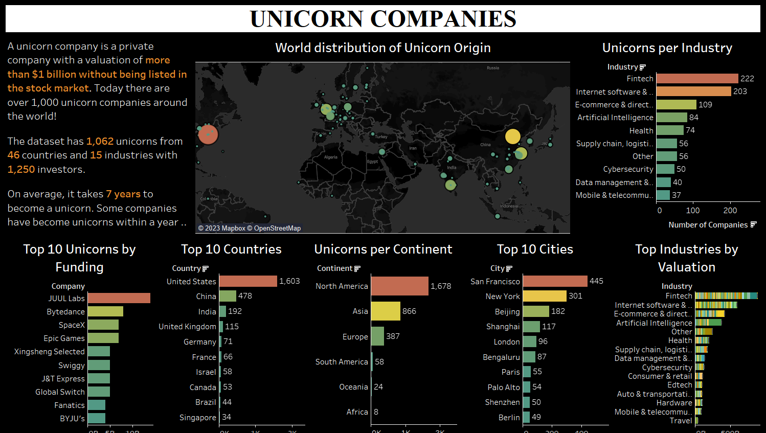
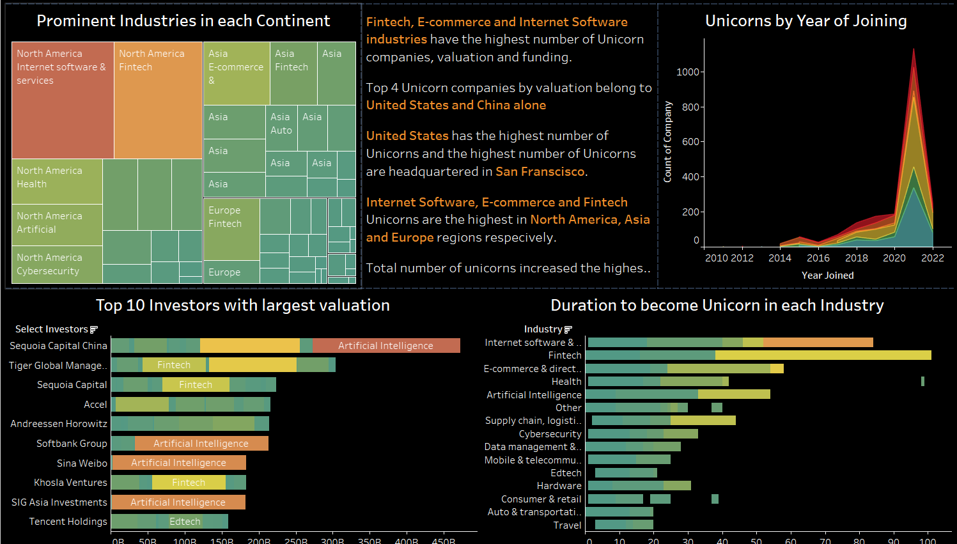
DATA VISUALIZATION

Slide 7
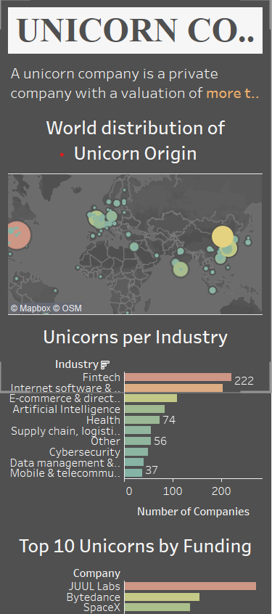
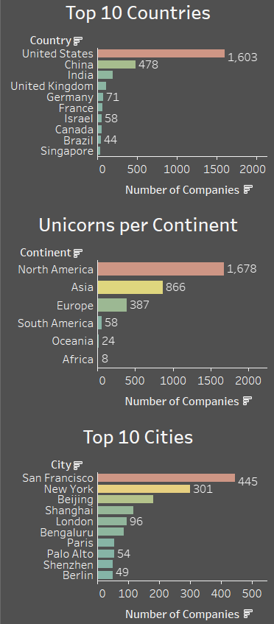
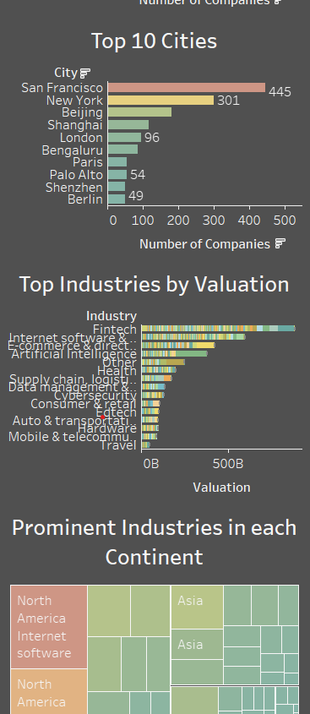
DATA VISUALIZATION

Slide 8
Key findings
Fintech, E-commerce and Internet Software industries have the highest number of Unicorn companies, valuation and funding.
Top five most valued unicorns are Bytedance, SHEIN, SpaceX, Stripe and Klarna. Of the five, four Unicorn companies belong to United States and China.
United States has the highest number of Unicorns and the highest number of Unicorns are headquartered in San Franscisco.
Internet Software, E-commerce and Fintech Unicorns are the highest in North America, Asia and Europe regions respecively.
2021 was the year of Unicorns, 54% of them attained the Unicorn status in 2021. AI, E-commerce, Ed-tech, Fintech and Health industries boomed in 2021 inspite of the pandemic.
Sequoia Capital China, Tiger Global management and Tencent Holdings are the most popular investors.
On average, it takes 7 years to become a unicorn. Some companies have become unicorns within a year of founding.

Slide 9
Thank you!

