Slide 1
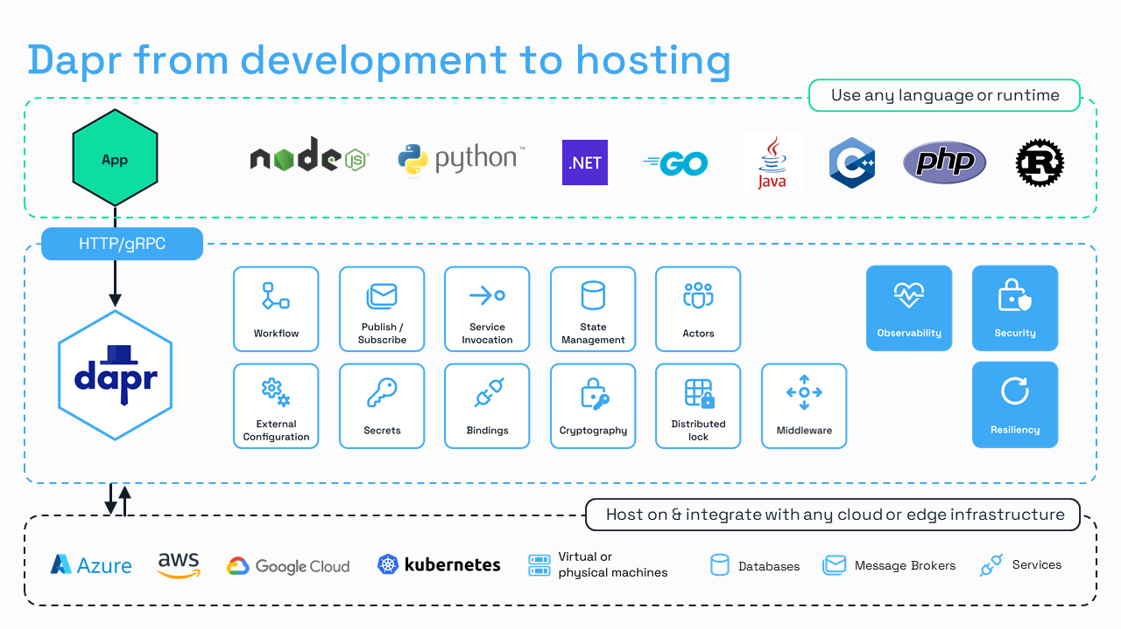
What is Dapr?
Distributed Application Runtime | CNCF Project | dapr.io | latest Dapr v1.17 used in this demo
Why Dapr is a strong software choice
Mature and trusted — CNCF Graduated project since 30 Oct 2024, signaling production readiness and stable governance.
Open standards by default — uses CloudEvents 1.0 for pub/sub and OpenTelemetry + W3C Trace Context for tracing.
Portable architecture — decouples app code from brokers, state stores, and underlying infrastructure.
Rich building blocks — covers pub/sub, service invocation, state, actors, workflows, secrets, config, locks, and more.
Developer productivity — sidecar APIs reduce boilerplate and keep business code cleaner and more focused.
Operational resilience and observability — built around security, resiliency, metrics, logs, and distributed tracing.
Ecosystem and extensibility — broad component model makes it easier to integrate different backends without rewriting services.

Slide 2
Dapr Pub/Sub capabilities
1. Vendor and Broker Portability
Dapr abstracts the underlying message broker behind a consistent API. This allows you to swap brokers (e.g., using Redis Streams for local development and Azure Service Bus for production) by simply changing a configuration file, without altering any application code.
2. Standardized delivery methods and communication
CloudEvents envelope - Dapr automatically wraps outgoing messages in a standardized format. This ensures consistent metadata and formatting across all services, which simplifies cross-platform integration and event routing.
Push and Pull
Ordered delivery
3. Built-in Resiliency and Reliability
Dapr provides features that you would otherwise have to implement manually using a direct SDK:
At-least-once delivery: Dapr guarantees messages reach subscribers even if the application or broker temporarily fails.
Automatic Retries: Dapr handles retries for failed message deliveries based on configurable policies.
Competing Consumers: Dapr manages consumer groups and ensures that only one instance of a scaled-out service processes a specific message.
4. Reduced Code Complexity
Smaller SDK footprint: By using Dapr’s HTTP or gRPC APIs, you avoid importing heavy, broker-specific SDKs into your code.
Simplified Subscriptions: You can define subscriptions declaratively in YAML files rather than writing code to manage connection strings and listener loops.
Content-Based Routing: Dapr allows you to route messages to different service endpoints based on the event's content without writing complex branching logic in your application.
5. Enhanced Observability and Security
Tracing: Dapr automatically injects trace headers, enabling end-to-end distributed tracing of messages through your entire system.
Scoped Access: You can use Dapr components to strictly control which applications are permitted to publish or subscribe to specific topics.

Slide 3
Dapr-based Stateful Actor for Pub/Sub
The biggest gains are on the subscriber side:
Crash recovery
Controlled ordering
Duplicate tolerance
Checkpointing
The core idea is this:
A pub/sub broker gets the event to your service, and a stateful actor becomes the durable, identity-based processor for that event.
1. Crash resiliency Dapr pub/sub provides at-least-once delivery, so messages may be redelivered if delivery or processing fails. Dapr explicitly says it will retry delivery until successful delivery.
A stateful actor helps because it keeps processing state in a Dapr state store, and that state outlives the in-memory actor instance.
2. Safer handling of duplicate delivery Because Dapr pub/sub is at-least-once, duplicates are a normal architectural concern. A stateful actor can persist: last processed message ID, last processed sequence number, current workflow step etc
3. Better ordering per business key Dapr actor runtime uses turn-based concurrency, meaning a single actor processes one request at a time.
Dapr says no more than one thread can be active inside an actor object at any time.
That is useful for pub/sub when events for the same entity must be processed in order. If all events for Order-123 are routed to actor OrderActor-123, that actor naturally serializes processing for that entity.
4. Durable checkpointing and progress tracking
Actors may involve ongoing state, such as: current status, retry count, last successful step etc

Slide 4
Dapr Pub/Sub vs Manual Azure Service Bus SDK
Manual Azure Service Bus SDK
Dapr Pub/Sub
♦ Connection management
ServiceBusClient + senders / receivers — connection lifecycle in app code
Zero lines — Dapr sidecar owns the connection entirely
♦ Broker coupling
Azure.Messaging.ServiceBus locks you to ASB; broker change means a rewrite
YAML component swap — RabbitMQ, Kafka, Redis Streams; app code unchanged
♦ Resiliency
Try/catch loops, manual retry policies, dead-letter wiring in every service
Retries, timeouts, circuit breakers in resiliency.yaml — no code at all
♦ Observability
Manual correlation-ID threading; custom logging and metrics wiring per service
W3C trace context propagated automatically; OpenTelemetry export built in
♦ Failover
Manual custom implementation.
Stateful actors support

Slide 5


This Demo: Pull Delivery in Practice
Publisher app
Publisher Worker
.NET Worker Service publishes every 5 s
Dapr Sidecar (pub)
pub-app-id : 3500 attaches SessionId=session1
Service Bus topic1 / subscription1 buffers messages for subscribers
Subscriber app
Subscriber Dapr Actor Dapr .NET stateful Actor business handler processes messages
Streaming subscription Dapr .NET Messaging SDK app pulls next message when ready
Dapr Sidecar (sub) sub-app-id : 3501 pulls from broker and exposes stream
state
Key features from Dapr:
✔ Pull delivery: streaming subscriptions let the app receive messages without an HTTP callback endpoint
✔ Back-pressure control: the subscriber requests work when ready instead of being pushed messages by Dapr
✔ Broker portability: no broker SDK in app code; switch brokers by updating the component YAML
✔ Crash resiliency: messages may be redelivered if delivery or processing fails

