Slide 1
What is text mining?
Process of deriving high-quality information from text.
Involves the discovery by computer of new, previously unknown information, by automatically extracting information from different written resources (Wikipedia).
The process of transforming unstructured text into structured data for easy analysis
qualitative and quantitative

Slide 2
Methods
lexical analysis
word frequency distributions, key term extraction, co-occurrence analysis
pattern recognition, parts of speech tagging, information extraction
sentiment analyses (identifying emotion or opinion in text)
machine learning approaches
topic modelling, supervised and unsupervised classification, clustering
content analysis (looks at word choice – common in social sciences)
prediction
visualization

Slide 3
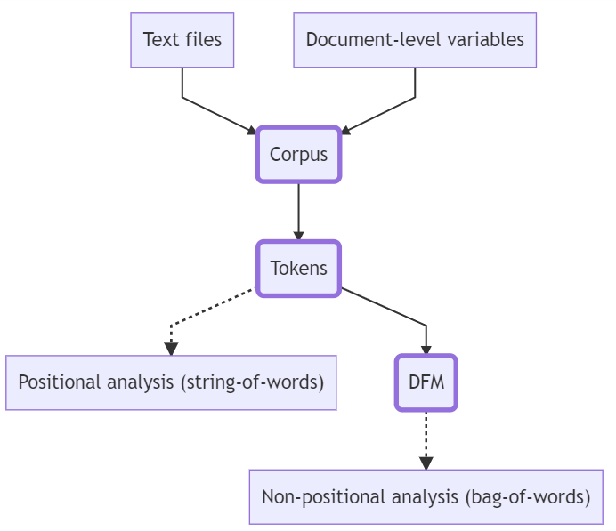
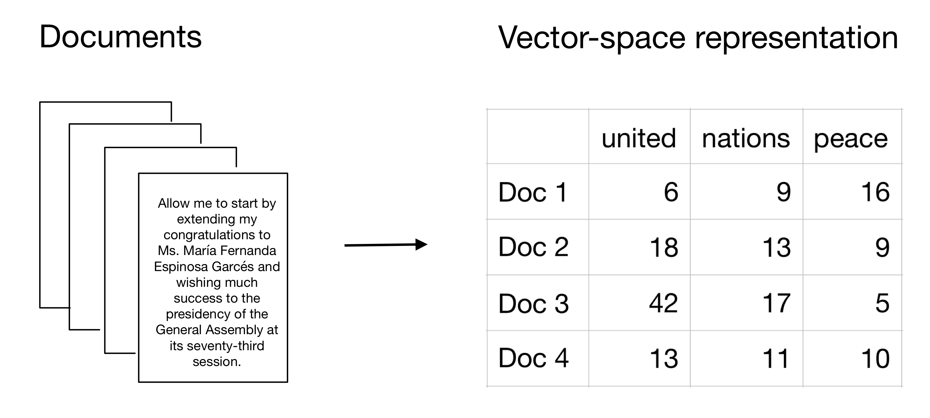
Text mining process

Slide 4
Text mining in R
Package quanteda (quantitative analysis of textual data)
fully-featured – does pretty much everything
great performance – very fast
extensive documentation and an active online community
regular updates
Integrates well with other packages and base R
Alternatives
tidytext
tm
Others!

Slide 5

Text mining processes we will cover
Step 1: read in text data and metadata
Step 2: build a corpus
Step 3: get tokens
Step 4: create document feature matrix
Step 5: analyses / visualisations
NO stats!

Slide 6
Go to Rmarkdown tutorial:
Step 1: read in text data

Slide 7
Regular Expressions (regex)
An expression to identify a text pattern
Used to: search, replace, count, validate, extract
Examples:
Expression to search for any occurrence of grey (or gray): gr[ae]y
Expression for a 10-digit number starting with 1: 1\\d{9}
Expression to search for a URL string: http\\S+
Expression to search for a valid UK mobile number (with optional +44 national code, allowing for optional brackets and spaces at appropriate positions)
^(\\+44\\s?7\\d{3}|\\(?07\\d{3}\\)?)\\s?\\d{3}\\s?\\d{3}$
Use a regex tester to make sure your regex does what you want it to!
regex101.com
https://spannbaueradam.shinyapps.io/r_regex_tester/

Slide 8
Go to Rmarkdown tutorial:
pre-process twitter data

Slide 9
What is a corpus?
Corpus (plural corpora)
a collection of linguistic data, either compiled as written texts or as a transcription of recorded speech.
a collection of texts (and their metadata)
quanteda::corpus()
saves character strings and variables in a data frame
combines texts with document-level variables (docvars) that describe attributes of each document
a data structure type that higher level functions need to operate on
a corpus holds documents separately from each other and is typically unchanged as we conduct our analysis

Slide 10
Go to Rmarkdown tutorial:
Step 2: Build our corpus

Slide 11
What is a token / tokenisation?
Tokens are the individual units of meaning
Words, numbers, punctuation, phonemes, or even full sentences.
Tokenization is the process of breaking text documents apart into those pieces
quanteda:tokens()
segments texts in a corpus into tokens by boundaries (separators)
Stored in a list of vectors
More efficient than character strings, preserves positions of words

Slide 12
Go to Rmarkdown tutorial:
Step 3: Get the tweet tokens

Slide 13
What is a document feature matrix?
The dfm is the analytical unit on which you perform analyses
for analyses that draw inferences from token frequency
Represents frequencies of features in documents in a matrix
rows are the original texts
columns are the features of that text (commonly tokens).
Very efficient structure (sparse matrix)
No information on word positions (bag-of-words type analyses)
So the order of the words matters in a corpus but NOT in a DFM
quanteda:dfm()
constructs a document-feature matrix (DFM) from a tokens or corpus object

Slide 14
Go to Rmarkdown tutorial:
Step 4: Build the dfm

Slide 15
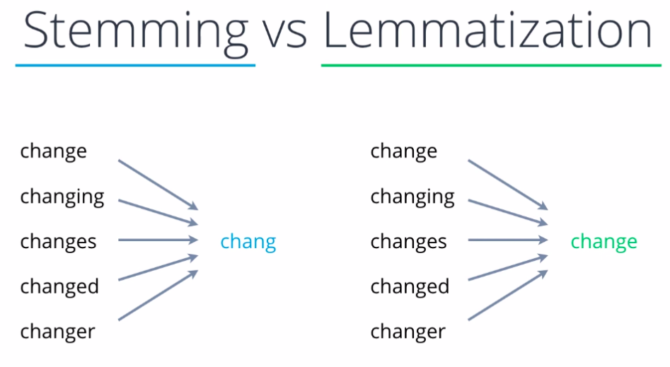
Stemming and Lemmatisation
Stemming removes the last few characters of a word (ignores context/meaning)
Lemmatisation considers context and converts words to their meaningful base form
 | Stemming | Lemmatization
1 | Stemming is faster – chops words without knowing the context of the word | Lemmatization is slower – but knows the context of the word before proceeding
2 | It is a rule-based approach | It is a dictionary-based approach
3 | Accuracy is lower | Accuracy is greater
4 | Stemming is preferred when the meaning of the word is not important for analysis | Lemmatization is preferred when the meaning of the word is important for analysis

Slide 16
Sentiment analysis
process of determining the emotional tone behind a series of words
determine the tone of a piece of text: positive, negative (or neutral)
gain understanding of the attitudes, opinions and emotions expressed within texts (often user feedback, online content)
Basic rule-based sentiment analysis:
Break each text document down into tokens
Identify each sentiment-bearing token (e.g. by using use a look-up to a sentiment dictionary)
Appy a function to calculate a sentiment score for a text (commonly based on counts of positive, negative, neutral components)
Ideally: Combine scores from different dictionaries/functions for multi-layered sentiment analysis

Slide 17
Go to Rmarkdown tutorial:
Run sentiment analysis of tweets

Slide 18
Case Study: Build a text classifier
Reason for skipping spirometry test
family commitment
pulse rate 105
cataract done 23rd april 2015
unable - nerve damage around mouth
collapsed lung; out of stock of filters
cracked ribs
because of BP
PROBLEM:
Need to classify 1000’s of short free-text entries describing why UK Biobank participants did not complete or perform particular activities.
Assign free-text to existing classes (labels)
SOLUTION:
Use already-classified texts as gold standards to train a machine learning algorithm that can then be used to predict the classes (labels) of new free-text entries.
Label | Meaning
101 | Against participant wishes
102 | Feeling unwell
103 | Unwilling to remove contact lenses
200 | Equipment unavailable or malfunction
401 | Physically unable or outside specs
402 | Amputee
403 | Limb injury
etc …

Slide 19
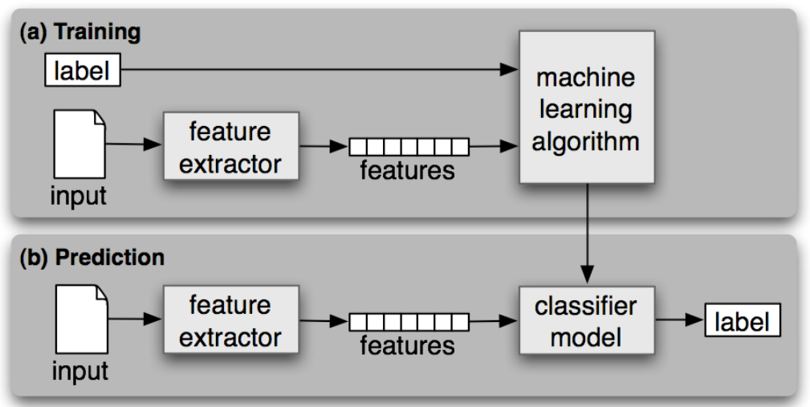
Aim: build a classification system/model that can label the free-text answers into one of the existing coded categories.
Process:
Create the corpus of free-text entries (in the data provided I have done the cleaning/pre-processing of the free-text field already)
Build the DFM
Split data into training and testing datasets
Apply an algorithm to classify and predict (linear SVM algorithm)
Assess the accuracy and precision of our model
Use the model to 'label' the new data

Slide 20
Go to Rmarkdown tutorial:
Case study – text classifier

Slide 21
Improve your classification accuracy
not stemming words
different training/testing split
use different model (e.g. naive bayes)
use a weighted term frequency score like tf-idf
Analyses on a standard dfm use the term frequency (how frequently a word occurs in a document),
Can use the tf-idf: measures how important a word is to a document in a corpus of documents.
The inverse document frequency decreases the weight for commonly used words and increases the weight for words that are not used very much in a collection of documents
so combined with term frequency (the two quantities multiplied together) gives the frequency of a term adjusted for how rarely it is used.
dfm_tfidf(base_dfm, scheme_tf = "count", scheme_df = "inverse")

Slide 22
Links to useful resources
https://quanteda.io/
https://tutorials.quanteda.io/
https://www.tidytextmining.com/
https://tm4ss.github.io/docs/index.html

