Slide 1
Building a Scalable Messaging Fabric with JRuby and Storm
R. Tyler Croy - Ian Smith
Lookout, Inc.
August 1, 2014

Slide 2
Your hosts
Notes:
Jump into who we are

Slide 3
R. Tyler Croy
@agentdero - github.com/rtyler

Slide 4
Ian Smith
@metaforgotten - github.com/ismith

Slide 5
Lookout
@lookouteng - github.com/lookout

Slide 6
What/Why is Storm

Slide 7
What/Why is Storm
What/Why is Kafka

Slide 8
Messaging Requirements
Notes:
Reliable delivery of messages (losing data is no good)
Decoupled producers from consumers, e.g. a producer of a message need not know who will be consuming the message
One-to-many delivery: a single message may need to be reliably consumed by multiple applications/consumers
Scalable/clusterable such that many services may use the messaging bus together
Should be scalable to stretch across multiple data-centers

Slide 9
The must-haves
Reliable message delivery
One-to-many message delivery
Scalability

Slide 10
Traditional Message Infrastructures
Notes:
First discuss the “old” way of messaging, i.e. shoveling messages to worker queues. Works for models where you’ve got a single known recipient of a message (e.g. deferred method call style invocations)

Slide 11
Redis-based
Resque - Sidekiq - BLPOP/RPUSH
Notes:
Discuss the problems with scaling redis-based solutions.
Hard to get good fault tolerance with Redis. Not distributed/clustered in a meaningful way. (Not investigated Redis Sentinel though)
Hard to scale redis to varying kinds of workload (it’s a single CPU loop people)

Slide 12
“Enterprise Message Queues”
ActiveMQ - RabbitMQ - HornetQ
Notes:
Our first pass at solving some of previous problems with redis-based message queueing was to deploy a more “enterprise” message queue. In our case we ended up on ActiveMQ
Difficult to scale too! To ensure message delivery we would persist messages to MySQL using the built in MySQL backend. This bolted ActiveMQ’s scalability to that of MySQL (read: shitty application level sharding)
Originally used STOMP for messaging protocol but ran into quirks with ActiveMQ’s support. Switching clients to JMS offered better performance however. Meant we were increasingly reliant on the JVM
Using advanced features such as “virtual topics” led to many issues, but gave us the functionality we wanted, e.g. single message from a producer being consumed by multiple consumers reliably. Accomplished by consumer groups in Kafka

Slide 13
Traditional Workers

Slide 14
loop { work(consume()) }
incredibly complex
Notes:
Need to go into detail on what most of our old style workers looked like, see: dumb ruby daemons

Slide 15
Kafka

Slide 16
tl;dr
more gooder
Notes:
Important features we need:
Clustered
Supports “consumer groups” which give us functionality similar to ActiveMQ’s “virtual topics” for managing different kinds of message consumers
Designed for scalability with it’s log offset design (TODO: desribe better)

Slide 17
Storm Basics

Slide 18
tuples
the currency of Storm

Slide 19
spouts
your input

Slide 20
bolts
basic unit of operation

Slide 21
topology
a directed graph of plumbing metaphors
Notes:
Discuss in this slide/section the basic topology deployment workflow: e.g. submitting a top, loading a top and then activating a top.

Slide 22
The Storm Cluster

Slide 23
zookeeper
doing things with input

Slide 24
supervisor nodes
doing things with input

Slide 25
nimbus nodes
doing things with input

Slide 26
Message Design

Slide 27
Not everybody will be Ruby
message definition should be cross-platform

Slide 28
Consistency is important
leave your JSON at home
Notes:
Message validation is important, using stock JSON or poorly formatted XML requires a lot more code to validate properly

Slide 29
Protobuf
Thrift
Avro
Home-grown
Notes:
A few options exist for defining messages consistently between platforms

Slide 30
Thrift
C++ for messages

Slide 31
Avro
JSON + Schema declarations

Slide 32
Home-grown
Always a bad idea

Slide 33
Protocol Buffers
C for messages
Notes:
Mention the utility of packaging up protobuf jars for the resulting clients (Androids)

Slide 34
Working with the rest of the “world”

Slide 35
Getting messages in

Slide 36
Metron

Slide 37
Metron Envelopes
wrapping up messages

Slide 38
package metron;
message Event {
required string channel = 1;
required bytes data = 2;
optional string tstamp = 3;
optional string uuid = 4;
optional string event_id = 5;
}
Notes:
What does a bolt look like?

Slide 39
Kafka Clients

Slide 40
Service-to-service messaging
the straight dope

Slide 41
Working with Applications

Slide 42
Who talks to data stores?
perhaps the most important question

Slide 43
The message’s purpose
an asynchronous invocation
Notes:
Do you consider your messages units of work by themselves, or do they represent an asynchronous invocation of a synchronous command? E.g. “persist(thisthing)” versus “enqueue(persist_queue, thisthing)”

Slide 44
Your cluster is important
Notes:
Before deciding how Storm topologies should be communicating with the rest of the world, consider what the production infrastructure might look like. Where services might live, what your security model will look like, etc.

Slide 45
Topologies talking to data stores
feasible but requires some footwork
Notes:
Discuss access control for nodes in the storm cluster and exposing that information to the topology itself

Slide 46
Topologies making RPC calls
better!
Notes:
Why this is a saner approach, benefits of good API design reaped here

Slide 47
Topology Design

Slide 48
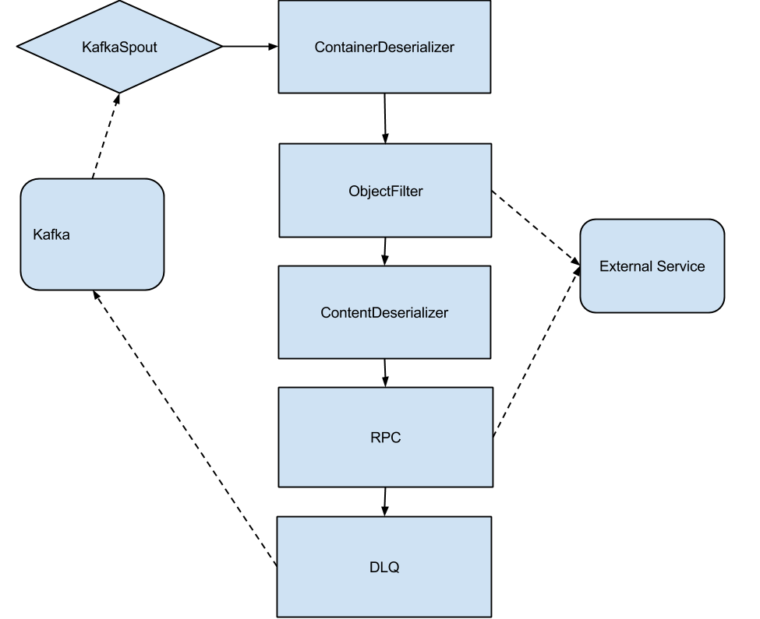

Slide 49
class OurTopology < RedStorm::DSL::Topology
def self.topology_name
“#{self.name}_#{commit_hash}”
end
Notes:
Define the topology class, with the commit hash in the name to disambiguate

Slide 50
class OurTopology < RedStorm::DSL::Topology
spout_config = SpoutConfig.new(...)
spout KafkaSpout, [spout_config] do
output_fields :bytes
end
Notes:
Add a Kafka spout

Slide 51
class OurTopology < RedStorm::DSL::Topology
bolt ContainerDeserializerBolt do
source KafkaSpout, :shuffle
end
bolt ObjectFilterBolt do
source ContainerDeserializerBolt
end
# ...
Notes:
Not much here; just one bolt passing to another

Slide 52
class OurTopology < RedStorm::DSL::Topology
submit_options do |env|
# ...
end
configure self.topology_name do |env|
# ...
end
end
Notes:
Not much here; just one bolt passing to another

Slide 53
class OurBolt < RedStorm::DSL::Bolt
output_fields :bytes, :dlq
on_init do
@connection = # ...
end
on_receive do |tuple|
...
end
end
Notes:
What does a bolt look like?

Slide 54
Developing Storm Topologies with JRuby

Slide 55
You could use ShellBolts - a bolt and a script in a non-JVM language (pipes & JSON)
But! Ruby *is* a JVM language, via JRuby
RedStorm
https://github.com/colinsurprenant/redstorm
Native, Trident & DSL

Slide 56
class HelloWorldBolt < RedStorm::DSL::Bolt
on_receive :emit => false do |tuple|
log.info(tuple[:word])
end
end
Notes:
Defining a new bolt or topology is pretty simple

Slide 57
class HelloWorldTopology
spout HelloWorldSpout do
output_fields :word
end
bolt HelloWorldBolt do
source HelloWorldSpout, :shuffle
end
bolt AnotherBolt do
source HelloWorldBolt, :shuffle
end
end
Notes:
Defining a new bolt or topology is pretty simple

Slide 58
Lessons Learned / Pitfalls

Slide 59
Make sure your messages aren’t mangled
Lots of logging. Try isolating spouts from bolts.
Notes:
E.g., our test of a factoried object being passed between bolts. Solved by wrapping in base64.

Slide 60
tuple[:foo]
Notes:
Defining a new bolt or topology is pretty simple

Slide 61
tuple[:foo]
tuple.value(:foo).to_s
Notes:
Defining a new bolt or topology is pretty simple

Slide 62
tuple[:foo]
tuple.value(:foo).to_s
String.from_java_bytes(tuple.value(:foo))
Notes:
Defining a new bolt or topology is pretty simple

Slide 63
The DSL doesn’t subclass directly
Use methods, not blocks

Slide 64
class HelloWorldBolt < RedStorm::DSL::Bolt
on_receive :emit => false do |tuple|
log.info(tuple[:word])
end
end
Notes:
Defining a new bolt or topology is pretty simple

Slide 65
class GenericBolt < RedStorm::DSL::Bolt
def on_receive(tuple)
log.info(tuple[:word])
end
end
Notes:
Generic bolt code can be shared, and subclassed

Slide 66
# Topology-specific subclass
class HelloWorldBolt < GenericBolt
on_receive :on_receive
def log
# topology-specific logging code
end
end
Notes:
Generic bolt code can be shared, and subclassed

Slide 67
Make sure you ack post-emit
You might emit multiple tuples

Slide 68
One topic is one topic
“Ok, you gave me a thing … what is it?”
Notes:
One datatype <-> one topic/queue

Slide 69
Shared behavior
Notes:
One datatype <-> one topic/queue

Slide 70
class Lookout::Bolt < RedStorm::DSL::Bolt
# Wrap these calls in an exception handler
def execute(*args)
Raven.capture { super }
end
# Same with #prepare, #cleanup
end
Notes:
Generic bolt code can be shared, and subclassed

Slide 71
class Lookout::Bolt < RedStorm::DSL::Bolt
def log
# Custom logging
end
end
Notes:
Generic bolt code can be shared, and subclassed

Slide 72
Submit in inactive mode
Reduce downtime

Slide 73
Questions?

