Slide 1
FoodCity Presentation
Martin Chung

Slide 2
Functionality
The web application “Foodcity” has features:
Filter restaurants by type
Display details about the restaurant
Allow a user to leave rating (out of 10 score)
Allow a user to edit business hours of the restaurant
Allow a user to delete a restaurant that is possibly closed for good

Slide 3
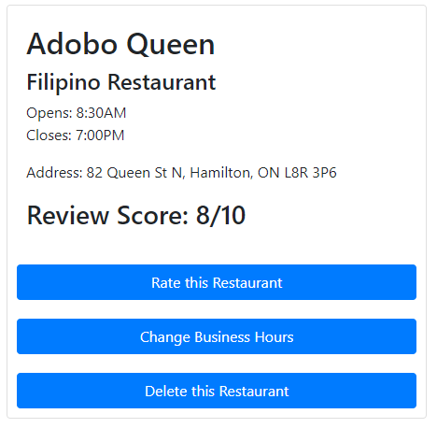
Restaurant Details
The application will display detail about the restaurant if a user chooses pinpointed restaurant The application will display:
Business Name
Type of the restaurant
Business hours
Review Score, which is average of scores left by all users who rated that restaurant

Slide 4
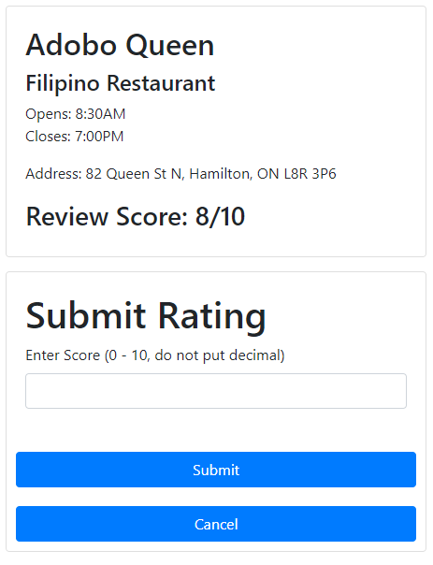
Leave Rating
The application will allow a user to leave rating, a score out of 10 to review the restaurant
Score will be stored into the server’s database using backend API
These scores will be organized by restaurant ID and its own ID
Therefore, it can be gathered to calculate average for each restaurant, which gets displayed on restaurant details

Slide 5
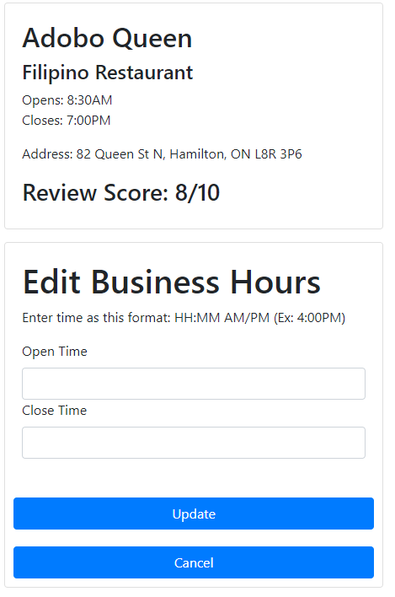
Change Business Hours
The application will allow a user to change business hours, since business hour may change sometimes.
User will need to enter hours in specific format, as specified on the form
Hours entered will go through validation
Update button will immediately change business hours
User can also cancel to edit business hours, which will return to information view

Slide 6
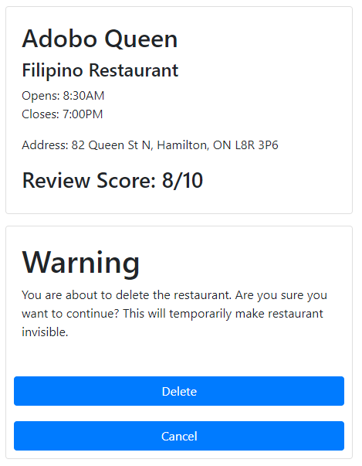
Delete Restaurant
The application also allows user to delete restaurant from database, in case it gets “closed for good”
By confirming that user will delete restaurant data, user will be able to make it invisible
Data is not actually deleted, so administrators can review delete from the user if it is actually closed
Cancelling will bring user back to information view

Slide 7
How it works
The frontend will run at port 3000, as a node.js React application. User interaction will be done in this part. This part do not directly communicate with MySQL database, rather, it communicates with backend API.
The backend API will communicate with MySQL database. It will take necessary actions based on user’s request. It will run SQL queries such as select, insert and update. Delete is not used since it does not actually delete any of data
MySQL database is set up separately using WampServer. This stores restaurant and review data that will be used for this web application.

Slide 8
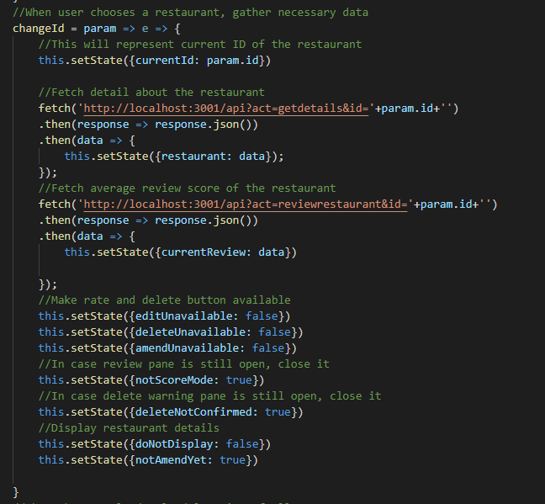
Problems
While implementing response to user’s request to change pinpointed location, the method that supposed to pinpoint location was repeating indefinitely.
The solution was simple. Using changeId(id) to implement the function was a cause
Changed it to changeId = param => e => so it would pass parameters better, which prevented infinite loop of locating restaurant.

Slide 9
Problems
While attempting to locate restaurants with pushpin, Bing Maps API could not properly locate restaurants.
The solution was hard to figure out, but could still figure it out. Returning JSON for just one restaurant was enough.
Instead returning JSON of whole list of restaurants, returning on at a time made the web application to work properly.

Slide 10
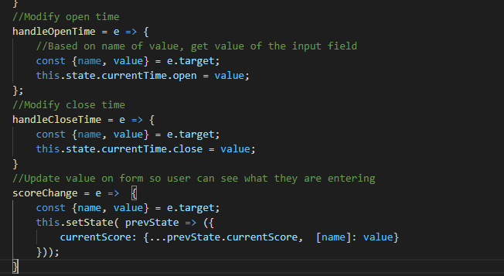
Problems
While implementing method to get user input for editing business hour, edit could not be made while using “value={this.state.currentTime.open} as a part of input.
Its chance of cause that the state was not empty at time of creation could be a cause (i.e. this.state.currentTime.open would have had 10:00AM as a value already)
Changed it to manually change the value of currentTime.open and currentTime.close, which required heavy level of validation but managed it working.

Slide 11
Thanks for listening
Feel free to ask any Questions / Queries

