Slide 1
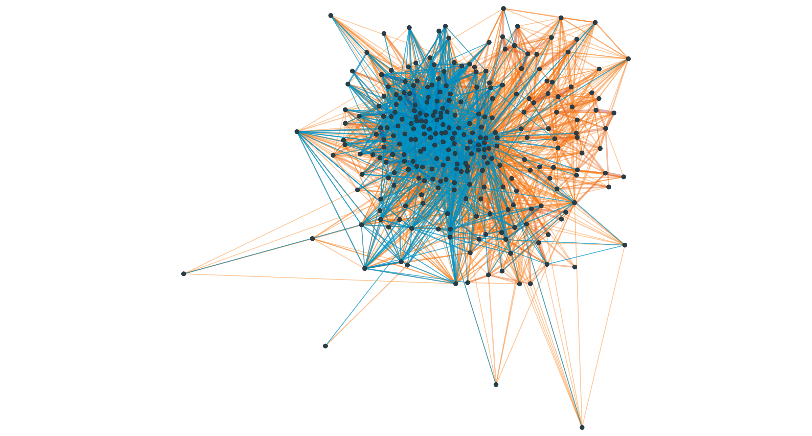
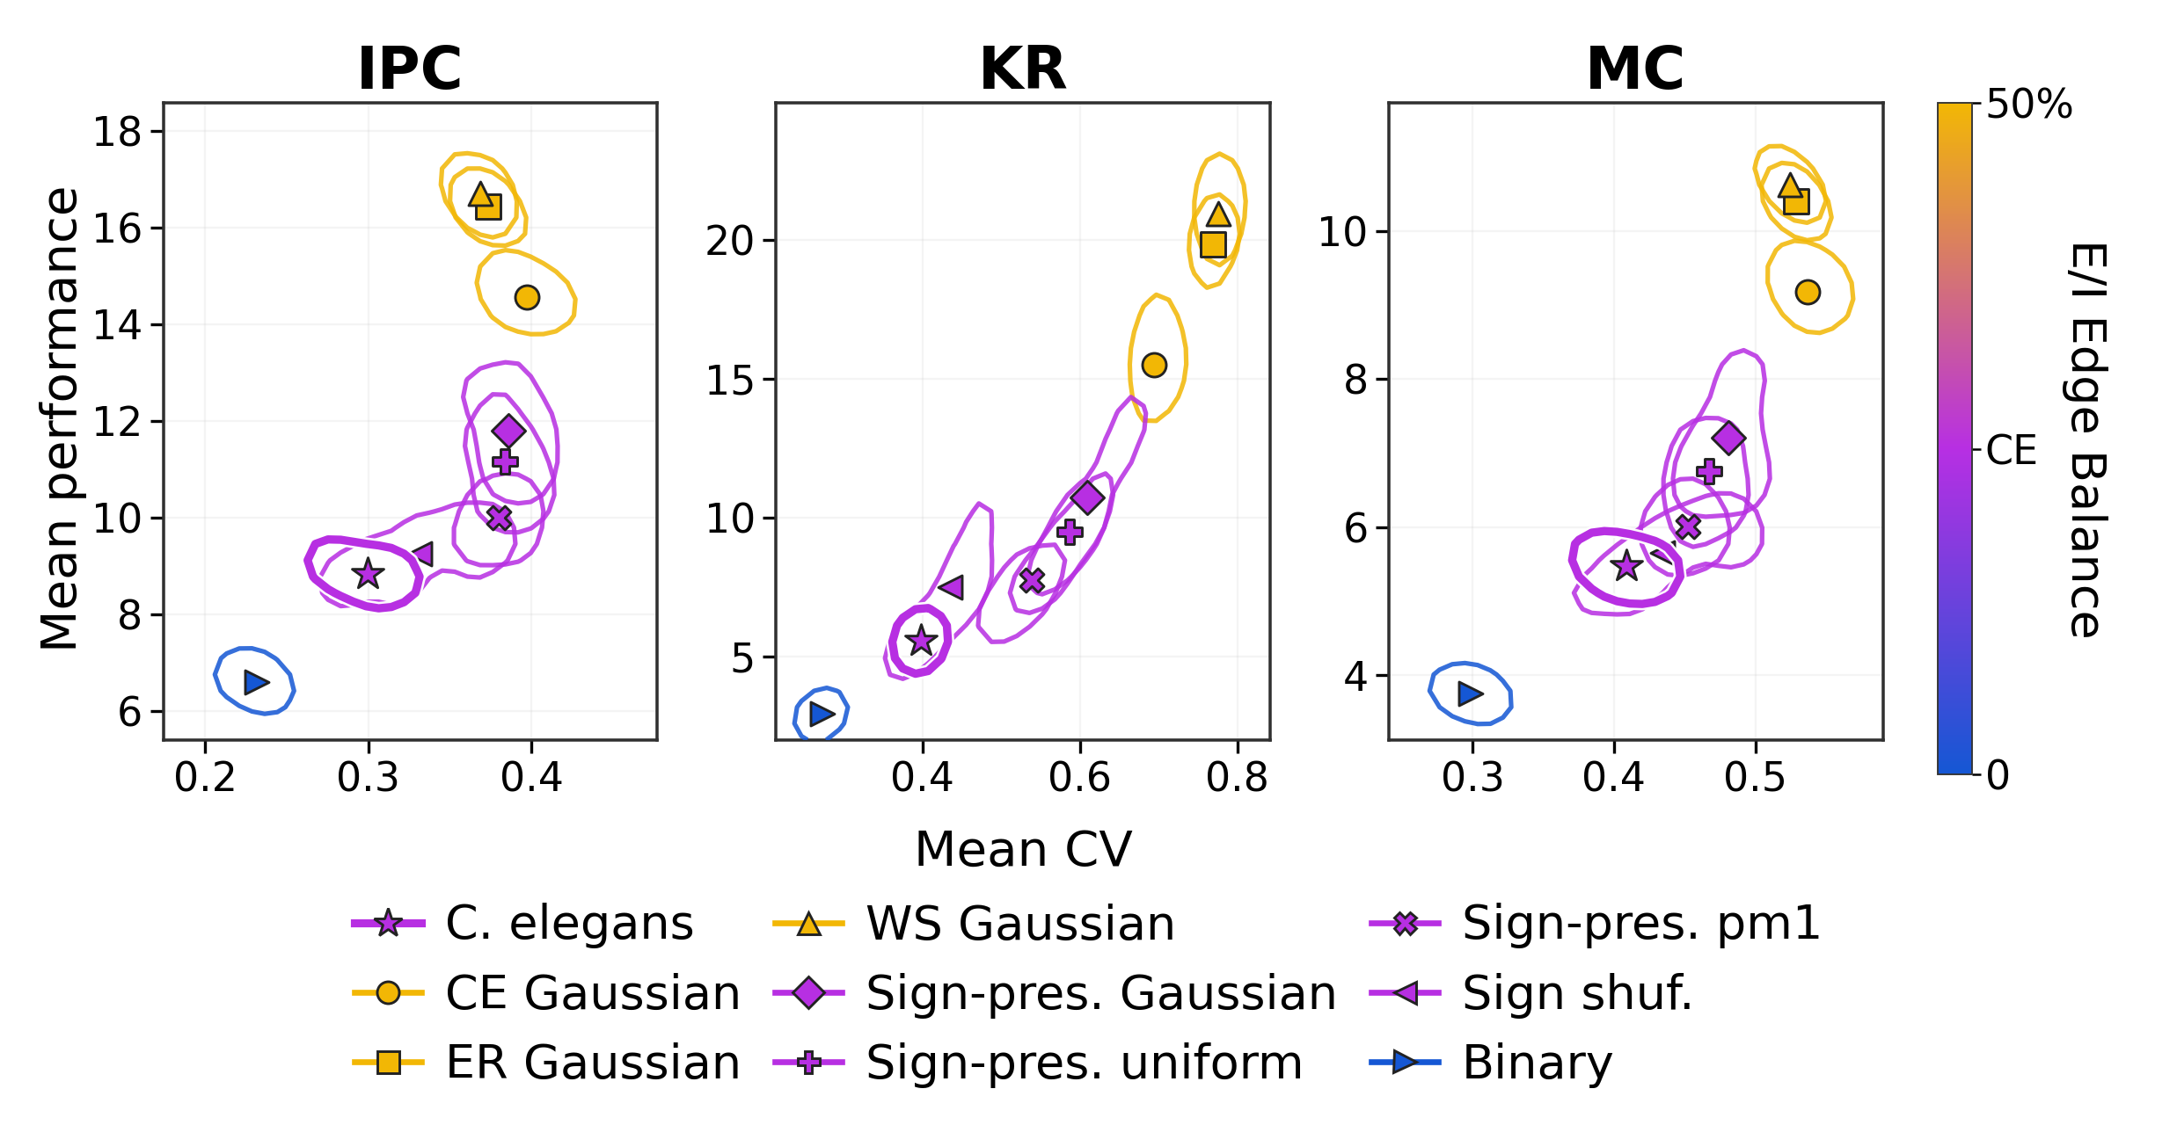
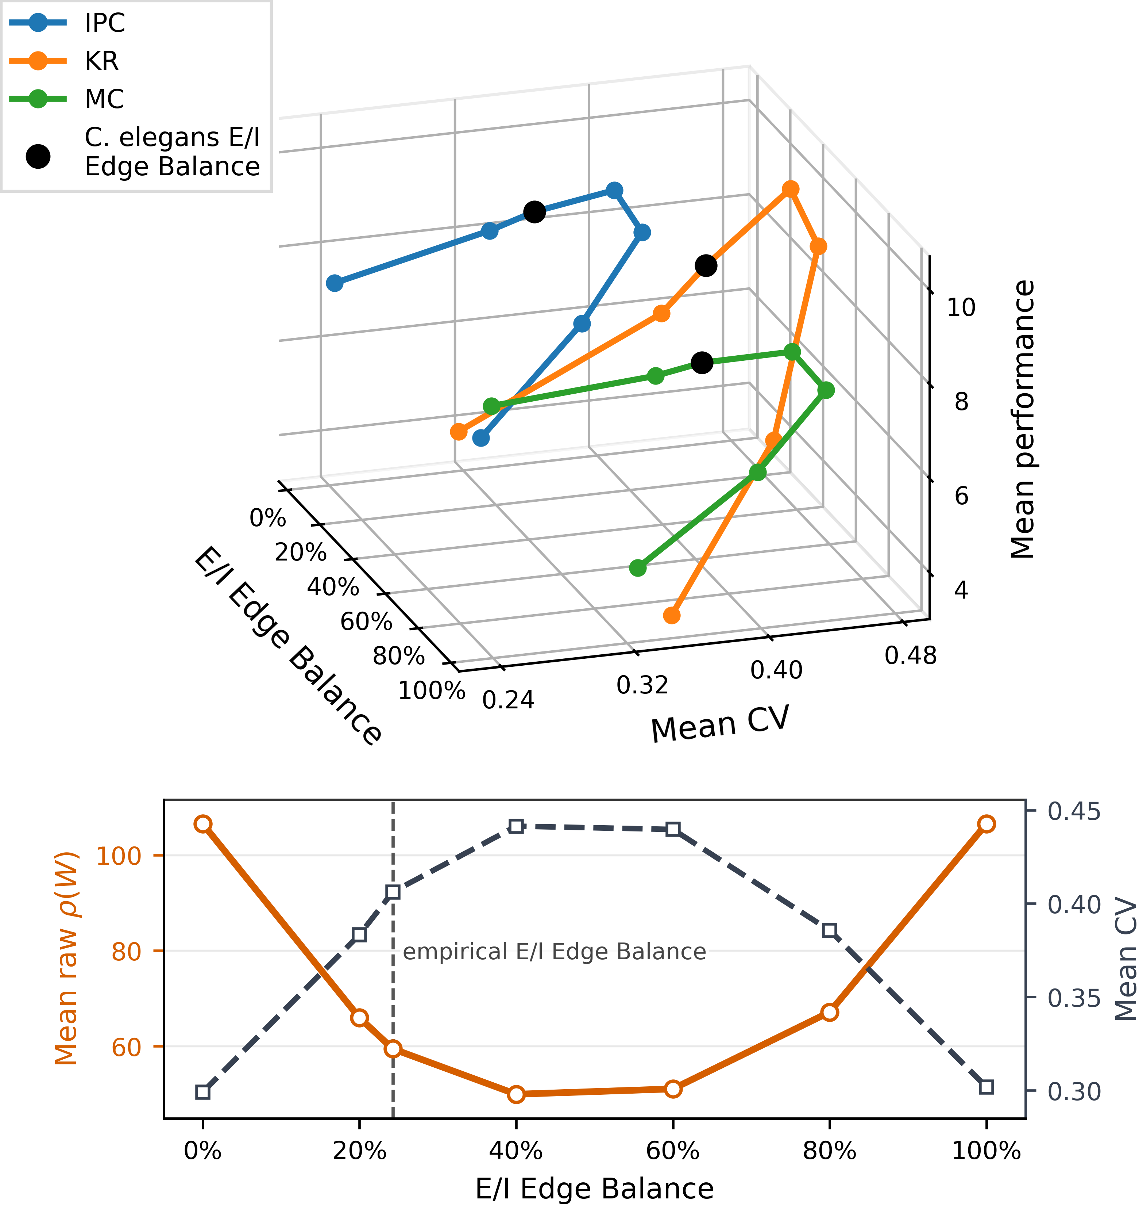
NeurReps 2026 Symmetry and Geometry in Neural Representations
Determinants of hyperparameter robustness
in connectome reservoir computing
Miles Walter Churchland¹, Raul de Palma Aristides², Jordi Garcia-Ojalvo¹,
Anna Ritz³, Greg Anderson⁴, Miguel C. Soriano²
¹Universitat Pompeu Fabra ²IFISC, CSIC–UIB ³Biology, Reed College ⁴Computer Science, Reed College
MAIN FINDING
Higher performance accompanies greater sensitivity
to hyperparameter choice.
We compare a C. elegans connectome reservoir with controlled network variants across 96 hyperparameter settings. The connectome occupies a relatively low-variance regime. Changes in excitatory/inhibitory (E/I) edge balance also alter the scaling required by spectral-radius normalization.
01 Connectome as a reservoir
02 Performance comes with sensitivity
C. elegans: 297 neurons, 3,604 chemical edges. EleganSign [1].
Orange: positive Blue: negative
Largest connected component shown; arrows omitted.
Fixed recurrent weights; only the readout is trained. Perturb topology, signs, and weights, then normalize spectral radius.
96 settings × 200 trials
Vary target radius, leak rate, input scale, and bias.
IPC: information processing capacity; nonlinear recall [2].
KR: kernel rank; history separation [3].
MC: memory capacity; recall of the past 30 inputs.
CV = sd / mean across the 96 settings.
Lower CV = greater robustness.
Higher and farther right: more performance, less robustness. Contours enclose the highest-density 50% of trials; markers identify architectures. Color indicates E/I edge balance: 0%, CE ≈24.25%, or 50%.
CE: C. elegans; ER: Erdős–Rényi; WS: Watts–Strogatz. Sign-pres.: signs preserved; sign shuf.: signs shuffled; pm1: ±1 weights.
03 E/I balance traces the tradeoff
04 What the curves show
Connectivity and weight magnitudes stay fixed while signs are randomly reassigned at each E/I edge balance.
Near the all-positive and all-negative endpoints: lower performance and lower CV, indicating greater hyperparameter robustness.
Toward 50% E/I edge balance: higher performance and higher CV, indicating greater sensitivity to hyperparameter choice.
Why normalization matters
Every perturbed matrix W′ is rescaled:
Wres = (ρtarget / ρraw) W′, ρraw = max |λᵢ(W′)|.
The raw radius decreases toward the balanced regime. Reaching the same target radius therefore requires a larger scaling factor.
These curves combine changes in sign balance and placement with normalization-induced rescaling. They do not isolate a causal effect of E/I balance alone.
Report raw spectral radius alongside architecture comparisons.
The full paper finds the same qualitative tradeoff in an edge-matched random topology and after removing unknown or complex-sign edges.
Changing signs moves performance and CV together. Top: IPC, KR, and MC across E/I edge balance; black markers denote empirical balance. Bottom: raw radius and CV averaged across metrics. Points average 200 trials.
Scope and limitations. Robustness means low relative variation across the tested hyperparameter grid. IPC omits products across different delays. Of 3,604 chemical edges, 1,864 have unknown or complex signs and are assigned signs to match the labeled-edge ratio; selected controls remove them. Electrical synapses and self-loops are excluded; input reaches all units.
Selected references [1] Fenyves et al. (2020), PLOS Comput. Biol. 16, e1007974.
[2] Dambre et al. (2012), Sci. Rep. 2, 514.
[3] Roy & Vetterli (2007), EUSIPCO, 606–610.

