Slide 1
DBS Project
Debra Huang, Michelle Chyn, Melissa Lin
Research Advisor: Sridevi Sarma, Sabato Santaniello

Slide 2
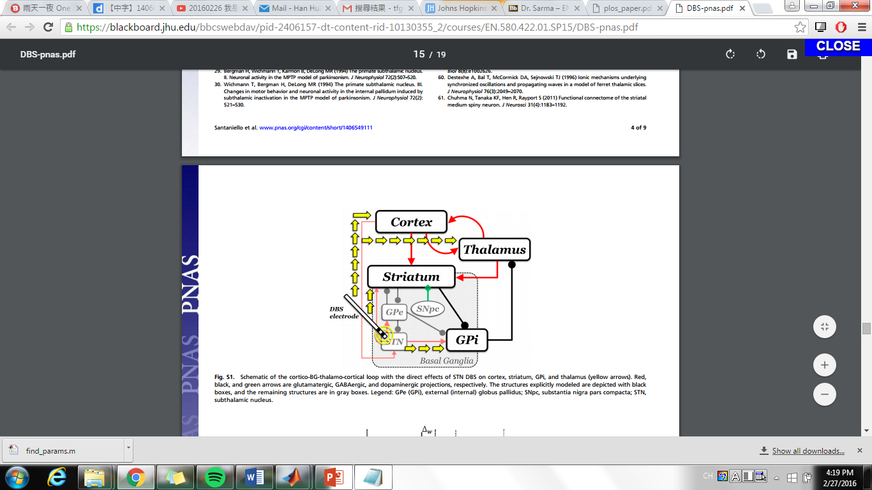
Cortico-BG-Thalamo-Cortical (CBTC) Loop

Slide 3
The Complex Model (Santaniello et. al)
Closed loop model which takes into account every structure in the CBTC loop
Input: at STN
Output: for our purpose, at the thalamus
Results closely resemble evidence from non-human experiments

Slide 4
Relation to DBS
DBS is currently open loop, using feedback control will save cost as well as be more therapeutic
However, trying to compute on a model with thousands of parameters is difficult
H
K

Slide 5
Simplified Model
A simplified model, H, that represents the closed loop CBTC system
A (positive) feedback controller that shifts H_PD closer to H_healthy
Input: at STN
Output: at Thalamus
Assuming that PD is due to problem in thalamic relay
Verify effectiveness of controller by applying it to the complex model
H
STN
Thalamus
K

Slide 6
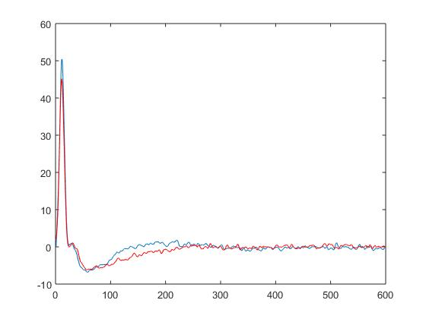
PSTH
Impulse response of the detailed CBTC model
We tried to build the same impulse response in a system using sine and cosine
Red- PD
Blue- normal

Slide 7
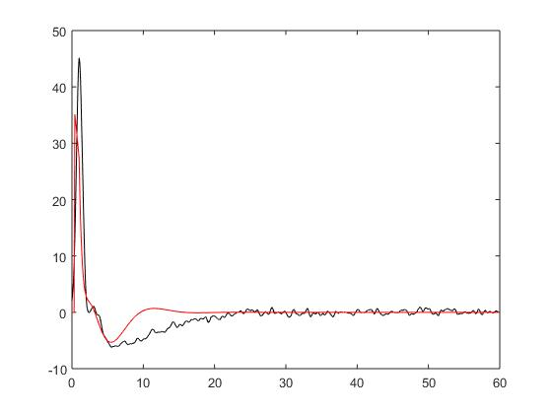

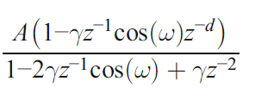
Impulse Response of Simple Model
For both healthy and PD we found a 2nd order system that minimized square error
Error=
Red- model
Black- CBTC data
H =

Slide 8
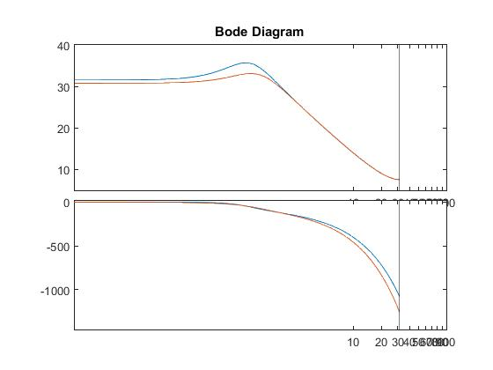
Model Results
H =
Parameters (with MSE = 60~65):
A_normal = 4.6560
gamma_normal = 0.9544
w_normal = 6.3461
d_normal = 6
A_pd = 4.232389
gamma_pd = 0.9497
w_pd = 0.0631
d_pd = 6
Red- PD
Blue- Normal
The normal curve has a greater hump at around 30 Hz (note that the x axis is in log scale) than the PD curve.

Slide 9
Controller Design
H_{PD}
?
H_{norm}
~
~
K

Slide 10
Controller Design
Zero Order (Gain):
K=constant, H_controlled=H_pd*K
1st Order
K=A/(B+z), H_controlled= K/(1-H_pd*K)
Using min(max(error in frequency response)) to choose best parameters

Slide 11
Simple Gain Controller
- Changed Ts (sampling time) from 0.1 to 0.001 in minmaxerr.m (not in find_param.m because the thalamus data should have had the same units as Ts)
- Beta pattern in GPi leads to stronger inhibition in the thalamus, so the normal curve is above the PD curve
Optimal K = -0.04762
Testing range: [-1,1], in 20 steps
Blue- healthy
Red- PD
Magenta- with controller

Slide 12
Simple Gain Controller (cont’d)
Optimal K approaches 0 with finer time steps
Behavior at low frequency across K = [-1,1]: stays flat for a while, the hump appears after a certain point
Optimal K = -0.0035
Testing range: [-1,1], in 2000 steps
Minmaxerr = 2.50307
Blue- healthy
Red- PD
Magenta- with controller

Slide 13
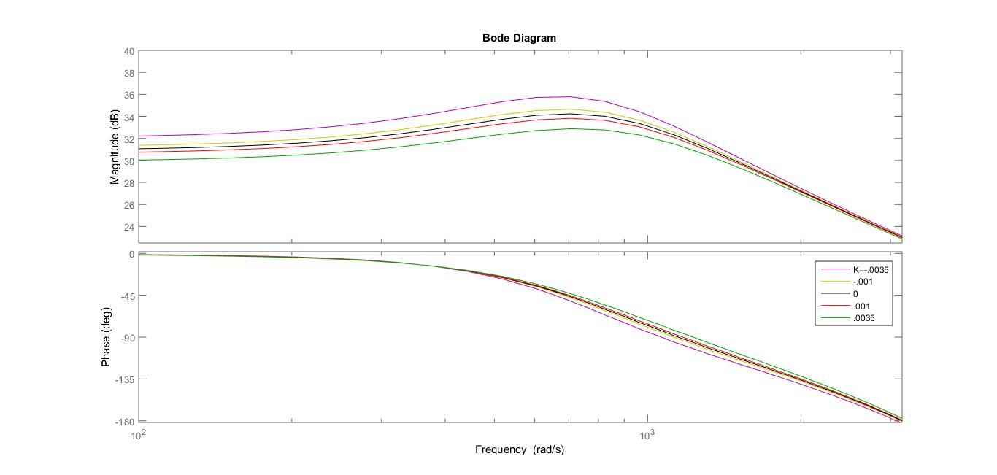
Simple Gain Controller (cont’d)
Zoomed in at several different K values
As absolute value of K increases, the controlled system response deviates from H_normal
Optimal K = -0.0035
Testing range: [-1,1], in 2000 steps
Minmaxerr = 2.50307

Slide 14
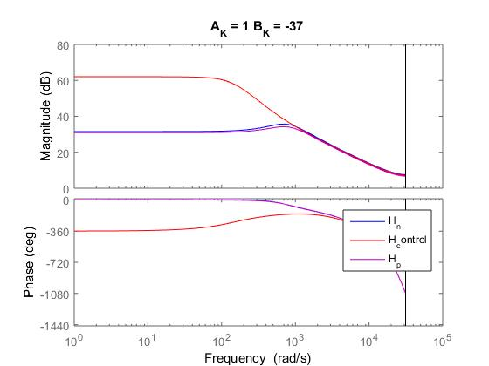
First Order Controller
Parameters and bode plot that minmaxerr.m gave
We have had some difficulty troubleshooting the minmaxerr code, which still predicts the incorrect set of parameters (even though we think the error calculations are right)

Slide 15
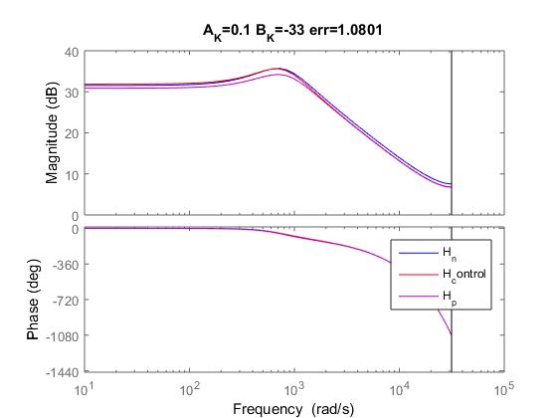
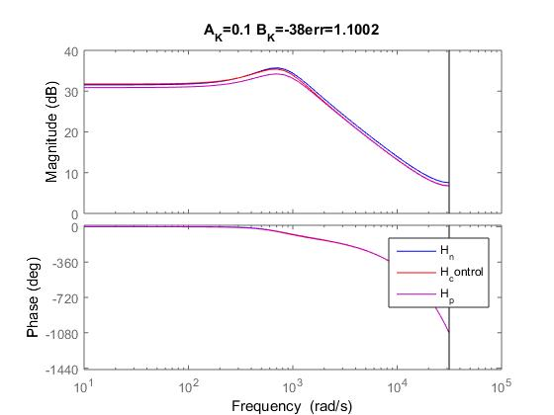
First Order Controller (cont’d)
We manually tried some values of A within a reasonable range, and got significantly better results:

Slide 16
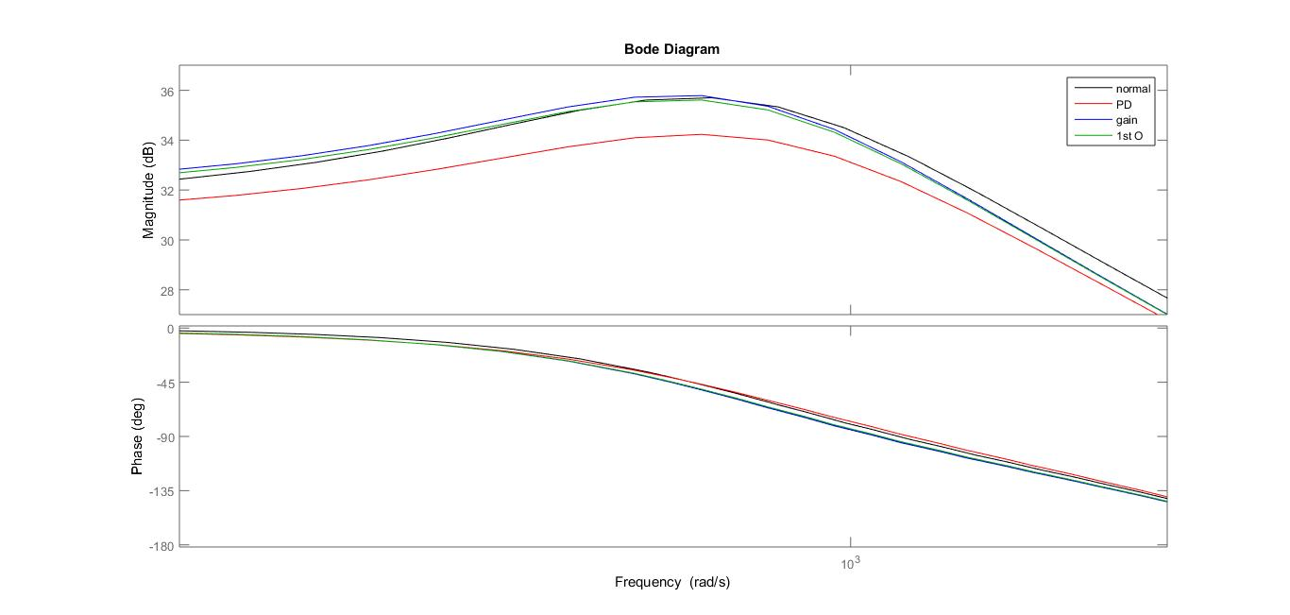
Gain vs First Order Controller

Slide 17
Questions & Plans
Can we get access and run our code on the ICM cluster? Yes!
We will try to find the minmaxerr near the range of the manually explored bode plots
Any suggestions?

