Slide 1
Open J2EE Session Cluster
December 2013

Slide 2
Agenda
Drivers
Existing products
Description
Technology choices
Demo
Plan

Slide 3
Drivers
Current architecture at Penn has dedicated servers for applications
Generally an app gets 3-10 app servers
Traffic is not constant
During the night or during certain times of year, servers are idle

Slide 4
Drivers (continued)
AWS auto-scales
The Elastic Load Balancer uses monitoring (cloud watch) to scale up or down for certain thresholds
The ELB uses sticky session for our applications
Scaling up is not problem (existing sessions stay put)
Scaling down might be an issue (if there are sessions on the machine which will be terminated)

Slide 5
Existing products
J2EE session replication
Tomcat has this
Multicast (inconvenient for multi-availability zones)
Not sure it scales well (other institutions I have talked to haven’t had good experience with it and don’t use it)
Other software add-ons didn’t look appealing

Slide 6
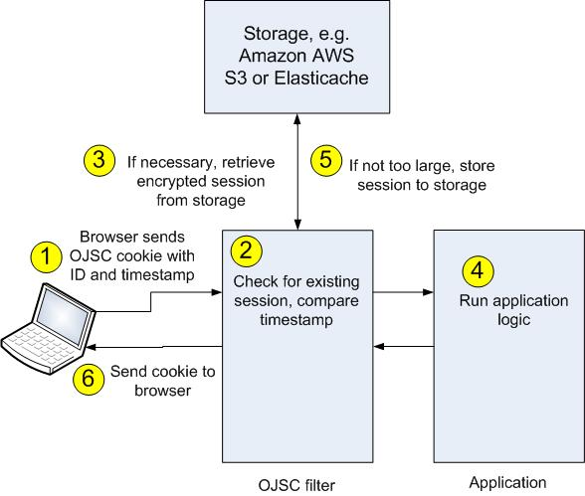
Description

Slide 7
Technology choices
Small Java filter, with few dependencies
Interfaces can customize various parts of the flow
Storage interface to S3 (Amazon Web Service Simple Storage Service)
AWS Elasticache might be better, but that is only available from EC2 (?)
AWS Dynamo DB was a candidate though items can only be 64kB
Could be in application database

Slide 8
Demo
See movie

Slide 9
Plans
Handle logout (delete session)
Ability to limit sessions for app or user?
Roll into AWS app in early 2014

