Slide 1
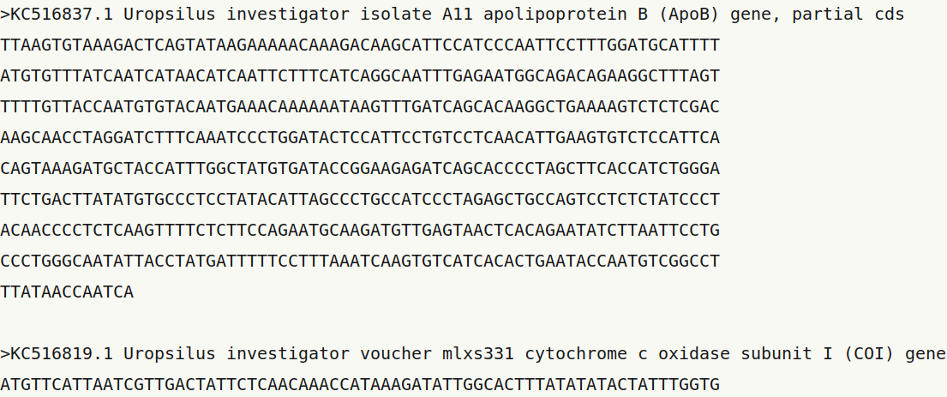
name / id
description
record
seq(uence)

