Slide 1
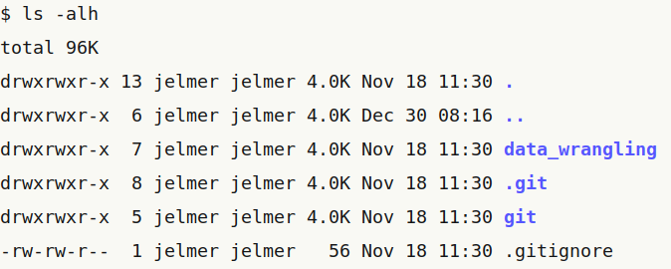

working dir
parent dir
permissions
owner
group
size
last
modified
name
(starting with a
“.” = hidden)
File type:
“d” = dir
“-” = regular file
Nr. of files
(top-level)
r: read
w: write
x: execute
-: not set
owner
group
others
(u)
(g)
(o)

