Slide 1
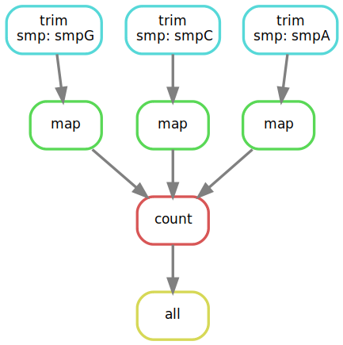
raw
FASTQ
trimmed
FASTQ
BAM
count
table

