Slide 1
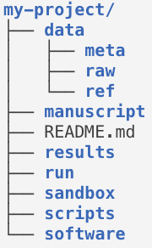
Metadata like sample treatments
Raw data like raw FASTQ files
Reference data like reference genomes
“Master scripts” or formal workflows
Playground, likely unnecessary files, etc.
Scripts that you wrote
External software

