Slide 1
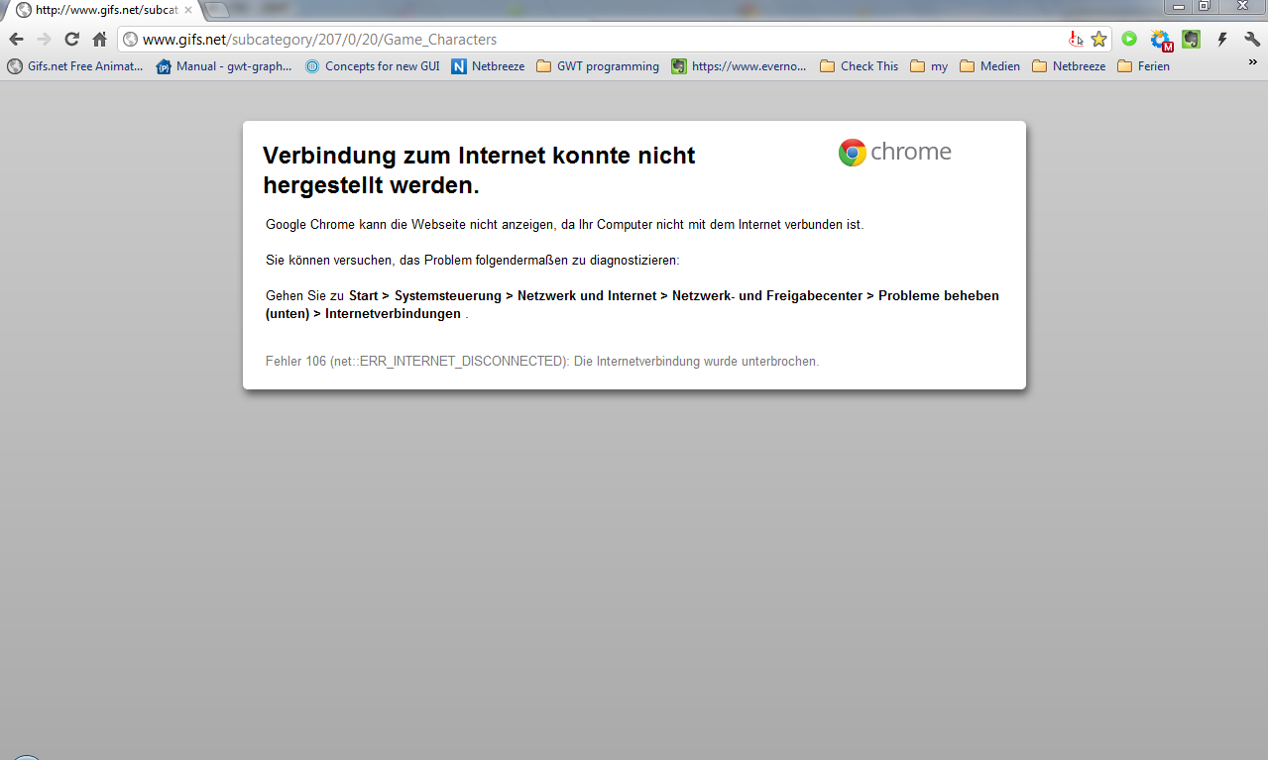





KidsTime
Endspurt
04:12
Pause
Endspurt
Bilderuhr
Countdown

Slide 2
KidsTime
powered by KidsTipps.ch
Countdown
04:12
Pause
Countdown
Bilderuhr
Countdown

Slide 3

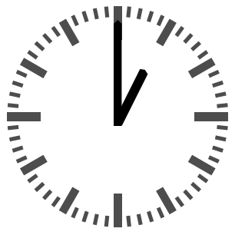
KidsTime
powered by KidsTipps.ch
BilderUhr
Countdown
Bilderuhr
Countdown

Slide 4
KidsTime
powered by KidsTipps.ch
StoppUhr
Countdown
Bilderuhr
Countdown

Slide 5



KidsTime
BACKUP

Slide 6
KidsTime
powered by KidsTipps.ch
Countdown
04:12
Pause
Countdown
Bilderuhr
Countdown

Slide 7

Countdown
04:12
Pause

Slide 8

04:12
Pause

Slide 9
04:12
Pause

Slide 10
04:12
Pause

