Slide 1
Who am I?
Mauricio Cisternas
April 25, 2016

Slide 2
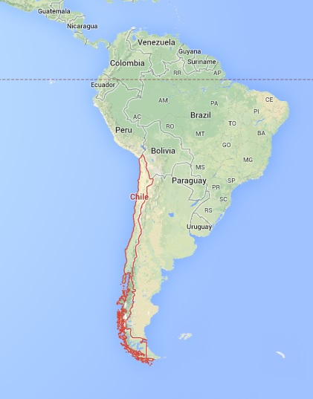
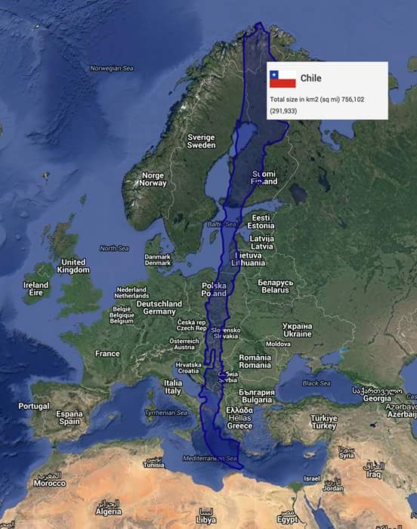
Born and raised in Santiago, Chile
Santiago

Slide 3
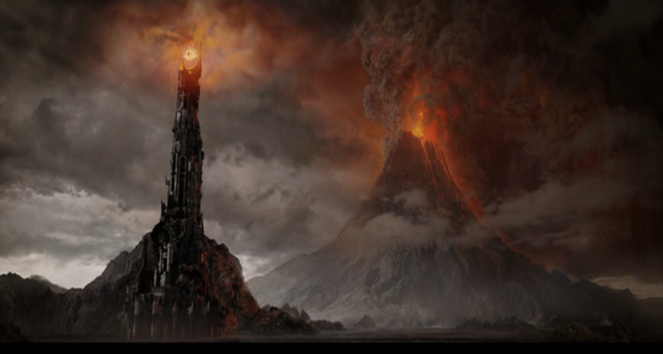
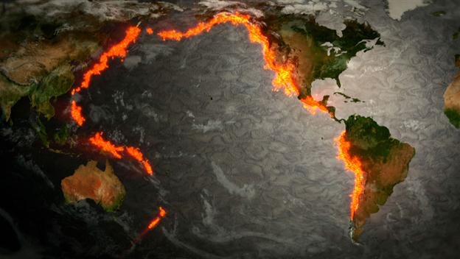
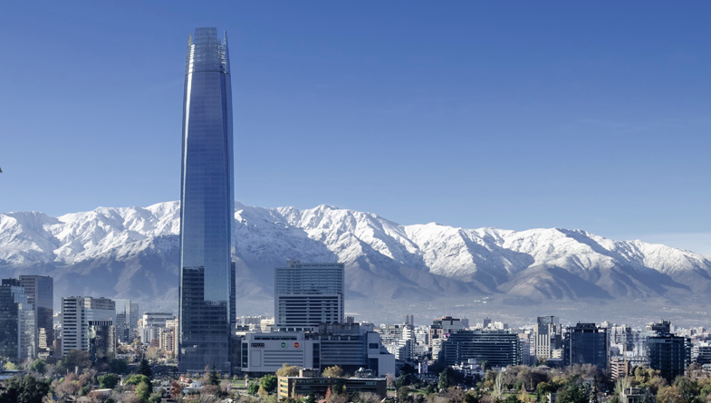
Born and raised in Santiago, Chile
Santiago

Slide 4
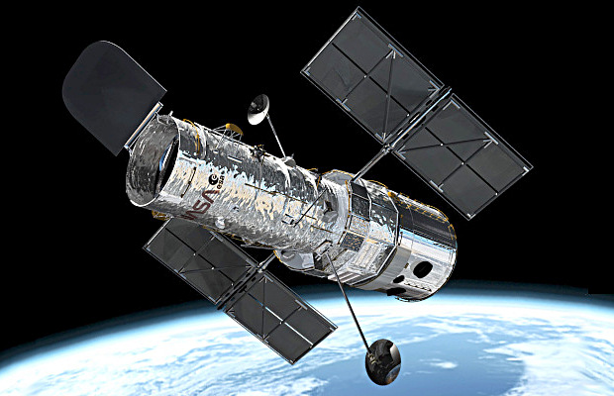
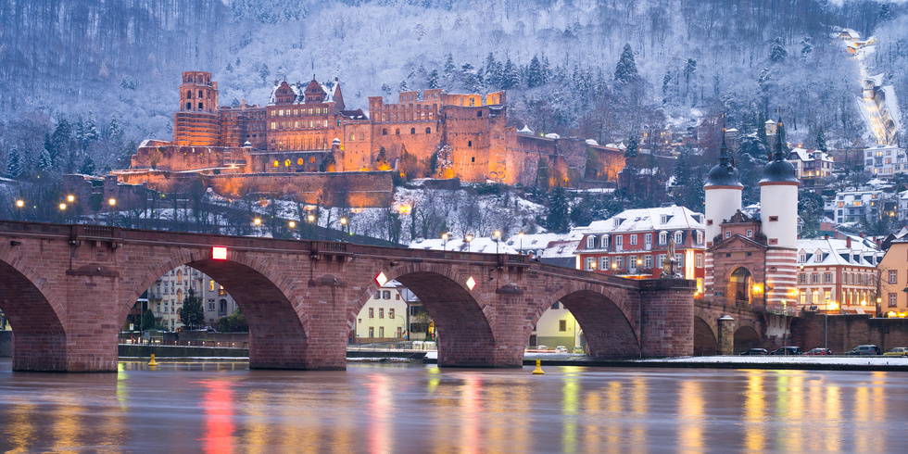
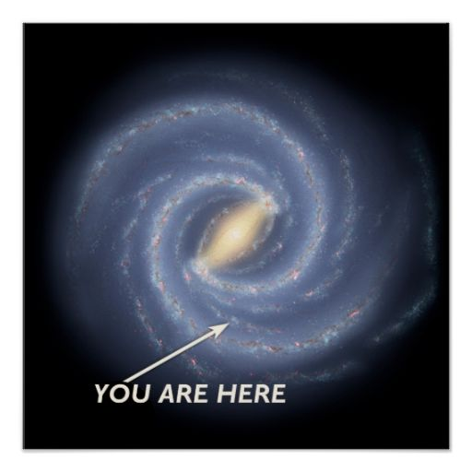


Moved to Heidelberg, Germany (2008-2012) Ph.D .in Astronomy
Max Planck Institute
for Astronomy

Slide 5
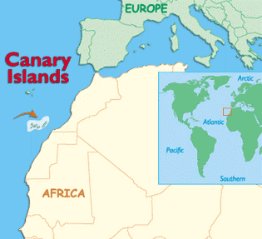
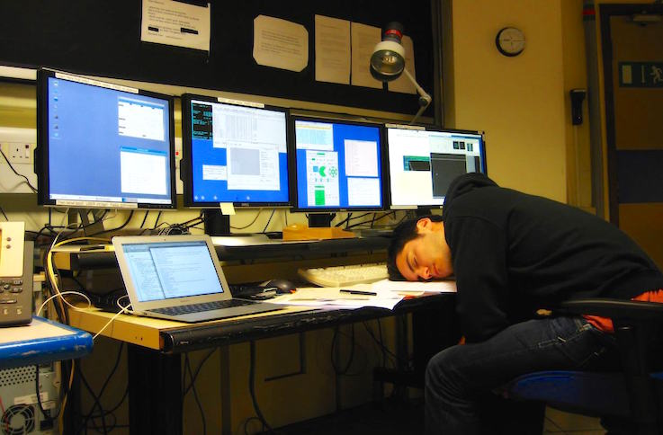
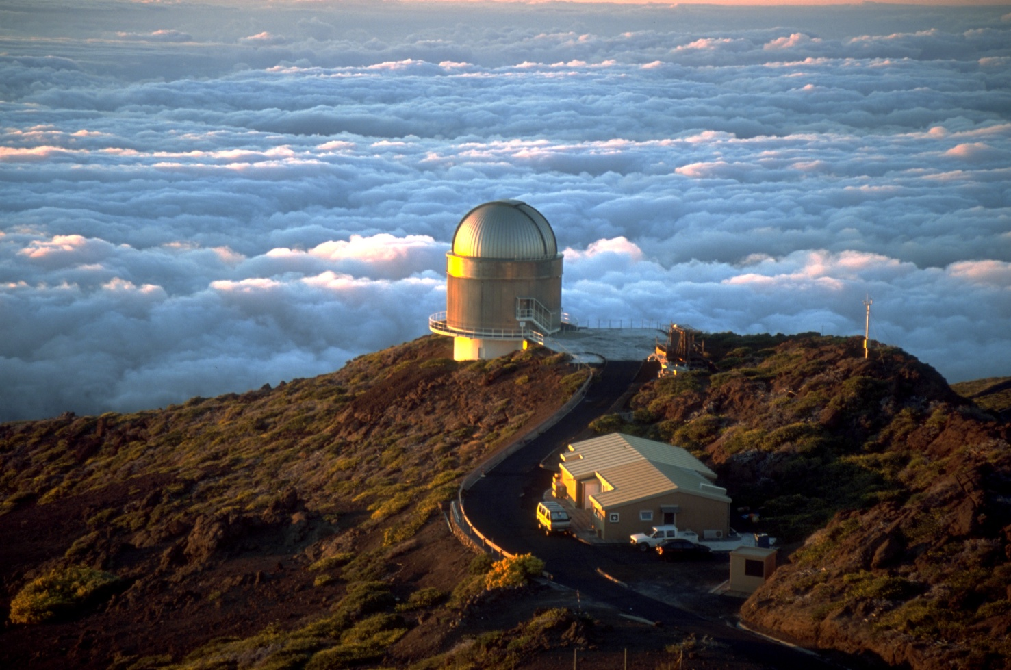
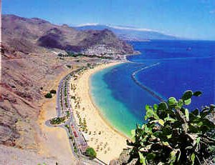
Moved to Tenerife (2012-2016) as Postdoctoral Researcher

Slide 6




Time to abandon ship: Academia -> Industry
London, Summer 2015
First “real world” work experience!

Slide 7





In my spare time
+

Slide 8
Thank you!

