Slide 1
Use of SystemVerilog Interfaces in RTL Design and Test Benches A small example based on SPI
Dr. Mark C. Johnson
March, 2016

Slide 2
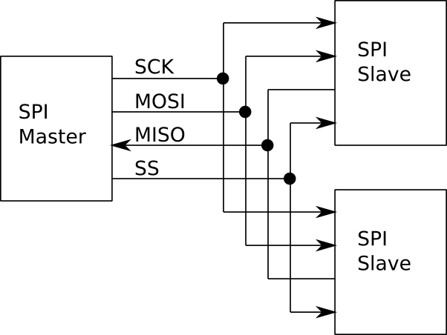
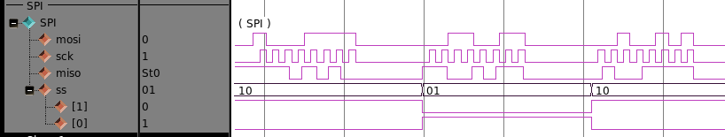
SPI Interconnect without
using modular interface
definition.

Slide 3
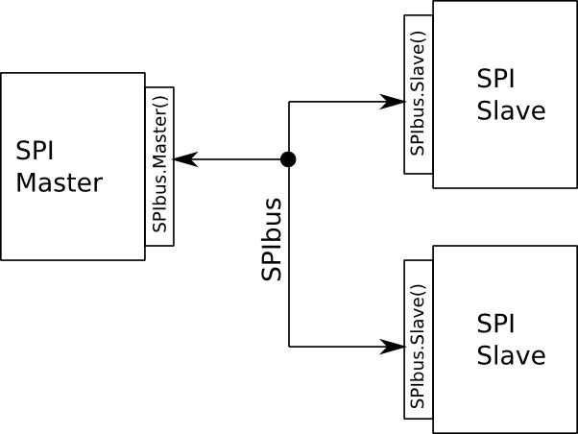
SPI Interconnect with modular interface
definition.

Slide 4
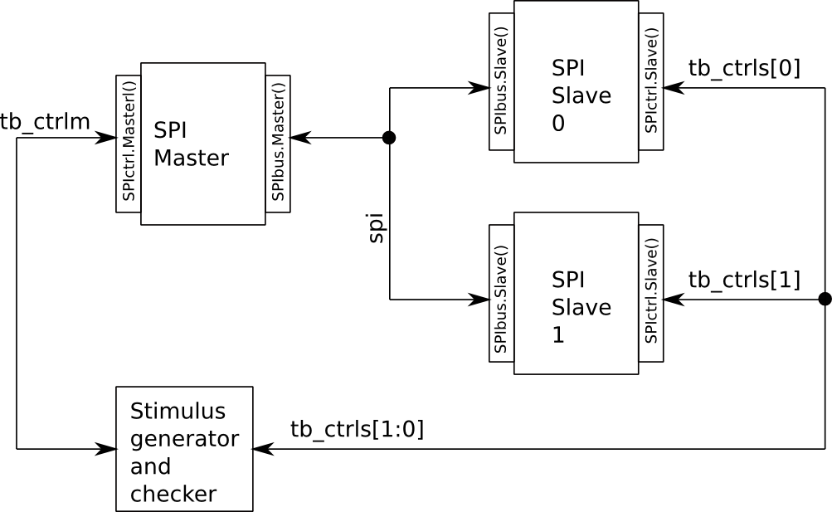
Organization of test bench using SV interfaces.

Slide 5
Walk-through of code for
Interface definition
Design of SPI master & slave
Test bench for SPI master & slave

