Slide 1
An example using System Verilog Interfaces to design and test an SPI master and slave
Dr. Mark C. Johnson, Director of Instructional Laboratories, School of ECE, Purdue University
March 7, 2016

Slide 2
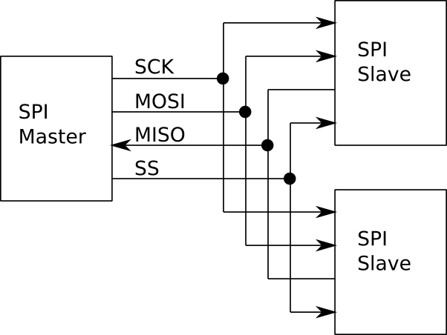
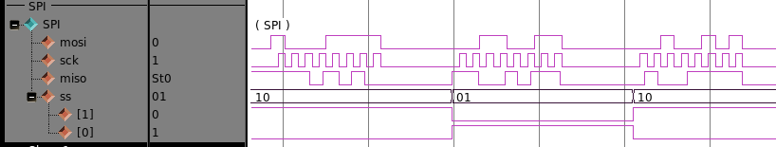
Without SystemVerilog interfaces:
A simple SPI interconnect
between one SPI master
and two SPI slaves.

Slide 3
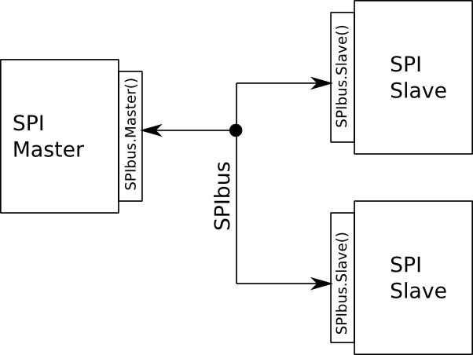
With SystemVerilog interfaces:
A simple SPI interconnect
between one SPI master
and two SPI slaves.

Slide 4
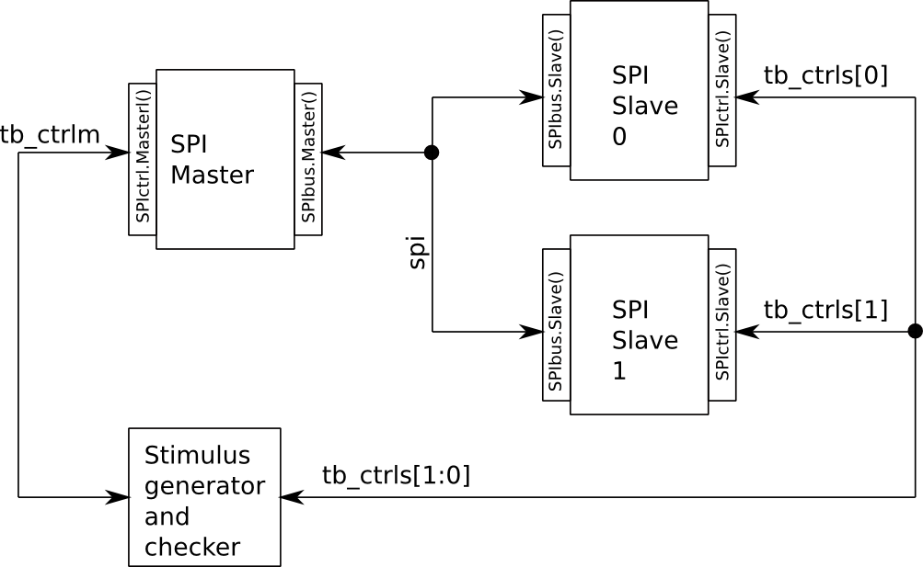
With SystemVerilog interfaces:

