Slide 1
What is FHIR, and how might we use it in public health? Justin McReynolds, University of Washington
“Learning on FHIR” WA State Dept. of Health
Notes:
https://creativecommons.org/licenses/by/3.0/

Slide 2
SPEAKER: JUSTIN MCREYNOLDS
Technical Program Manager, UW Clinical Informatics Research Group
MS Biomedical & Health Informatics, UW School of Medicine
Health Informatics for clinical care, public health, consumer health, research...
Yes, I still do like to write software!
This talk: https://github.com/mcjustin/fhir-wadoh-talk-2022
https://creativecommons.org/licenses/by/3.0 (do as you wish, but attribute)
Notes:
My aim is to improve health by helping people leverage computing and informatics, on the providing and receiving sides of clinical care, public health, and research. Much of my work is focused on engineering details, but I endeavor to understand the larger context of individual-driven health, clinical care, public health, and research - I'd like to address problems with tech appropriately, not amplify them. I've been a technical program manager with the University of Washington's Clinical Informatics Research Group for fifteen years, wearing many hats: team lead, engineer, designer, informaticist, budget and proposal developer, compliance officer, and perhaps most importantly, translator between engineers and stakeholders! Much of my work is focused on individual-driven (consumer) health, and patient engagement in clinical care; other key projects of mine include large scale data integrations (community health, HIV research, and syndromic surveillance of influenza), and clinical/shared decision support tools. Systems interfacing is a goal common to most of my projects; my current toolset there includes FHIR and SMART on FHIR, and more established tech like HL7 v2 and CCDA. I'm excited about patient/consumer-directed initiatives such as carinalliance.com.

Slide 3
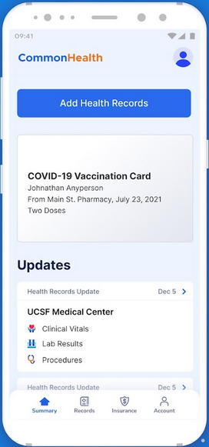
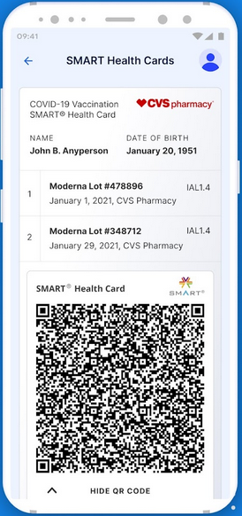
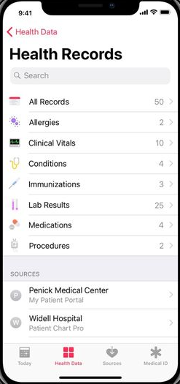
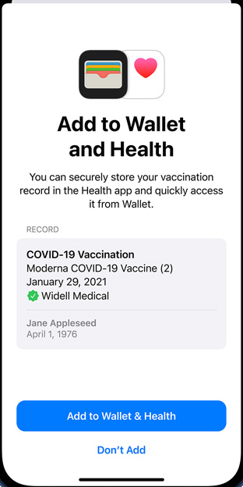
Example: Patient-Mediated Data Connectivity
CommonHealth (Android)
Apple Health
Notes:
PATIENT-MEDIATED DATA CONNECTIVITY
Integration of data from clinical organizations and immunization registries
https://play.google.com/store/apps/details?hl=en_US&id=org.thecommonsproject.android.phr (has screenshots)
SMART cards as an example of an existing DOH FHIR system
https://spec.smarthealth.cards
https://build.fhir.org/ig/HL7/fhir-shc-vaccination-ig/

Slide 4
UW CIRG’s FHIR STORY
WE’VE BEEN AT IT SINCE 2014...
2014: Internal APIs (RESTful ajax)
2015: Nascent SMART on FHIR architectures
2017: Integrations with ~8 partners
HL7 Connectathons & ONC pilots along the way...
2019: Most new work is FHIR

Slide 5
FAST HEALTHCARE INTEROPERABILITY RESOURCES “MANIFESTO”
Focus on implementers
Target support for common scenarios (80/20 rule)
Leverage cross-industry web technologies
Human readability as base level of interoperability
Make content freely available
Support multiple paradigms & architectures
Demonstrate best practice governance
Notes:
Focused on implementation –Fast and easy to implement Solutions have been created in one day!
Supported by large implementation libraries – Examples are available to accelerate development
Provides Interoperability out-of-the-box – Base resources can be used as is,or adapted as needed
Evolved from HL7 standards at the heart of Meaningful use – FHIR supports all of them
Leverages Web standards – XML, JSON, HTTP, Atom, OAuth, and many more
Supports REST and Service Oriented Architectures,as well as message and document exchanges
Specifications are concise and easily understood, by both clinicians and developers with little or no clinical experience. This reduces application development time and cost.
FHIR is licensed (under Creative Commons) to be free and withoutrestrictions
From: http://www.hl7.org/documentcenter/public/standards/FHIR/FHIR%20for%20the%20C-Suite.4Sep19.pdf
“FHIR’s 80:20 rule: … something cannot be accepted into the core specification unless it would be useful to and used by 80 percent of systems around the world.”
https://www.smilecdr.com/our-blog/fhir-101-with-james-agnew
http://www.healthintersections.com.au/?p=1924

Slide 6
FHIR “LEVELS”
COMPOSITIONAL HIERARCHY
Basic framework on which the spec is built
Implementation, binding to external specs
Linking to real world concepts in healthcare
Record-keeping & data exchange
The ability to reason
Notes:
Show this: https://hl7.org/fhir/ FHIR community does indeed have something to say, and work towards, all these levels

Slide 7
FUNDAMENTALS: “RESOURCES” (DATA MODELS)
THE ACTUAL DATA
Human readable
E.g. Patient, Observation, Immunization, ImmunizationEvaluation, PlanDefinition, ValueSet
Categories eg: Terminology, Clinical, Workflow, Financial, Administration, Security & Privacy
Notes:
Try dev tools in your browser sometime and look at the network traffic

Slide 8
FUNDAMENTALS: COMMUNICATION CHANNELS
ARCHITECTURAL PATTERNS ON TOP OF THESE FOR PUSH/PULL
RESTful APIs (modern http-based comms)
Messaging (machine to machine, efficient, legacy)
Document exchange (support for legacy eg CCDA)
Bulk Data (“Flat FHIR”) large volumes for population health and research analysis (nascent)
See also: Subscriptions (push)
Notes:
RESTful: Try dev tools in your browser sometime and look at the network traffic
https://www.hl7.org/fhir/exchange-module.html
One can use a variety of architectural patterns to achieve push/pull
https://hl7.org/fhir/us/davinci-hrex/exchanging.html#organization-of-this-section lists 7 types of exchange, and a nice flowchart for deciding on channels.

Slide 9
HIGHER LEVEL STANDARDIZATION & GUIDANCE: IMPLEMENTATION GUIDES (IG)
SMART on FHIR – “app store for EMRs”
US Core
FHIR Bulk Data Access
Notes:
http://www.fhir.org/guides/registry/
Currently 169 of these

Slide 10
HIGHER LEVEL STANDARDIZATION & GUIDANCE: IMPLEMENTATION GUIDES (IG) – PUBLIC HEALTH
Electronic Case Reporting
MedMorph (Making EHR Data More Available for Research and Public Health)
SMART Health Cards: Vaccination & Testing
SANER
Vital Records Mortality and Morbidity Reporting
Notes:
http://www.fhir.org/guides/registry/
https://build.fhir.org/ig/HL7/fhir-saner/
http://hl7.org/fhir/us/vrdr/

Slide 11
HIGHER LEVEL STANDARDIZATION & GUIDANCE: PROFILES
Specifies which data and APIs to use for particular use cases
Examples:
US Core (dozens, incl immunization, provenance)
eICR (8 profiles of its own, uses dozens of others)
MedMorph (~12 of its own, uses )
US Public Health (PH) Library (umbrella; early draft)
Notes:
http://hl7.org/fhir/us/ecr/artifacts.html#eicr-profiles
https://hl7.org/fhir/us/medmorph/2022Jan/background.html#relationship-between-medmorph-ig-electronic-case-reporting-ecr-fhir-ig-and-us-public-health-ph-library
US Core IG PH example: https://www.hl7.org/fhir/us/core/StructureDefinition-us-core-immunization.html

Slide 12
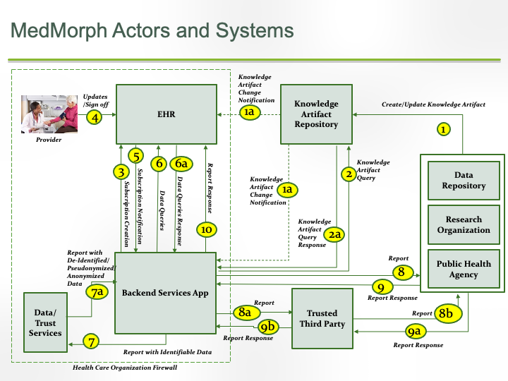
MEDMORPH: Making EHR Data More available for Research and Public Health
A “Learning Health System”
Hepatitis C
Cancer registry reporting
Cool Architecture!
Notes:
Example of a public health, backend smart on fhir app architecture w/ feedback loops

Slide 13
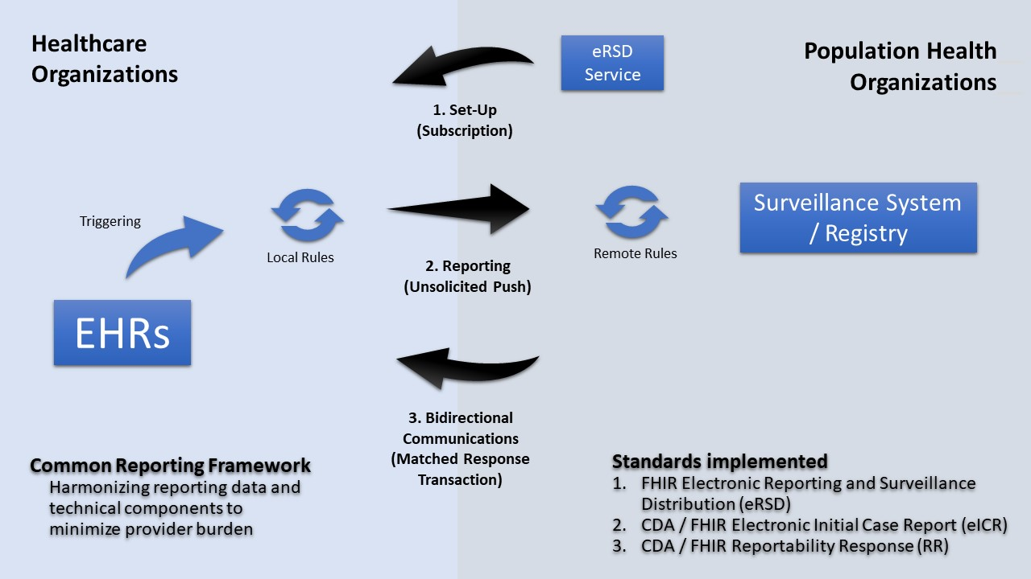
electronic Case Reporting (eCR)
Notes:
Electronic Case Reporting
An SoF app, reports CDA to HIE etc
https://ecr.aimsplatform.org/ecr-now-fhir-app
Example of a public health, backend smart on fhir app architecture

Slide 14
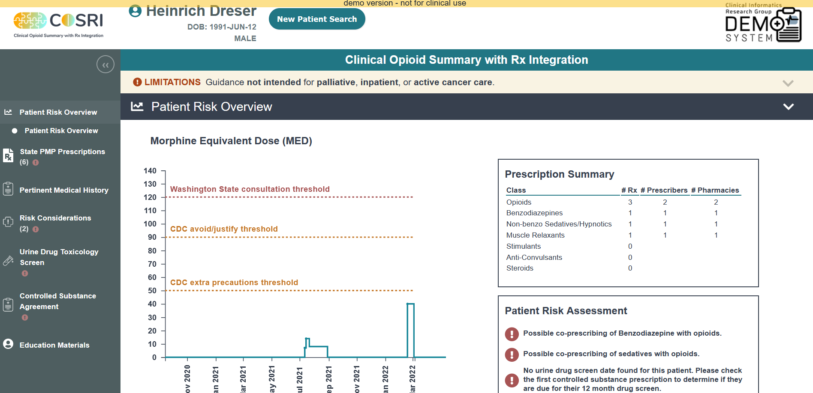
COSRI: Clinical Opioid Summary w/ Rx Integration
Notes:
One of our group’s apps
A WA-state specific implementation of an AHRQ CDS Connect project.
In use at 3 clinics in WA.
https://project.cosri.app/demo.html
https://dashboard.cosri-demo.cirg.washington.edu/

Slide 15
CHALLENGES
FHIR removes many hurdles, but “real” health informatics systems are difficult to build and own!
Enterprise-level requirements
Clinical Safety checklist https://www.hl7.org/fhir/safety.html
Can be tough to innovate in standards and other project aspects simultaneously
Avoid displacing functional systems that use older tech / standards
Notes:
https://www.hl7.org/fhir/safety.html
simultaneously (COVID-19 example).

Slide 16
ADOPTION
US FEDERAL MANDATES
The Office of the National Coordinator for Health Information Technology’s (ONC’s) Interoperability and Information-Blocking Final Rule
U.S. Centers for Medicare & Medicaid Services (CMS) Interoperability and Patient Access final rule (2020/2021)

Slide 17
ADOPTION
US FEDERAL MANDATES
U.S. Centers for Medicare & Medicaid Services (CMS) Interoperability and Patient Access final rule
Clinical data exchanged via the FHIR API, using the U.S. Core Data for Interoperability (USCDI)
CARIN Consumer Directed Payer Data Exchange - Medicare fee-for-service beneficiaries' digital access to their historical claims information through an application of their choice
Notes:
(2020/2021)

Slide 18
ADOPTION
US FEDERAL MANDATES
Open FHIR APIs
One result: open FHIR endpoints published by EMR vendors, eg:
https://open.epic.com/MyApps/Endpoints
Notes:
https://open.epic.com/MyApps/Endpoints

Slide 19
ADOPTION
SOCIAL ENABLER
“Data Liberation” movement
Patients as a first-level participant in FHIR
https://www.epatientdave.com
Check out his “Gimme my data” rap!
Notes:
PATIENT-MEDIATED DATA CONNECTIVITY

Slide 20
Thanks for attending! Questions? https://github.com/mcjustin/fhir-wadoh-talk-2022 Justin McReynolds, University of Washington
“Learning on FHIR” WA State Dept. of Health

Slide 21
A SIMPLE TECHNICAL EXAMPLE
Get the patient w/ medical record number 123
GET https://myfhirserver/Patient?identifier=MR-123

Slide 22
WEB STANDARD, HUMAN READABLE (VERBOSE)
GET https://myfhirserver/Patient?identifier=MR-123
That returns this data in JSON (JavaScript Object Notation):
{
"resourceType": "Bundle",
"id": "1.2.840.113619.21.1.1566559555105852911.10.1599847628615.341412",
"meta": {
"lastUpdated": "2020-09-11T18:07:08.615Z"
},
"type": "searchset",
"total": 1,
"link": [
{
"relation": "self",
"url": "https://apsandbox.fhirapi.athenahealth.com/demoAPIServer/fhir/Patient?_format=json&identifier=MR-123"
}
],
"entry": [
{
"fullUrl": "https://apsandbox.fhirapi.athenahealth.com/demoAPIServer/fhir/Patient/1239620410000620",
"resource": {
"resourceType": "Patient",
"id": "1239620410000620",
"meta": {
"lastUpdated": "2020-08-17T18:48:37.920Z",
"profile": [
"http://hl7.org/fhir/StructureDefinition/daf-patient",
"http://hl7.org/fhir/StructureDefinition/ge-patient-profile.html"
],
"security": [
{
"system": "http://www.hl7.org/fhir/v3/Confidentiality",
"code": "N",
"display": "Normal"
}
]
},
"text": {
"status": "generated",
"div": "<div xmlns=\"http://www.w3.org/1999/xhtml\"><table width=\"100%\"><tbody><tr><td width=\"25%\">Justin X. McReynolds M DOB: 1976/07/04</td><td width=\"42%\">330 NW Montgomery St. Portland, IL 98105 USA Phone: 2067180090 Phone: 2065556054 Fax: 2067180091 Email: Justin.McReynolds@outlook.com</td></tr></tbody></table></div>"
},
"extension": [
{
"url": "http://hl7.org/fhir/StructureDefinition/us-core-race",
"valueCodeableConcept": {
"coding": [
{
"system": "http://hl7.org/fhir/v3/Race",
"code": "2106-3",
"display": "White"
}
]
}
},
{
"url": "http://hl7.org/fhir/StructureDefinition/us-core-ethnicity",
"valueCodeableConcept": {
"coding": [
{
"system": "http://hl7.org/fhir/v3/Ethnicity",
"code": "2186-5",
"display": "Not Hispanic or Latino"
}
]
}
},
{
"url": "http://hl7.org/fhir/StructureDefinition/ge-patient-extension-RESPPROVID",
"valueReference": {
"reference": "Practitioner/1225652472001060"
}
},
{
"url": "http://hl7.org/fhir/StructureDefinition/ge-patient-extension-preferredContact",
"valueString": "E-mail"
},
{
"url": "http://hl7.org/fhir/StructureDefinition/ge-patient-extension-patientAsGuarantor",
"valueBoolean": false
},
{
"url": "http://hl7.org/fhir/StructureDefinition/ge-patient-extension-guarantorDetails",
"valueReference": {
"reference": "RelatedPerson/G-2_1239620410000620"
}
},
{
"url": "http://fhir.org/guides/argonaut/StructureDefinition/argo-race",
"extension": [
{
"url": "ombCategory",
"valueCoding": {
"system": "http://hl7.org/fhir/v3/Race",
"code": "2106-3",
"display": "White"
}
}
]
},
{
"url": "http://fhir.org/guides/argonaut/StructureDefinition/argo-ethnicity",
"extension": [
{
"url": "ombCategory",
"valueCoding": {
"system": "http://hl7.org/fhir/v3/Ethnicity",
"code": "2186-5",
"display": "Not Hispanic or Latino"
}
}
]
},
{
"url": "http://fhir.org/guides/argonaut/StructureDefinition/argo-birthsex",
"valueCode": "M"
}
],
"identifier": [
{
"type": {
"coding": [
{
"system": "http://hl7.org/fhir/v2/0203",
"code": "PI"
}
]
},
"system": "http://www.gehealthcare.com/fhir/cpsemr/namingsystem/PatientId/Training",
"value": "721"
},
{
"use": "secondary",
"type": {
"coding": [
{
"system": "http://hl7.org/fhir/identifier-type",
"code": "SB"
}
]
},
"system": "http://hl7.org/fhir/sid/us-ssn",
"value": "822846624"
},
{
"type": {
"coding": [
{
"system": "http://hl7.org/fhir/v2/0203",
"code": "MR"
}
]
},
"system": "http://www.gehealthcare.com/fhir/cpsemr/namingsystem/MRN/Training",
"value": "MR-123"
}
],
"active": true,
"name": [
{
"use": "official",
"family": [
"McReynolds"
],
"given": [
"Justin",
"S."
]
},
{
"use": "nickname",
"given": [
"Justin"
]
}
],
"telecom": [
{
"system": "phone",
"value": "2067180090",
"use": "work"
},
{
"system": "phone",
"value": "2065556054",
"use": "home"
},
{
"system": "fax",
"value": "2067180091"
},
{
"system": "email",
"value": "Justin.McReynolds@outlook.com"
}
],
"gender": "male",
"_gender": {
"extension": [
{
"url": "http://hl7.org/fhir/StructureDefinition/ge-originalCode",
"valueCoding": {
"system": "http://www.gehealthcare.com/fhir/cpsemr/codesystem/gender",
"code": "M",
"display": "Male"
}
}
]
},
"birthDate": "1976-07-04",
"deceasedBoolean": false,
"address": [
{
"line": [
“330 NW Montgomery St."
],
"city": "Portland",
"state": "IL",
"postalCode": "98105",
"country": "USA"
}
],
"maritalStatus": {
"coding": [
{
"system": "http://hl7.org/fhir/v3/MaritalStatus",
"code": "M",
"display": "Married"
}
],
"text": "Married"
},
"photo": [
{
"url": "Binary/Photo-1239620410000620"
}
],
"communication": [
{
"language": {
"coding": [
{
"system": "urn:ietf:bcp:47",
"code": "en",
"display": "English"
}
],
"text": "English"
},
"preferred": true
}
],
"managingOrganization": {
"reference": "Organization/LO-1225648184001060"
}
},
"search": {
"mode": "match"
}
}
]
}

Slide 23
HIGHER LEVEL STANDARDIZATION & GUIDANCE
HEAT RISES: HIGHER LEVEL OF CONTEXT
Clinical Reasoning
CDS Hooks

Slide 24
INTEGRATION POINTS WITH OTHER INNOVATIONS
ELEMENTS OF A “REAL-TIME HEALTH SYSTEM”
AI / machine learning / NLP
IoT
Sensors
Notes:
https://www.hl7.org/fhir/safety.html

Slide 25
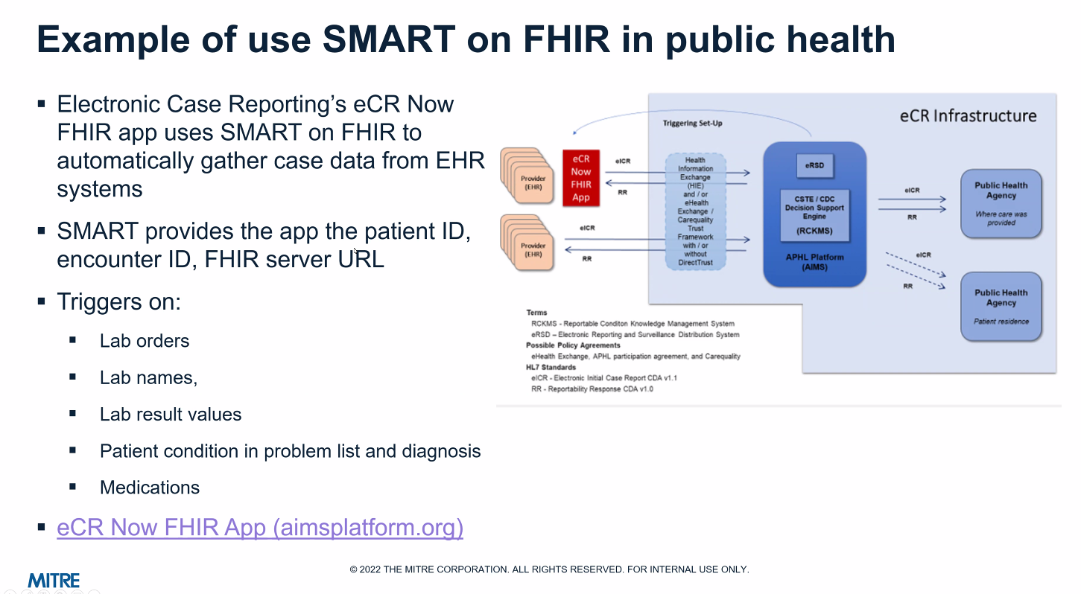
Notes:
MITRE presentation today re eCR Now; background material just for reference.

