Slide 1
Final Project Service Fabric
Lim, Isaac
Deep Azure@McKesson
Dr. Zoran B. Djordjević

Slide 2
Introduction
Microsoft Azure Service Fabric gives the user the ability to easily package and deploy applications and services. As well, Service Fabric clusters provide high scalability and reliability for these applications and services.
Service Fabric is highly customizable. For instance, you can create a cluster that has multiple VMs each being a node, or you can have a single VM with multiple nodes attached.
Applications can be deployed quickly once a Service Fabric cluster is created, unlike traditional deployments where a VM needs to be created every time.

Slide 3
Problem Statement
A Company is wanting to expand their infrastructure, and one of the initiatives is to create a scalable service fabric for their client facing web service. Create a service fabric cluster containing 1 node and deploy a web service application which will return a row from the dataset.

Slide 4
Steps
Install Service Fabric SDK
Create Service Fabric Cluster
Create sample application
Deploy application to Service Fabric Cluster
Run application web service

Slide 5
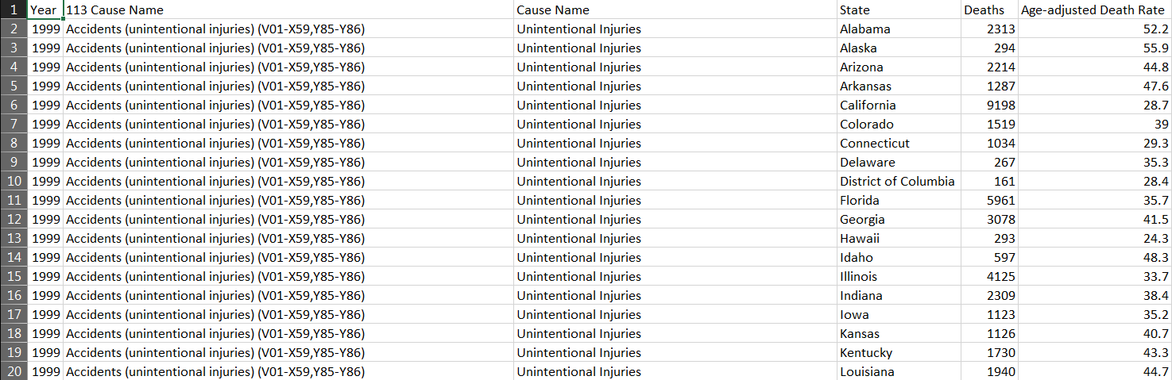
Dataset
Dataset used was leading causes of deaths in the US
https://catalog.data.gov/dataset/age-adjusted-death-rates-for-the-top-10-leading-causes-of-death-united-states-2013

Slide 6
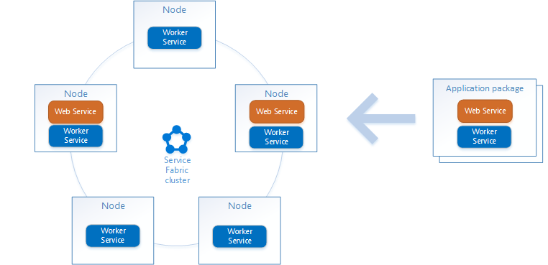
Service Fabric Cluster
The Service Fabric cluster created in Azure gives flexibility with how applications are distributed

Slide 7
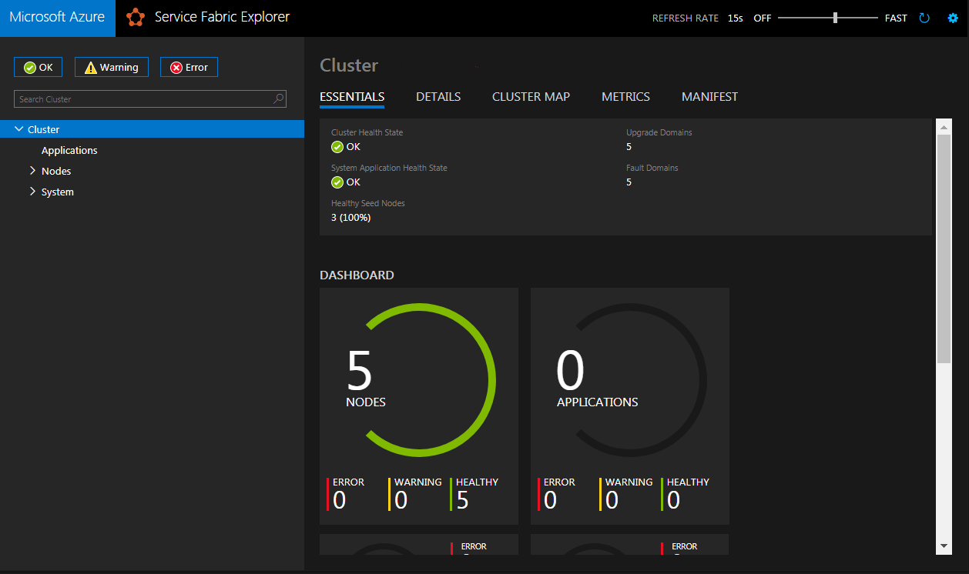
Service Fabric Cluster
The Service Fabric Cluster dashboard explorer

Slide 8
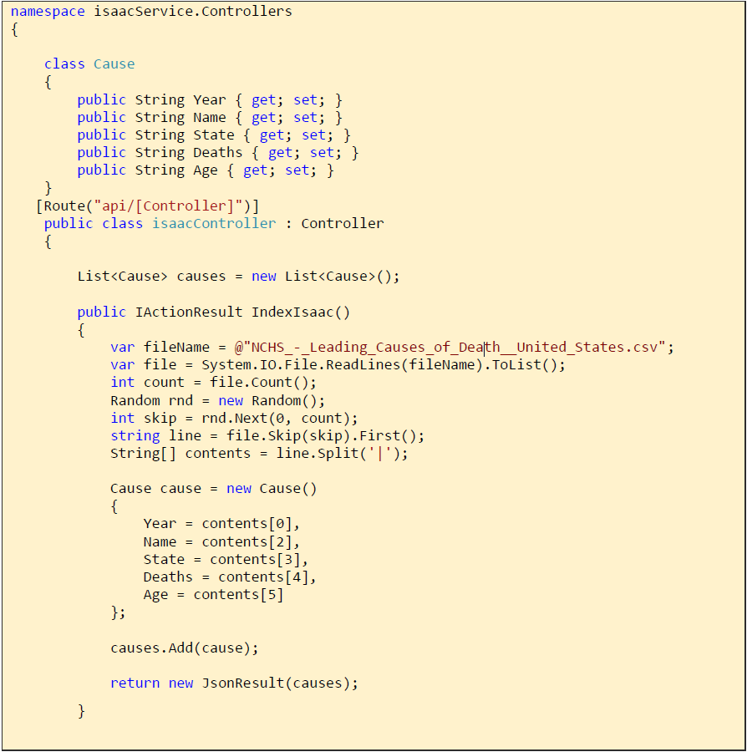
Code
The application that is then deployed to the cluster grabs a random row in the dataset and presents it to the client

Slide 9
Lessons Learned, Pros/Cons
Azure Service Fabric provide for a very customizable and fast deployment of applications which can alleviate the problem of standing up VMs for every need
For secured clusters, the need to distribute a certificate was necessary. This was something that I could not get the client computer to communicate properly
The cluster deployment can sometimes take a long time, and every time there was a change in the configuration it seemed to take a long time to update

Slide 10
YouTube URLs, GitHub URL, Last Page
Two minute (short): N/A
15 minutes (long): N/A
GitHub Repository with all artifacts: https://github.com/mck-isaac/azurefinal

