Slide 1
Crypto-Solver
By Zoey-Alexa Abrigo & Carolina Kimbrough
Notes:
Hello everyone, I am Zoey Abrigo. [And I am Carolina Kimbrough] Today we are here to present our project that we call crypto-solver.

Slide 2
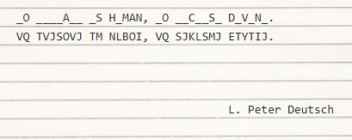
What is a cryptogram?
Notes:
http://www.devtopics.com/101-great-computer-programming-quotes/
Now who here knows what a cryptogram is?
A cryptogram is a type of puzzle that consists of a short piece of encrypted text .
Typically a substitution cipher is used, as shown on the slide above , where each letter is replaced by a different letter or number.
This is the problem we sought to tackle, the solution? To create an a.i. that could successfully recover the original lettering.

Slide 3
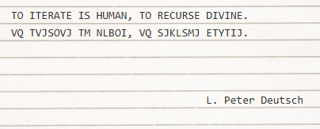
What is a cryptogram?
Notes:
http://www.devtopics.com/101-great-computer-programming-quotes/

Slide 4
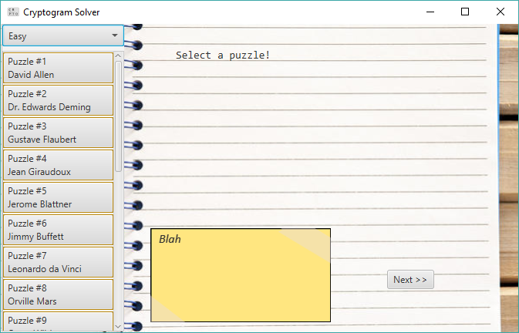
The GUI
Notes:
So our program was written in java, and the gui was created with javaFx
The cryptogram will be displayed on the paper, the yellow notecard will display the attempts the a.i. makes to solve the puzzle,
Which will be put into action through clicking the next button.
On the left we have 20 quotations of < 46 characters, this includes special characters,
We also have a difficulty selector above the quotations.
Originally we wanted for this to be able to solve these puzzles on three different difficulties, easy, medium and hard, in which each difficulty corresponds to the number of letters available to be known before the program attempts to solve the puzzle. However, as we worked on our project we came to realize that was not as easy as we first thought.

Slide 5
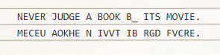
The Approach
Solve like
A human
Or a computer?
Notes:
Initially, we had planned on going about solving these puzzles similar to how a human would and applying computer logic to it like the Sudoku project.
However, a main problem we encountered is that, to a computer, words don’t have any real meaning.
To human beings, a puzzle like the one above has an immediately obvious solution, but not to a computer.
This is because we understand context. To us, it’s obvious that the word is ‘by’ but how can a computer not know it’s a word like, say, ‘be’?
A way to solve this problem is come up with a vocabulary. We did this by parsing the quotes and storing the words which the computer can reference as they solve a puzzle, similar to a human.
Using this vocabulary, we are able to verify is a possible answer is a word or not
So far, we’ve used a couple of methods to solve some easy puzzles.
One tried and true method is to look for words with one space and then to search the computer’s vocabulary for words that match. If there’s only one match, this must be the solution
Similarly, in another method we also search for words with one space, but this time we look at the neighboring letters found. Obviously, letters that have already been chosen cannot be re-used so
One space & neighbors
Two space & Search
First, we look for a word with two empty spaces.
Second, we find possible solutions for that word using our built-in vocabulary & aggregate a list
Third, we check the effects these possible solutions have on neighboring words, narrowing down our list if a solution produces strange results ie words that don’t exist in our vocabulary
In the end there if there’s just one viable solution, then that is the answer.

