Slide 1
Crypto-Solver
By Zoey-Alexa Abrigo & Carolina Kimbrough

Slide 2
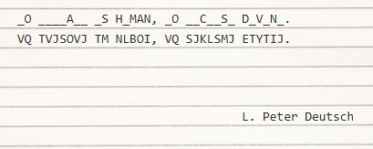
What is a cryptogram?
Notes:
http://www.devtopics.com/101-great-computer-programming-quotes/

Slide 3
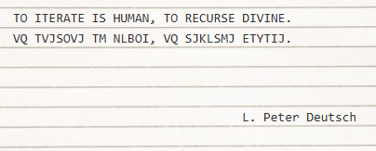
What is a cryptogram?
Notes:
http://www.devtopics.com/101-great-computer-programming-quotes/

Slide 4
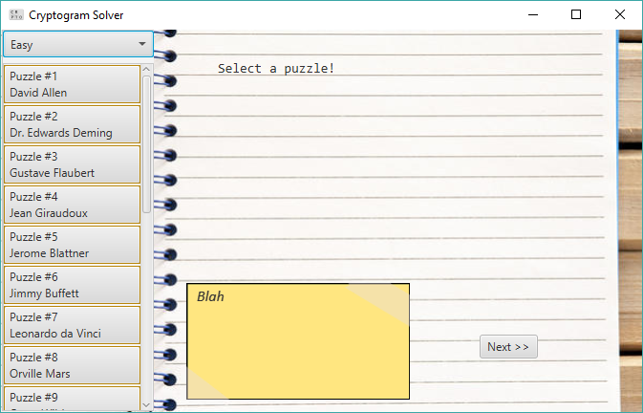
The GUI

Slide 5
The Approach
Solve like
A human
Or a computer?
Notes:
With

