Slide 1
Crypto-Solver
By Zoey-Alexa Abrigo & Carolina Kimbrough
Notes:
Hello everyone, I am Zoey Abrigo. Today we are here to present our project that we call crypto-solver.

Slide 2
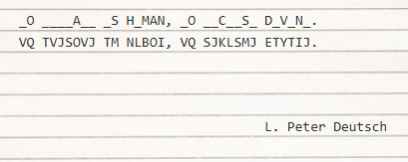
What is a cryptogram?
Notes:
http://www.devtopics.com/101-great-computer-programming-quotes/
Now who here knows what a cryptogram is?
A cryptogram is a type of puzzle that consists of a short piece of encrypted text .
Typically a substitution cipher is used, as shown on the slide above , where each letter is replaced by a different letter or number.
This is the problem we sought to tackle, the solution? To create an a.i. that could successfully recover the original lettering.

Slide 3
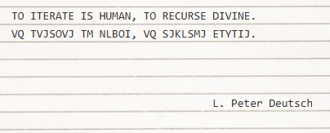
What is a cryptogram?
Notes:
http://www.devtopics.com/101-great-computer-programming-quotes/

Slide 4
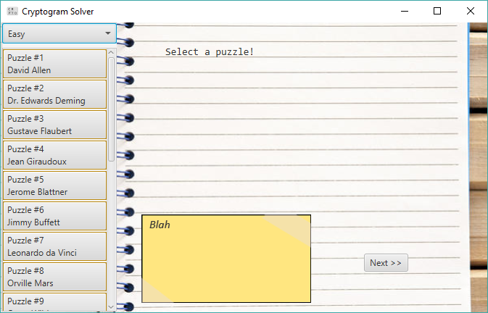
The GUI
Notes:
So our program was written in java, and the gui was created with javaFx
The cryptogram will be displayed on the paper, the yellow notecard will display the attempts the a.i. makes to solve the puzzle,
Which will be put into action through clicking the next button.
On the left we have 20 quotations of < 46 characters, this includes special characters,
We also have a difficulty selector above the quotations.
Originally we wanted for this to be able to solve these puzzles on three different difficulties, easy, medium and hard, in which each difficulty corresponds to the number of letters available to be known before the program attempts to solve the puzzle. However, as we worked on our project we came to realize that was not as easy as we first thought.

Slide 5
The Approach
Solve like
A human
Or a computer?
Notes:
With

