Slide 1
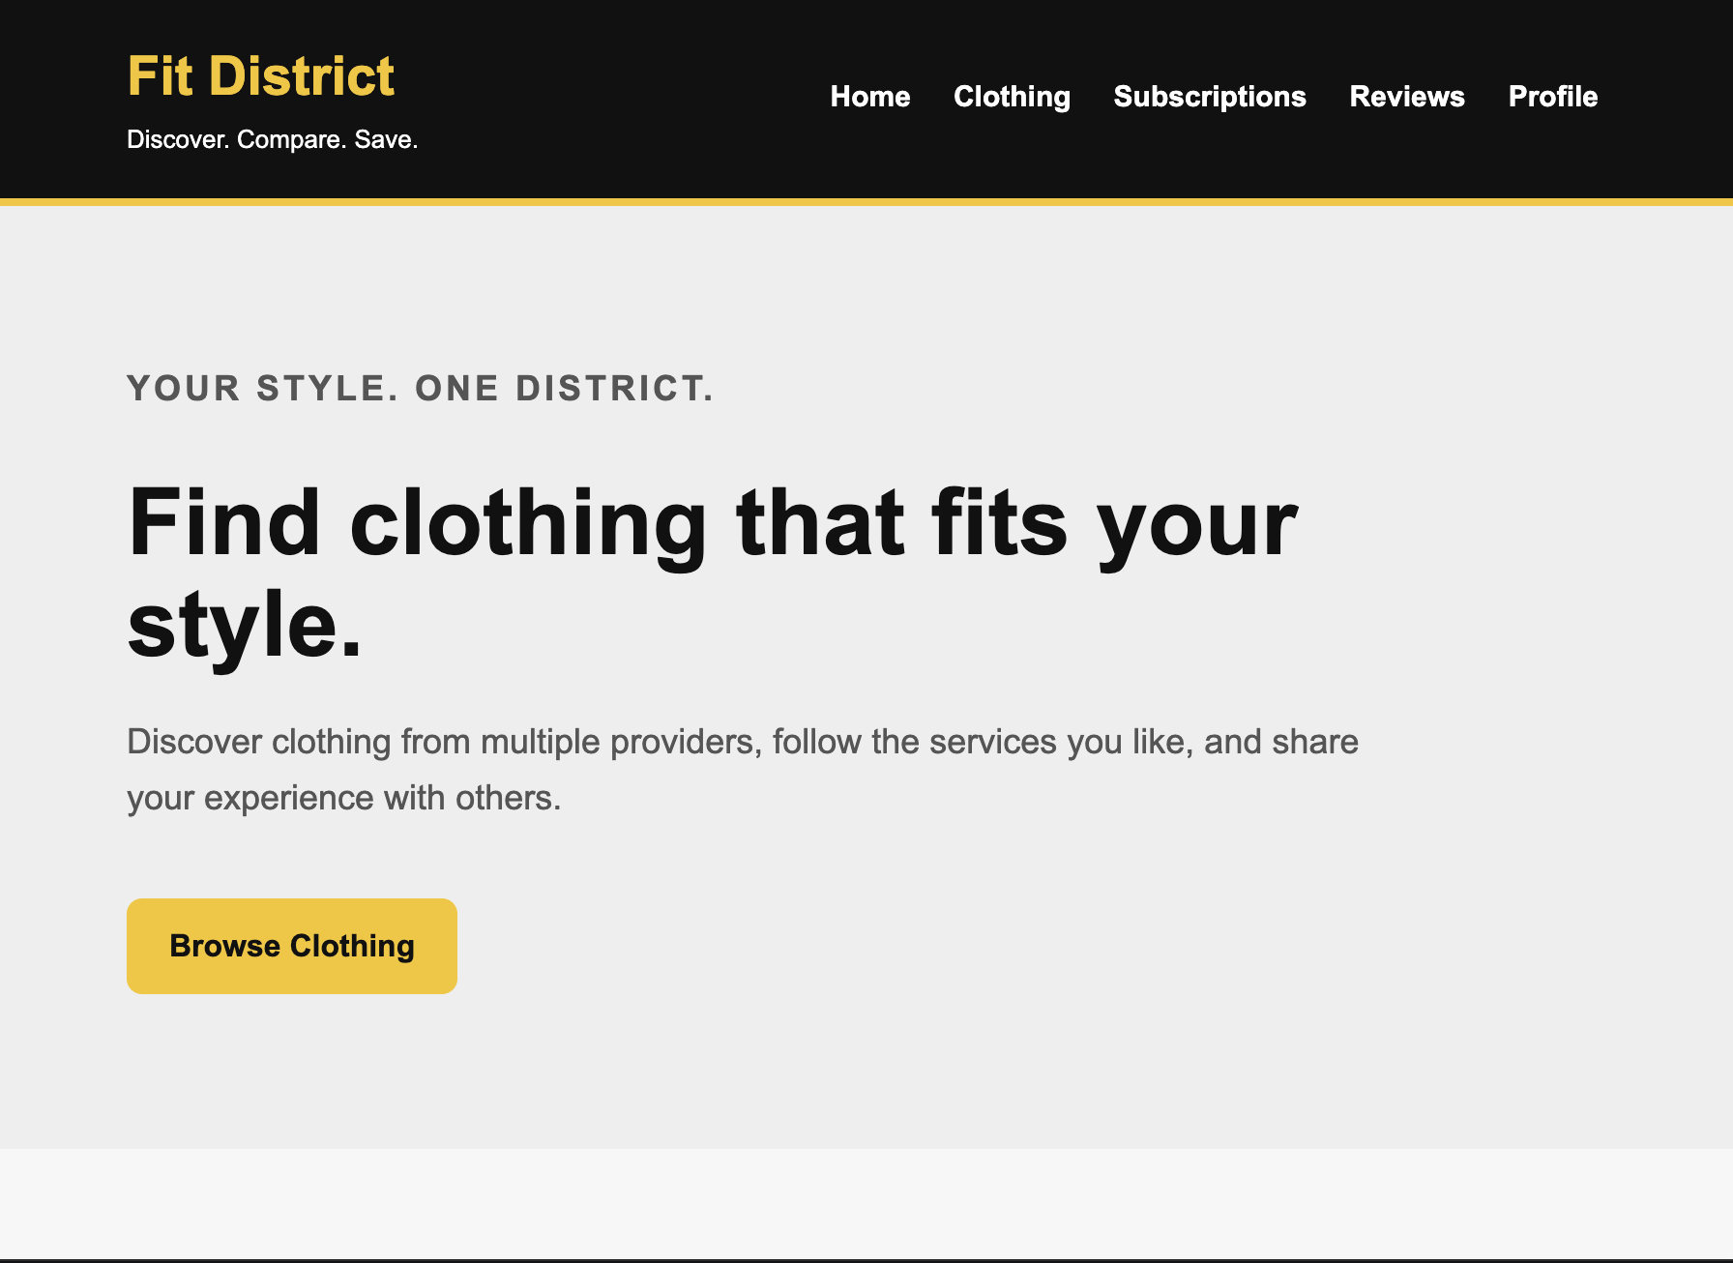
FIT DISTRICT
Discover. Compare. Save.
Fit District brings multiple clothing providers into one place so users can discover, compare, and save.
TARGET USERS
Shoppers ages 18–30
PROBLEM
Finding specific or trending items across different stores takes too much time.
SOLUTION
One place to discover clothing, compare options, and save time.
Notes:
Our project is called Fit District. It's a clothing platform designed mainly for shoppers between 18 and 30. The problem we're trying to solve is that people often have to search through multiple websites to find specific or trending clothing. Fit District brings those providers together in one place so users can discover clothing, compare their options, and save time.

Slide 2
Main Functionality
What users can do in the Fit District prototype
01
02
03
Create an Account
Browse Providers
Discover Products
Set up and manage a user profile.
Explore clothing from multiple retail providers.
Find specific and trending clothing items.
04
05
06
Subscriptions
Reviews
Shopping Experience
Subscribe to preferred providers.
View and leave feedback for providers.
Move between providers and product options from one interface.

Slide 3
High-Fidelity Prototype
Current milestone: user interface and interaction flow
RJ Hester
CAMERON WILKERSON
My Prototype Contributions
My Prototype Contributions
Designed the Provider Portal interface
Built provider profile management
Created product management with add, edit, remove, and search functionality
Developed activity tracking and customer review replies
Designed the Sys-Admin dashboard
Built review moderation and usage statistics
Added interactive navigation and functionality with JavaScript
Designed the customer-facing interface
Created the clothing browsing experience
Built the provider subscription interface
Created the customer review section
Developed the customer profile page
Focused on navigation and usability
Demo flow: Home → Provider → Subscribe → Reviews
Notes:
My main responsibility for this milestone was the customer side of Fit District. I worked on the interface customers would use to browse clothing, subscribe to providers, leave reviews, and manage their profile. I also focused on making it easy for customers to navigate between these different sections.

