Slide 1
Procedural Music
By: McKade Umbenhower, Robert Randolph,
Taylor Bleizeffer

Slide 2
What we’ve done so far
Simple command line
Load
Generate
Save
Play
1-1 note transition generation

Slide 3
Process
Grab sample
Create Markov Table
WFC (Wave Function Collapse)
Finished output

Slide 4
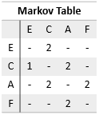
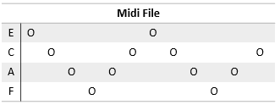
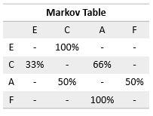
Visual Steps

Slide 5
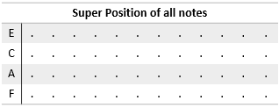
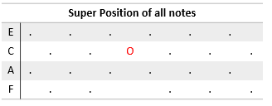
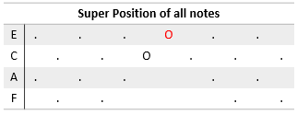

WFC
Lowest Shannon Entropy:

Slide 6
Visual Representation

Slide 7
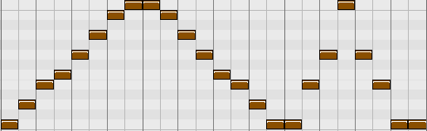
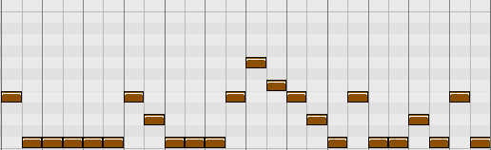
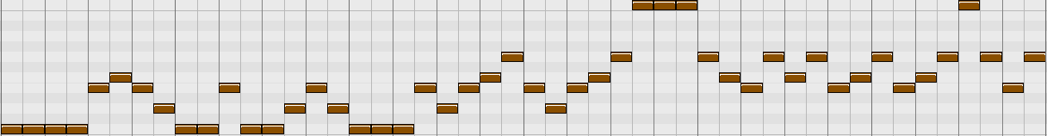
Visual Representation
Input MIDI
Output MIDI
WFC
Markov Chains
Longer Output

Slide 8
Plans
Work on a GUI
Add more note transitions
Ex: 2-2 (chords)

