Slide 1
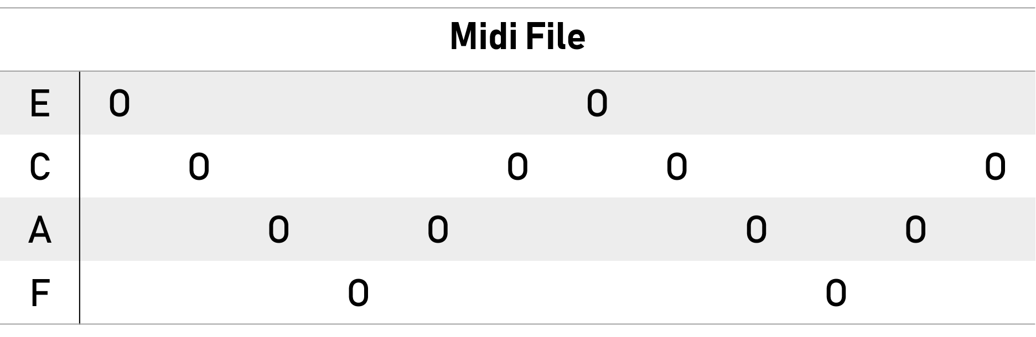
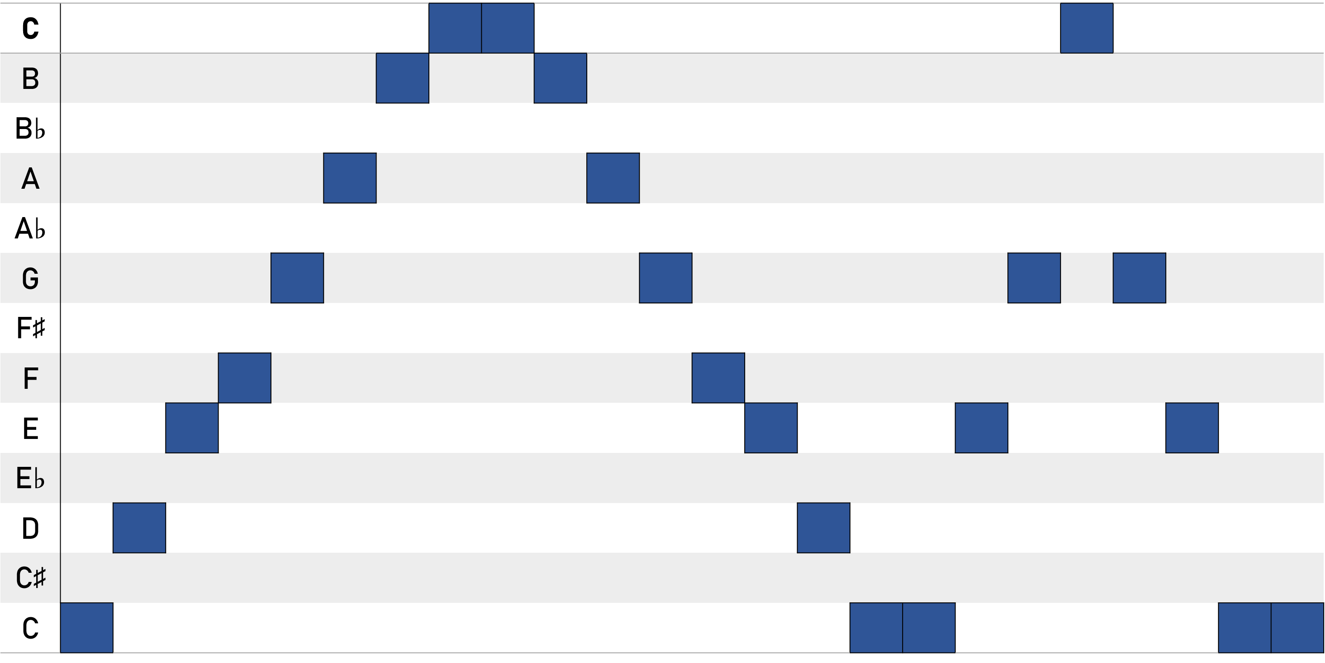
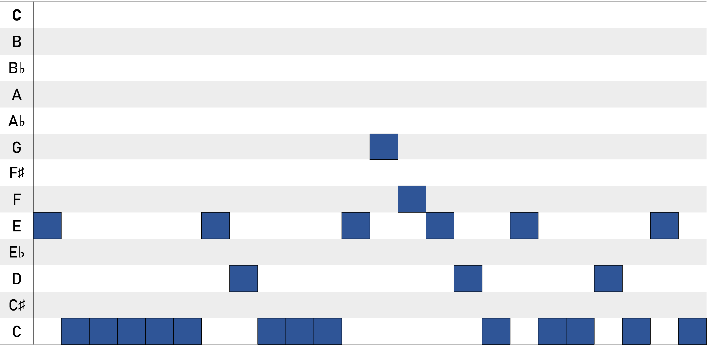
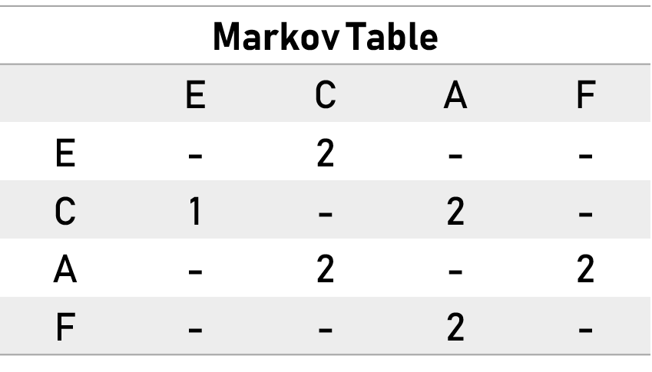
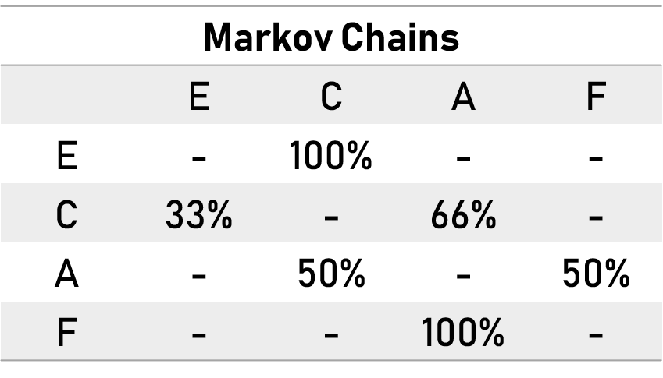
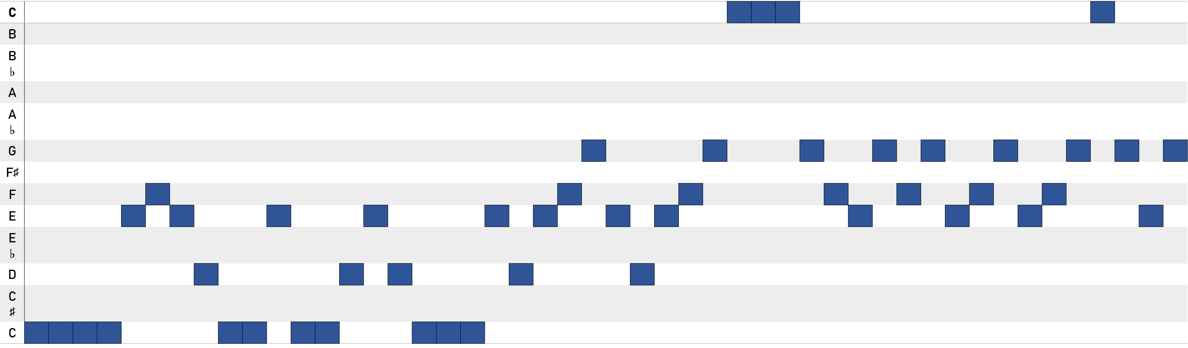

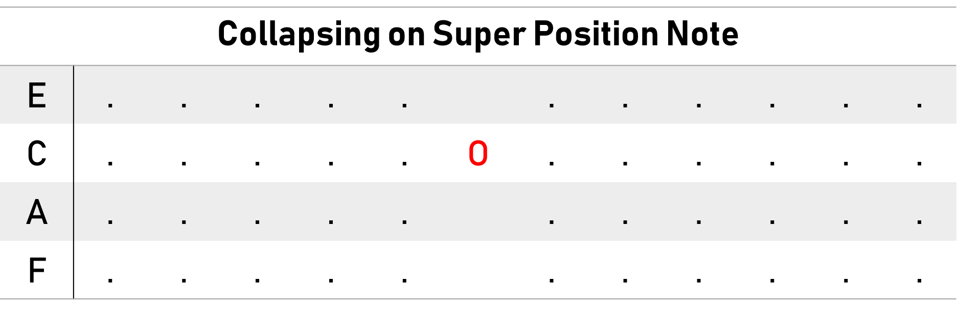

Procedural Music
McKade Umbenhower, Robert Randolph, Taylor Bleizeffer
COSC Senior Design, University of Wyoming
Intro
General overview
Use cases
Problem being solved
benefits
Implementation
How we build it
What was used
Challenges we had
Results
What we currently can make
Take away points
Introduction
Implementation
Results
Project Goal:
Generate music based on an input
Project Questions:
Can an algorithm produce listenable music?
Can Wave Function Collapse make the music?
Benefits and Uses:
Inspire music creation
Original music to listen to
Music for games, videos, podcasts, etc.
Recreate pieces similar to others
Tools Used:
Java
JMusic – Open source music programming library
Project Challenges:
Determine a good sample feature set
Find a similarity balance between inputs and outputs
Input a sample
Generate Markov Tables/Markov Chains
Apply Wave Function Collapse (WFC)
Repeat WFC until all notes are collapsed
Current music productions:
Input a simple sample with fixed-length notes
Output a locally similar, original piece
Unique output every run
Controllable output length
Example input sample
Short example output
100%
50%
33%
F
A
C
E
50%
66%
100%
Longer example output
Takeaways:
Good proof on concept
Lots of room for improvement
Lots of feature tuning needed
Related Work
Future Work
Related Work
Future Work
Wave Function Collapse:
Texture Synthesis
Model Generation
Other procedural music:
Markov Chains
Cellular Automata
References:
Brown, Andrew R. JMusic - Computer Music
Composition in Java.
explodingart.com/jmusic/.
mxgmn. “mxgmn/WaveFunctionCollapse.”
GitHub, 14 Nov. 2018,
github.com/mxgmn/WaveFunctionCollapse.
WolframTones, Wolfram Research, Inc., 2018,
tones.wolfram.com/about/how-it-works/.
User interface:
Add a GUI
Add note visualization
Options to toggle sampling features
Input/Save music
Improving the music:
Note length
Chords
Phrasing
Multiple Parts
Noise

