Slide 1
Data Technologies Group 1 Update 11/18/2021
Tyler Antoloci
Ragan Astle
Nate Nellis
McKade Thomas

Slide 2
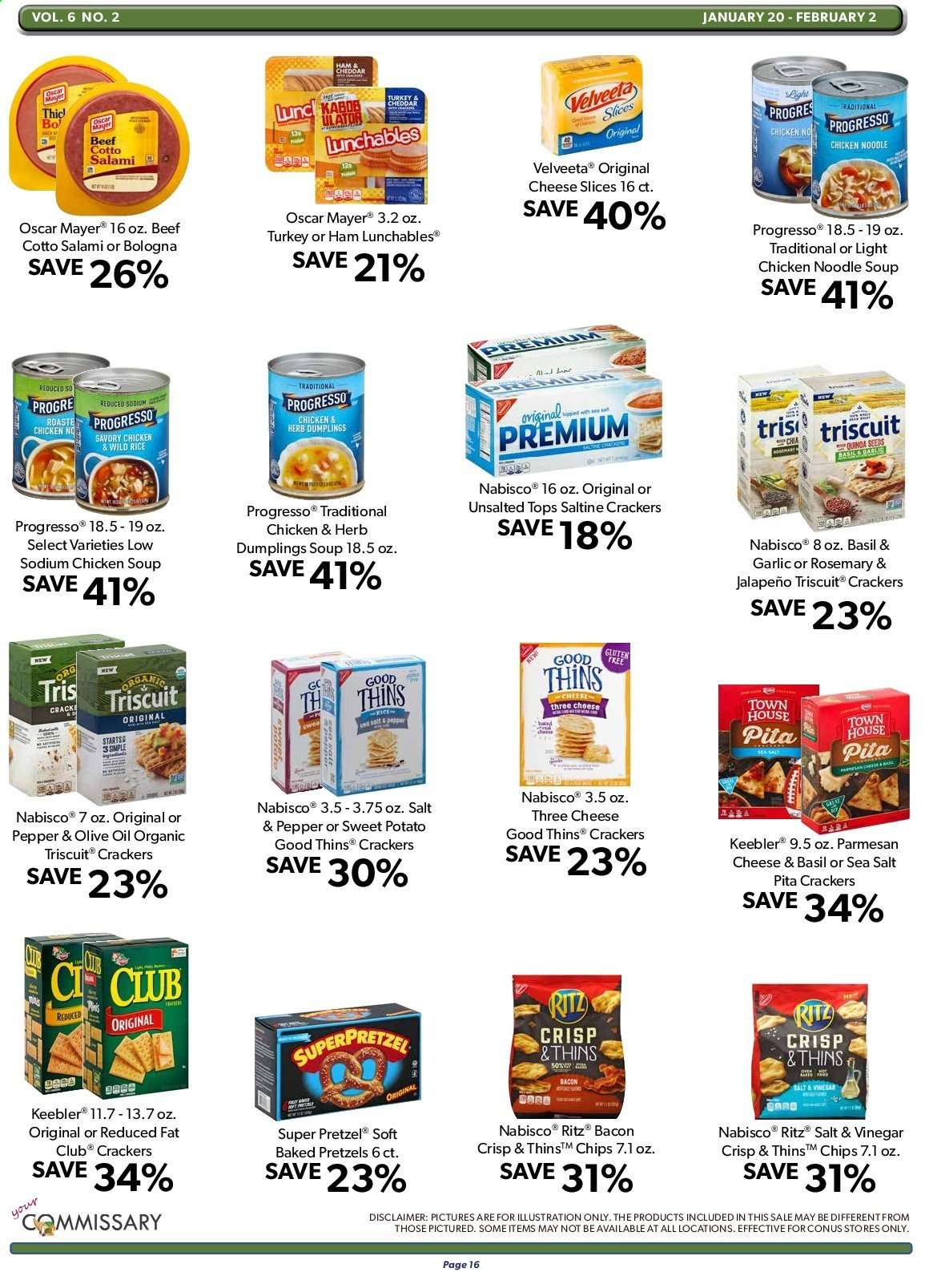
Image Processing
All ads have a grid like layout that facilitates cropping
May attempt to filter all non-black colors to help remove product images
Front Page advertises dollars off, while rest of the ad advertises % off.

Slide 3
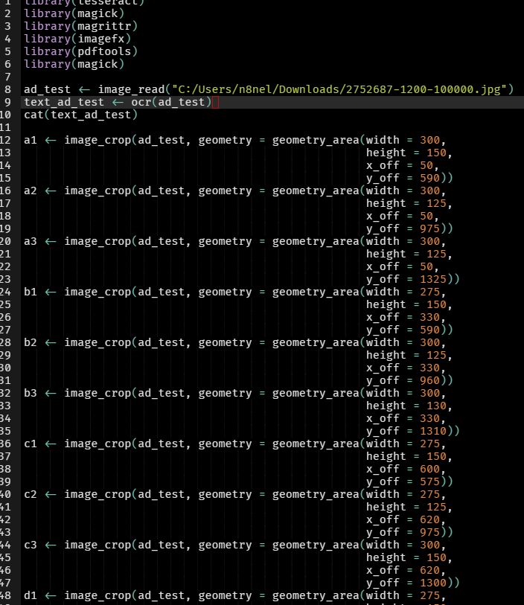
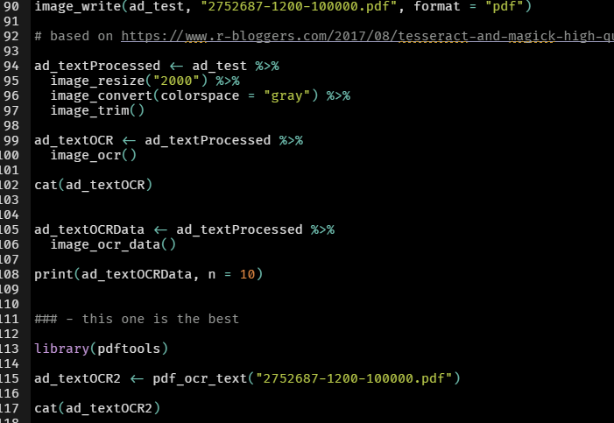
Image Processing Code

Slide 4
Data Collection
Weekly-ads.us continues to thwart our efforts at scraping.
Have successfully downloaded single jpeg with script, but implementing loops results in ip blocking.
Using multiple web browsers helped but didn’t get us all the way.
Will be attempting to automate tor to randomize ip address throughout scraping process.

Slide 5
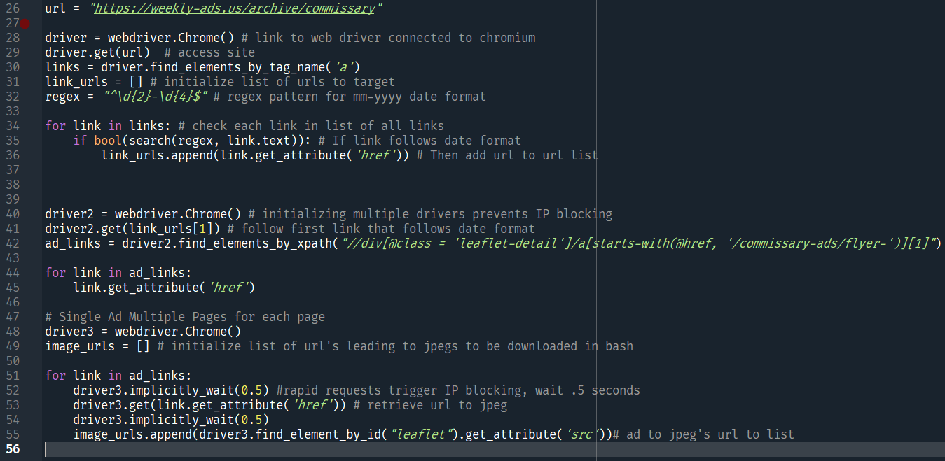
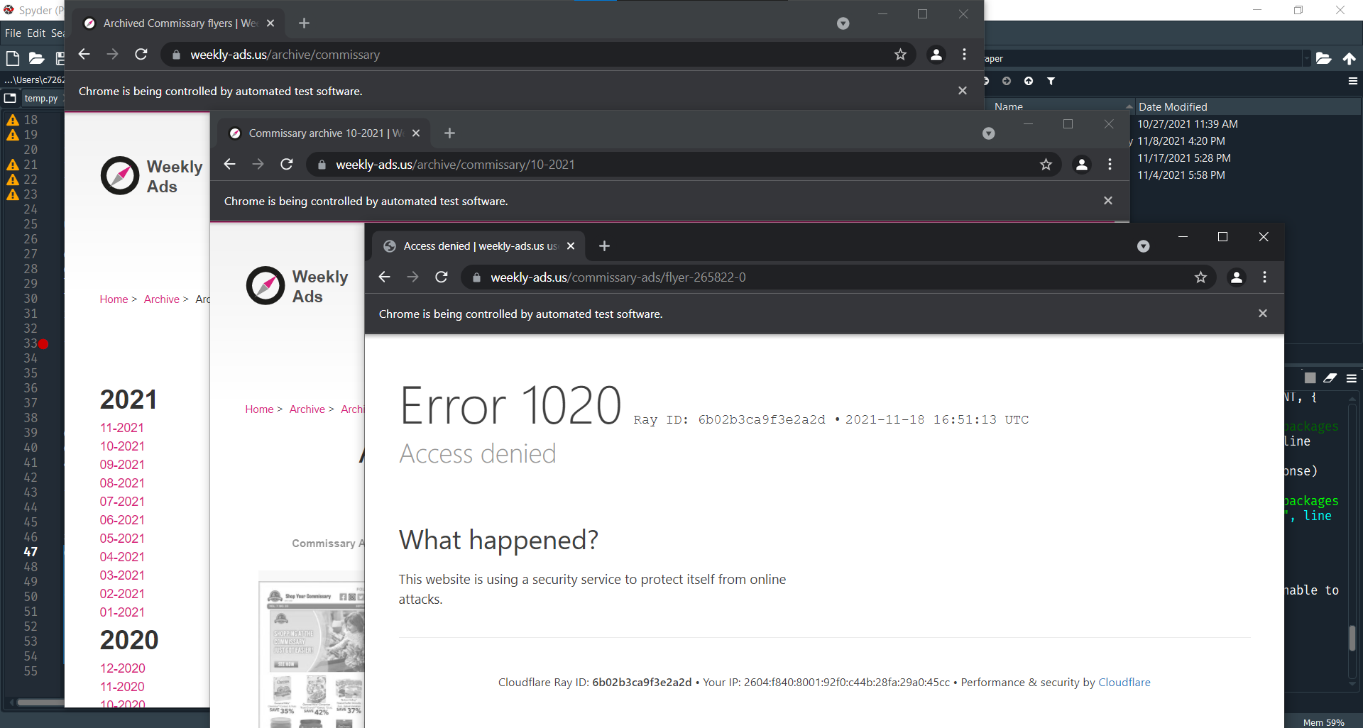
Data Collection Code

