Slide 1
Python/R Post Workshop Survey
Wednesday, June 19, 2019

Slide 2
41
Total Responses
Date Created: Monday, June 10, 2019
Complete Responses: 41

Slide 3
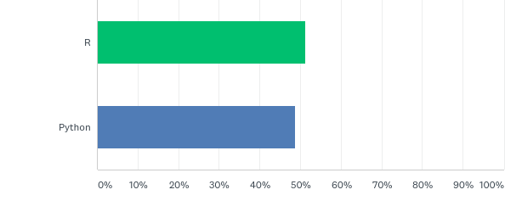
Q1: Which workshop did you attend?
Answered: 41 Skipped: 0

Slide 4
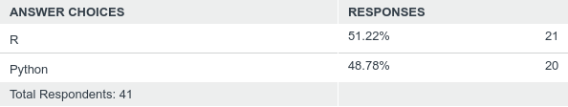
Q1: Which workshop did you attend?
Answered: 41 Skipped: 0

Slide 5
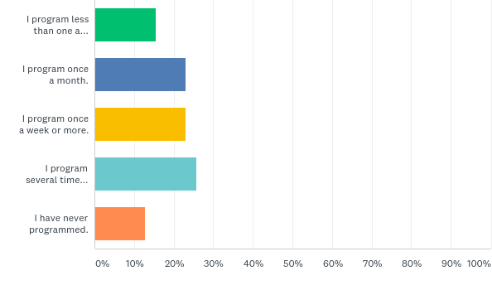
Q4: What best describes how often you currently program?
Answered: 39 Skipped: 2

Slide 6
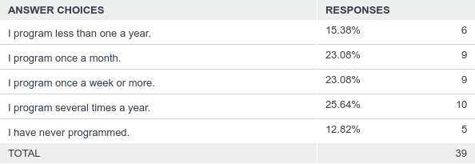
Q4: What best describes how often you currently program?
Answered: 39 Skipped: 2

Slide 7
Q5: What programming language was used in your workshop?
Answered: 41 Skipped: 0

Slide 8
Q5: What programming language was used in your workshop?
Answered: 41 Skipped: 0

Slide 9
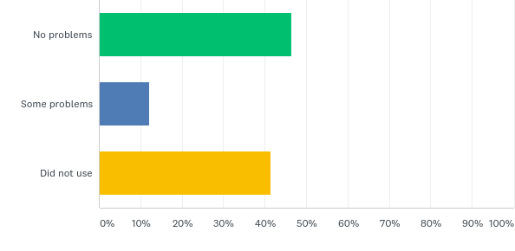
Q6: How well did the following technology work in your workshop? [RStudio server]
Answered: 41 Skipped: 0

Slide 10
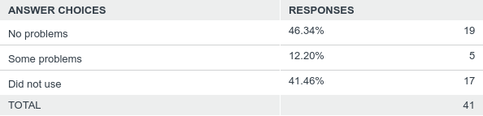
Q6: How well did the following technology work in your workshop? [RStudio server]
Answered: 41 Skipped: 0

Slide 11
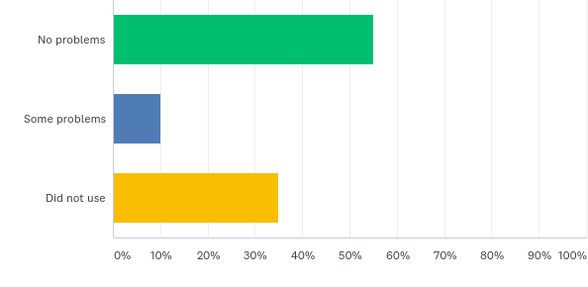
Q7: How well did the following technology work in your workshop? [JupyterHub server]
Answered: 40 Skipped: 1

Slide 12
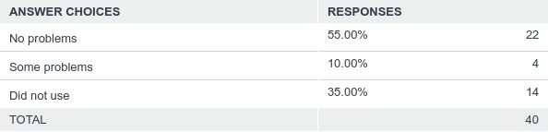
Q7: How well did the following technology work in your workshop? [JupyterHub server]
Answered: 40 Skipped: 1

Slide 13
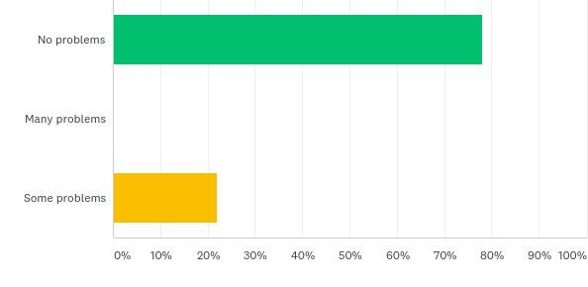
Q8: Were there any problems encountered during the following topics? [Shell]
Answered: 41 Skipped: 0

Slide 14
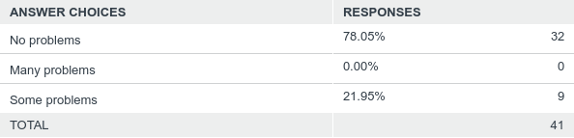
Q8: Were there any problems encountered during the following topics? [Shell]
Answered: 41 Skipped: 0

Slide 15
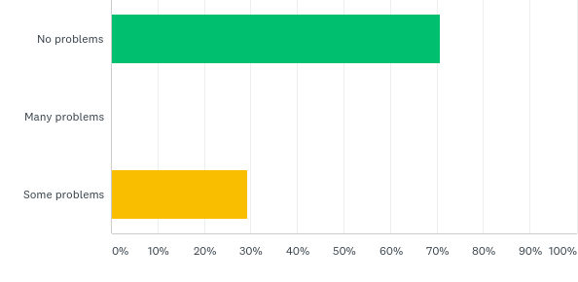
Q9: Were there any problems encountered during the following topics? [Programming]
Answered: 41 Skipped: 0

Slide 16
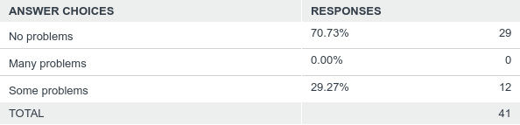
Q9: Were there any problems encountered during the following topics? [Programming]
Answered: 41 Skipped: 0

Slide 17
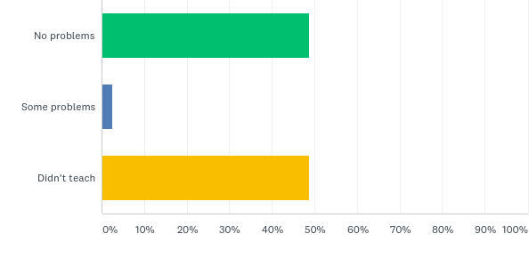
Q10: Were there any problems encountered during the following topics? [Version Control]
Answered: 41 Skipped: 0

Slide 18
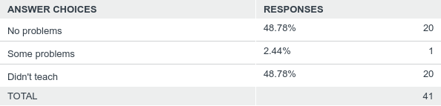
Q10: Were there any problems encountered during the following topics? [Version Control]
Answered: 41 Skipped: 0

Slide 19
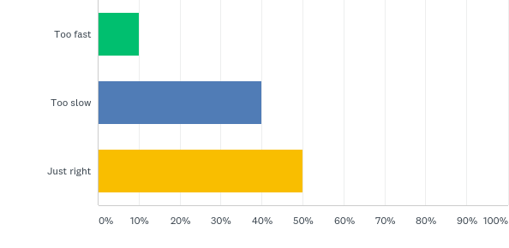
Q11: Please indicate the pace of instruction [Shell]
Answered: 40 Skipped: 1

Slide 20
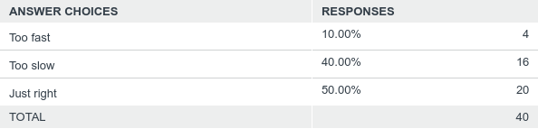
Q11: Please indicate the pace of instruction [Shell]
Answered: 40 Skipped: 1

Slide 21
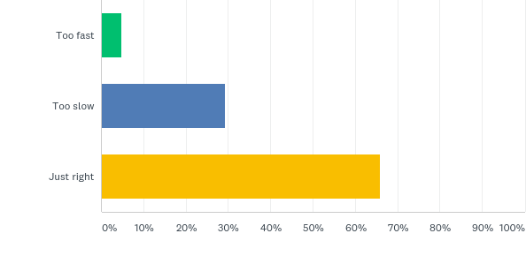
Q12: Please indicate the pace of instruction [Programming]
Answered: 41 Skipped: 0

Slide 22

Q12: Please indicate the pace of instruction [Programming]
Answered: 41 Skipped: 0

Slide 23
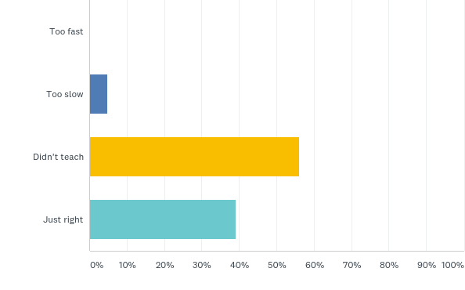
Q13: Please indicate the pace of instruction [Version Control]
Answered: 41 Skipped: 0

Slide 24
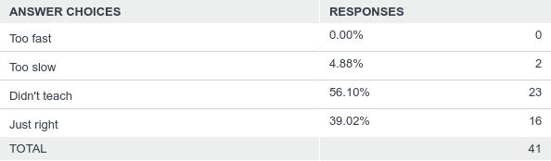
Q13: Please indicate the pace of instruction [Version Control]
Answered: 41 Skipped: 0

Slide 25
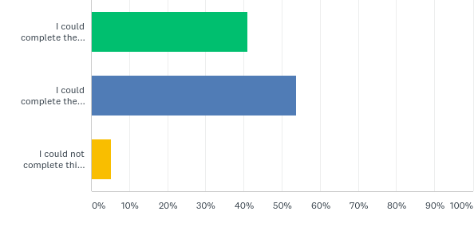
Q14: Consider this task: A comma-delimited file has two columns showing the date and the number of sun spots recorded for that day. Write a program to produce a graph showing the average number of sun spots for each month.
Answered: 39 Skipped: 2

Slide 26
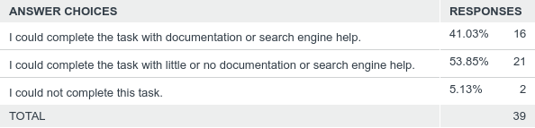
Q14: Consider this task: A comma-delimited file has two columns showing the date and the number of sun spots recorded for that day. Write a program to produce a graph showing the average number of sun spots for each month.
Answered: 39 Skipped: 2

Slide 27
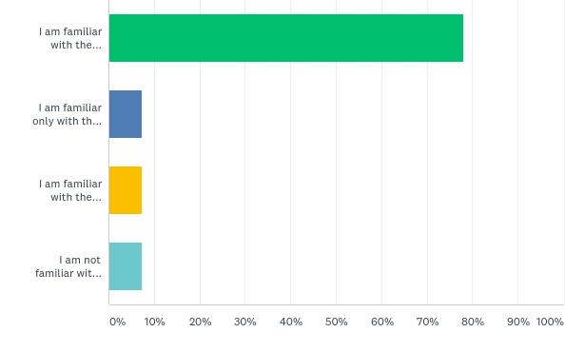
Q15: How familiar do you think you are with the command line?
Answered: 41 Skipped: 0

Slide 28
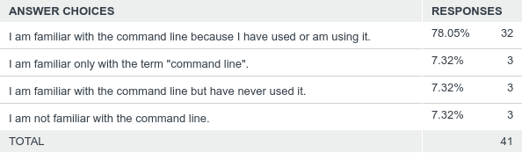
Q15: How familiar do you think you are with the command line?
Answered: 41 Skipped: 0

Slide 29
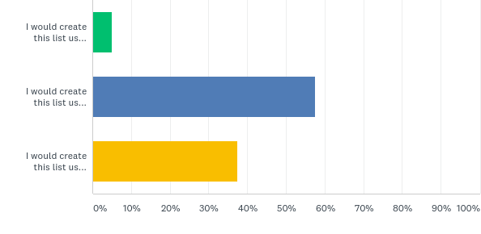
Q16: How would you solve this problem? A directory contains 873 named text files. Create an alphabetical sorted list of all files beginning with '2009' and save the results as results.txt.
Answered: 40 Skipped: 1

Slide 30
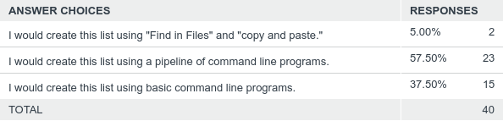
Q16: How would you solve this problem? A directory contains 873 named text files. Create an alphabetical sorted list of all files beginning with '2009' and save the results as results.txt.
Answered: 40 Skipped: 1

