Slide 1
Python/R Pre-Workshop Survey
Wednesday, June 19, 2019

Slide 2
56
Total Responses
Date Created: Monday, June 10, 2019
Complete Responses: 56

Slide 3
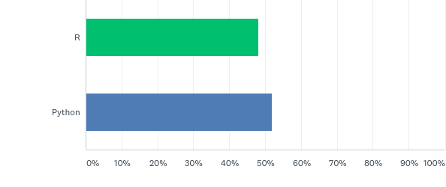
Q1: Which workshop do you plan to attend?
Answered: 56 Skipped: 0

Slide 4
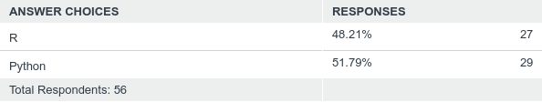
Q1: Which workshop do you plan to attend?
Answered: 56 Skipped: 0

Slide 5
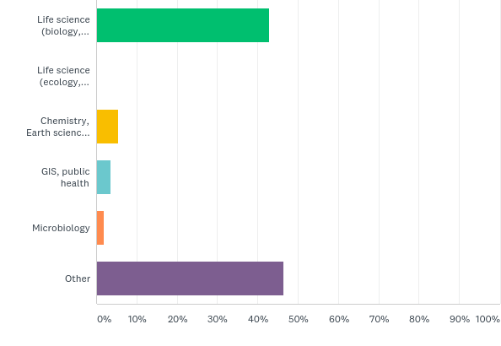
Q3: What best described your discipline?
Answered: 56 Skipped: 0

Slide 6
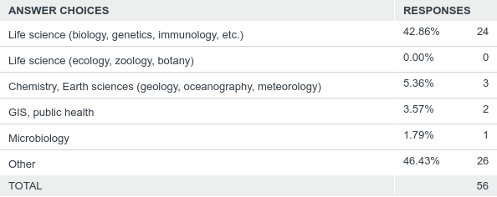
Q3: What best described your discipline?
Answered: 56 Skipped: 0

Slide 7
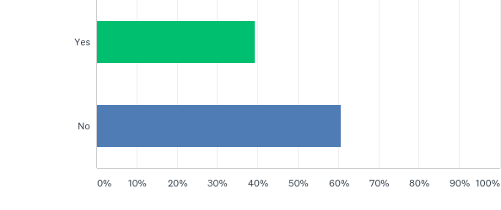
Q5: Will you be attending the workshop with a group of colleagues, friends, or classmates?
Answered: 56 Skipped: 0

Slide 8
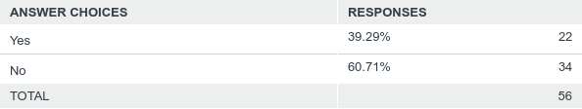
Q5: Will you be attending the workshop with a group of colleagues, friends, or classmates?
Answered: 56 Skipped: 0

Slide 9
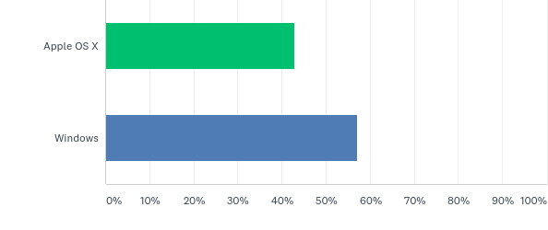
Q6: What OS will you use on the laptop you bring to the workshop (Note: only Mac or Windows laptops are supported)?
Answered: 56 Skipped: 0

Slide 10
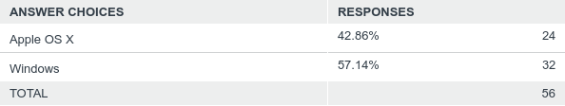
Q6: What OS will you use on the laptop you bring to the workshop (Note: only Mac or Windows laptops are supported)?
Answered: 56 Skipped: 0

Slide 11
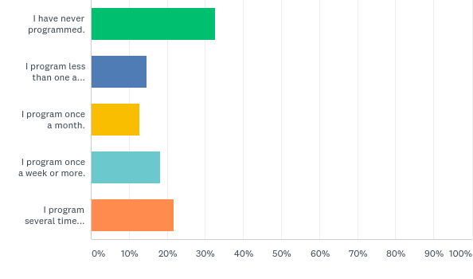
Q8: What best describes how often you currently program?
Answered: 55 Skipped: 1

Slide 12
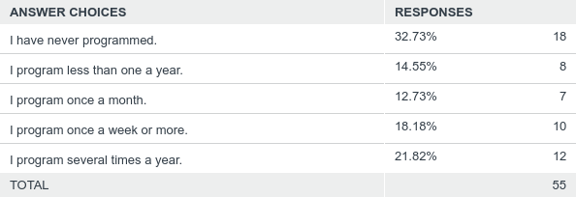
Q8: What best describes how often you currently program?
Answered: 55 Skipped: 1

Slide 13
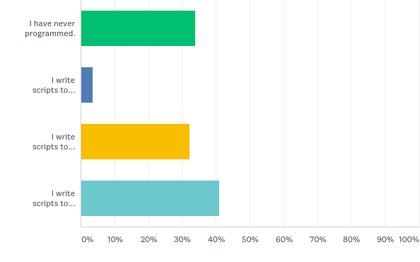
Q9: What best describes the complexity of your programming? (Choose all that apply.)
Answered: 56 Skipped: 0

Slide 14
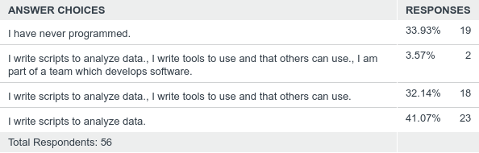
Q9: What best describes the complexity of your programming? (Choose all that apply.)
Answered: 56 Skipped: 0

Slide 15
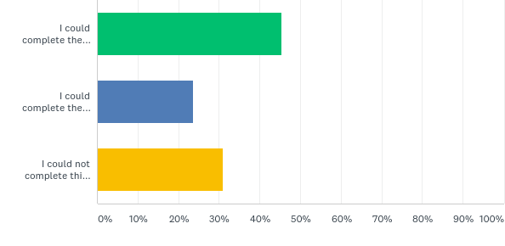
Q11: A tab-delimited file has two columns showing the date and the highest temperature on that day. Write a program to produce a graph showing the average highest temperature for each month.
Answered: 55 Skipped: 1

Slide 16
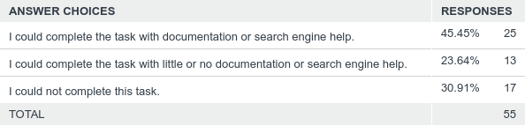
Q11: A tab-delimited file has two columns showing the date and the highest temperature on that day. Write a program to produce a graph showing the average highest temperature for each month.
Answered: 55 Skipped: 1

Slide 17
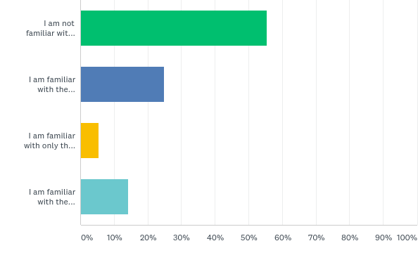
Q12: How familiar do you think you are with the unix/linux command line?
Answered: 56 Skipped: 0

Slide 18
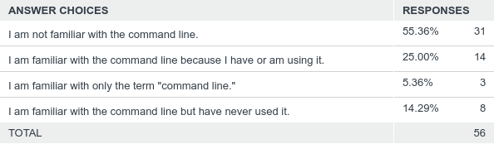
Q12: How familiar do you think you are with the unix/linux command line?
Answered: 56 Skipped: 0

Slide 19
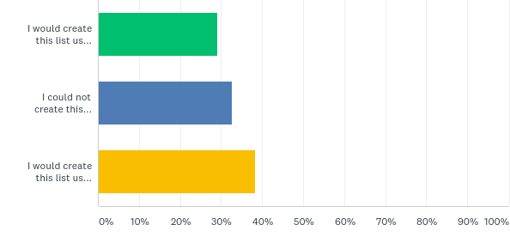
Q13: How would you solve this problem: A directory contains 1000 text files. Create a list of all files that contain the word "Drosophila" and save the result to a file called results.txt.
Answered: 55 Skipped: 1

Slide 20
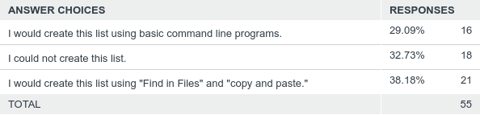
Q13: How would you solve this problem: A directory contains 1000 text files. Create a list of all files that contain the word "Drosophila" and save the result to a file called results.txt.
Answered: 55 Skipped: 1

Slide 21
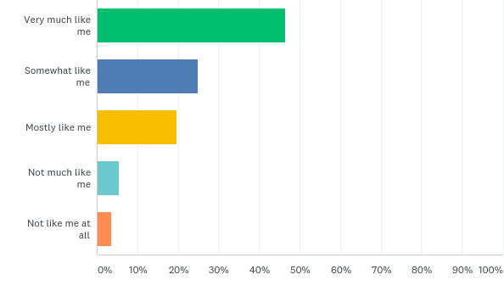
Q14: Consider the extent to which the following statement applies to you: "Setbacks don't discourage me."
Answered: 56 Skipped: 0

Slide 22
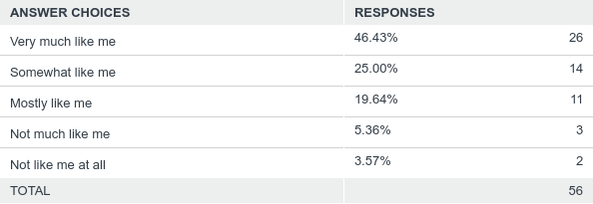
Q14: Consider the extent to which the following statement applies to you: "Setbacks don't discourage me."
Answered: 56 Skipped: 0

