Slide 1

Homework 6 Data visualization
Kelli McKeegan

Slide 2
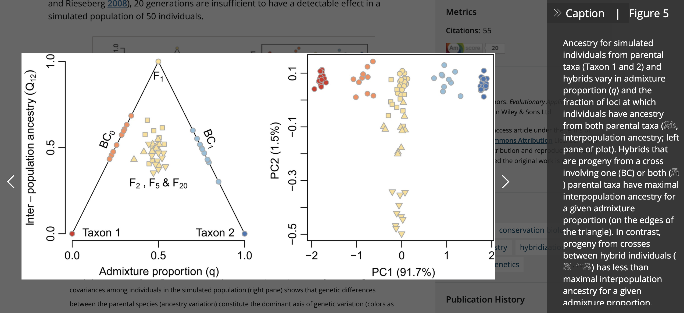
One I like
Gompert & Buerkle 2016

Slide 3
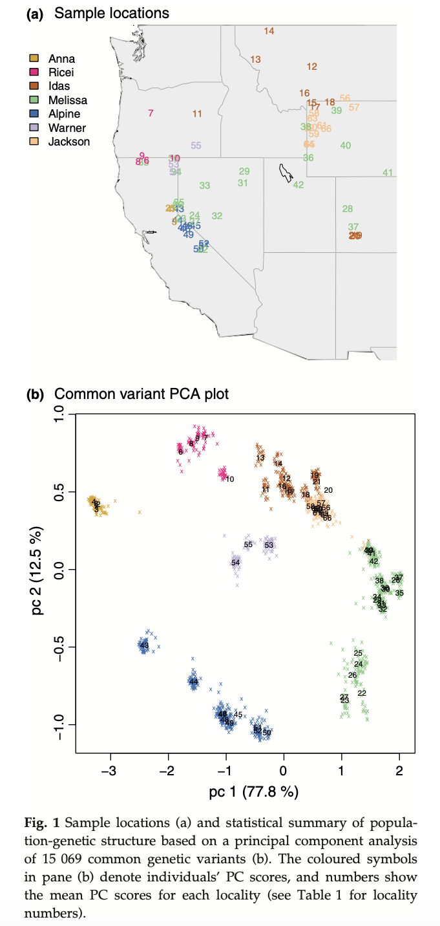
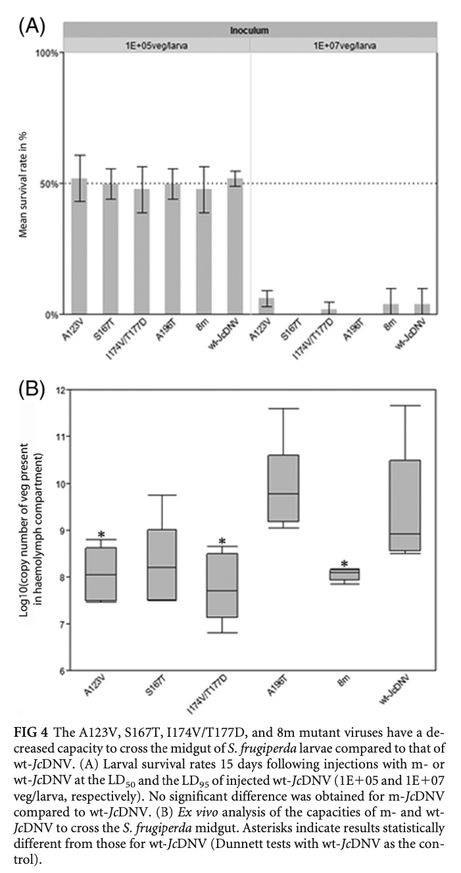
Some I dislike
Still good papers!!!!!!!!!!!
The first one was only because I was searching for figures by this author (he has a lot of cool data, hence selecting one of his figures for the previous slide), but found the numbers & colors very hard to distinguish in this one.
The second one is from a paper I cite often, but I just don’t really think it shows much or is visually appealing or very clear.
Gompert et al. 2014
Multeau et al. 2012

Slide 4
Figure 2.5 re-do

