Slide 1

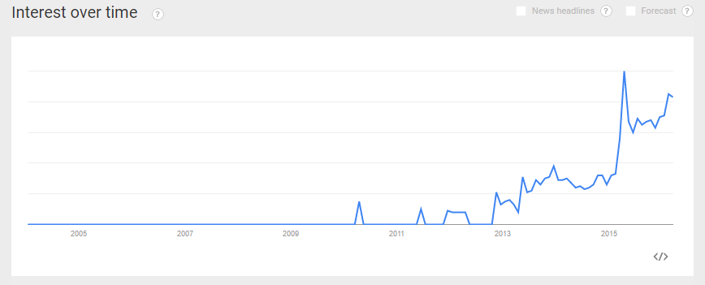
The open-source database for the real-time web.

Slide 2
The Plan
Introduction & Getting Started with RethinkDB
ReQL with Python
Full-Stack RethinkDB with Flask
Real-time Interlude
DB to Web Server
Web Server to Client
Real-time ReQL with Python
Full-Stack RethinkDB with Tornado (Full-Stack Real-Time)

Slide 3





Introduction to RethinkDB
Open-source NoSQL database. (https://github.com/rethinkdb/rethinkdb)
Schema-less JSON in / JSON out.
Distributed (Scalable).
Built from the ground-up with a real-time architecture in mind.
The focus is on serving the real-time web (think streaming analytics).
Not So Much
Getting Hotter

Slide 4





Getting Started.
RethinkDB (the server) is officially supported on Ubuntu, OS X, CentOS, and Debian… Windows now has beta ☺
RethinkDB (the client) is officially available for JavaScript, Ruby, Java, and Python (2 or 3). Many other community supported drivers (Go, Node.js, C#)
RethinkDB 2.0 drivers also introduced native support for the Tornado web server (Python), which shares a focus on asynchronous, real time web architecture.

Slide 5

What isn’t RethinkDB?
RethinkDB would obviously not fit all the needs!
If you need full ACID support, a relational database is better. While RethinkDB allows joins on tables, and atomic transactions involving a single document, a relational database is better suited for deep relational models.
Deep data analytics and number crunching are better left to Hadoop.
Search, is still better with ElasticSearch / Lucene solution.

Slide 6
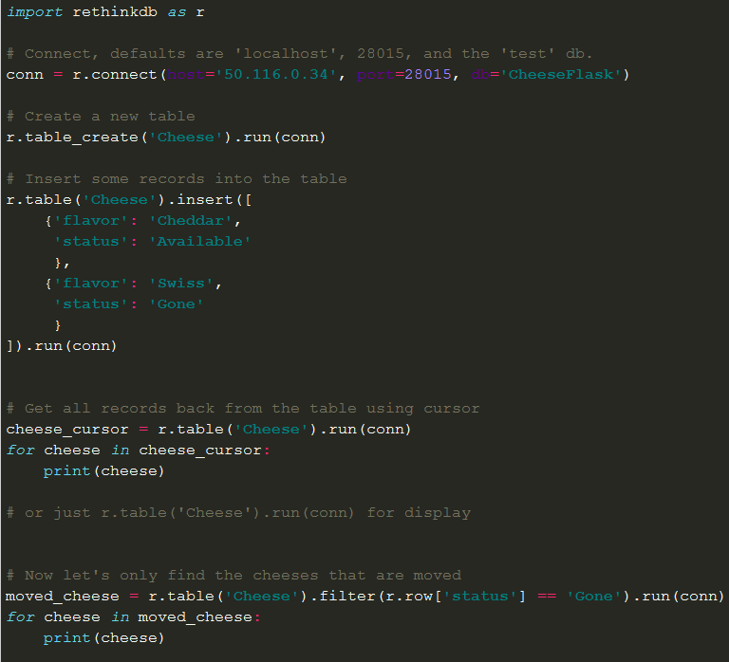
ReQL
(RethinkDB Query Language)
Three Key Principles
Embedded into the client language. If you know DBAPI / PEP 249 it is easy.
Chainable
Executes on the server

Slide 7


RethinkDB with Flask
Demo web app using RethinkDB and Flask

Slide 8

Real-time Interlude
So we have seen that RethinkDB can be used as a good NoSQL database solution.
We get the awesome GUI, amazingly clean python client, and the scalability that RethinkDB offers.
But… What we really, really want are the real-time features!

Slide 9
Why is real-time so difficult ?
Group Discussion – What real-solutions have you seen / used?
Long-Polling (making a connection to the web server and waiting for a response to be returned) is not very efficient. Once data is actually returned we must handle the http-based approach of closing after the request and then opening a new one. This really doesn’t work well for streaming data.
We must also attempt to handle things like HTTP caching, etc. HTTP was designed around request/response approach.

Slide 10
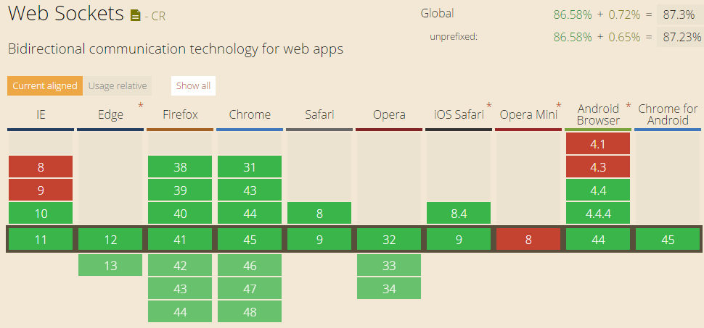
Solution?
WebSockets (https://tools.ietf.org/html/rfc6455 )
WebSockets is quickly being supported by all major browsers
The protocol establishes a connection using HTTP, but then relies upon a TCP connection between the server and client.
Also – Plethora of libs that support failback to Long-Polling (SignalR, SocketIO, etc..)

Slide 11
RethinkDB satisfies the database side.
Even though websockets and/or a framework for live updating from the web server to the client exist and work well, most databases are not built for live streaming.
It can be done (SQL Server even has a way to maintain a persistent connection using SQL Server Broker)
Many solutions involve the use a message queue.
BUT…. RethinkDB was built from the ground up to handle live updates from the database to the server. Let’s take a look!

Slide 12
RethinkDB Changefeeds
Changefeeds allow you to monitor a table for changes. Similar to subscribing to a message queue.
Filters can also be applied so you can watch only for changes you are interested in.
Let’s take a look!

Slide 13
RethinkDB with Tornado
Demo web app using RethinkDB and Tornado

Slide 14
Thank You!
And many thanks to the following resources:
http://www.giantflyingsaucer.com/blog/?p=5606
https://mrjoes.github.io/2013/06/21/python-realtime.html
https://rethinkdb.com/blog/realtime-web/
https://www.youtube.com/watch?v=wFxaSgaiaOQ

