Slide 1
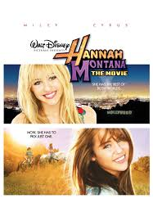

Hannah Montana Word Cloud
By McKenna Archbald

Slide 2
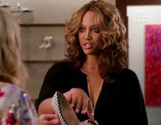
What did you build and how does it work?

Slide 3
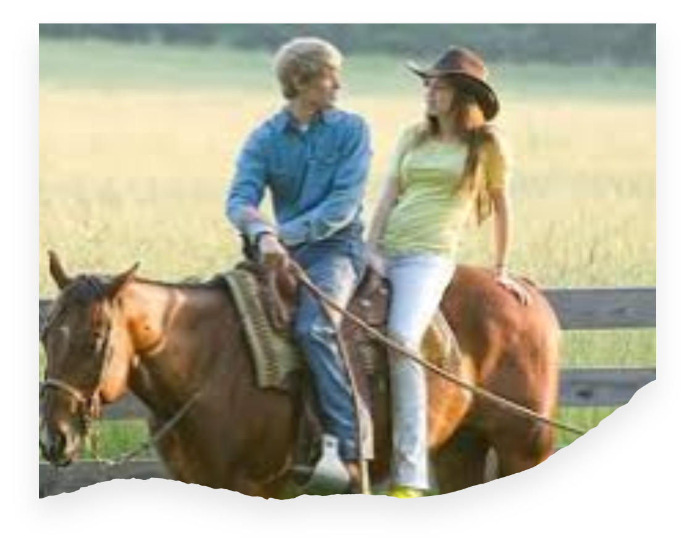
What is the purpose and objective of your dashboard?
My purpose is to find themes from the movie using the visualizations

Slide 4
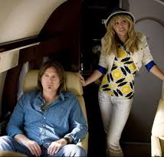
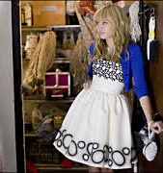
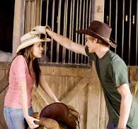
What does this dashboard teach us about your data source?

