Slide 1
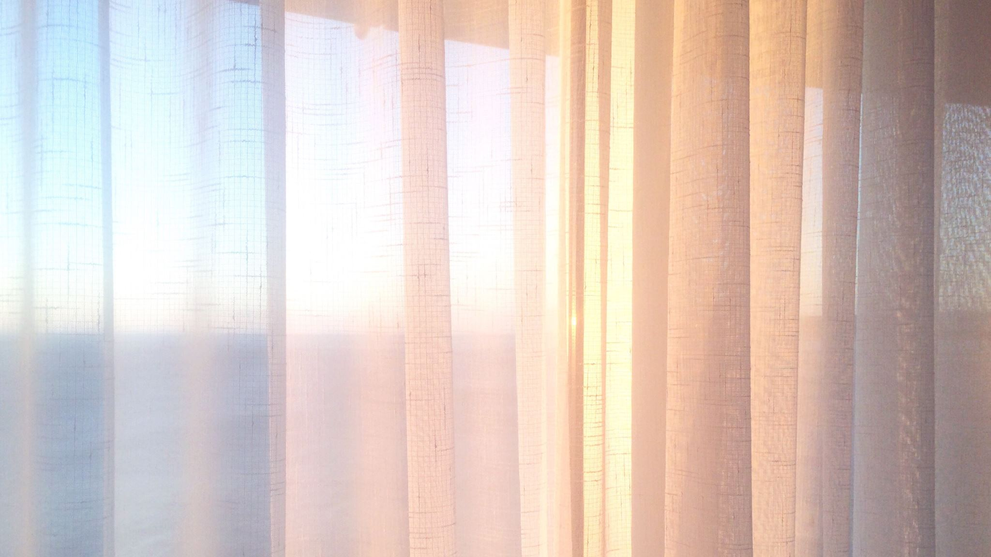
Housing Prices
Mckenna Archibald

Slide 2
What did you build and how does it work?
I Used Excel and Power BI, but I had difference results.
I also just deleted the columns with words in them to properly allow the machining to run

Slide 3
What is the purpose and objective of your project?
To Evaluate how much square footage affects House Prices

Slide 4
What does this your solution teach us about predicting house prices?
Square Footage Matters, but isn’t everything
$14M / 25,000 Square feet= $560 per square foot
$326,000 / 2,531 Square feet = $129 per square foot

