Slide 1
Avocado project
By McKenna Archibald

Slide 2
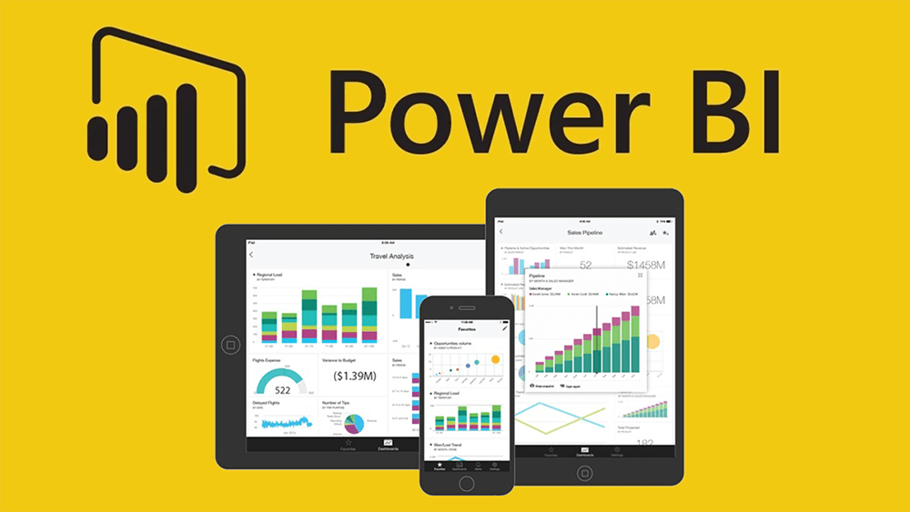
I Built a Power BI Presentation

Slide 3
The Purpose of my presentation
My purpose is to evaluate the profitability, availability, demand, and overall function of the avocado industry by using data analysis in order to make good business decisions.

Slide 4

The Geocoding Experience

Slide 5
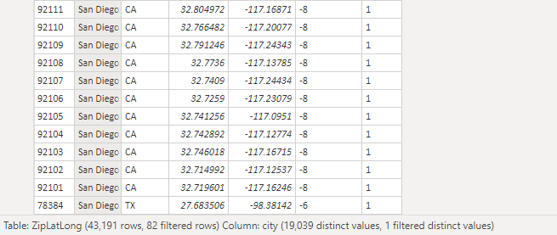
How I overcame Cities listed in multiple states.
I simply selected the City with the most Zip Codes to represent the state

Slide 6
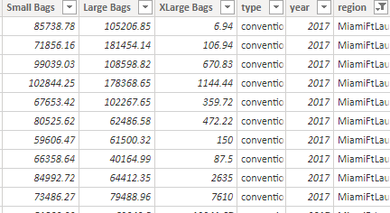
How I overcame Regions using larger Metro Areas.
I simply plotted Miami and Fort Lauderdale separately in the Area Plot Excel

Slide 7

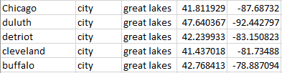
How I overcame Larger Geographical Areas.
I did a quick google search of what cities include the great lakes, plotted them accordingly and assigned them their region. AKA Region 8

Slide 8
How I Rebranded Region into Area (the best part)

