Slide 1

Factors That Drive Home Prices
Thinkful Capstone 2
McKennon Griffin

Slide 2

01
Data Set and Objectives

Slide 3
1
Goal
How to allocate money earmarked for Mortgage Backed Securities (MBS)
Where
Ames Iowa
What
1,460 buildings
How
Regression stats, T stats,

Slide 4
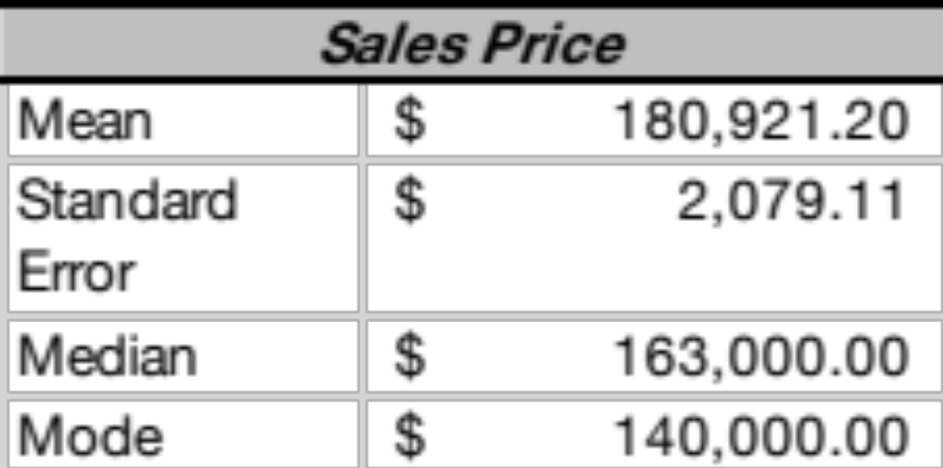
2
Data
There are 1,460 houses in the data set
There are 82 variables within the data set
Most of the buildings are houses in 25 different neighborhoods

Slide 5
3
Hypothesis
Hypothesis
Lot area has a significant effect on sales price.
1
General living area has significant effect on sales price.
2
3
Neighborhoods has a significant effect on sales price.

Slide 6
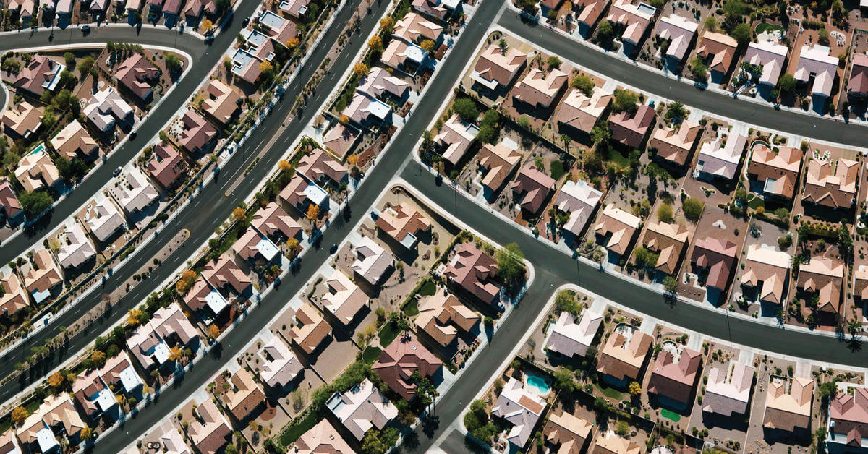
4
Strategy
Regression statistics used to reduce time
T tests applied to data with similar quantity
Bias testing used to eliminate bias when comparing data sets

Slide 7
5
02
Findings
Factors that effect housing price

Slide 8
6
1
House Quality
2
Fireplace
3
House Condition
4
Year Built
5
Neighborhoods

Slide 9
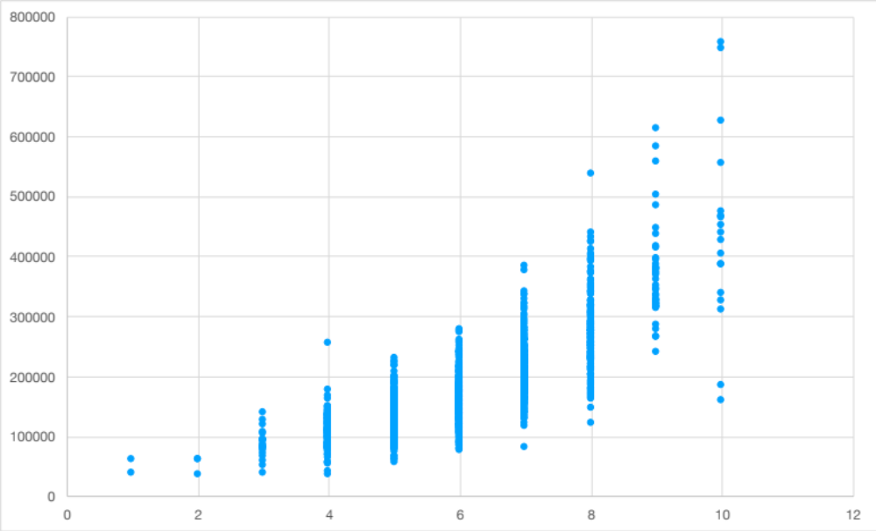
7
1
2
3
Overall quality is 79% correlated with sales price.
Scatter plot indicates positive trend.
Findings show significant difference in avg sales price with 95% confidence.

Slide 10
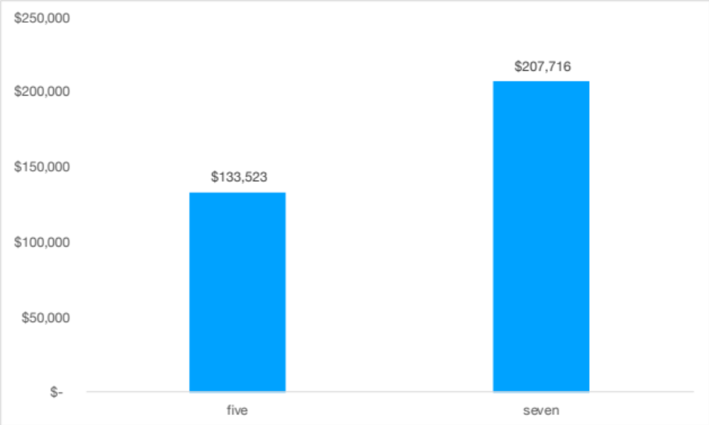
8
Avg Sales Price
Used T-test
78 house difference between groups
$75,000 difference in avg sales price
Overall quality is a significant factor

Slide 11
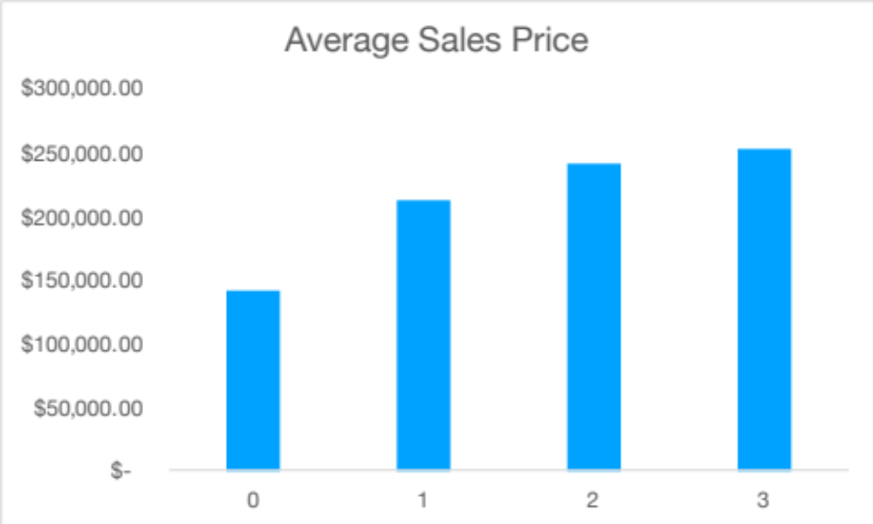
9
Fireplaces
Iowa is cold.
Homes with fireplaces have higher avg sales price.
$70,000 difference between homes with 1 fireplace and 0.
120 homes with > 1 fireplace

Slide 12
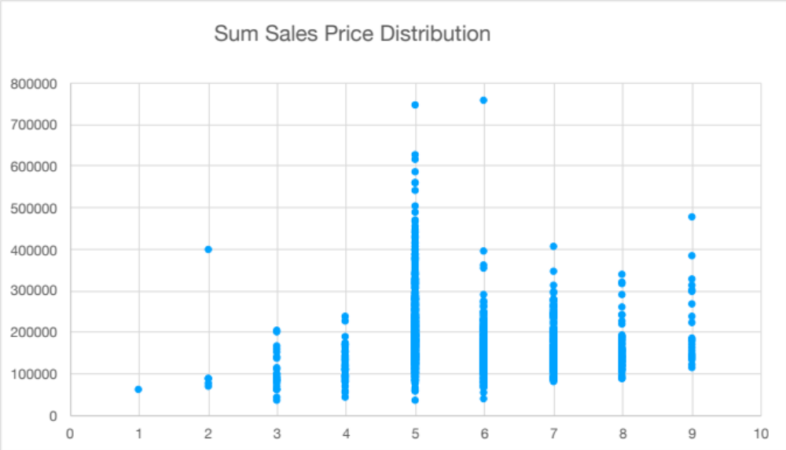
10
Overall Condition
Data is more clustered.
821 homes are rated 5.
Homes increase 50,000 per increase rating.
Overall condition is less significant than overall quality.

Slide 13
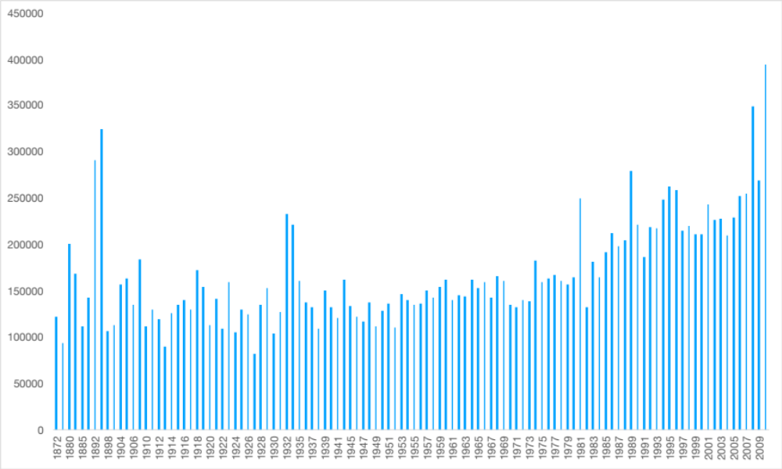
11
Year Built and Average Sales Price

Slide 14
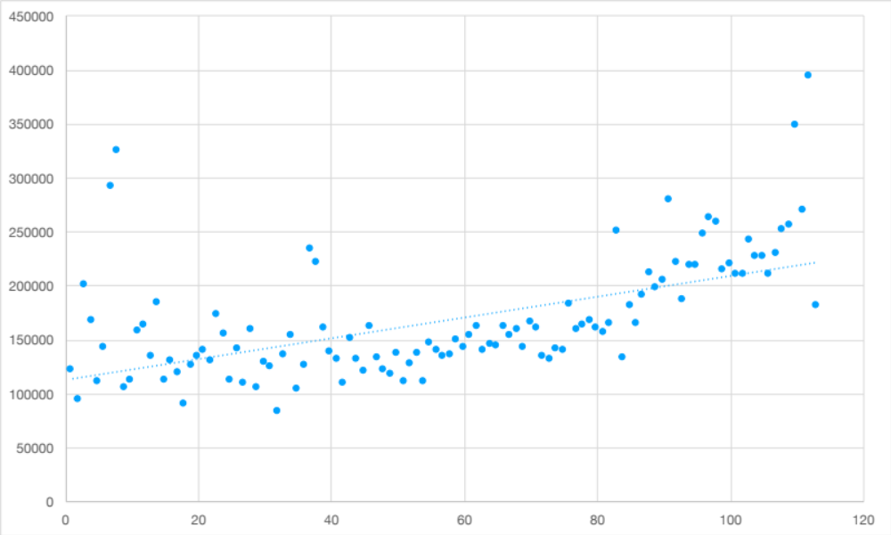
12
Year Built and Average Sales Price

Slide 15
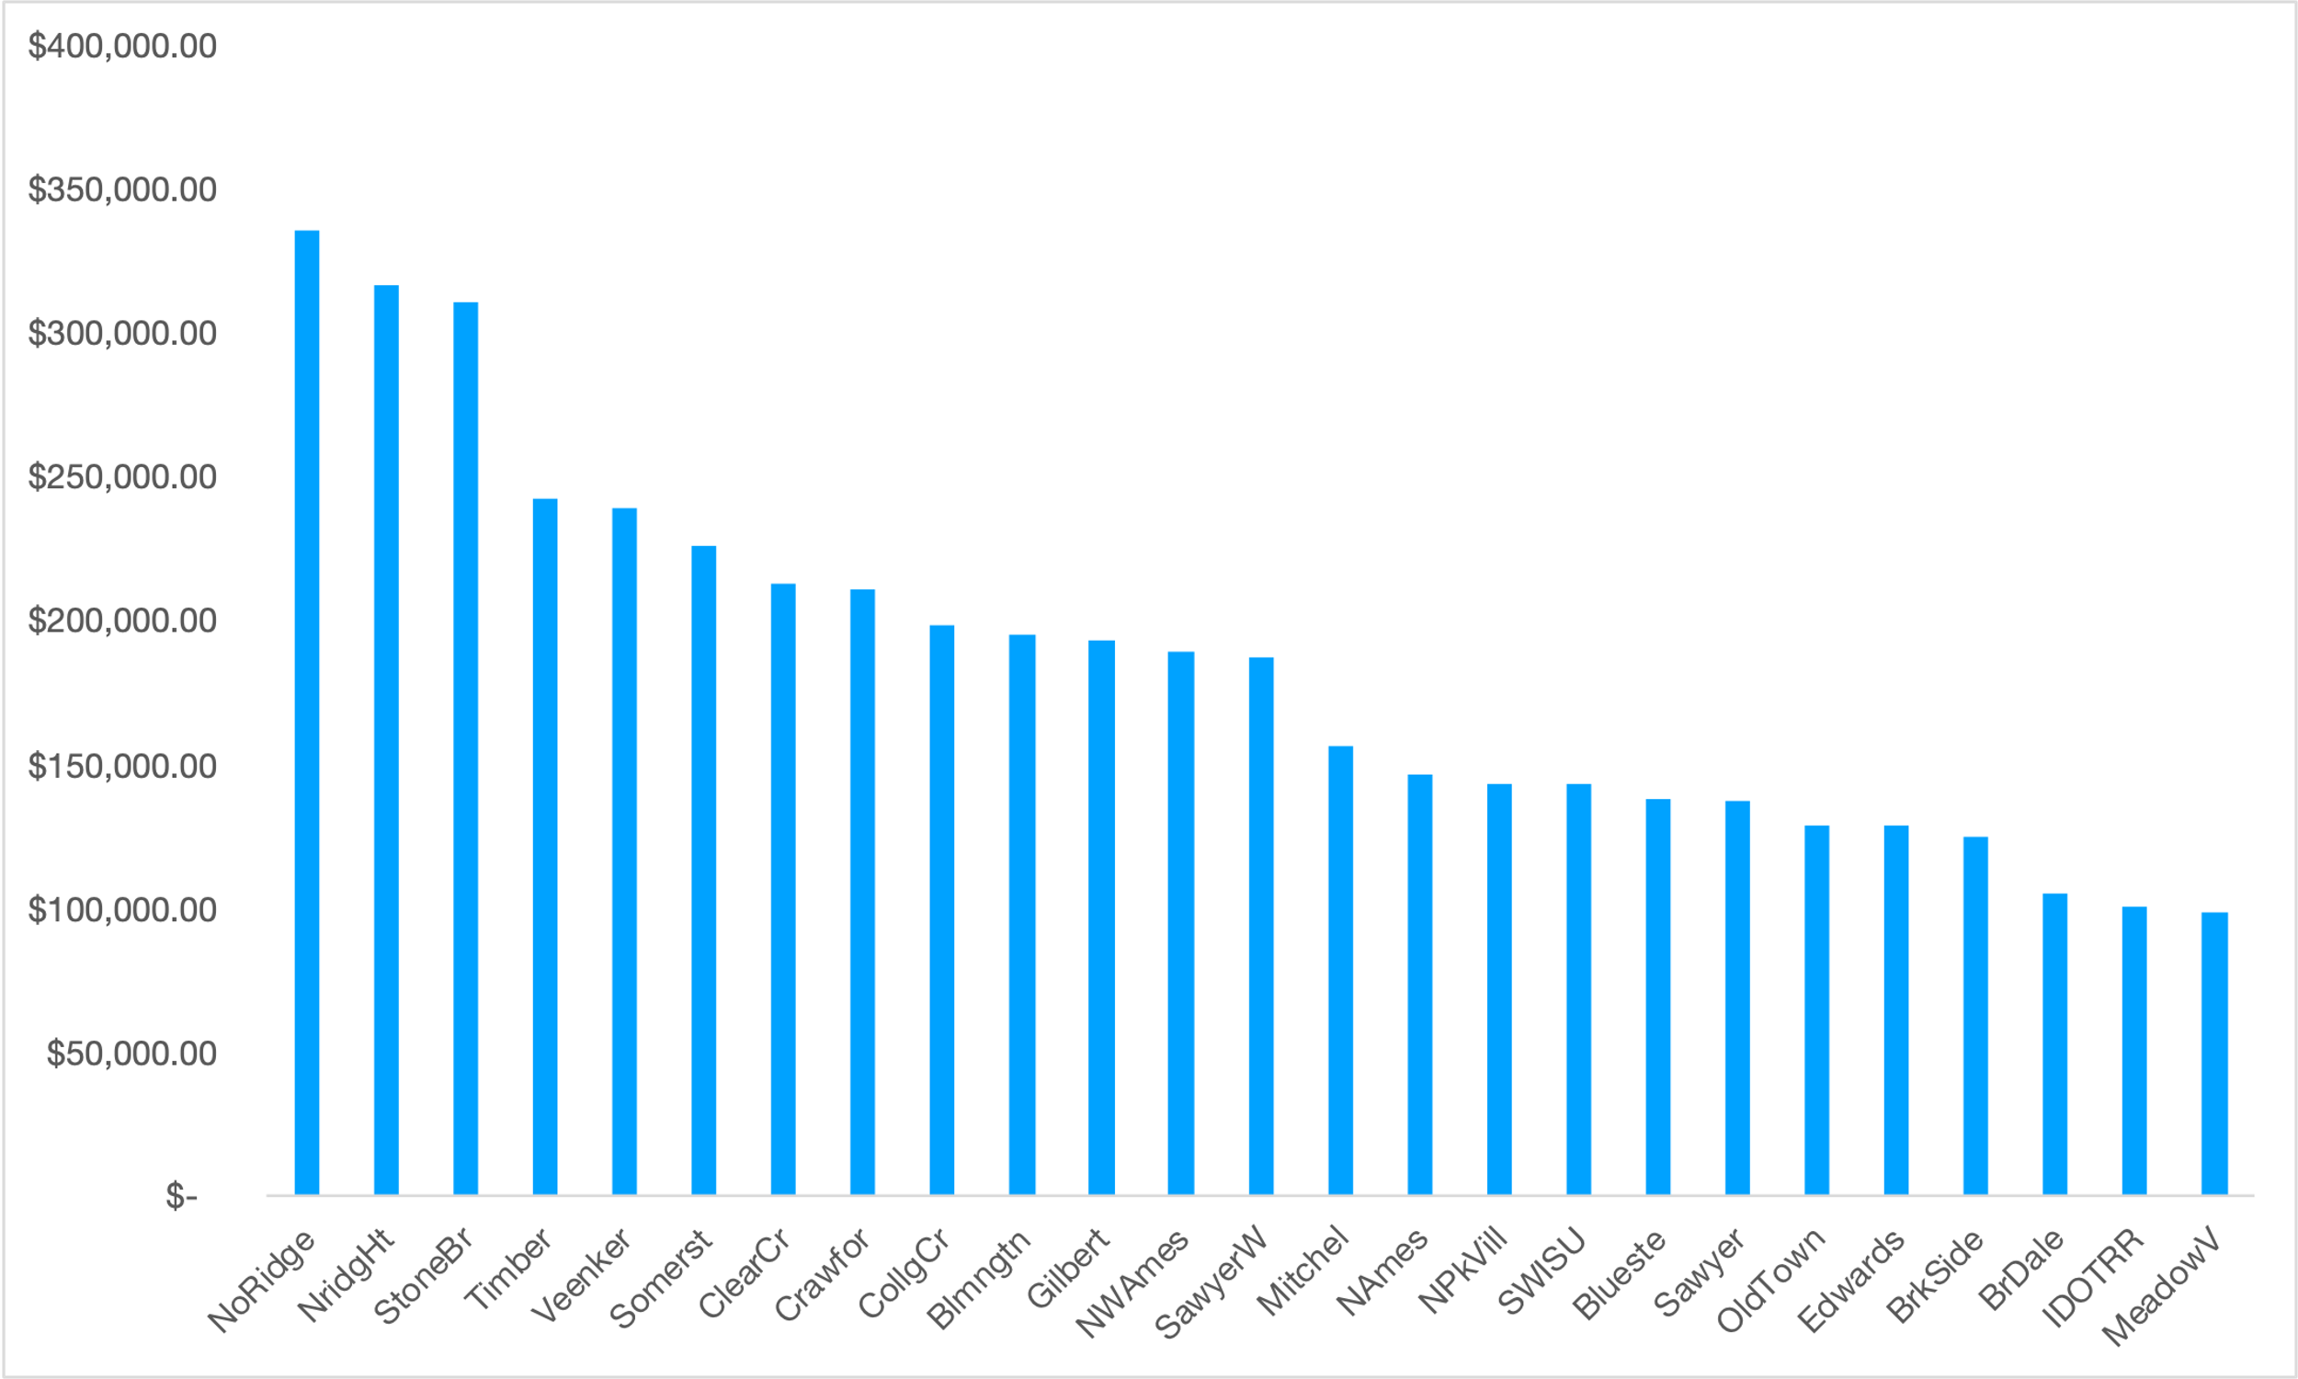
13
Neighborhoods AVG Sales Price
There are 25 different neighborhoods
Most properties are in CollgCr, Names, OldTown, and Edwards
Avg house price $180,000

Slide 16
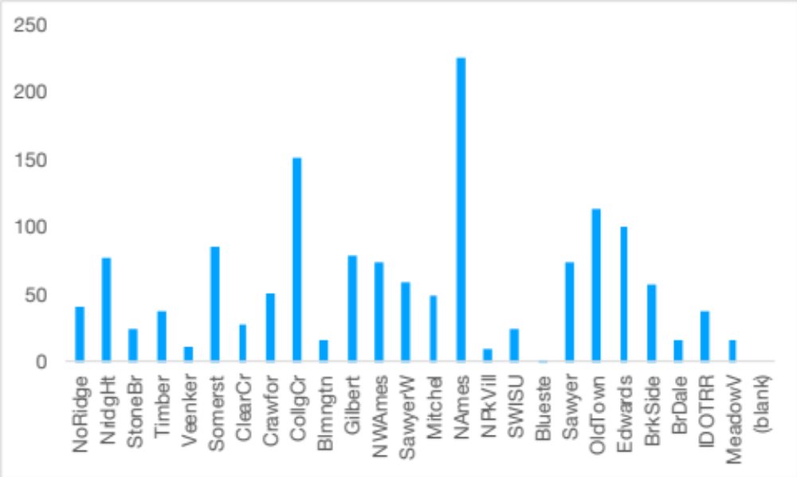
14
Neighborhoods Count

Slide 17
15
Neighborhood
Top 4 neighborhoods with highest average sales price.
NoRidge
$335,297
NridgHt
$316,270
StoneBr
$310,499
Timber
$242,247

Slide 18
16
03
Conclusion

Slide 19
17
Conclusion
Overall Quality
Fireplace
Overall quality is the dominant factor and must be highly considered.
Data indicates homes with central heating and fireplaces are higher in value.
2021, and beyond
The current condition of the home is of upmost importance.
Homes built in this century are much more valuable
Overall Condition
Year Built

Slide 20
Thankyou!

