Slide 1

Factors That Effect Country Development Status
Thinkful Capstone 3
McKennon Griffin

Slide 2

01
Data Set and Objectives

Slide 3
1
Goal
Identify factors that effect a nations development status
Metric
Human Capital Index HCI
What
Socioeconomic world data set (66 countries)
How
Pearson R, T stats,

Slide 4
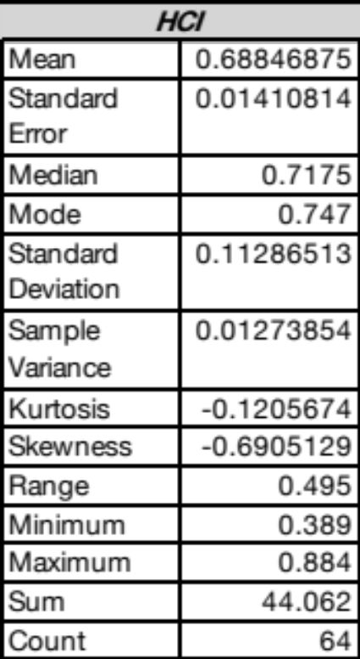
2
Data
66 nations from around the world
99 variables
Messy to start with

Slide 5
3
Hypothesis
Hypothesis
High exports = high HCI
1
2
High safety rating = high HCI

Slide 6

4
Strategy
Test HCI to eliminate bias
Use correlation and Pearsonr for efficiency
Use T Test to verify

Slide 7
5
02
Findings

Slide 8
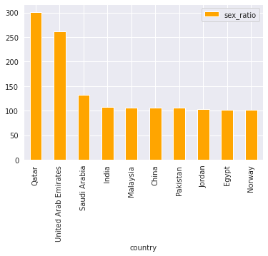
12
Sex Ratio

Slide 9
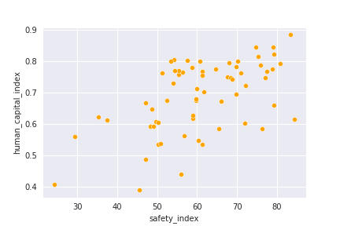
8
Safety Index
Correlation coefficient .56
15th
P value 1.46
Relatively strong

Slide 10
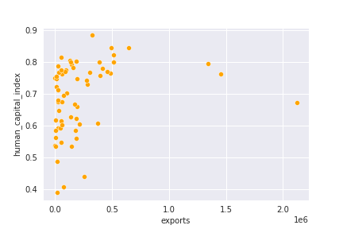
10
Exports
Correlation Coefficient .26
36th
P value .034
Moderate

Slide 11
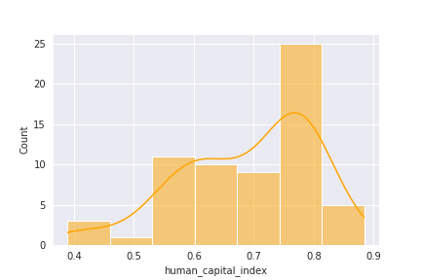
7
1
2
3
HCI score is from 0 - 1.
Top 5 factors have strong correlation with HCI.
Findings show significant difference HCI with 95% confidence.

Slide 12

8
Singapore
HCI .88
Surface area 719km²
Population 5,109,000
Exports: $329,871 billion
Safety: 83.42

Slide 13

8
Pakistan
HCI: .389
Surface area: 796,095km²
Population: 197,016,000
Exports: $205,340 billion
Safety: 45.62

Slide 14
6
1
Female Life Expectancy
2
Mobile Cellular Subscriptions
3
Income per capita
4
Cost of living
5
Employment in services

Slide 15
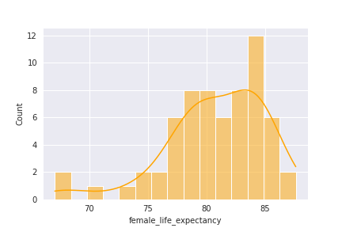
8
Female Life Expectancy
Hong Kong 87.6
Mean 80.7
Correlation Coefficient .88
Confidence interval is between 4.3 – 7.3

Slide 16
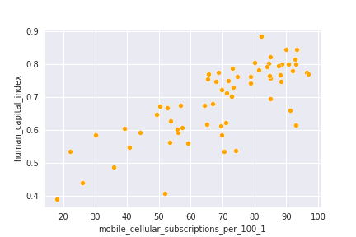
9
Mobile Cellular subscriptions
Norway 96.8
Statistic 7
P value 2.022e-9
Correlation Coefficient .78

Slide 17
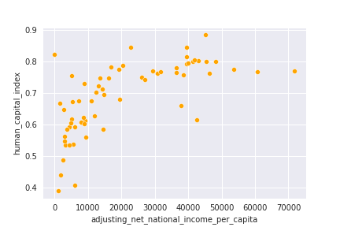
10
Adjusted net national income per capita
Norway 71,669
Statistic 7.09
P value 1.44e-9
Correlation Coefficient .66

Slide 18
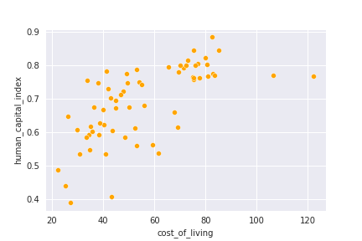
9
Cost of living
Switzerland 122.06
Statistic 6.79
P value 4.91e-09

Slide 19
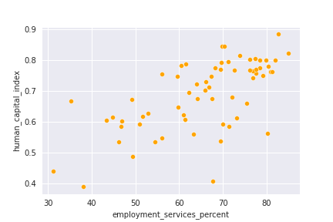
10
Employment in Service sector
Hong Kong 84.9%
Statistic 6.07
P value 8.45e-08
Correlation Coefficient .64

Slide 20

11
What are indicators of developing nations?

Slide 21
15
Top indicators for developing nations
Infant Mortality rate
Pollution Index
Percent in agriculture
Fertility
rate

Slide 22
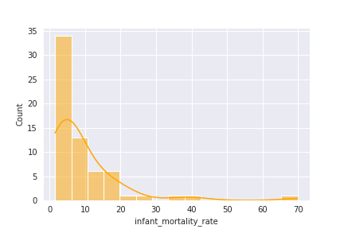
12
Infant Mortality Rate

Slide 23
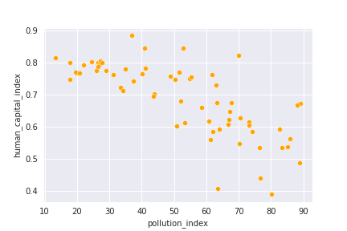
14
Pollution

Slide 24
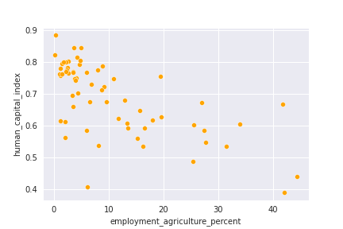
13
Percent of workers in agriculture

Slide 25
16
03
Conclusion

Slide 26
17
Conclusion
Female Life
Expectancy
Mobile cellular subscriptions
Moving forward
Pollution
Employment opportunities

Slide 27
Thankyou!

