Slide 1
ECON 5305 Data Translation: Step 1 Group 2: McKenzie Maidl, Tuan Anh Nguyen, Samikshya Pandey

Slide 2
Traffic Prediction Dataset
Hourly data on the number of vehicles crossing an intersection.
November 2015 through June 2017
14,592 data points
Source: Kaggle (original source confidential)
https://www.kaggle.com/datasets/fedesoriano/traffic-prediction-dataset

Slide 3
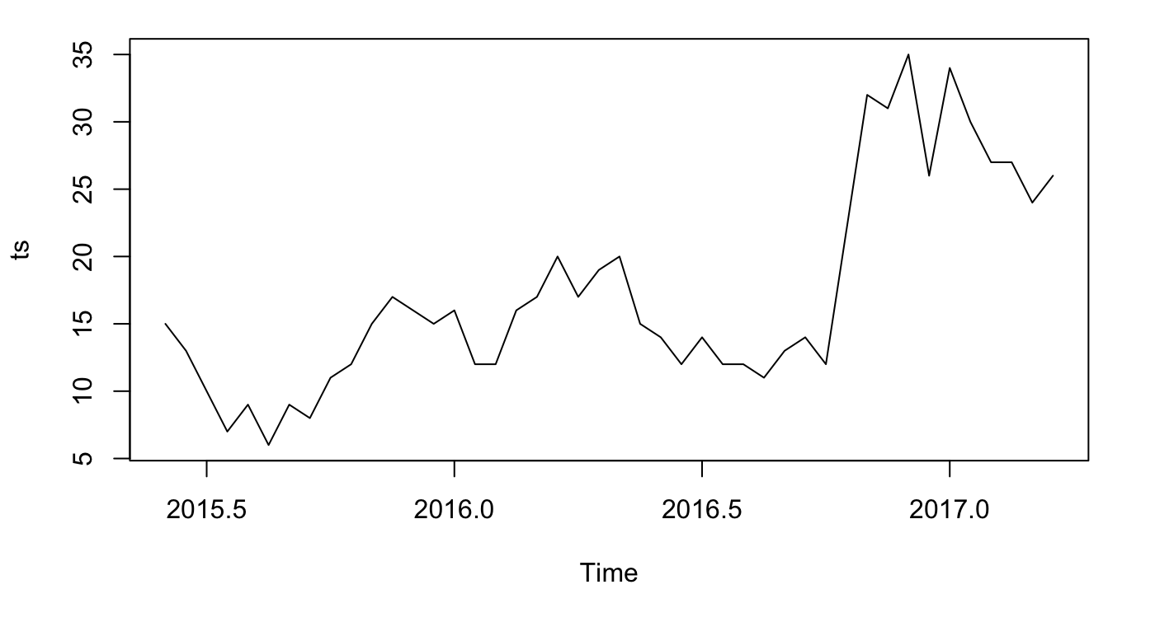
Time Series Original Data
There appears to have both seasonal and time trends.

Slide 4
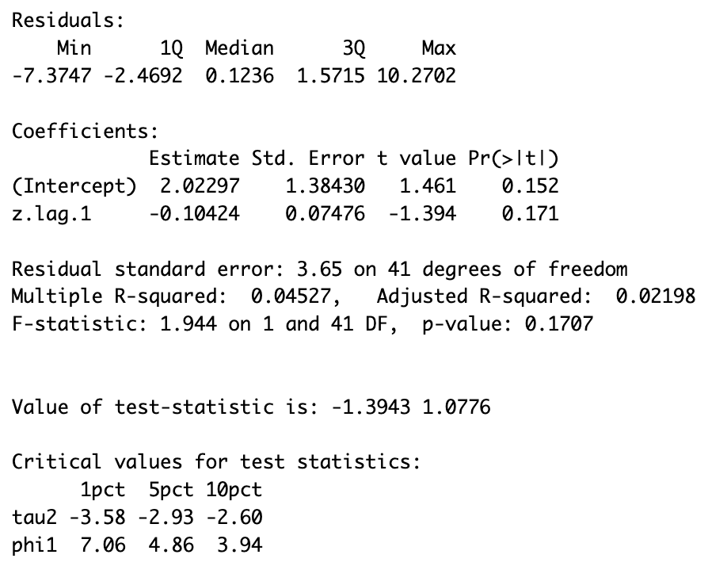
Testing for Stationarity
Augmented Dickey-Fuller Test
With a test statistic of -1.39 we do not reject the null hypothesis.

Slide 5
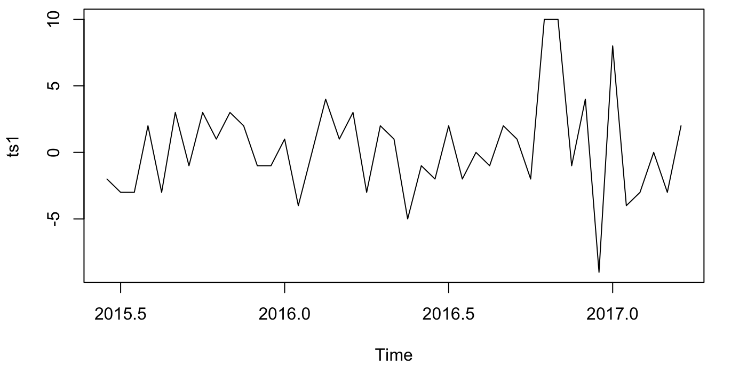
Make Data Stationary
The log difference of the time series is stationary.
The new Augmented Dickey-Fuller Test results in a test statistic of -7.44. We can reject the null hypothesis.
Subsequent analysis will use this time series.

Slide 6
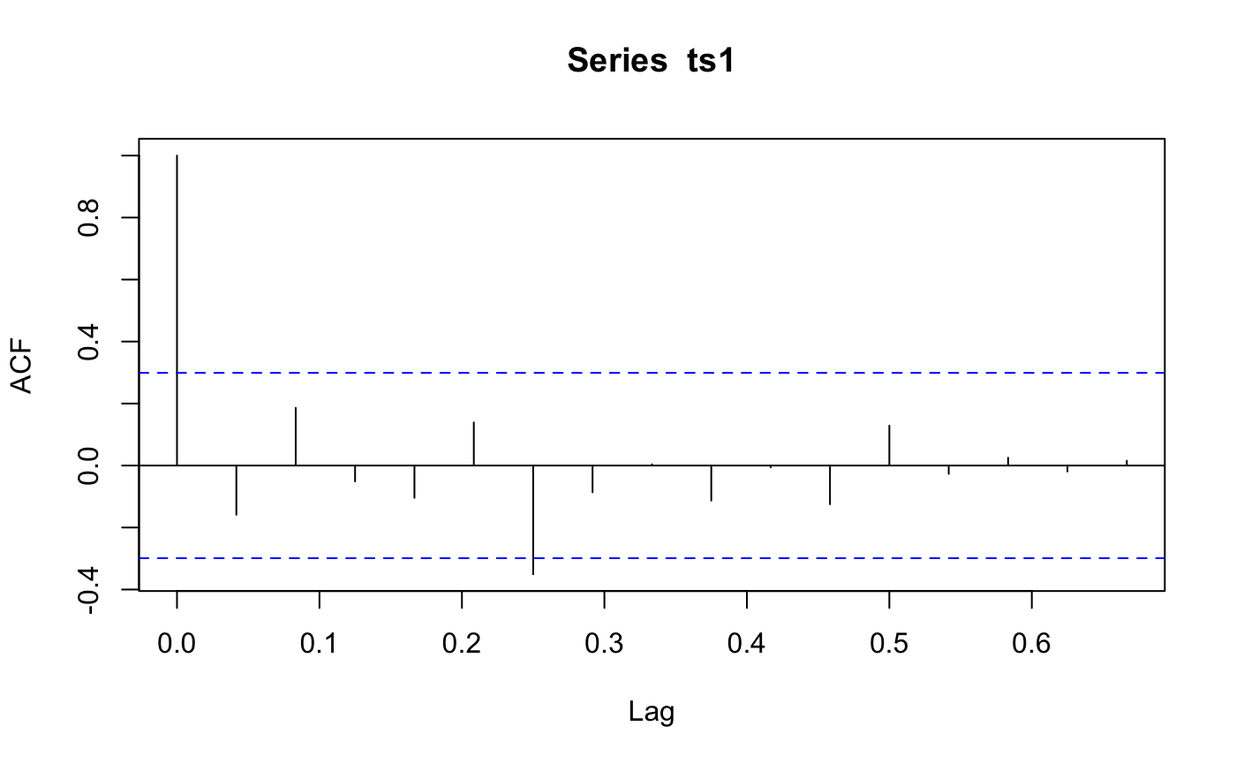
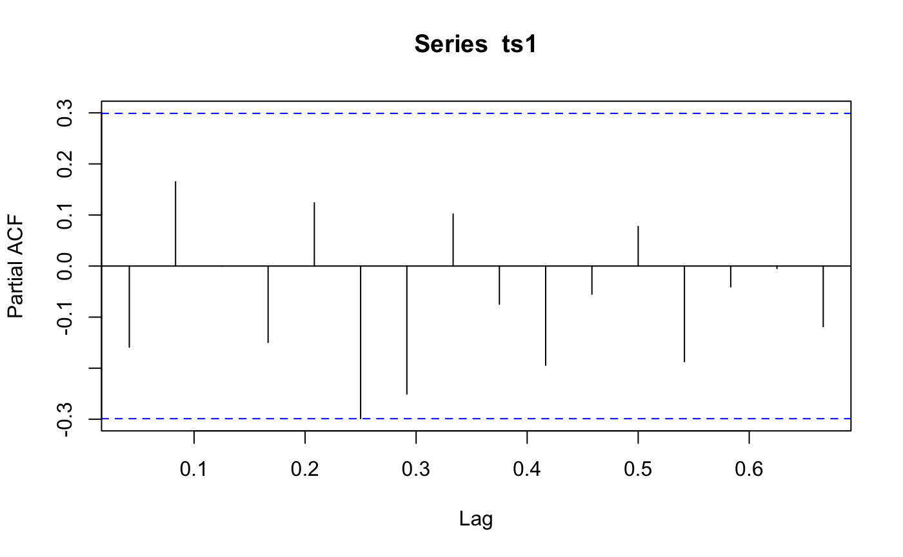
ACF and PACF
Notes:
The ACF and PACF indicate that an MA(1) model might be appropriate.

Slide 7
Different Models:
Model | R^2 | AIC | BIC | Mean residual
MA(6) | 0.4409296 | 232.6891 | 246.7787 | -0.232139905
ARMA(2,2) | 0.2961370 | 234.8351 | 245.4023 | 0.004423279
ARMA(1,6) | 0.4421626 | 234.6683 | 250.5191 | -0.227868827

Slide 8

Model in Regression format:
MA(6)
Y(t) = 0.3685 -0.1627​${\text{ϵ}}_{\text{t}\text{−1}\text{​}}$+ 0.1893​${\text{ϵ}}_{\text{t}\text{−2​}}$ -0.4914 ${\text{ϵ}}_{\text{t}\text{−3}}$ -0.0392​​${\text{ϵ}}_{\text{t}\text{−4}}$ + 0.0228${\text{ϵ}}_{\text{t}\text{−5​}}$ -0.5188 ${\text{ϵ}}_{\text{t}\text{−6​}}$+ 0.3685
Notes:
-0.1627 0.1893 -0.4914 -0.0392 0.0228 -0.5188 0.3685 ma1 ma2 ma3 ma4 ma5 ma6 intercept

Slide 9
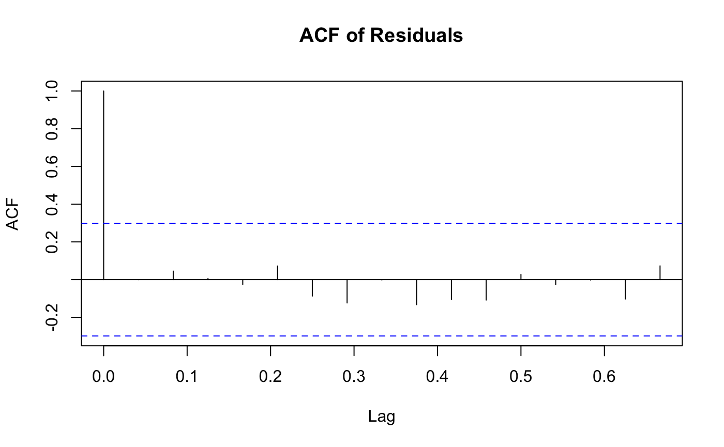
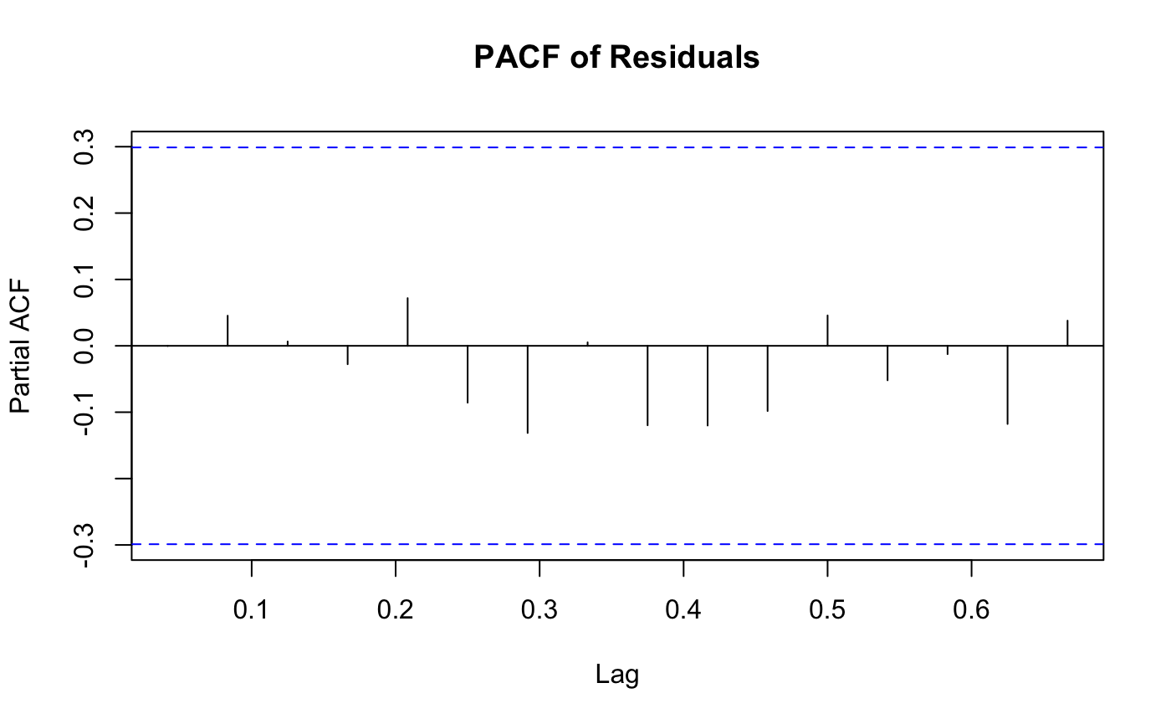
Choosing MA(6):
ACF and PACF of residuals:

Slide 10
White Noise confirmations:
Box-Ljung test data for residuals MA6 has p-value of 0.9745. So our residual is white noise so we can move ahead with forecasting

Slide 11
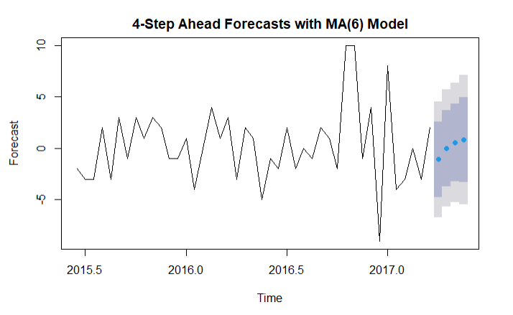
MA(6) forecast

Slide 12
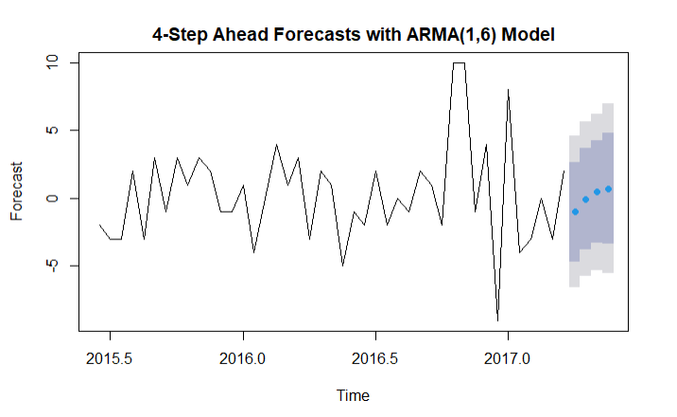
ARMA(1,6) forecast

Slide 13
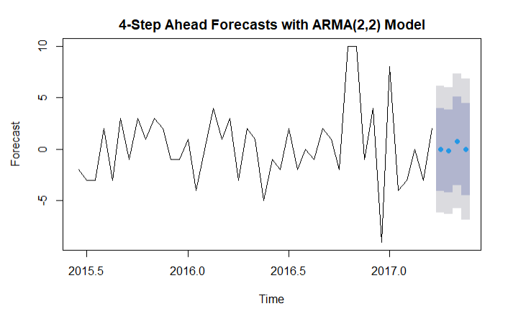
ARMA(2,2) forecast

