Slide 1
ECON 5305 Data Translation Step 2 Group 2: McKenzie Maidl, Tuan Anh Nguyen, Samikshya Pandey

Slide 2
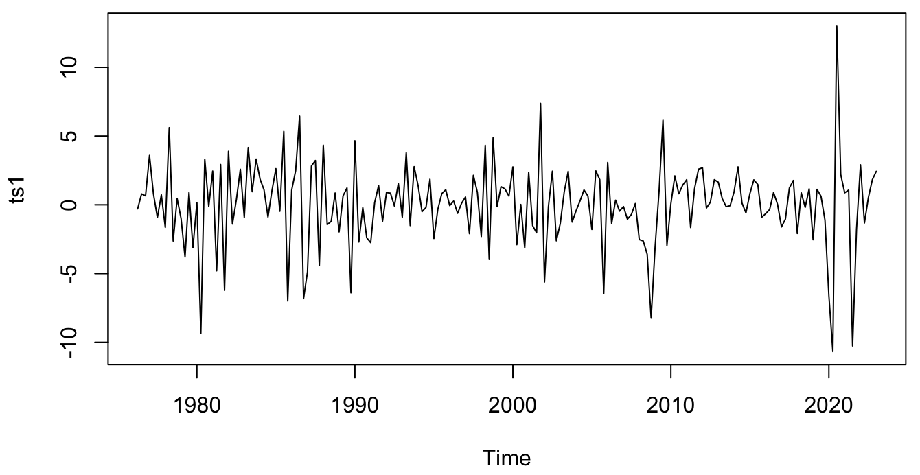
Dataset Update
Total Vehicle Sales
Monthly Data
January 1976 – January 2023
Differenced to make stationary.
Source:
Federal Reserve Economic Data (FRED)

Slide 3
Three Best Models
Step 1
Model | R2 | AIC | BIC
ARMA(3,3) | 0.12836401 | 942.5077 | 968.3993
MA(1) | 0.05695238 | 942.6554 | 952.3647
AR(1) | 0.05283403 | 943.4648 | 953.1741

Slide 4
Model | Scheme | MPE | IE | MSE | MAE | MAPE
Naïve | Fixed
Naïve | Recursive
Naïve | Rolling
Simple Average | Fixed
Simple Average | Recursive
Simple Average | Rolling
ARMA(3,3) | Fixed | -0.1933 | -2.5508 | 32.0649 | -0.2509 | 185.8910
ARMA(3,3) | Recursive | -0.4301 | -1.6352 | 27.3286 | -0.5133 | 135.0248
ARMA(3,3) | Rolling | -0.1852 | -1.8625 | 28.0679 | -0.2249 | 135.7547
MA(1) | Fixed | -0.5188 | -0.3659 | 23.4502 | -0.5724 | 107.6271
MA(1) | Recursive | -0.4287 | -0.7748 | 24.5204 | -0.4847 | 110.7798
MA(1) | Rolling | -0.3705 | -1.2314 | 25.5516 | -0.4281 | 108.4712
AR(1) | Fixed | -0.4814 | -0.8891 | 24.7411 | -0.546 | 101.8744
AR(1) | Recursive | -0.3958 | -1.1591 | 25.5312 | -0.4569 | 103.4629
AR(1) | Rolling | -0.3191 | -1.4461 | 26.1227 | -0.3731 | 101.7838
Loss Comparison
1 Step Ahead

Slide 5
Model | Scheme | MPE | IE | MSE | MAE | MAPE
Naïve | Fixed
Naïve | Recursive
Naïve | Rolling
Simple Average | Fixed
Simple Average | Recursive
Simple Average | Rolling
ARMA(3,3) | Fixed | -0.1120 | -2.5705 | 31.205 | -0.1475 | 160.0239
ARMA(3,3) | Recursive | -0.2662 | -2.1672 | 28.4399 | -0.334 | 138.1209
ARMA(3,3) | Rolling | -0.2229 | -1.4143 | 27.137 | -0.2733 | 133.2515
AR(1) | Fixed | -0.3098 | -1.5607 | 26.1955 | -0.3728 | 93.6637
AR(1) | Recursive | -0.3135 | -1.5380 | 26.0621 | -0.3762 | 94.8429
AR(1) | Rolling | -0.3397 | -1.3478 | 25.7483 | -0.405 | 94.1394
Loss Comparison
2 Steps Ahead

Slide 6
Combined Forecasts
1 Step Ahead
Model | Combination Method | MSE
ARMA(3,3) | Equal-weighted Forecast | 28.2425
ARMA(3,3) | MSE-inversely-weighted Forecast | 23.7676
ARMA(3,3) | OLS-weighted Forecast | 23.1534
MA(1) | Equal-weighted Forecast | 24.4741
MA(1) | MSE-inversely-weighted Forecast | 23.6128
MA(1) | OLS-weighted Forecast | 10.0221
AR(1) | Equal-weighted Forecast | 25.4147
AR(1) | MSE-inversely-weighted Forecast | 23.6892
AR(1) | OLS-weighted Forecast | 11.9996

Slide 7
Combined Forecasts
2 Steps Ahead
Model | Combination Method | MSE
ARMA(3,3) | Equal-weighted Forecast | 28.3514
ARMA(3,3) | MSE-inversely-weighted Forecast | 25.1455
ARMA(3,3) | OLS-weighted Forecast | 21.7659
AR(1) | Equal-weighted Forecast | 25.9950
AR(1) | MSE-inversely-weighted Forecast | 24.9736
AR(1) | OLS-weighted Forecast | 22.5865

Slide 8
Forecast for Best Model
[MODEL] | 1 Step Ahead

Slide 9
Forecast for Best Model
[MODEL] | 2 Steps Ahead

