Slide 1
ECON 5305 Data Translation Step 2 Group 2: McKenzie Maidl, Tuan Anh Nguyen, Samikshya Pandey

Slide 2
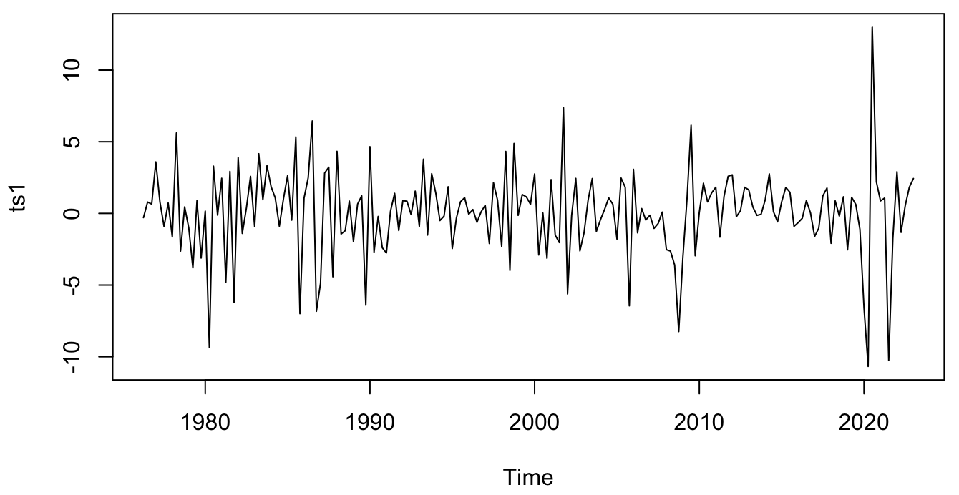
Dataset Update
Total Vehicle Sales
Quarterly Data
January 1976 – January 2023
Differenced to make stationary.
Source:
Federal Reserve Economic Data (FRED)

Slide 3
Three Best Models
Step 1
Model | R2 | AIC | BIC
ARMA(3,3) | 0.12836401 | 942.5077 | 968.3993
MA(1) | 0.05695238 | 942.6554 | 952.3647
AR(1) | 0.05283403 | 943.4648 | 953.1741

Slide 4
Loss Comparison
1 Step Ahead
Model | Scheme | MPE | IE | MSE | MAE | MAPE
Naïve | Fixed | 0.1206 | NA | 26.7800 | 3.9700 | 0.2388
Simple Average | Fixed | 0.1091 | NA | 23.6300 | 3.1600 | 0.1033
ARMA(3,3) | Fixed | -0.1933 | -2.5508 | 32.0649 | 4.0842 | 0.1859
ARMA(3,3) | Recursive | -0.4301 | -1.6352 | 27.3286 | 3.5896 | 0.1350
ARMA(3,3) | Rolling | -0.1852 | -1.8625 | 28.0679 | 3.7473 | 0.1358
MA(1) | Fixed | -0.5188 | -0.3659 | 23.4502 | 3.2570 | 0.1076
MA(1) | Recursive | -0.4287 | -0.7748 | 24.5204 | 3.3378 | 0.1108
MA(1) | Rolling | -0.3705 | -1.2314 | 25.5516 | 3.3770 | 0.1085
AR(1) | Fixed | -0.4814 | -0.8891 | 24.7411 | 3.3132 | 0.1019
AR(1) | Recursive | -0.3958 | -1.1591 | 25.5312 | 3.3641 | 0.1035
AR(1) | Rolling | -0.3191 | -1.4461 | 26.1227 | 3.3778 | 0.1018

Slide 5
Loss Comparison
2 Steps Ahead
Model | Scheme | MPE | IE | MSE | MAE | MAPE
Naïve | Fixed | 0.1091 | NA | 27.7300 | 4.0200 | 0.2334
Simple Average | Fixed | 0.1003 | NA | 24.8000 | 3.2800 | 0.1001
ARMA(3,3) | Fixed | -0.1120 | -2.5705 | 31.205 | 3.9093 | 0.1600
ARMA(3,3) | Recursive | -0.2662 | -2.1672 | 28.4399 | 3.6589 | 0.1381
ARMA(3,3) | Rolling | -0.2229 | -1.4143 | 27.1370 | 3.6996 | 0.1333
AR(1) | Fixed | -0.3098 | -1.5607 | 26.1955 | 3.3358 | 0.0937
AR(1) | Recursive | -0.3135 | -1.5380 | 26.0621 | 3.3281 | 0.0949
AR(1) | Rolling | -0.3397 | -1.3478 | 25.7483 | 3.2988 | 0.0941

Slide 6
Combined Forecasts
1 Step Ahead
Models: ARMA(3,3), MA(1), and AR(1)
Scheme: Fixed for each
Combination Method | MSE
Equal-weighted Forecast | 26.01
MSE-inversely-weighted Forecast | 23.61
OLS-weighted Forecast | 17.85

Slide 7
Combined Forecasts
2 Steps Ahead
Models: ARMA(3,3), MA(1), and AR(1)
Scheme: Fixed for each
Combination Method | MSE
Equal-weighted Forecast | 26.60
MSE-inversely-weighted Forecast | 24.97
OLS-weighted Forecast | 19.40

Slide 8
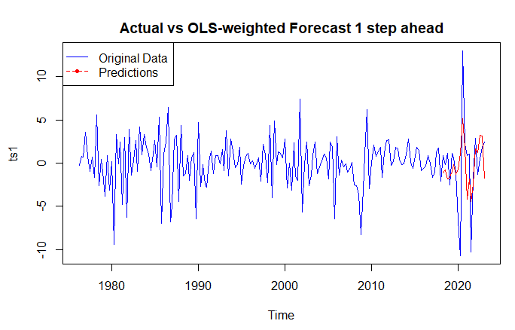
Combined Forecast
1 Step Ahead

Slide 9
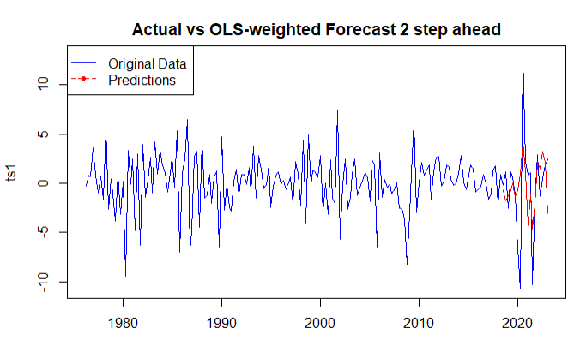
Combined Forecast
2 Steps Ahead

