Slide 1
ECON 5305 Data Translation: Step 1 Group 2: McKenzie Maidl, Tuan Anh Nguyen, Samikshya Pandey

Slide 2
Traffic Prediction Dataset
Hourly data on the number of vehicles crossing an intersection.
November 2015 through June 2017
14,592 data points
Source: Kaggle (original source confidential)
https://www.kaggle.com/datasets/fedesoriano/traffic-prediction-dataset

Slide 3
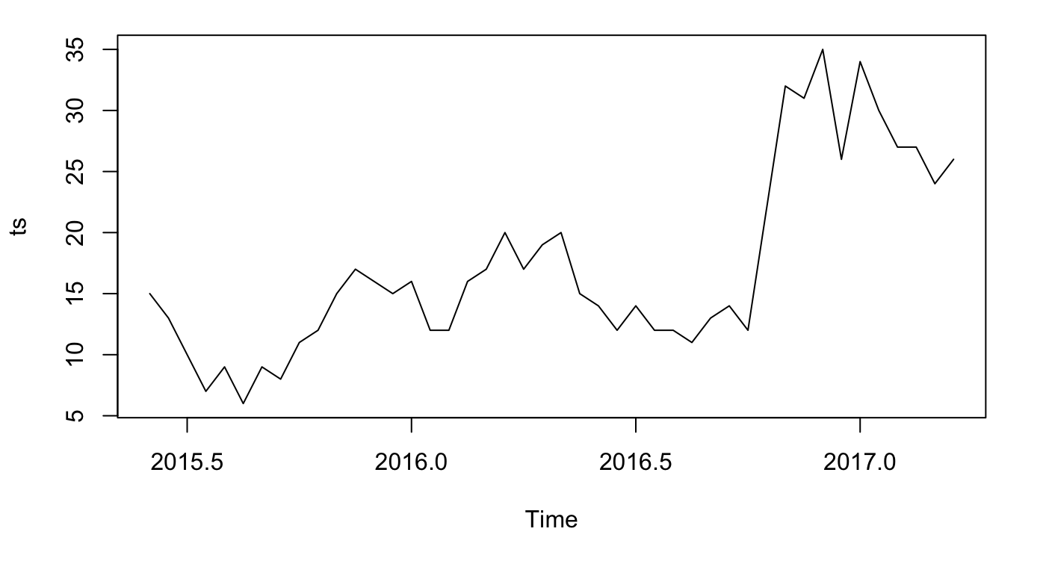
Time Series Original Data
There appears to have both seasonal and time trends.

Slide 4
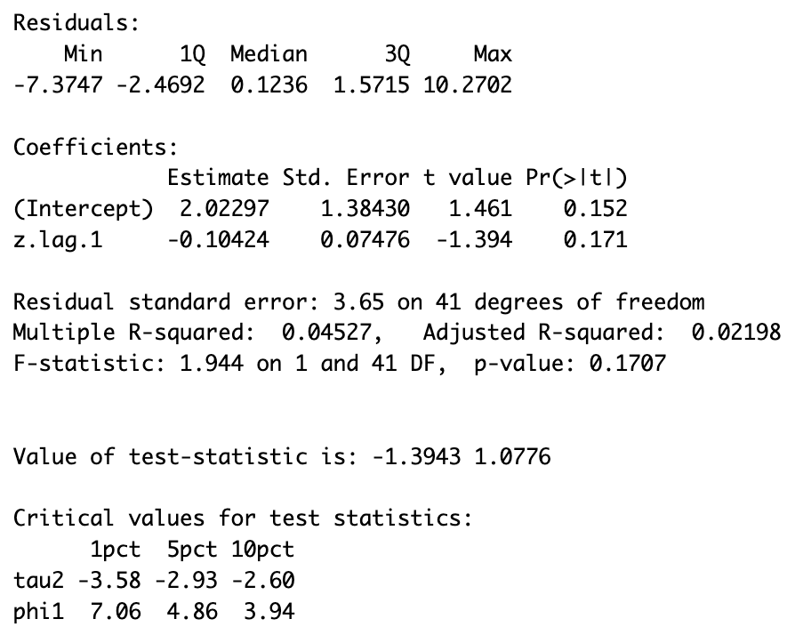
Testing for Stationarity
Augmented Dickey-Fuller Test
With a test statistic of -1.39 we do not reject the null hypothesis.

Slide 5
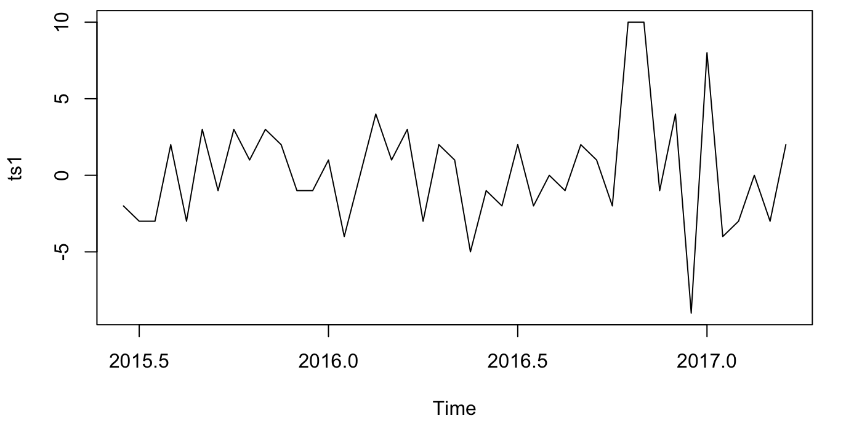
Make Data Stationary
The log difference of the time series is stationary.
The new Augmented Dickey-Fuller Test results in a test statistic of -7.44. We can reject the null hypothesis.
Subsequent analysis will use this time series.

Slide 6
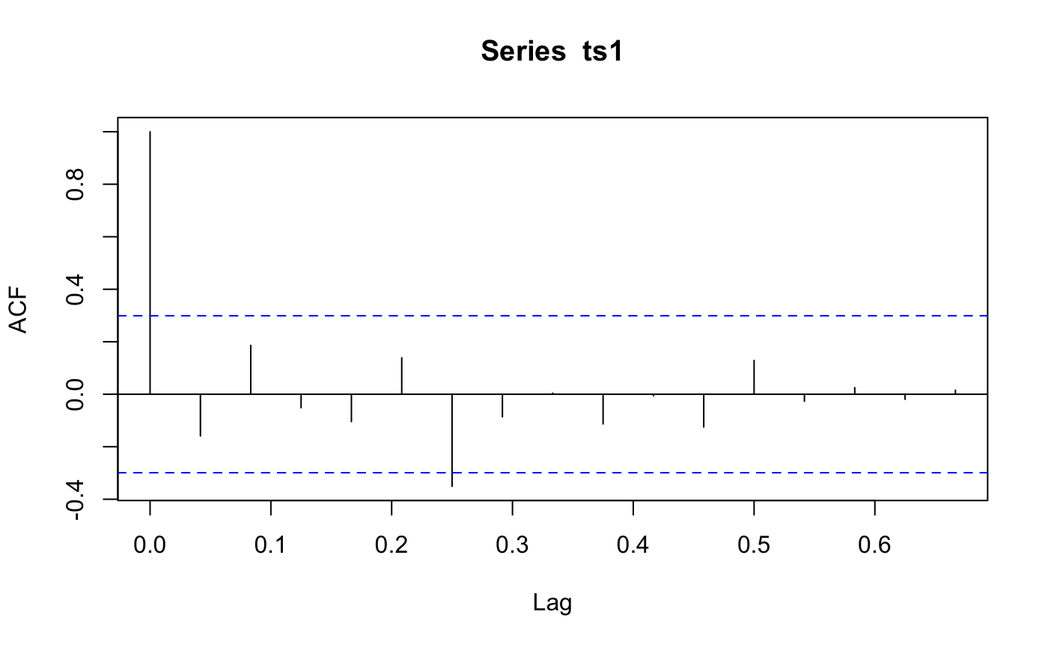
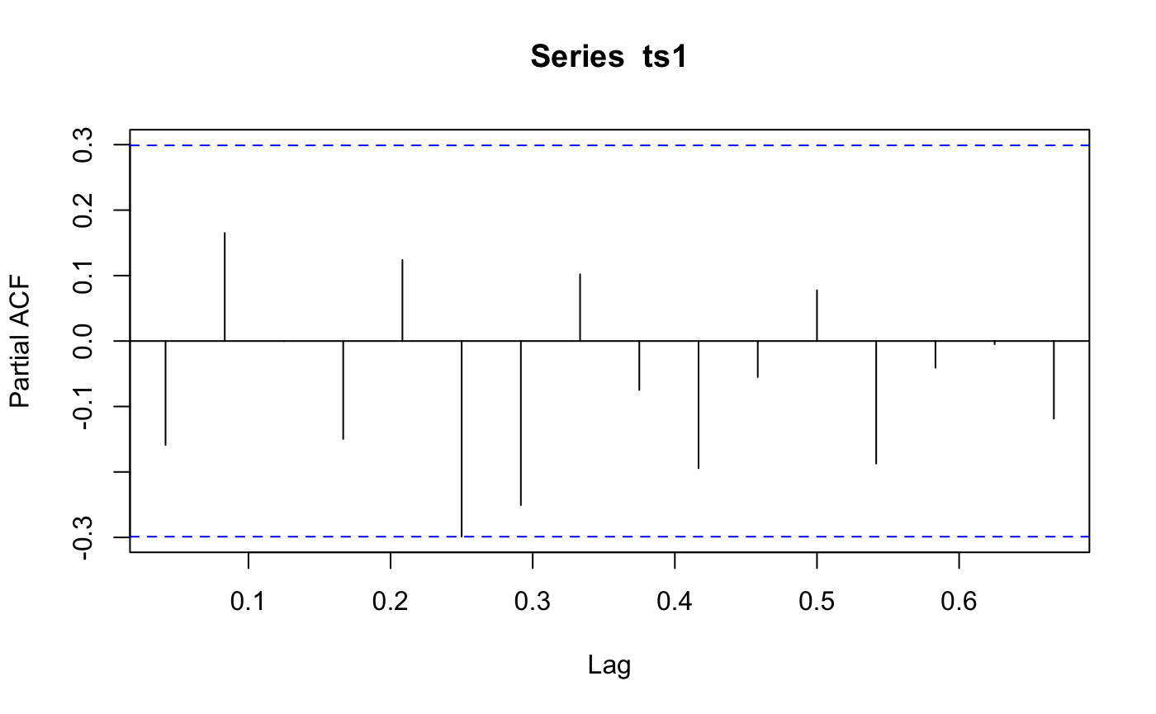
ACF and PACF
Notes:
The ACF and PACF indicate that an MA(1) model might be appropriate.

