Slide 1
ECON 5305 Data Translation Group 2: McKenzie Maidl, Tuan Anh Nguyen, Samikshya Pandey

Slide 2
Goal
Understand existing time series patterns in vehicle sales in US.
Can we predict the demand for vehicle sales in future?

Slide 3
Vehicle Sales Prediction Dataset
Quarterly Total vehicle sales in US in millions
Seasonally Adjusted from 1976 Quarter 1 to 2023 Quarter 1
Source: FRED (https://fred.stlouisfed.org/series/TOTALSA)

Slide 4
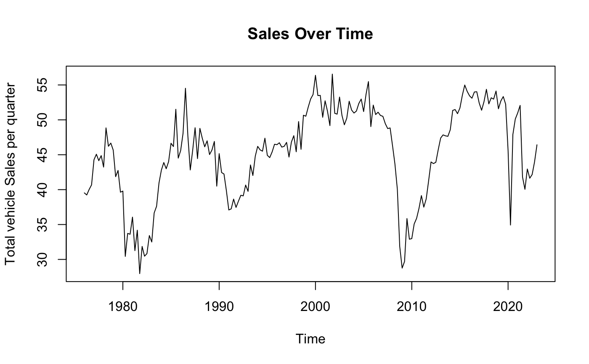
Time Series Original Data
There appears to have some cyclical patterns.

Slide 5
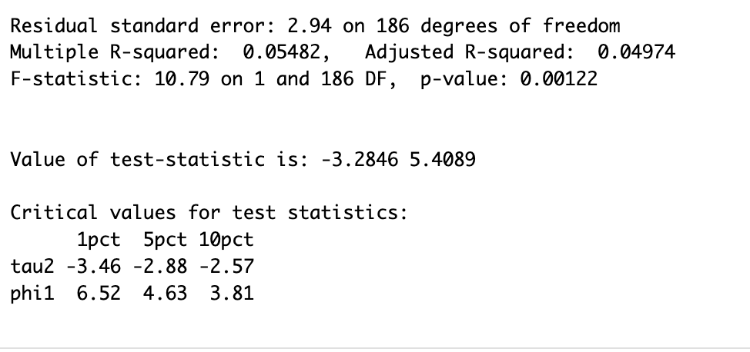
Testing for Stationarity
Augmented Dickey-Fuller Test
Test statistic value is -3.28 and the critical value is greater than 1pct critical value.
Do not reject the null hypothesis.
Shows our data is not stationary

Slide 6
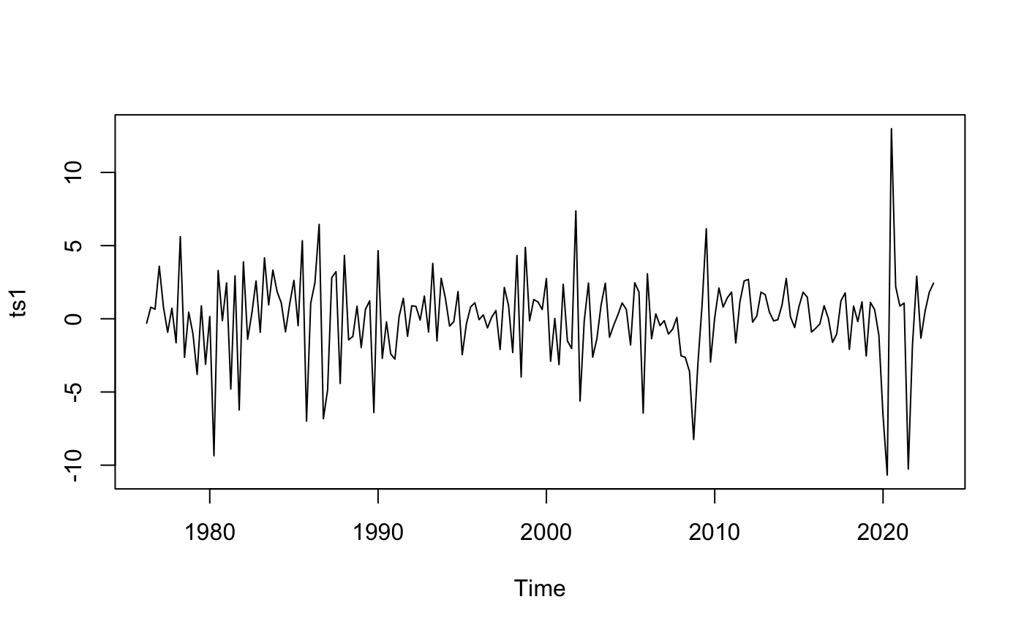
Make Data Stationary
The log difference of the time series is stationary
The new Augmented Dickey-Fuller Test results in a test statistic of -17.20. We can reject the null hypothesis.
Subsequent analysis will use this time series.
Notes:
Diff with “drift”

Slide 7
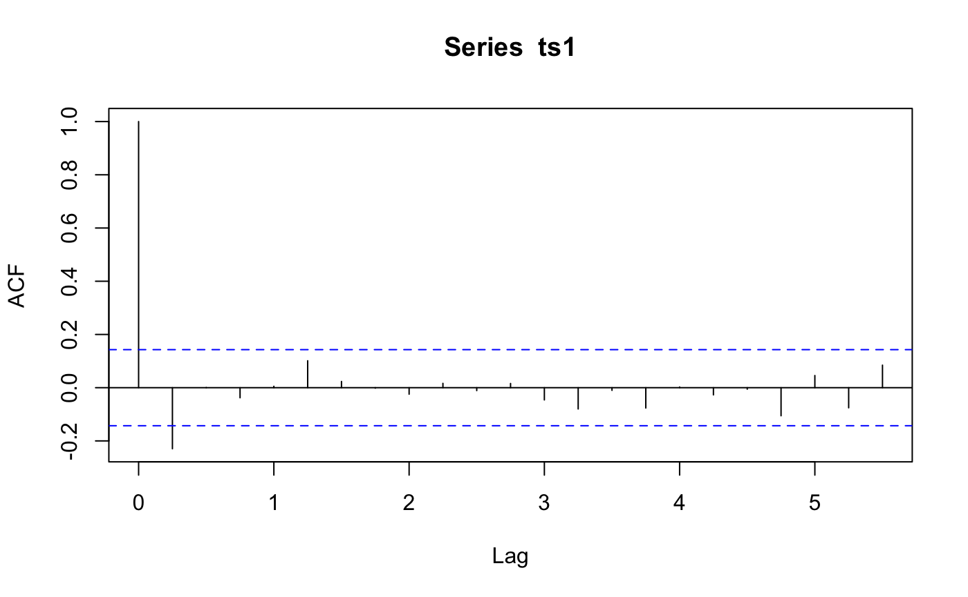
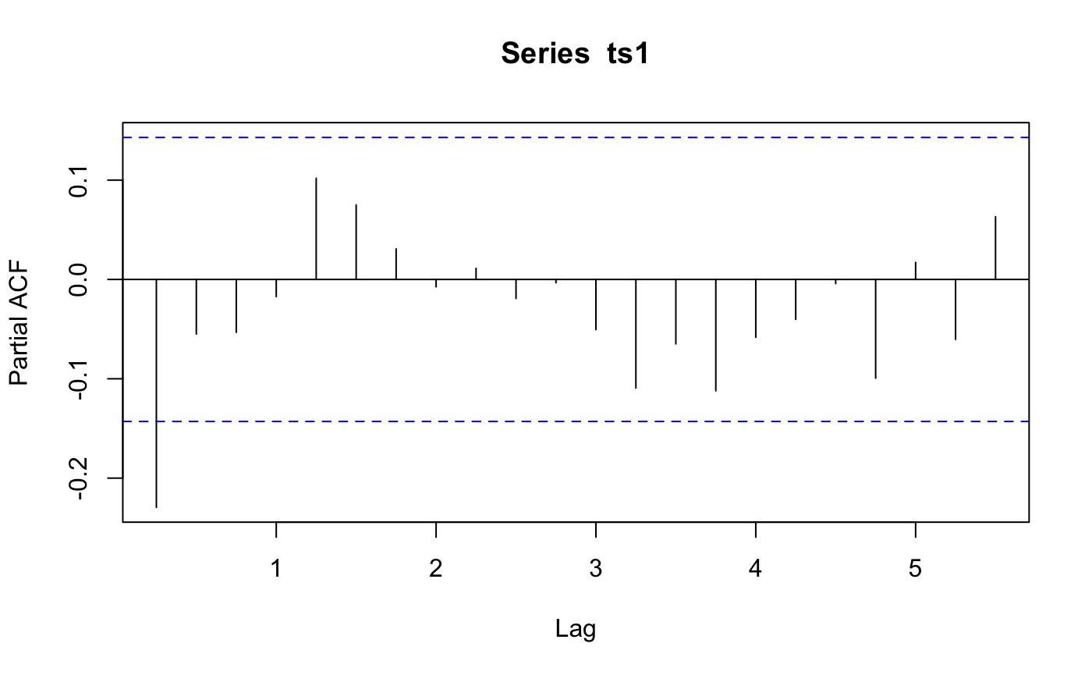
ACF and PACF
PACF seems to have some cyclical patterns but all within
significant lines
Significant spike till lag 1
Notes:
The ACF and PACF indicate that an MA(1) model might be appropriate.

Slide 8
Top 3 Models
Model | R^2 | AIC | BIC | Mean residual
AR(1) | 0.05283403 | 943.4648 | 953.1741 | -3.659734e-04
MA(1) | 0.05695238 | 942.6554 | 952.3647 | -7.351305e-06
ARMA(3,3) | 0.12836404 | 942.5077 | 968.3993 | -7.619365e-03
We chose AR(1) and MA(1) because both models had the best AIC and BIC score. We chose ARMA (3,3) because it had significantly high R^2 value compared to all other combinations.
The mean residuals is close to 0 for all models which shows that the residuals in our models are white noise

Slide 9
White noise confirmations through Q-Test of the residuals.
Ljung-Box
Model | P-value | White Noise Confirmation
AR(1) | 0.9981 | Yes
MA(1) | 0.955 | Yes
ARMA(3,3) | 0.9136 | Yes

Slide 10
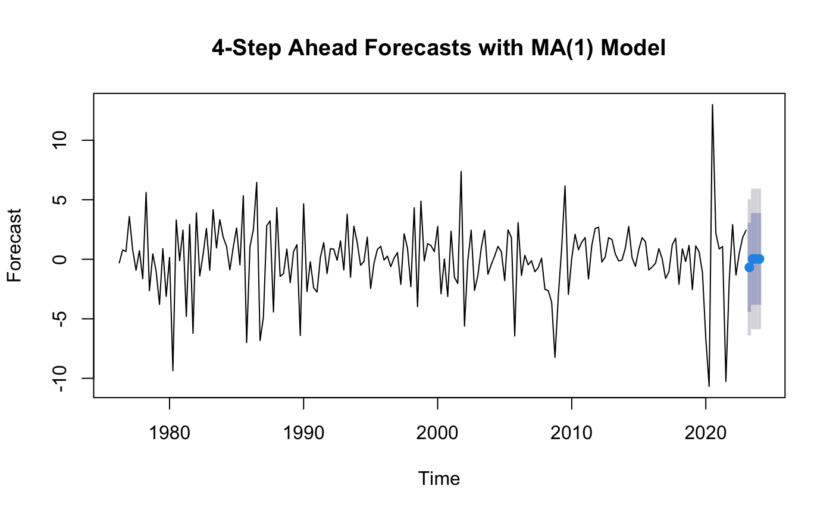
4 Step Ahead Forecast MA(1)
Notes:
The ACF and PACF indicate that an MA(1) model might be appropriate.

Slide 11

4 Step Ahead Forecast AR(1)
Notes:
The ACF and PACF indicate that an MA(1) model might be appropriate.

Slide 12

4 Step Ahead Forecast ARMA(3,3)
Notes:
The ACF and PACF indicate that an MA(1) model might be appropriate.

Slide 13
Fine-tuning Models
Fine-tuning models via:
Loss Comparisons
Different fixed, rolling and recursive schemes
Goal is to create the best forecasting models given the data.

Slide 14
Loss Comparison
1 Step Ahead
Model | Scheme | MPE | IE | MSE | MAE | MAPE
Naïve | Fixed | 1.2061 | 0 | 26.7831 | 3.9701 | 2.3880
Simple Average | Fixed | 1.0031 | 0 | 23.6329 | 3.1610 | 1.0031
ARMA(3,3) | Fixed | 1.8126 | 1 | 32.0649 | 4.0842 | 1.8589
ARMA(3,3) | Recursive | 1.2483 | 0 | 27.3286 | 3.5896 | 1.3502
ARMA(3,3) | Rolling | 1.3119 | 0 | 28.0679 | 3.7473 | 1.3575
MA(1) | Fixed | 1.0763 | 0 | 23.4502 | 3.2570 | 1.0763
MA(1) | Recursive | 1.1078 | 0 | 24.5204 | 3.3378 | 1.1078
MA(1) | Rolling | 1.0847 | 0 | 25.5516 | 3.3770 | 1.0847
AR(1) | Fixed | 1.0187 | 0 | 24.7411 | 3.3132 | 1.0187
AR(1) | Recursive | 1.0346 | 0 | 25.5312 | 3.3641 | 1.0346
AR(1) | Rolling | 1.0159 | 0 | 26.1227 | 3.3778 | 1.0178

Slide 15
Loss Comparison
2 Step Ahead
Model | Scheme | MPE | IE | MSE | MAE | MAPE
Naïve | Fixed | 1.0908 | 0 | 27.7322 | 4.0234 | 2.3349
Simple Average | Fixed | 1.0014 | 0 | 24.8338 | 3.2799 | 1.0014
ARMA(3,3) | Fixed | 1.5532 | 1 | 31.2050 | 3.9093 | 1.6002
ARMA(3,3) | Recursive | 1.3812 | 1 | 28.4399 | 3.6589 | 1.3812
ARMA(3,3) | Rolling | 1.3325 | 0 | 27.1370 | 3.6996 | 1.3325
AR(1) | Fixed | 0.9010 | 0 | 26.1955 | 3.3358 | 0.9366
AR(1) | Recursive | 0.9077 | 0 | 26.0621 | 3.3281 | 0.9484
AR(1) | Rolling | 0.9102 | 0 | 25.7483 | 3.2988 | 0.9414

Slide 16
Combined Forecasts
1 Step Ahead
Models: ARMA(3,3), MA(1), and AR(1)
Scheme: Fixed for each
Combination Method | MSE
Equal-weighted Forecast | 26.01
MSE-inversely-weighted Forecast | 23.61
OLS-weighted Forecast | 17.85

Slide 17
Combined Forecasts
2 Step Ahead
Models: ARMA(3,3) and AR(1)
Scheme: Fixed for each
Combination Method | MSE
Equal-weighted Forecast | 26.60
MSE-inversely-weighted Forecast | 24.97
OLS-weighted Forecast | 19.40

Slide 18
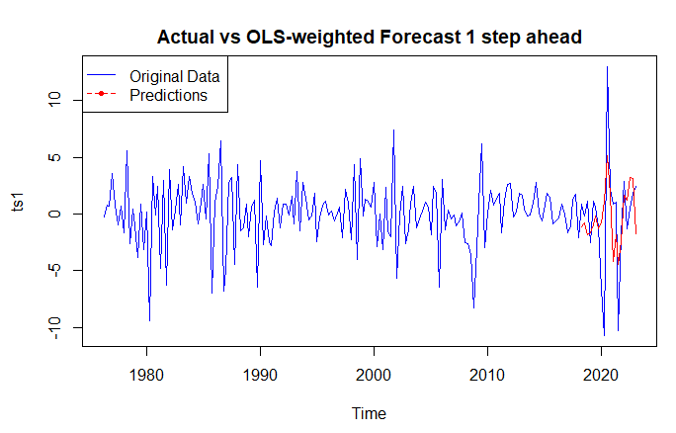
Combined Forecasts
1 Step Ahead
Models: ARMA(3,3), MA(1), and AR(1)
Scheme: Fixed for each
Combination Method: OLS-weighted

Slide 19
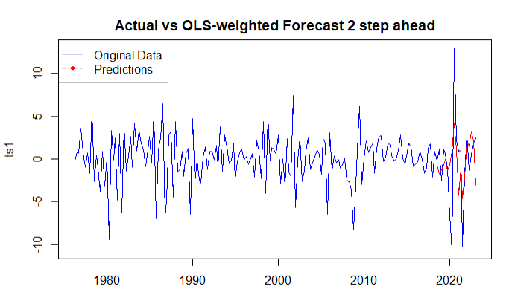
Combined Forecasts
2 Step Ahead
Models: ARMA(3,3) and AR(1)
Scheme: Fixed for each
Combination Method: OLS-weighted

