Slide 1

Let’s Make an Interactive Map!
Tom McKeon, MPH PhD Candidate | Department of Geography and Urban Studies
Temple University | mckeont@temple.edu
Link to data for this tutorial: mckeont/GeoTag (github.com)

Slide 2

What is an interactive map?
A browser-based map with user engagement.
Zoom, paning, pop-ups, toggle layers, buttons, etc.
Created using HTML, CSS, and Javascript (leaflet library)
Need to write code in a text editor (notepad, atom, brackets, etc.)
Host your code on Github to create a shareable URL link.
Great way to make a map-based holiday card, or share points of interest after a hike, vacation, or anything really.
Keeping an eye on PA Streams (mckeont.github.io)
Property Trees (mckeont.github.io)

Slide 3
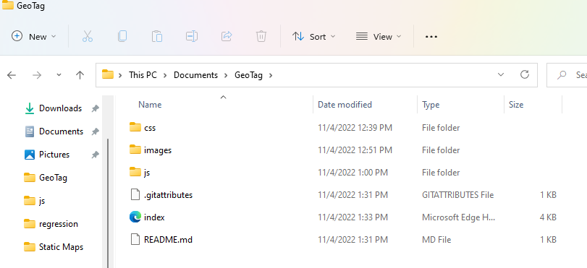
Let’s get started
Download Github Desktop: https://desktop.github.com/
Download Atom: https://atom.io/
Create a Github Account: https://github.com/
Create a project folder:

Slide 4
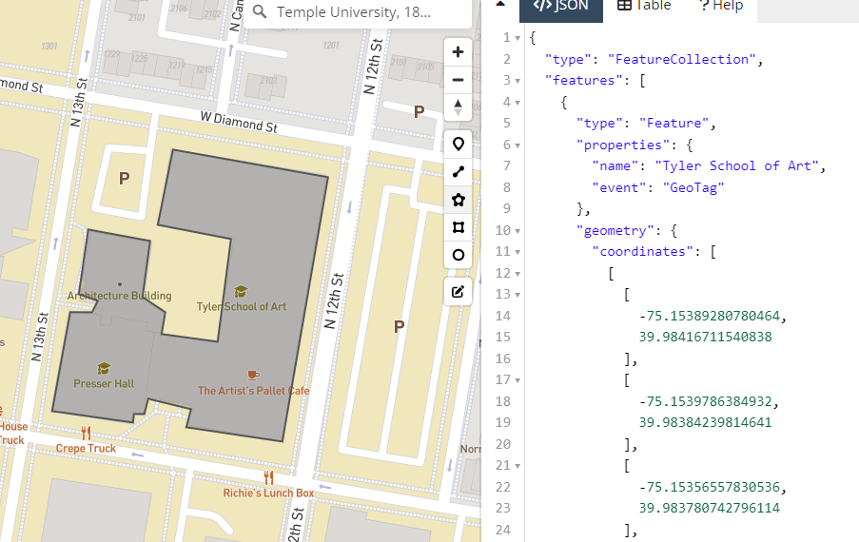
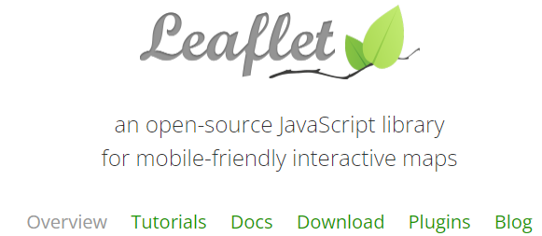
Resources
Draw layers: https://geojson.io/
Tutorials: https://leafletjs.com/

Slide 5
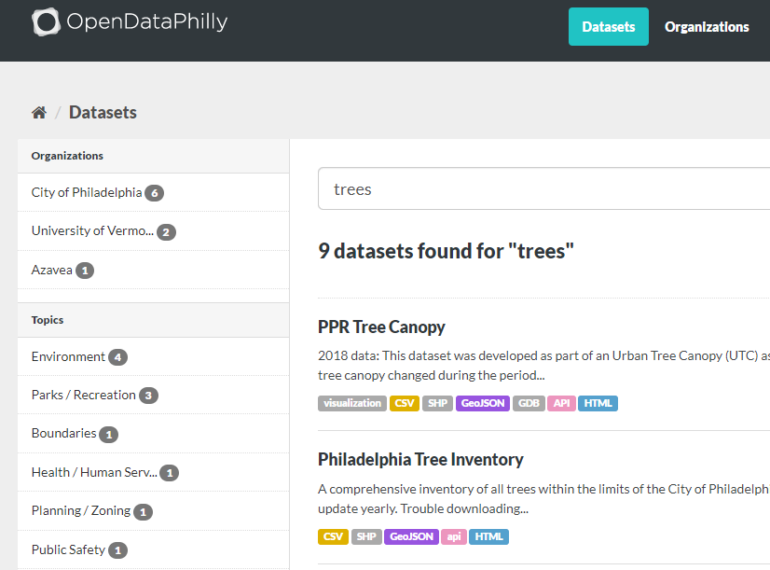
Bringing in your data
For this demo we will create a GeoJSON
You can work with anything spatial!
Shapefile, KML, GeoJSON, csv, etc…

Slide 6
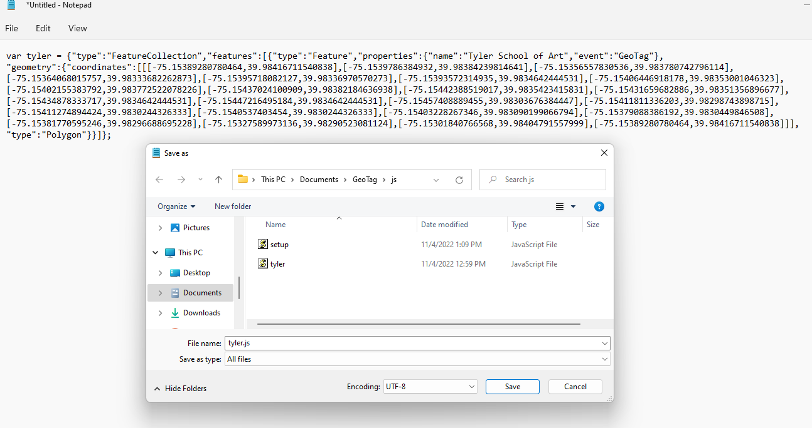

Slide 7
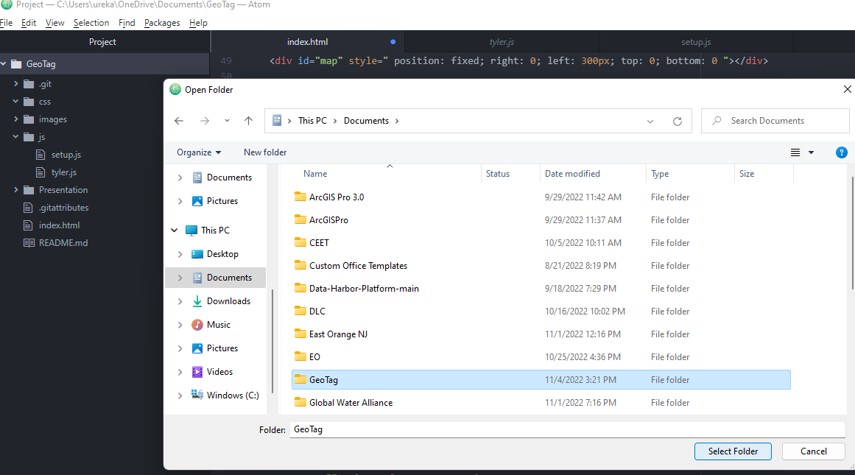
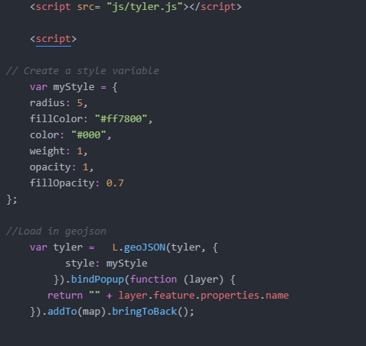
Add project folder to atom

Slide 8
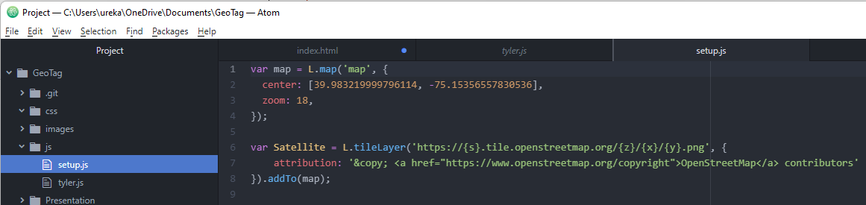
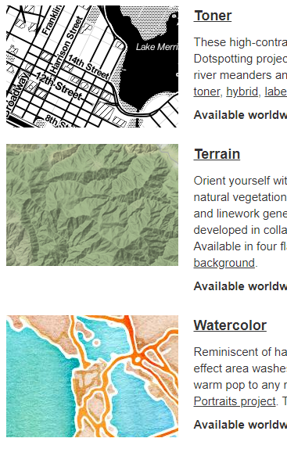
Initiate a map
Choose your basemap!

Slide 9
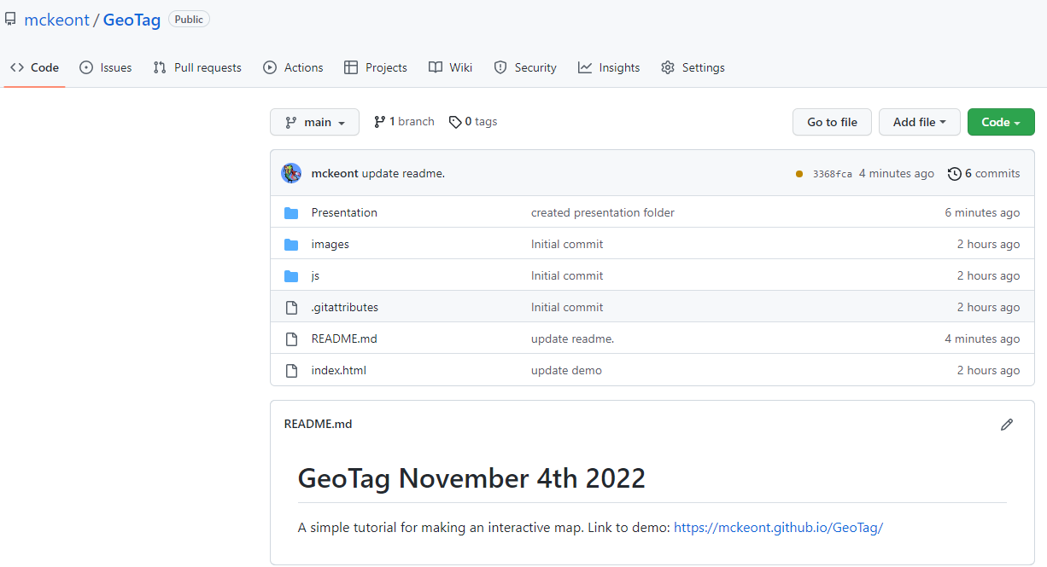
https://github.com/mckeont/GeoTag

Slide 10
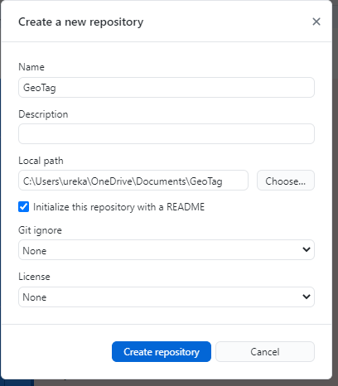

Slide 11
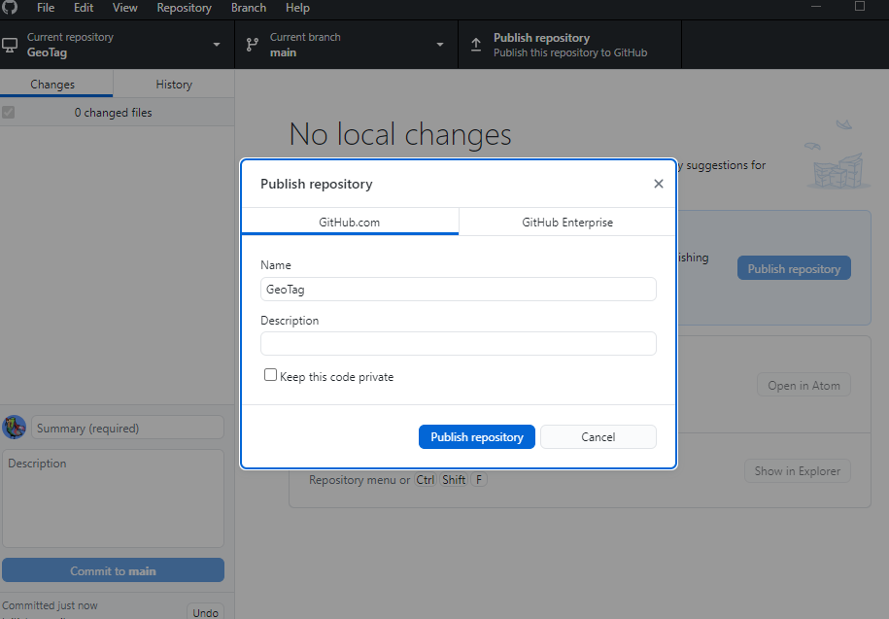

Slide 12
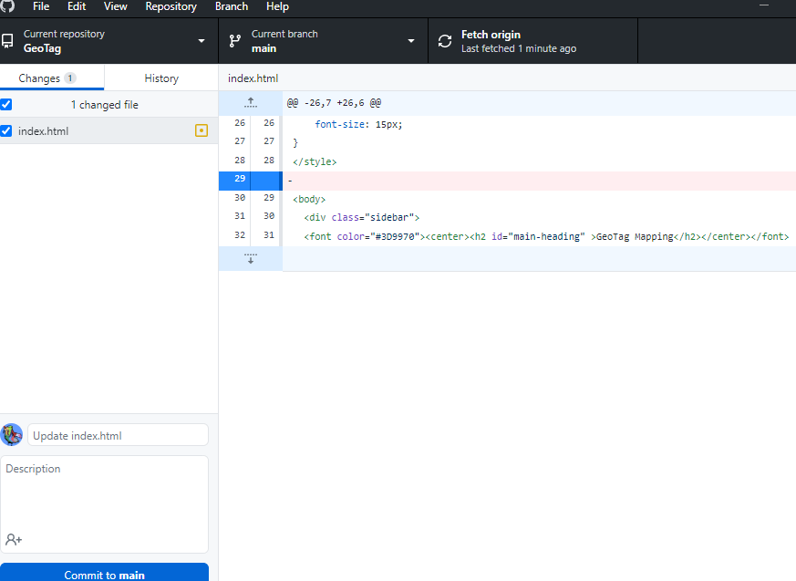

Slide 13
