Slide 1
Let’s Make an Interactive Map!

Slide 2
What is an interactive map?
A browser-based map with user engagement.
Zoom, paning, pop-ups, toggle layers, buttons, etc.
Created using HTML, CSS, and Javascript (leaflet library)
Need to write code in a text editor (notepad, atom, brackets, etc.)
Host your code on Github to create a shareable URL link.
Great way to make a map-based holiday card, or share points of interest after a hike, vacation, or anything really.
Keeping an eye on PA Streams (mckeont.github.io)
Property Trees (mckeont.github.io)

Slide 3
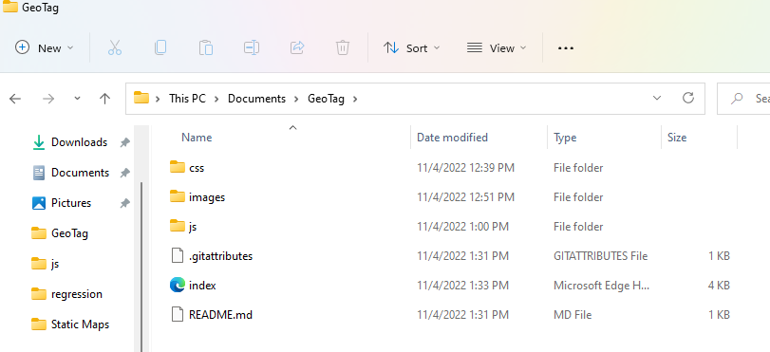
Let’s get started
Download Github Desktop: https://desktop.github.com/
Download Atom: https://atom.io/
Create a Github Account: https://github.com/
Create a project folder:

Slide 4
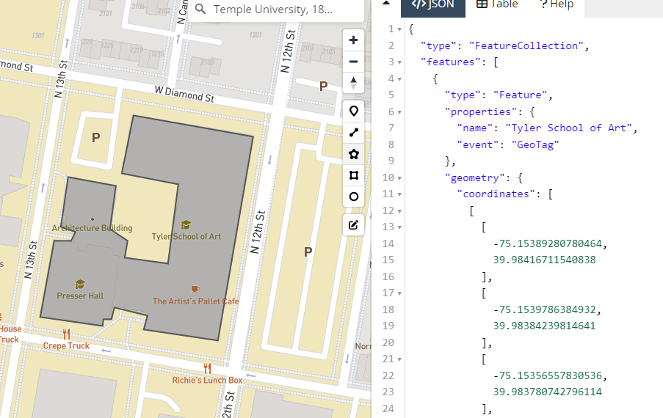
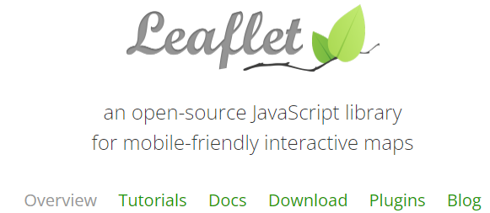
Resources
Draw layers: https://geojson.io/
Tutorials: https://leafletjs.com/

Slide 6
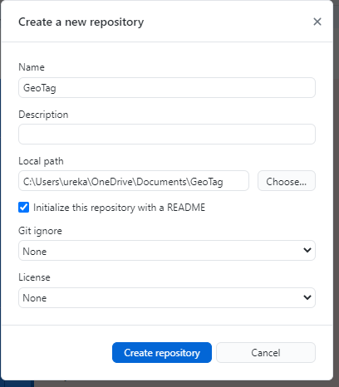

Slide 7
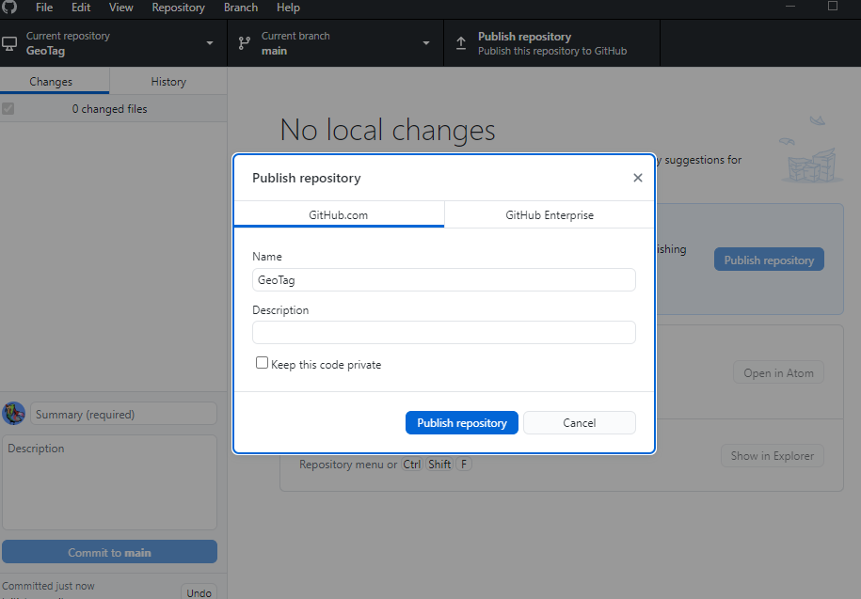

Slide 8
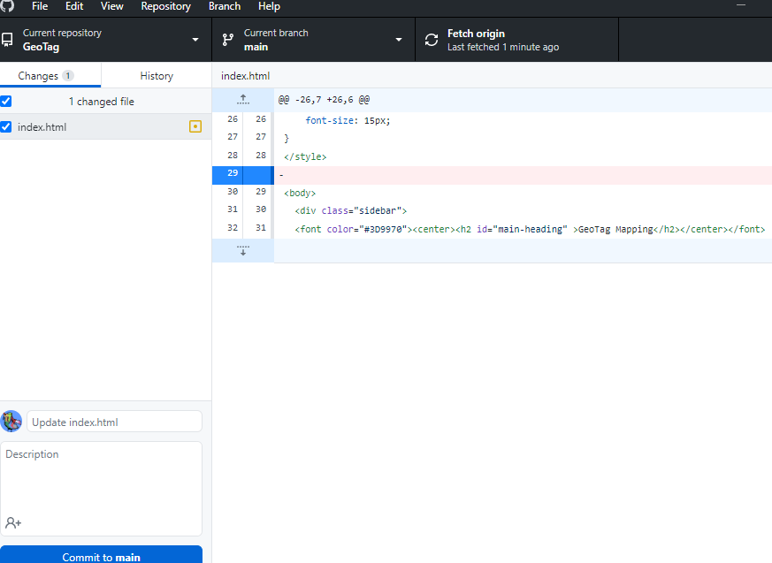

Slide 9
