Slide 1
Group 3 Final Group Project
Jim McKerney
Alexander Hernes
Drew Lewis
Charles Mancuso

Slide 2
Problem Description
As a group, we wanted to come up with a project we thought would challenge our knowledge of Java.
We also wanted to come up with something that people would actually use outside of this class.
With both of these tasks in mind, we came up with our version of a…

Slide 3
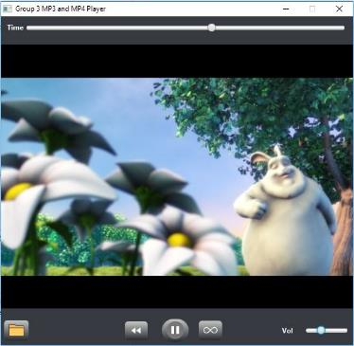
MP3/MP4 Player
This is an advanced media player with fully functional play, pause, volume, loop, and seek functions.

Slide 4
Approach
The basic Design of the program is centered around using a MediaView Node centered BorderPane window with a with control functionality present using the MediaPlayer class through Buttons and Sliders located in the UI

Slide 5
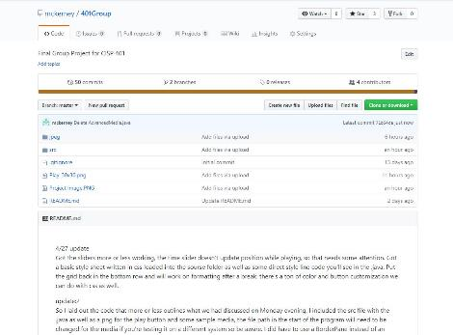
Version Control
Made the decision early on to handle version control and track the project issues through GitHub

Slide 6
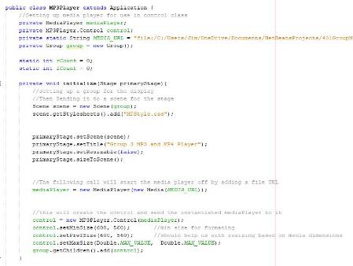
Major Components
We start off instantiating a MediaPlayer Object with a file, setting the the scene up, and then calling our Control constructor and passing the MediaPlayer Object as the argument.

Slide 7
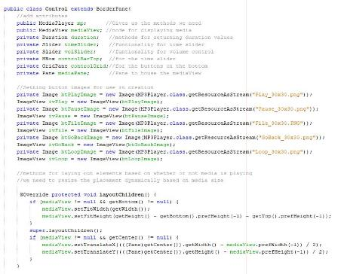
Major Components
We declare most of the used object names as part of our Control class that extends BorderPane

Slide 8
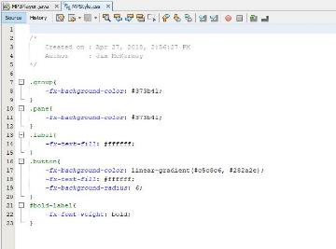
Major Components
Cascading Style Sheets (CSS) was used to format and design the various Label, Button, and Pane elements in the project. Both through direct setStyle() as well as a style spreadsheet.

Slide 9
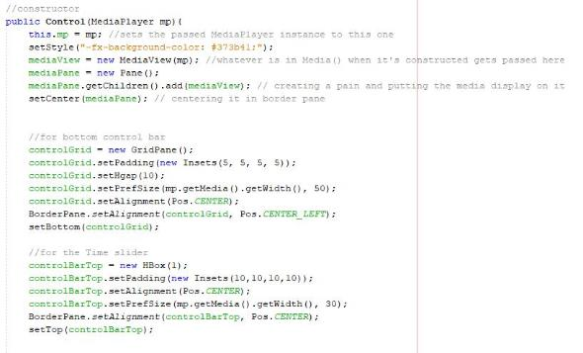
Major Components
Our program is almost entirely defined in the Constructor for our Control class. Making it possible to relaunch itself again and again as we load new files for display.

Slide 10
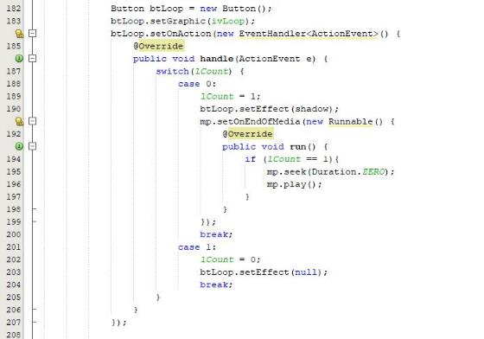

Major Components
Play/Pause button switched graphics based on whether the media was playing or paused

Slide 11
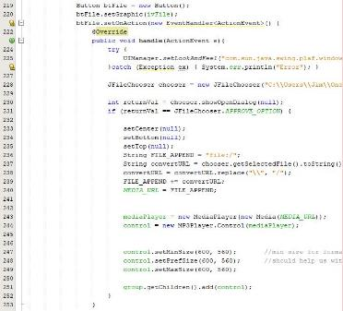
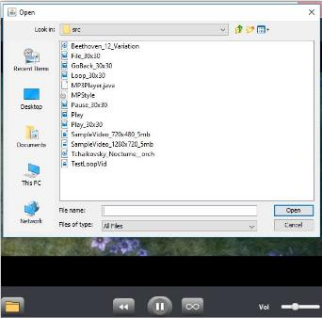
Major Components
File manager functionality provides the ability to choose your own files.

Slide 12



Other Notable Buttons
Pause button, allowing the user to pause the movie or song at will.
Loop button to replay favorite songs over and over.
Volume slider. Exactly like the time slider, but used to adjust volume instead
File opener, allowing the user to pick and choose which files to play
Play/Pause button switched graphics based on whether the media was playing or paused

Slide 13
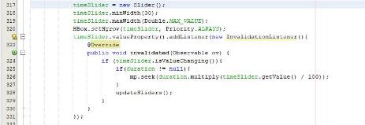
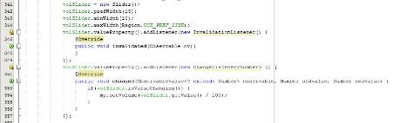
Sliders
Sliders were used to track Video and Audio playback as well as control volume levels.

Slide 14
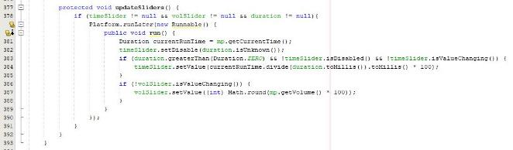
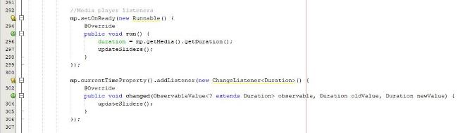
Listeners
Several listeners were used to track sliders positions as well as MediaPlayer instance status.

Slide 15
Task List
Jim – Design and Programming
Alexander – Button Guru Programming
Drew – Loop design specialist and Programming
Charles – Music Support and Programming
It was really a group effort, tons of communication and people tackling problems and iterating as often as possible.

