Slide 1
Gates-funded HPV Study
Baseline Characteristics & HPV-related findings
Among Participants at Screening

Slide 2
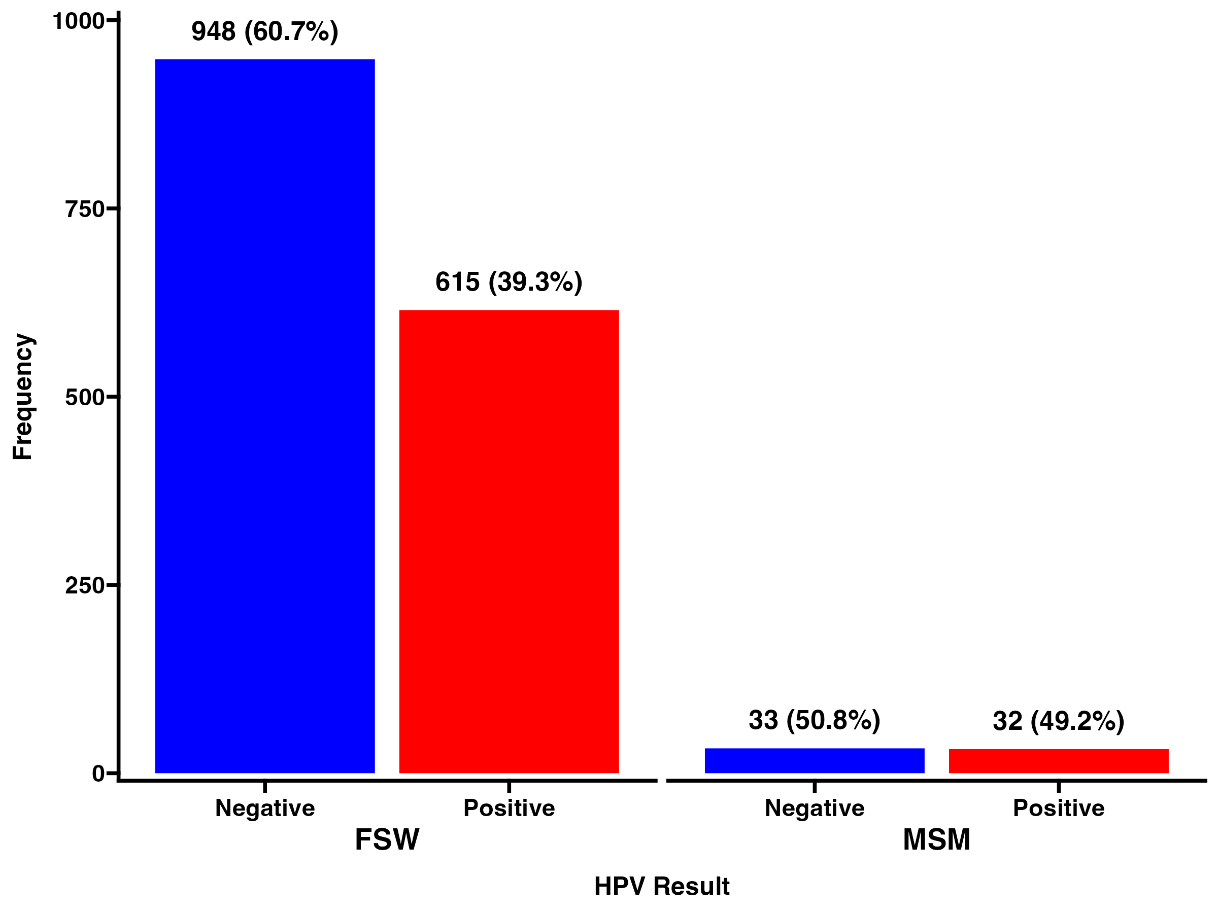
Prevalence of HPV by cohort type

Slide 3
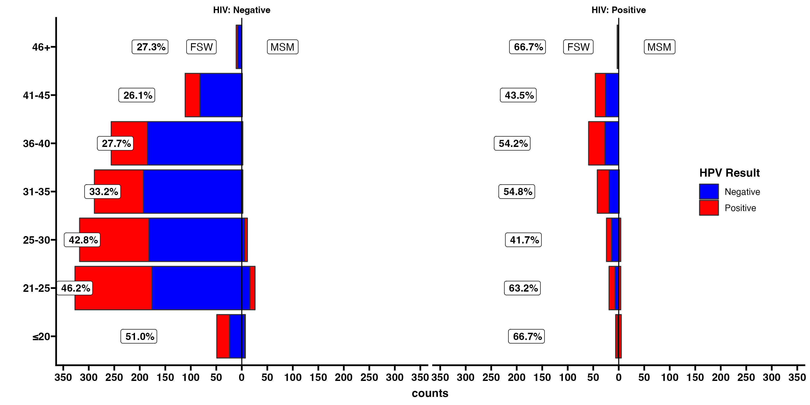
HPV prevalence by age and HIV status

Slide 4
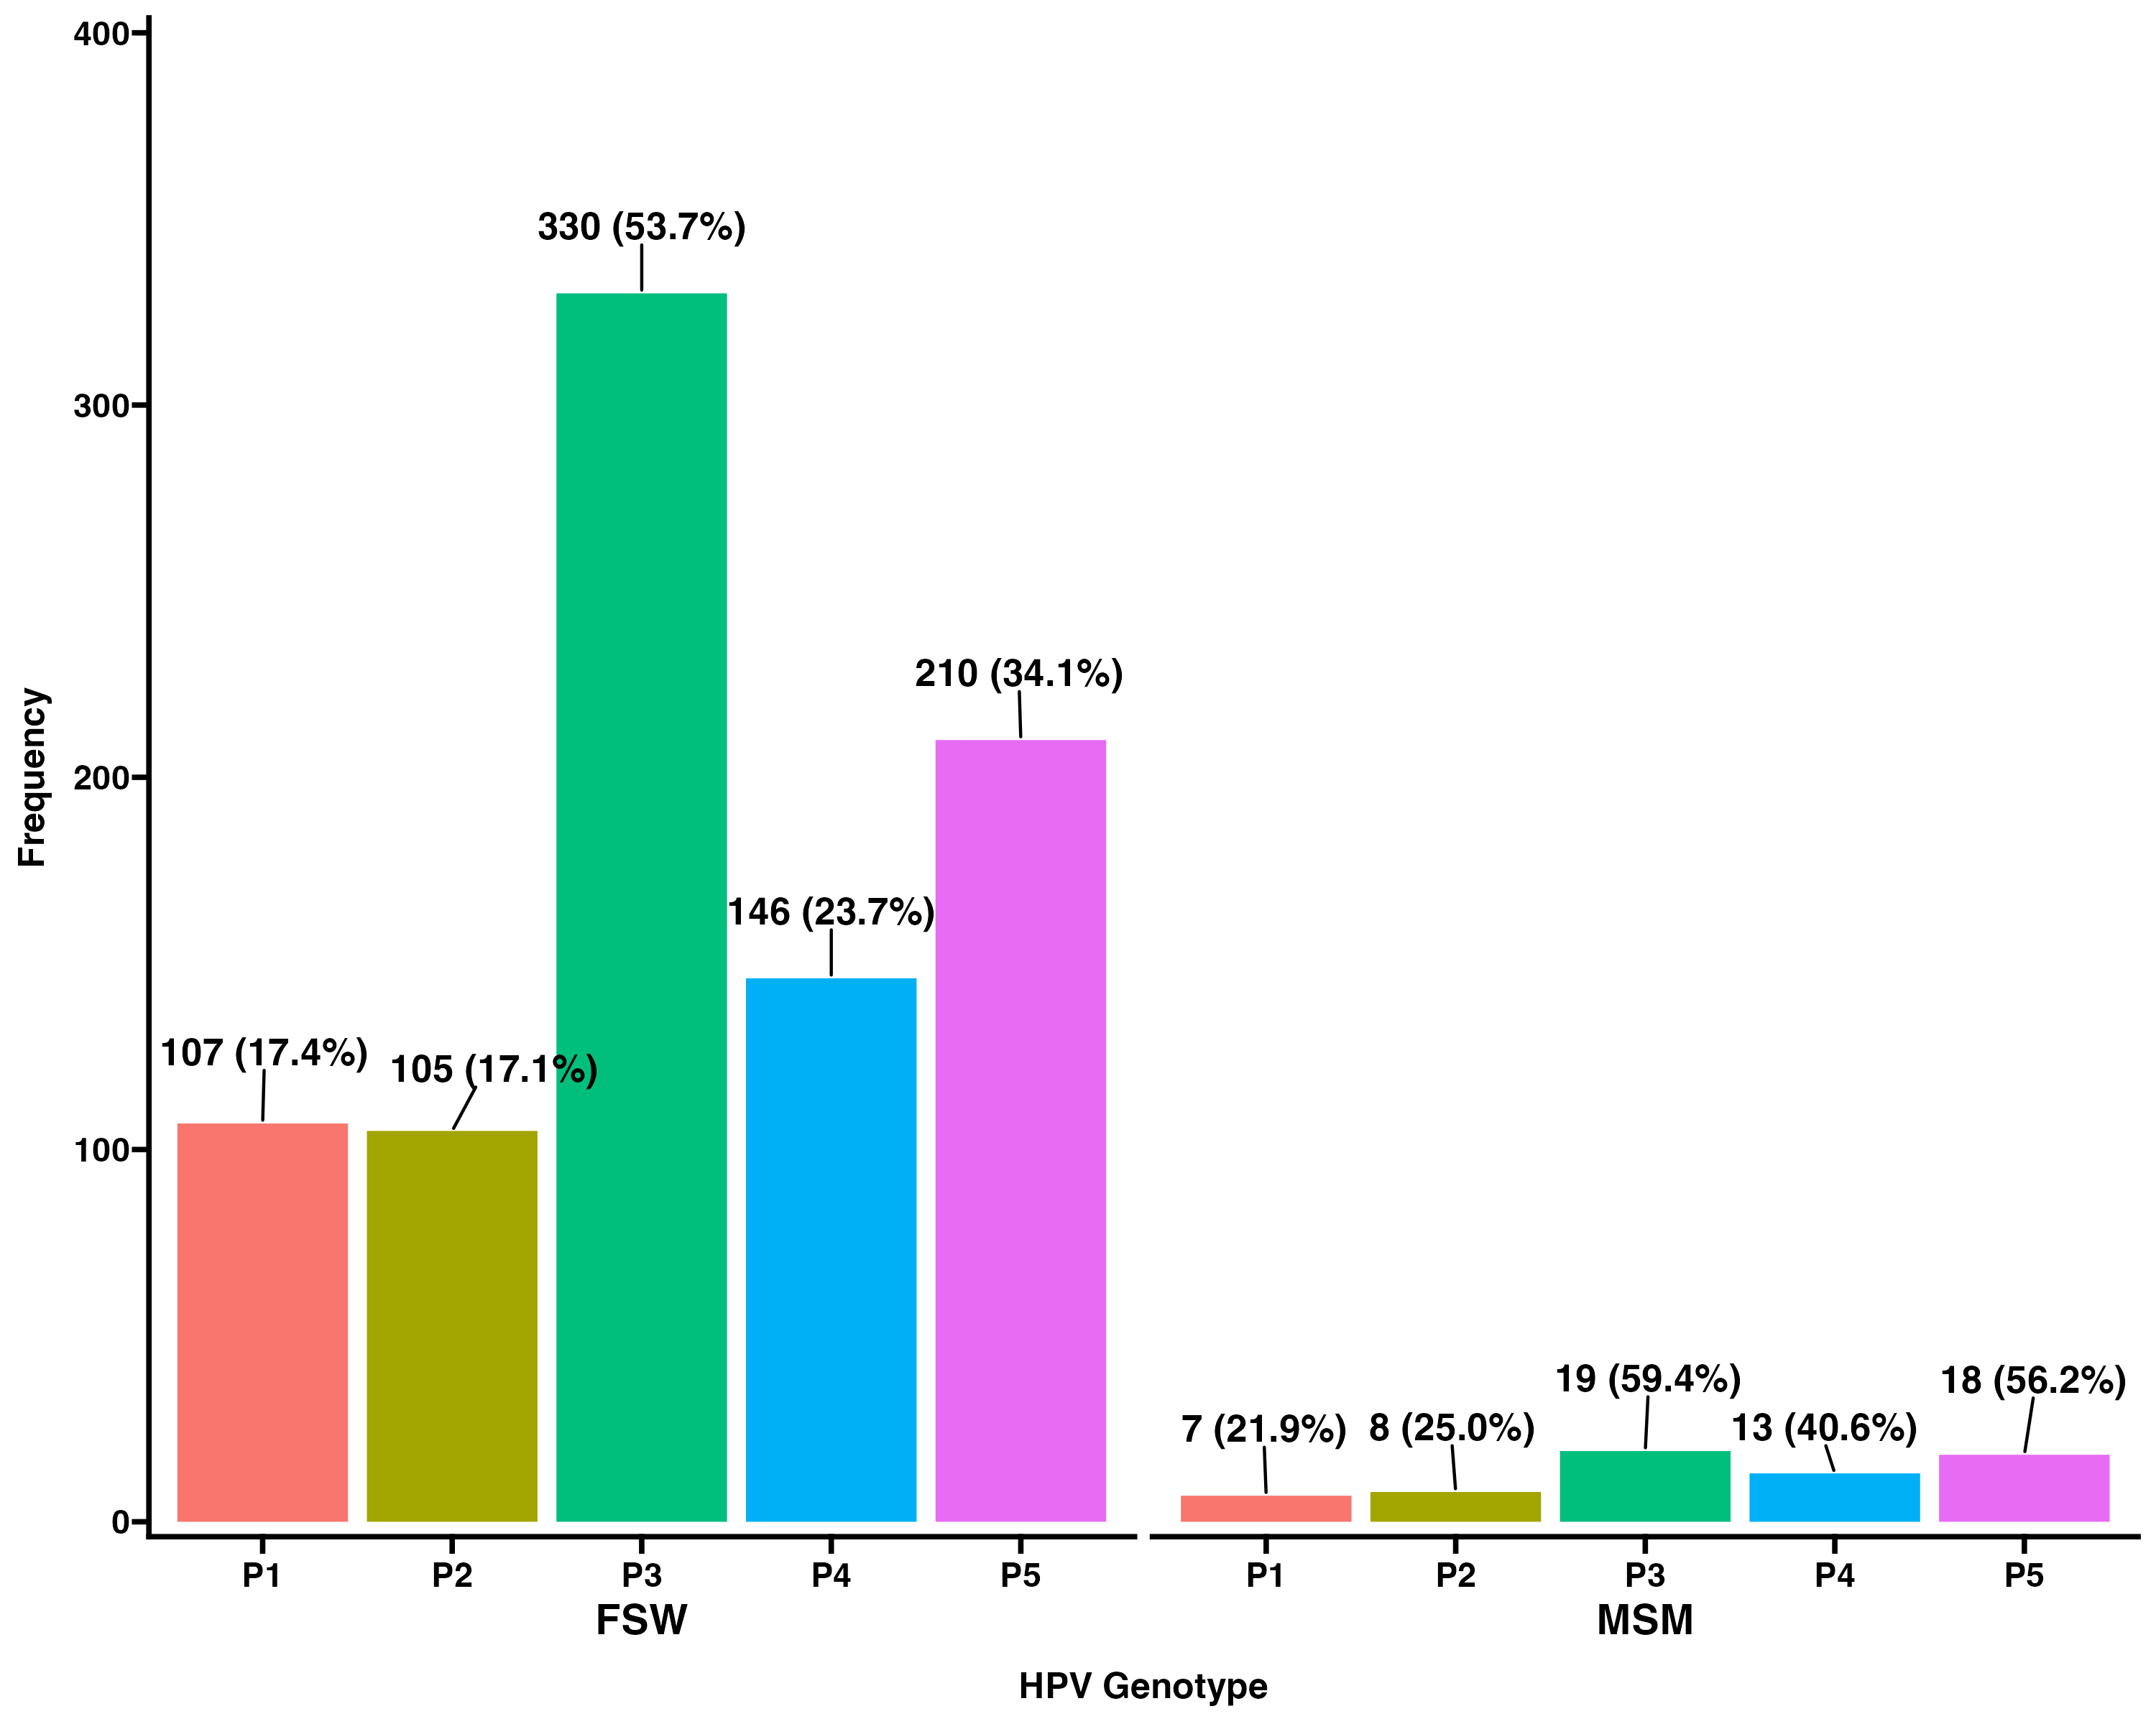
Genotypes by cohort type
P1 = HPV 16
P2 = HPV 18 or 45
P3 = HPV 31,33,35,52 or 58
P4 = HPV 51 or 59
P5 = HPV 39, 56, 66 or 68

Slide 5
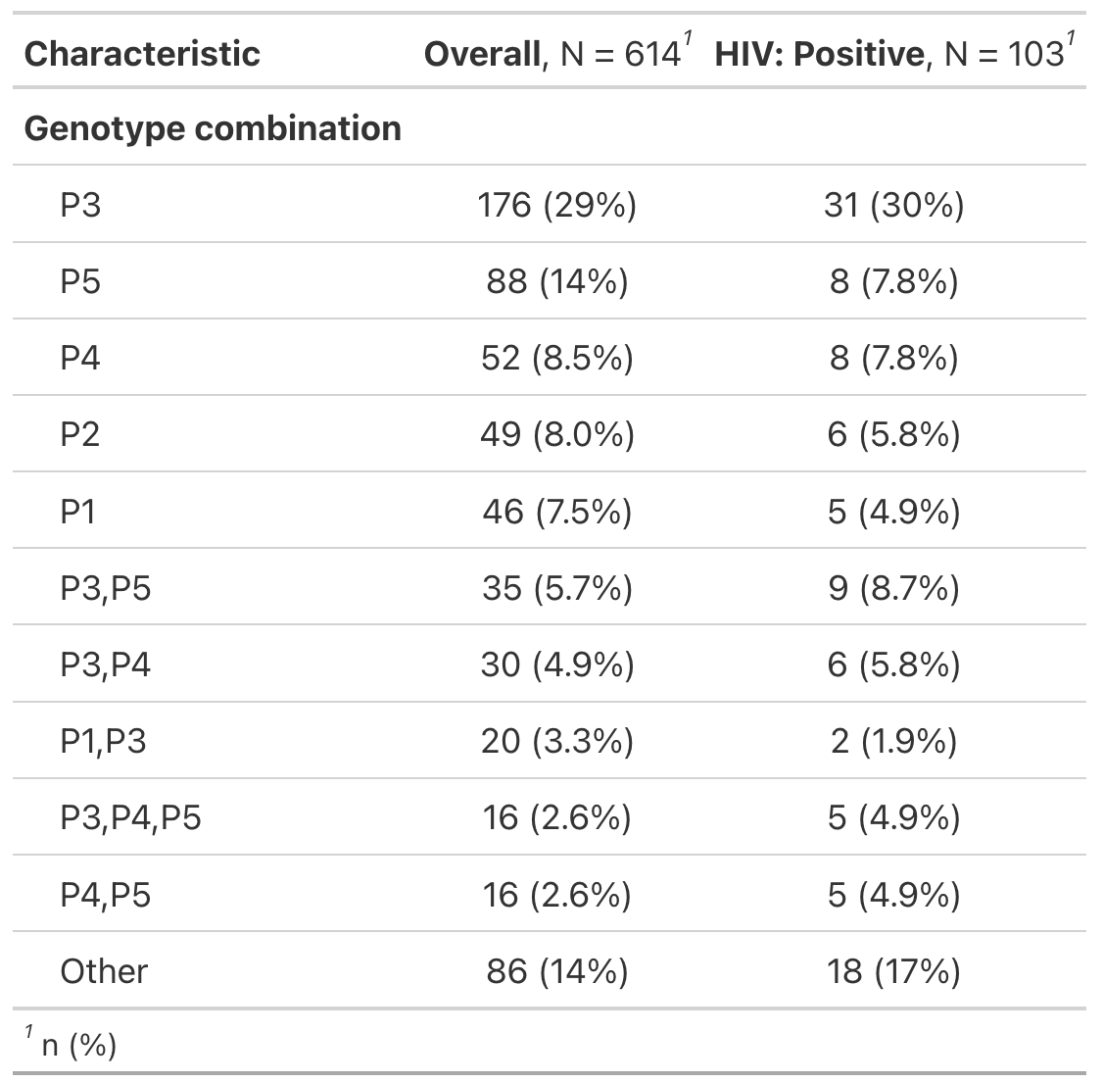
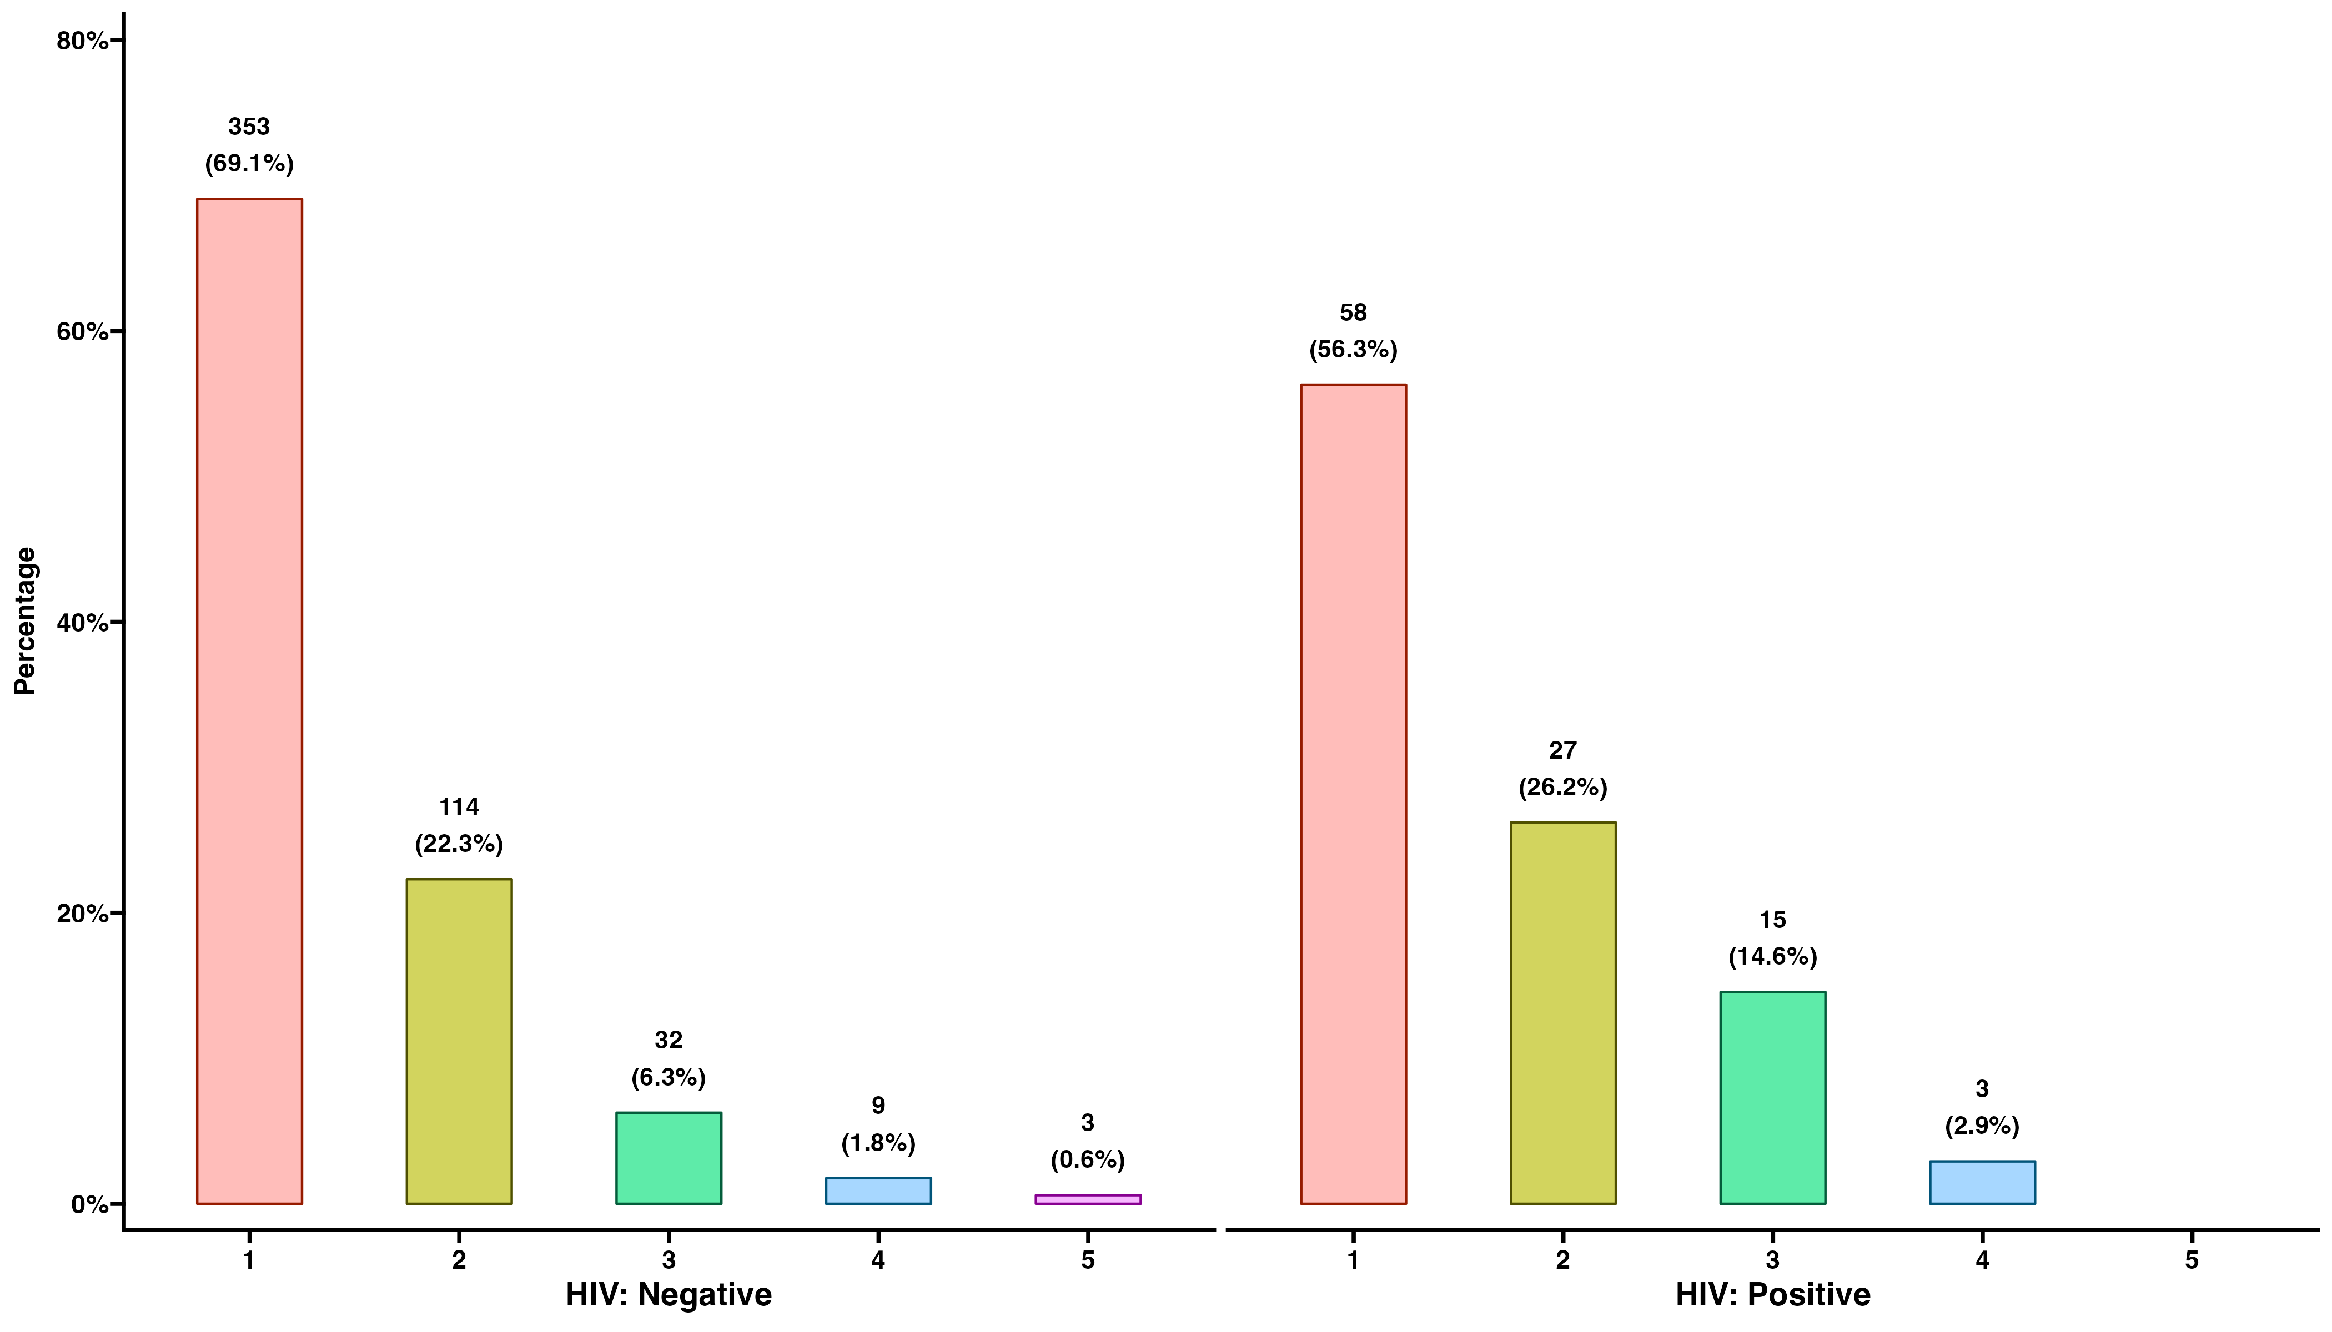
Number of HPV Genotypes by HIV (FSW)
P1 = HPV 16
P2 = HPV 18 or 45
P3 = HPV 31,33,35,52 or 58
P4 = HPV 51 or 59
P5 = HPV 39, 56, 66 or 68

Slide 6
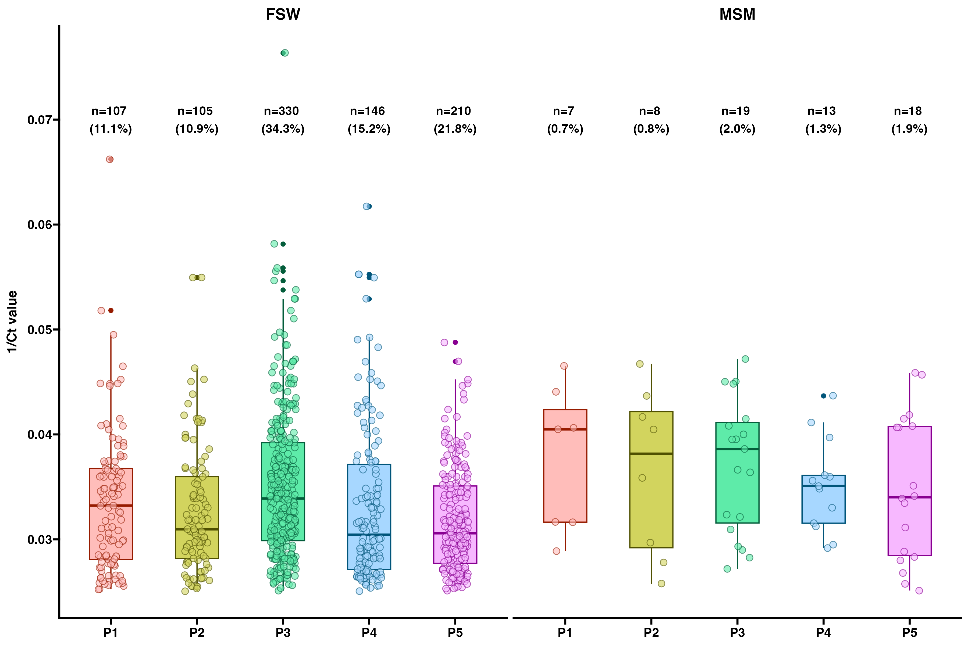
1/ct values (GeneXpert Genotype Channels)
P1 = HPV 16
P2 = HPV 18 or 45
P3 = HPV 31,33,35,52 or 58
P4 = HPV 51 or 59
P5 = HPV 39, 56, 66 or 68

Slide 7
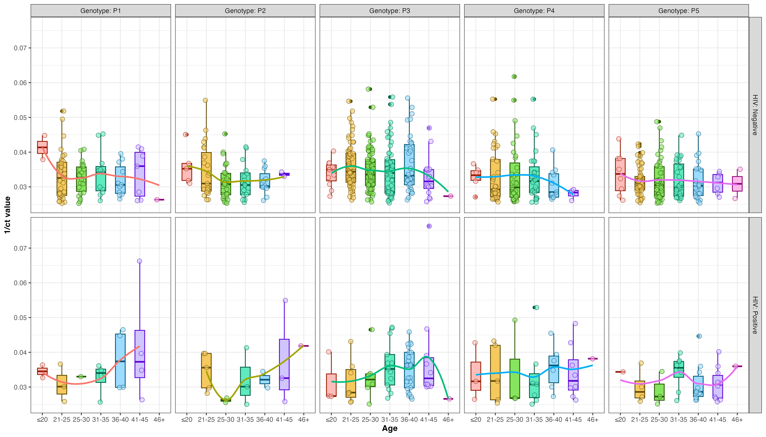
Genotypes by age and HIV Status (FSW)

Slide 8
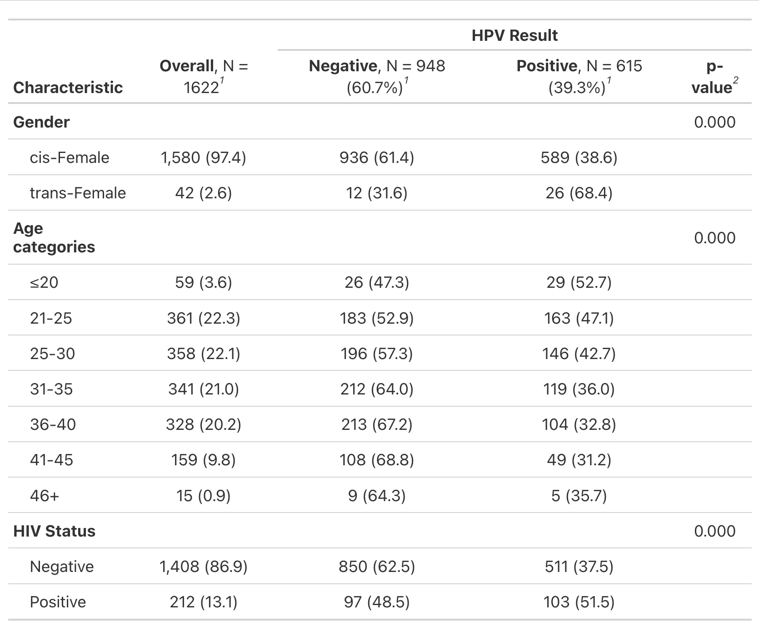
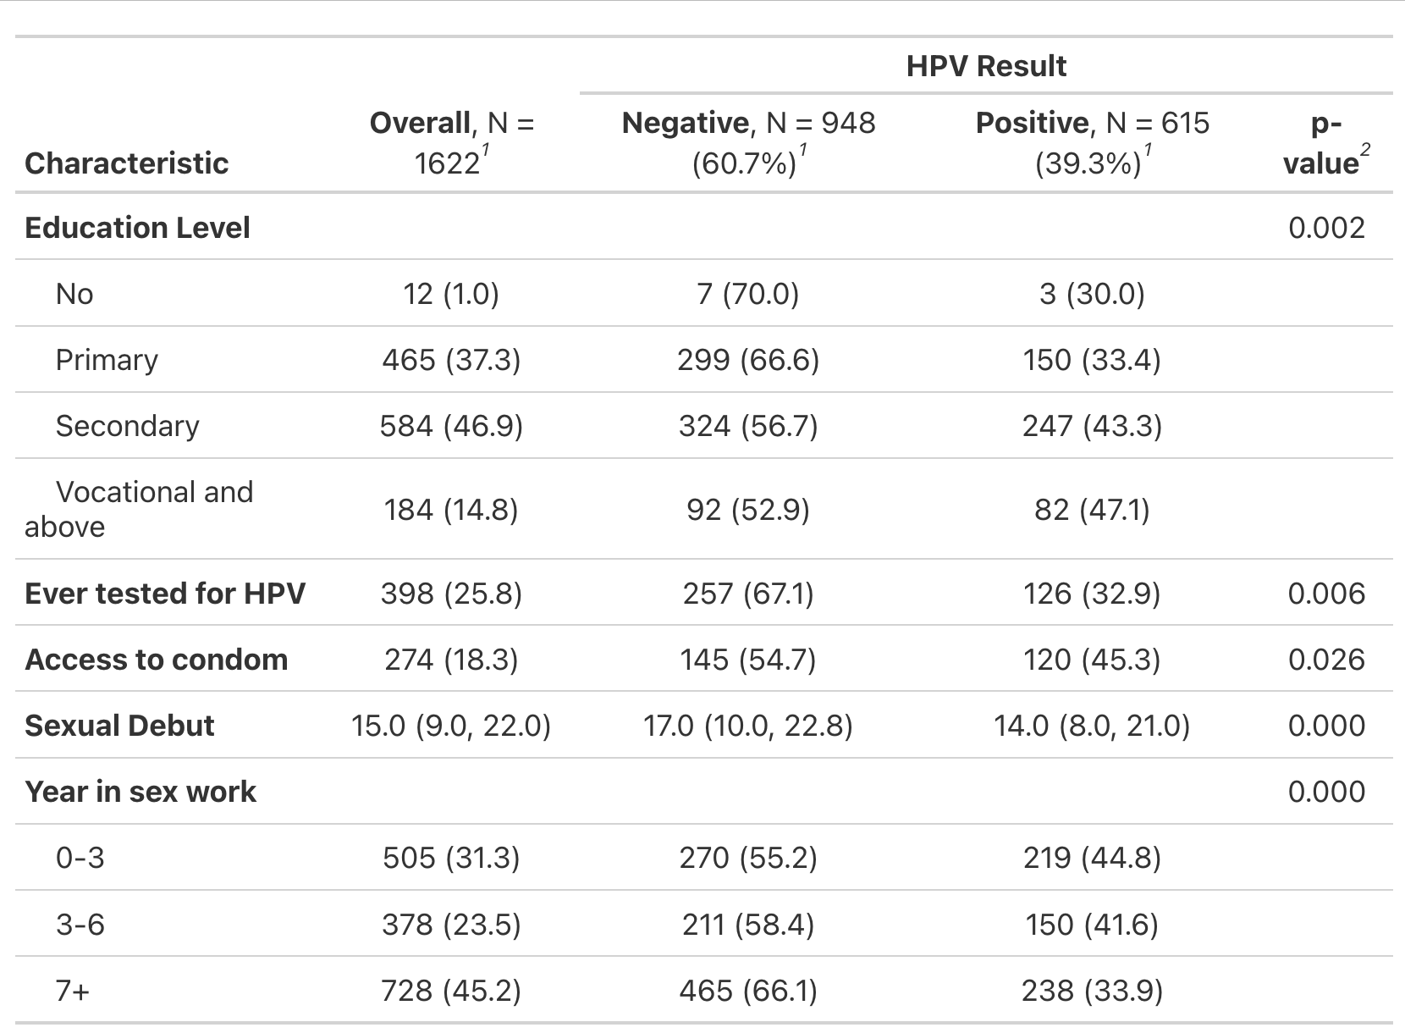
Baseline characteristics by

Slide 9
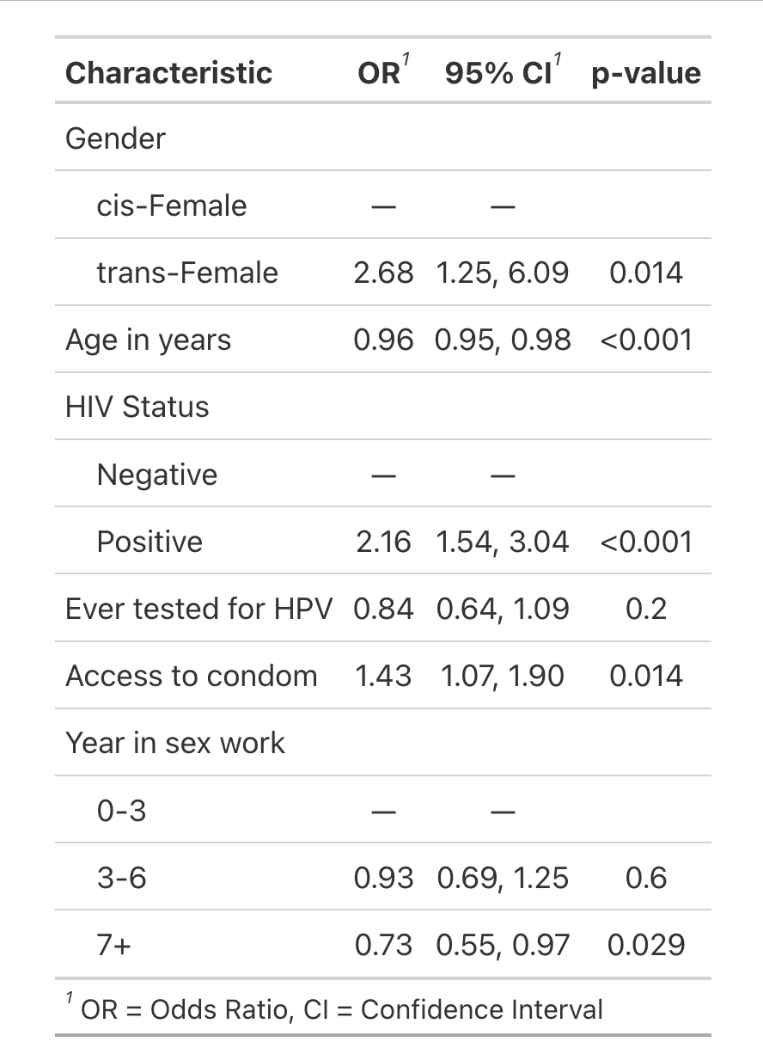
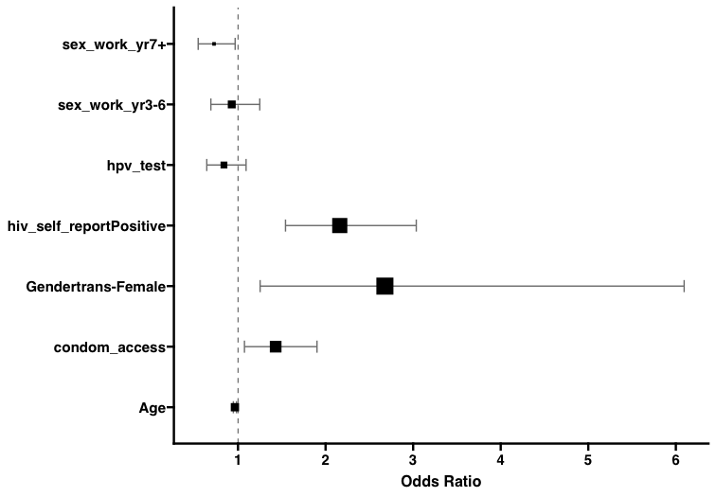
Factors associated with baseline HPV positivity

