Slide 1

Senior Design Project
Year Spring/Fall
C.U.R.A
Team member 1
CpE or EE?
Team member 2
CpE or EE?
Team member 3
CpE or EE?
Team member 4
CpE or EE?
Faculty Advisor:
Department of Electrical and Computer Engineering

Slide 2
Introduction/Background
Background and motivation, significance and/or potential impact of your project to any of ----- public health, safety, and welfare, as well as global, cultural, social, environmental, and economic factors
Existing/Similar product(s) in the market, and compare the advantages and disadvantages of your solution
Use bullets and concise descriptions. Include figures and charts if helpful. Same applied to all slides.

Slide 3
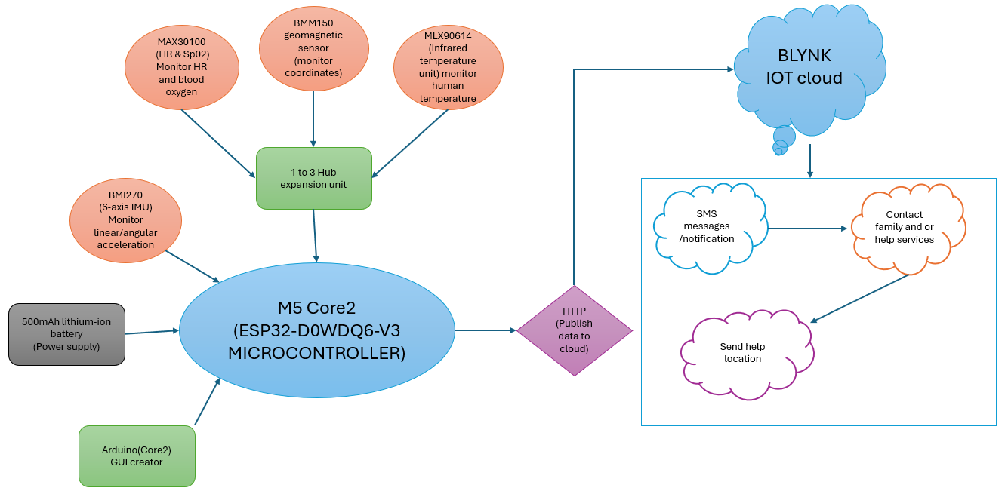
System Diagram

Slide 4
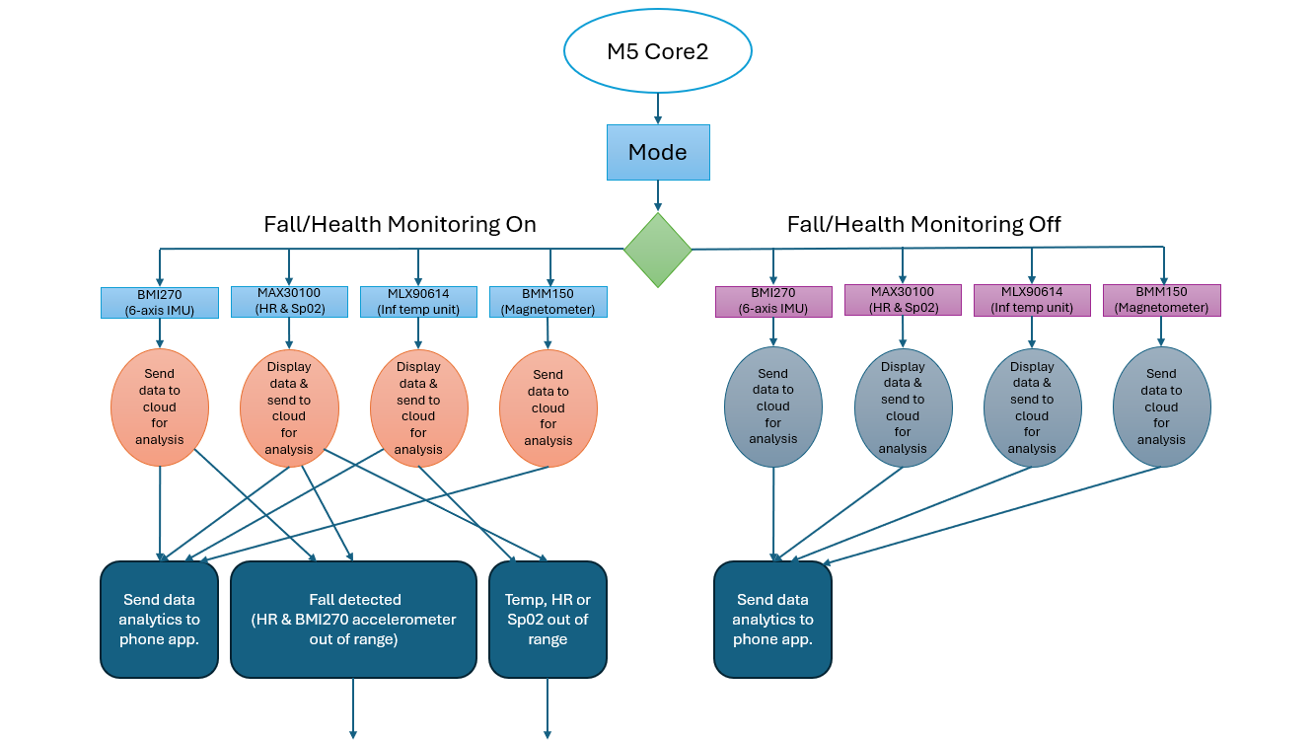
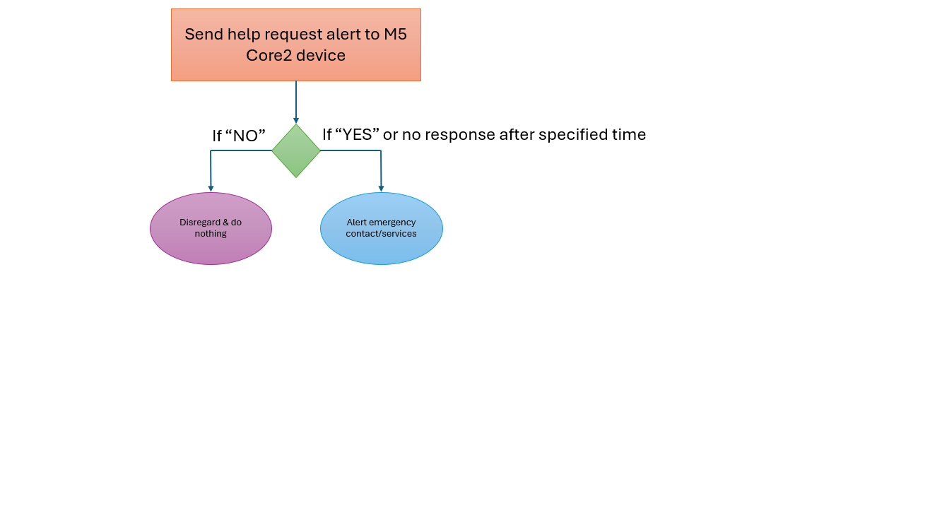
System Data Flow
Notes:
CURA offers 2 modes of operation:
Fall/health monitoring on:
All data is monitored continuously and if data is out of a specified range a help request response is trigged and emergency contact is alerted.
Fall/health monitoring off:
- All data is monitored continuously but no help request response activated.

Slide 5
Fall Detection on/off Mode and Med Reminder
Function/Module 1:
Description (inputs, outputs, relationship/modeling of outputs vs inputs, how it works, etc.)
Detailed data/control flow chart/diagram if necessary
Specifications (voltage ranges, power rates, distances for the measurements, sensitivities, the standards/protocols you used, etc.)
Hardware/Software list
If any simulation results
If implemented, include the demo video link:
Description and analysis based on the outcomes (with screenshots and/or photos if applicable):
  Figures/Photos, charts, tables help.
  Does it meet the requirements? If not, why?
  How many tests have you run? All meet the requirements? Reliability? Accuracy? etc.
*** Recommended to use up to 2 pages for each function/module illustration

Slide 6
LLM Module (large language model)
Utilizes communication and control through the Core2 UART(G13/G14) interface.
Performs integrated offline AI computing and data communication.
Energy efficient operation of 1.5W power consumption. 1 GB system memory, 3GB to hardware acceleration.
Voice activated phrase “Call Help” in case of emergency.
Notes:
Reasonings and benefits of voice activated help commands:
Hands-free emergency access — Seniors can use CURA to call for help even if they are unable to press a button due to injury, weakness, or limited mobility.
Higher likelihood of use — Seniors may feel more confident knowing help is accessible simply by speaking.
Useful during disorientation — If a senior becomes dizzy, confused, or temporarily unable to navigate menus or buttons, voice commands still work.
Encourages adoption of safety technology — CURA provides a simpler interface with only one phrase required in emergency situations. Helps seniors view wearable safety devices as less intimidating and more appealing.
Reduces fear of being alone — CURA Provides peace of mind to both seniors and caregivers by ensuring help is always a spoken command away.

Slide 7
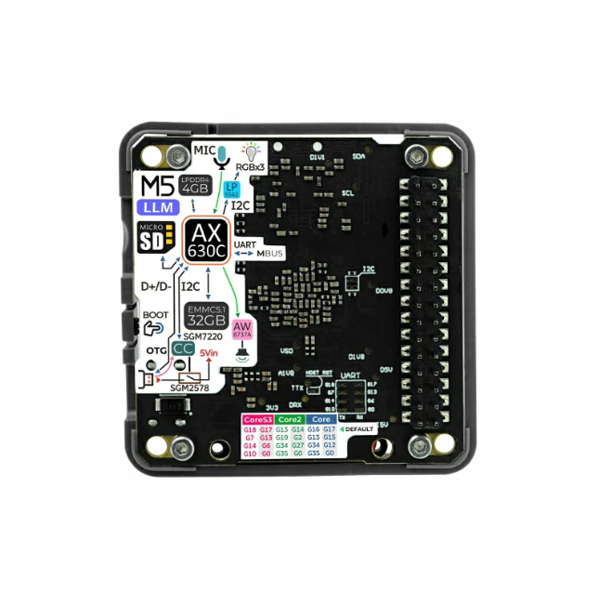
LLM Module (large language model)
Video Demo:

Slide 8

Help Request Button
CURA provides instant access to help with a single touch, reducing delay during emergencies.
Communication is simplified for seniors who may struggle with smartphones or voice commands.
Increases independence, allowing seniors to live confidently without constant supervision.
Emergency access in cases where speech is impaired.
Once pressed preferred family members or emergency services are contacted immediately.
Notes:
CURA provides instant access to help with a single touch, reducing delay during emergencies.
With CURA communication is simplified for seniors who may struggle with smartphones or voice commands.
Independence is increased, allowing seniors to live confidently without constant supervision.
With CURA’s simple and easy to read help request button, emergency access is still available even in cases where speech is impaired.
Once the help request button is pressed the users preferred family member or emergency contact is alerted immediately.

Slide 9
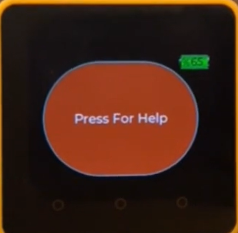
Help Request Button
Request send to Blynk cloud immediately through HTTP.
Once pressed user is notified on screen that request was delivered.
Video Demo:

Slide 10
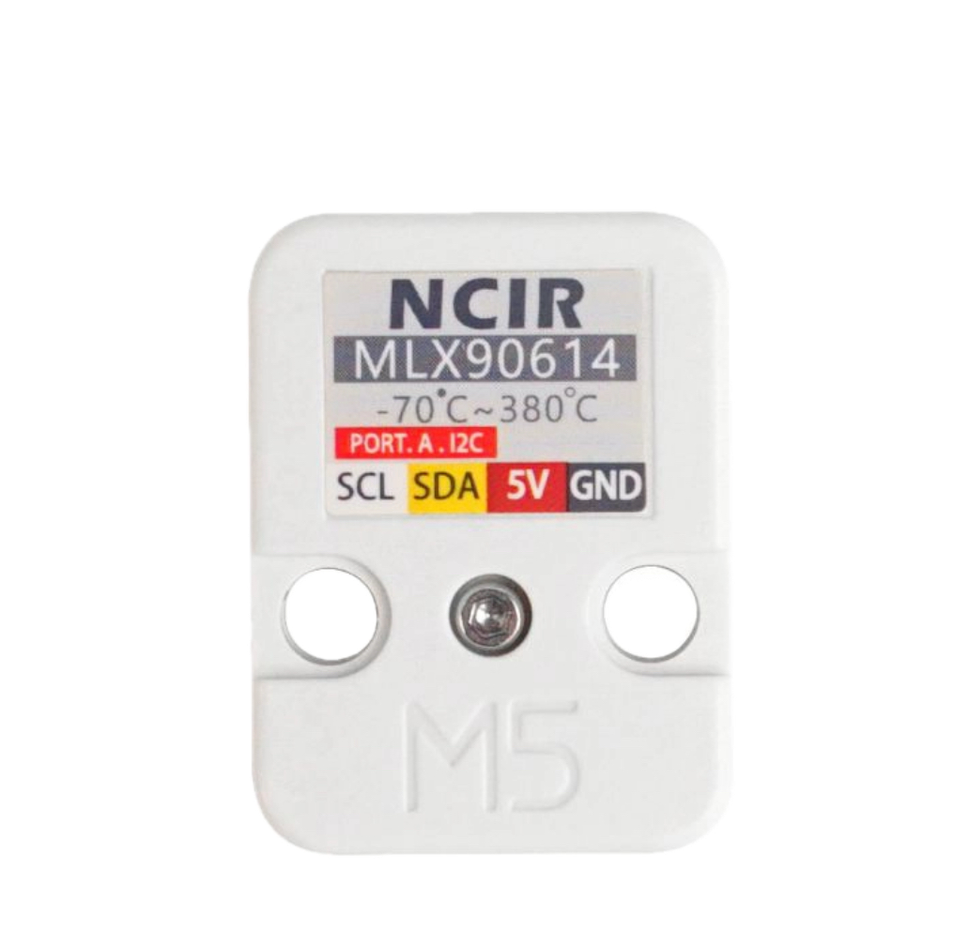
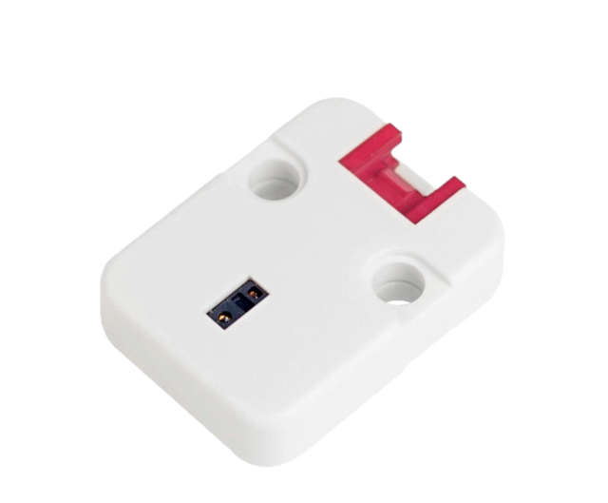
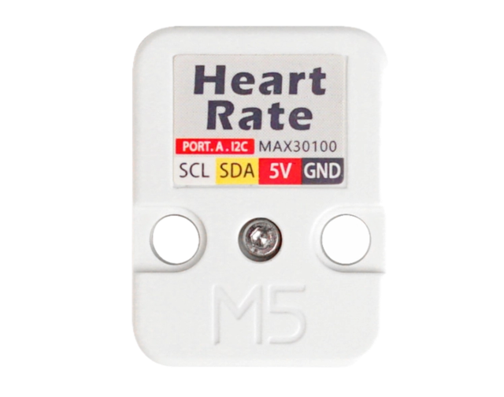
Healthcare Monitoring
Utilizes the MAX30100 sensor which monitors saturation of peripheral oxygen (SPO₂) to detect low oxygen levels early.
Utilizes the MLX90614 temperature sensor for quick identification of abnormal temp changes.
MAX30100 sensor also monitors heart rate for continuous cardiovascular insight.
When sensor levels are out of range emergency services are contacted immediately.
Notes:
Reasonings and Benefits of health monitoring on CURA device:
CURA has several health monitoring sensors on board, specifically saturation of peripheral oxygen known as SPO2 used to detect low oxygen levels early, Temperature sensing for quick identification of abnormal temp changes and heart rate sensing for continuous cardiovascular insight.
CURA provides Early detection of health issues through continuous monitoring that can help identify abnormal trends such as fever, irregular heart rate, or low oxygen levels before they become serious.
CURA also supports chronic condition management of conditions such as heart disease, COPD, asthma, or circulation issues by providing ongoing insight into the user's health status.
CURA is non-invasive and comfortable providing essential health information without needles, wires, or clinic visits.
When sensor levels are out of range emergency services are contacted immediately.

Slide 11
C.U.R.A Sensor Demonstration
Demo:

Slide 12
Function/Module Breakdown
Function/Module 1:
Description (inputs, outputs, relationship/modeling of outputs vs inputs, how it works, etc.)
Detailed data/control flow chart/diagram if necessary
Specifications (voltage ranges, power rates, distances for the measurements, sensitivities, the standards/protocols you used, etc.)
Hardware/Software list
If any simulation results
If implemented, include the demo video link:
Description and analysis based on the outcomes (with screenshots and/or photos if applicable):
  Figures/Photos, charts, tables help.
  Does it meet the requirements? If not, why?
  How many tests have you run? All meet the requirements? Reliability? Accuracy? etc.
*** Recommended to use up to 2 pages for each function/module illustration

Slide 13
New Skills Learned
New skill 1: to achieve ...
New skill 2: to achieve …
…

Slide 14
Team Member Responsibilities
Team member name | Contributions & Implemented Functions (use bullets)

Slide 15
Conclusions
Summarize your project or current progress, including the completion of functionality, budget, etc.
Illustrate your next steps and/or perspectives

Slide 16

Acknowledgement
Acknowledge the contributions from individuals other than your team (e.g., faculty advisors, friends, peer fellows, etc.)

Slide 17
References
List the key link/literature source that you cited in the reports

